Slide 1
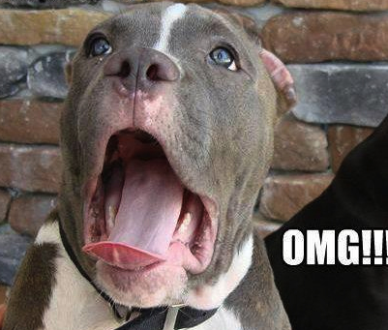
Writing with Sources

Slide 2
Why Use Sources?
Why do professors want you to use sources in your writing?

Slide 3
Why Use Sources?
Why do professors want you to use sources in your writing?
  Support your own ideas
  Demonstrate you can do the research work
  Borrow the source’s credibility
  Join the discussion on the topic

Slide 4
Why Cite?
Why do we cite outside information?
  (hint: it’s not just because our professors require it)

Slide 5
Why Cite?
Why do we cite outside information?
  (hint: it’s not just because our professors require it)
  To give credit to the creators and originators of those ideas
  To “borrow” their credibility
  To help readers who might be interested in learning more about the topic

Slide 6
Academic Consequences
  Any time you use information, ideas, words or statistics from your research, you MUST give the original author credit. Remember, they did the work, so they deserve the credit.
  Failure to credit a source for ideas and information you use in your paper is plagiarism and often has severe academic consequences.
  MSU’s Academic Honesty Policy: https://www.minotstateu.edu/handbook/code-of-conduct/academic-policies.shtml

Slide 7
Different Kinds of Plagiarism
We often think of plagiarism as simply failing to cite your sources. But there are many different kinds of plagiarism, some of which we may not even think about when we think of plagiarism.

Slide 8
Different Kinds of Plagiarism
Passing another student’s writing off as your own
Submitting a paper you wrote for one course to complete an assignment for a different course
Paying someone (or a web site) to write your paper for you

Slide 9
Different Kinds of Plagiarism
Patchwriting, or copying phrases from different sources and pasting them together to form a paper.
Not using quotation marks around direct quotes
Failing to cite your sources
Copying a picture or other media or sound files without crediting the source

Slide 10
Avoiding Plagiarism
“Plagiarism…comes from a Latin verb that means, “to kidnap.” If you plagiarize, you’re kidnapping and stealing others’ hard work and intellectual property.” (Wadsworth.com)
Usually means taking credit or not giving credit to others for their ideas which you use in your paper. (but can be unintentional)
(and yes, internet sources need to be cited)

Slide 11
Avoiding Plagiarism
Why is this important?
In the US, we value ideas as much as we do possessions
Someone worked hard to write those words and create those ideas
Professors usually want to hear your own ideas/thoughts

Slide 12
Avoiding Plagiarism
Tips for writers:
  Start early.
    If you are rushed, you’re more likely to miss places where you need to credit a source when drafting.
    You’re also more likely to be careless in your note taking and paraphrasing.
    If you rush the process, you don’t allow yourself time to thoroughly check your paper for proper citations.

Slide 13
Avoiding Plagiarism
Tips for writers: note taking:
  Resist the urge to copy and paste from online sources.
    Copy/paste often leads to plagiarism because we forget to credit that source
    Take the time to put the source’s ideas into your words.
    If you must copy/paste, include the source and page numbers in your notes next to the quote and the fact that it’s a direct quote.

Slide 14
Avoiding Plagiarism
Tips for writers: note taking:
  As you take notes from sources:
    Write the name of the author/source in parentheses next to information that will need to be cited
    If you outline, write “mine” next to information that’s your own ideas
    Or you could use different colored highlighters for your own ideas and for ideas from a source—but still write down the name of the source

Slide 15
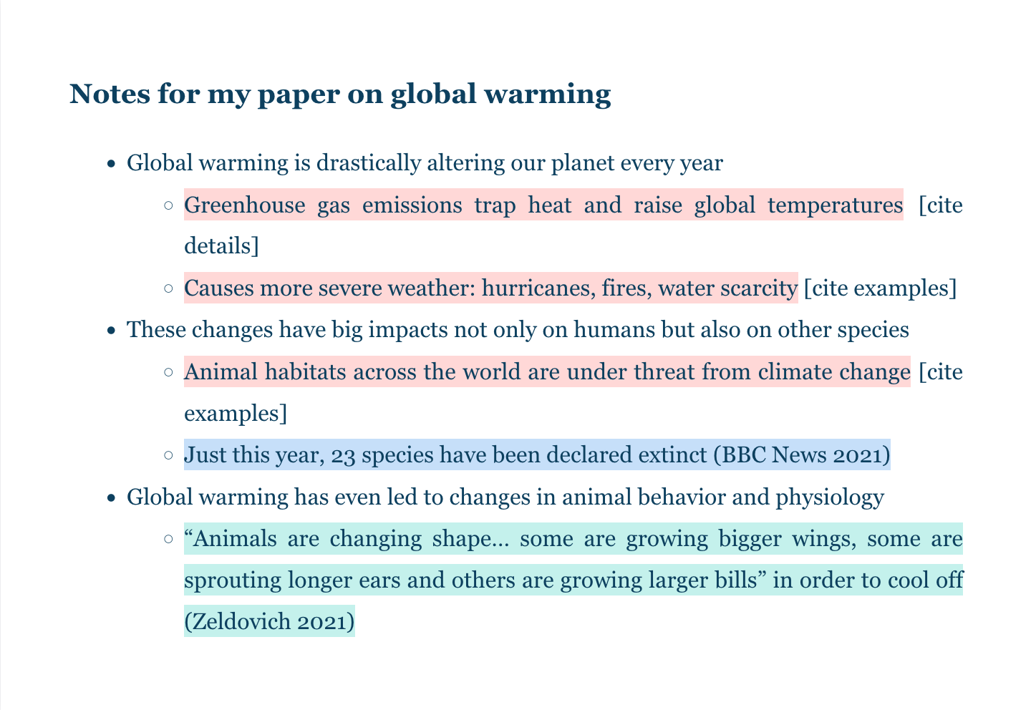
Avoiding Plagiarism
Tips for writers: note taking:

Slide 16
Avoiding Plagiarism
Tips for writers when drafting:
  Use quotations sparingly. You should only use a direct quote when the original author has said it much better than you can.
  Avoid long block quotes if possible. Paraphrase instead (more on that to come).
  Use quotation marks around all of the exact words you take from another source.
  All direct quotes must be cited.

Slide 17
Avoiding Plagiarism
Tips for writers:
  Paraphrase properly.
    To paraphrase means to put another writer’s ideas into your own words.
    Avoid just changing a few words in the original
    If you struggle with this, read the passage, then set the source aside and try to rewrite it in your own words without looking at the original.

Slide 18
Paraphrasing
Original: “Plastics harm wildlife in myriad ways, many of which scientists are just beginning to grasp. When birds, fish and other larger animals eat plastics, the material can get tangled up inside their bodies and cause damage; plastics can also make animals feel falsely full, so they stop eating” (Dzombak, 2021).
Incorrect: Plastics hurt animals in a lot of ways, many of which scientists are just starting to understand. When birds, fish and other bigger animals swallow plastics, the substance can get tangled up inside their stomachs and cause harm; plastics can also make animals feel artificially full, so they cease eating.

Slide 19
Paraphrasing
Original: “Plastics harm wildlife in myriad ways, many of which scientists are just beginning to grasp. When birds, fish and other larger animals eat plastics, the material can get tangled up inside their bodies and cause damage; plastics can also make animals feel falsely full, so they stop eating” (Dzombak, 2021).
Much better: Scientists are still learning the extent to which plastics harm animals. According to Dzombak (2021), ingesting plastic can lead to internal damage if it gets tangled when swallowed, and can also lead animals to feel falsely full. Both prevent them from getting the nutrients they need.
(example taken from Scribbr’s “How to Avoid Plagiarism.”

Slide 20
Summarizing
  Summarizing is when you create a concise statement of the original author’s ideas in your own words.
  Summaries are much shorter than the original
  Summaries still need to be cited

Slide 21
Summarizing
  Tips for effective summarizing:
    Read the original a few times
    Ask yourself what the author’s main idea is
    Set the original aside
    Write down several sentences that capture that idea
    Avoid using the author’s exact words (if you do, you need quotation marks around them)
    Double check summary with the original
    Write down the source

Slide 22
Summarizing
Original: “Business communication is increasingly taking place internationally – in all countries, among all peoples, and across all cultures. An awareness of other cultures – of their languages, customs, experiences and perceptions – as well as an awareness of the way in which other people conduct their business, are now essential ingredients of business communication” (Chase, O’Rourke & Wallace, 2003, p.59).
Bad Summary: Business communication is worldwide, and it is essential to build awareness of other cultures and the way in which other people conduct their business. (Chase, O’Rourke & Wallace, 2003, p.59).
(summary uses too many of the same words as the original)

Slide 23
Summarizing
Original: “Business communication is increasingly taking place internationally – in all countries, among all peoples, and across all cultures. An awareness of other cultures – of their languages, customs, experiences and perceptions – as well as an awareness of the way in which other people conduct their business, are now essential ingredients of business communication” (Chase, O’Rourke & Wallace, 2003, p.59).
Better: In a world that is increasingly connected, effective business communication requires us to learn about other cultures, languages, and business norms (Chase, O’Rourke & Wallace, 2003, p.59).
(example taken from Johns Hopkins Guide to Avoiding Plagiarism)

Slide 24
Avoiding Plagiarism
Tips for writers:
  Check your draft
    Highlight your ideas in one color
    Highlight sources’ ideas in a different color
    Be sure you have cited the source of ideas that aren’t yours.
    Be sure you’ve used quotation marks where needed
    (If your paper is mostly the ideas of your sources, you might need to add more of your own ideas)

Slide 25
Avoiding Plagiarism
Tips for writers:
  Always cite any outside information.
  This includes quotes and paraphrases
  It also includes information obtained via personal interview or email.
  You should include an intext cite and an entry in your list of sources at the end of your paper.
  Every source cited in the text should be listed in your list at the end of the paper.

Slide 26
What to Cite
  Direct quotes, summaries and paraphrases
  Statistics and studies
  Information that is not common knowledge
  What is “common knowledge”?
    If you can find this information in 5 credible sources where it is not cited, it’s considered common knowledge
    Example: “Bismarck is the capital of North Dakota” does not need to be cited

Slide 27
What to Cite
  Matters of opinion or judgments that are not your own:
    Example: “Minot should be the capital of North Dakota” would need to be cited if it’s not your own opinion only.
  Any images or media you use from another source
  Summaries or paraphrases of ideas that are not your own

Slide 28
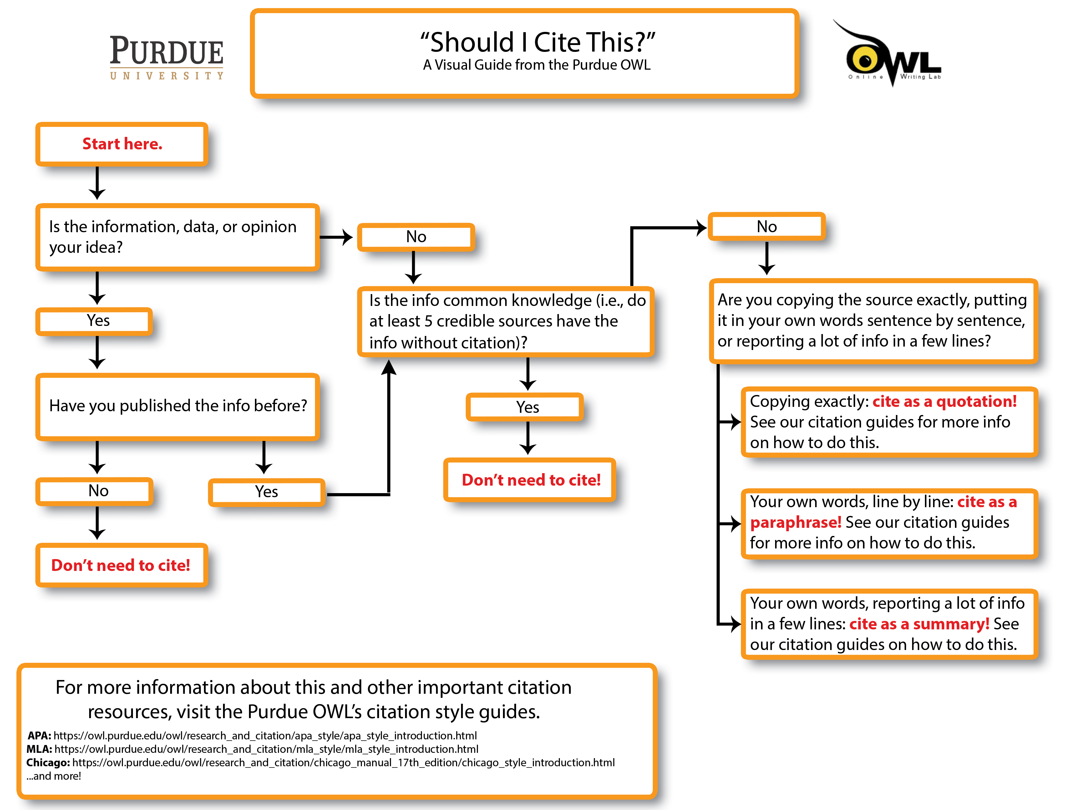
What to Cite

Slide 29
How to Cite
  There are various citation formats depending on the subject of the course you’re writing for
  Check with your professor for which format he/she wants you to use
  Citation guides can be found in the MSU Writing Center (to be used there, not taken out)
  Once you know your citation format, be consistent throughout your paper.

Slide 30
How to Cite
  All citation formats require 2 sets of citations: in the text and at the end
  In the text:
    provide enough information that readers can find this in your list at the end
    Don’t give all the publication information in the text
    Don’t give the web address
    Do give the page number(s) and author(s)

Slide 31
Resources
  The OWL at Purdue: https://owl.purdue.edu/owl/avoiding_plagiarism/best_practices.html
    Online writing lab site with help in citation, grammar, etc.
  Excelsior’s OWL: https://owl.excelsior.edu/plagiarism/plagiarism-additional-resources/
    This site has a lot of links to resources about plagiarism and tips to avoid it

Slide 32
Resources
The MSU Writing Center: https://minot.mywconline.com/
    Our tutors can help you cite, blend and paraphrase your sources.
    Tutors can also help you catch inadvertent plagiarism.
    Make appointments early (not the day before the paper’s due) and often.
    Use our on line appointment site

Slide 33

Questions????
Now go out there and write!!!!

