Slide 1


Conflict Resolution

Slide 2


Insert Slide Title Here

Slide 3
Conflict is normal!

Slide 4
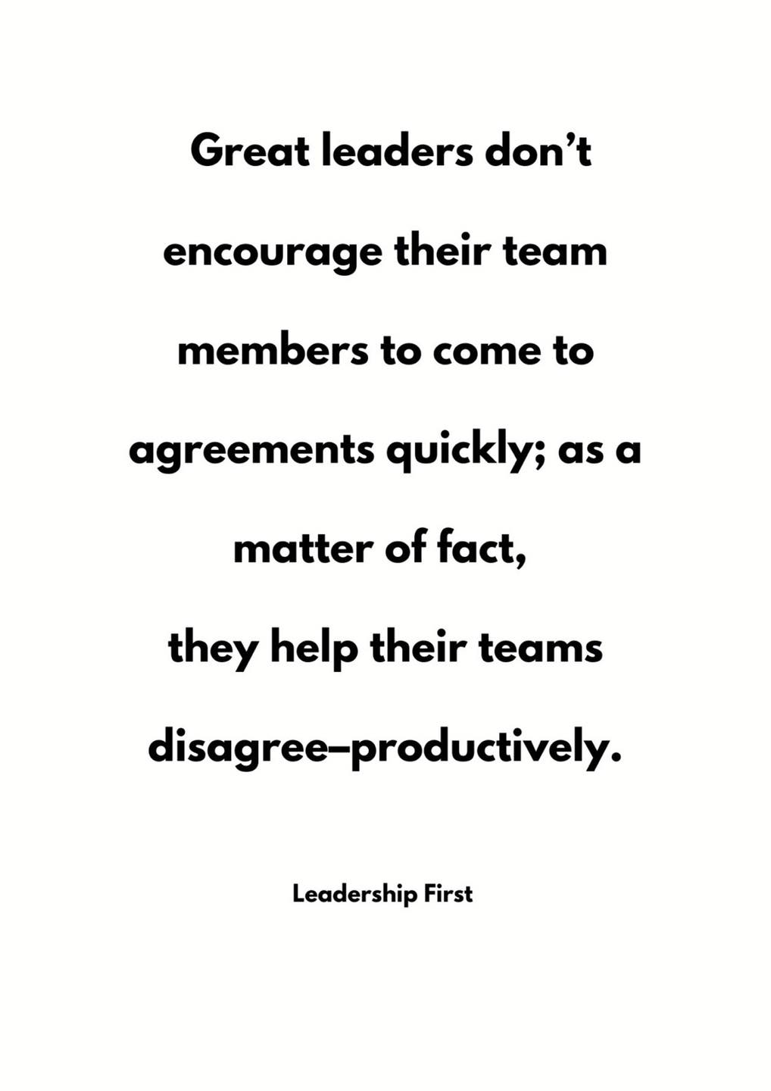

Slide 5

Be Proactive: Create a Positive Environment
Be proactive in building positive relationships
Set clear and reasonable policies/expectations
Promote a culture of collaboration
Create a positive physical environment
Avoid playing favorites
Be transparent
Be calm and objective
Avoid escalating behaviors
Think win-win

Slide 6

How To Deal With Conflict (youtube.com)
This Photo by Unknown Author is licensed under CC BY-SA-NC

Slide 7
What Causes Conflict
Personal Values
Culture, Background, Gender, Age
Individual Perception
Motivation
Ideas
Jealousy
Opinions
Personal Work Style
Roles and Goals
Scarcity of Resources
Policies and Rules
Job Pressures/Performance
Personality/Behavior
Harassment and Bullying

Slide 8
Common Signs of Conflict
Body Language
Behavioral Changes
Passive Aggressiveness or Hostility
Not Listening
Clipped Responses
Isolation or Clique Formation

Slide 9
Common Signs of Conflict
Resistance to Collaboration
Reduced Productivity
Anxiety
Comments
Complaints
Increased Absenteeism
Turnover

Slide 10
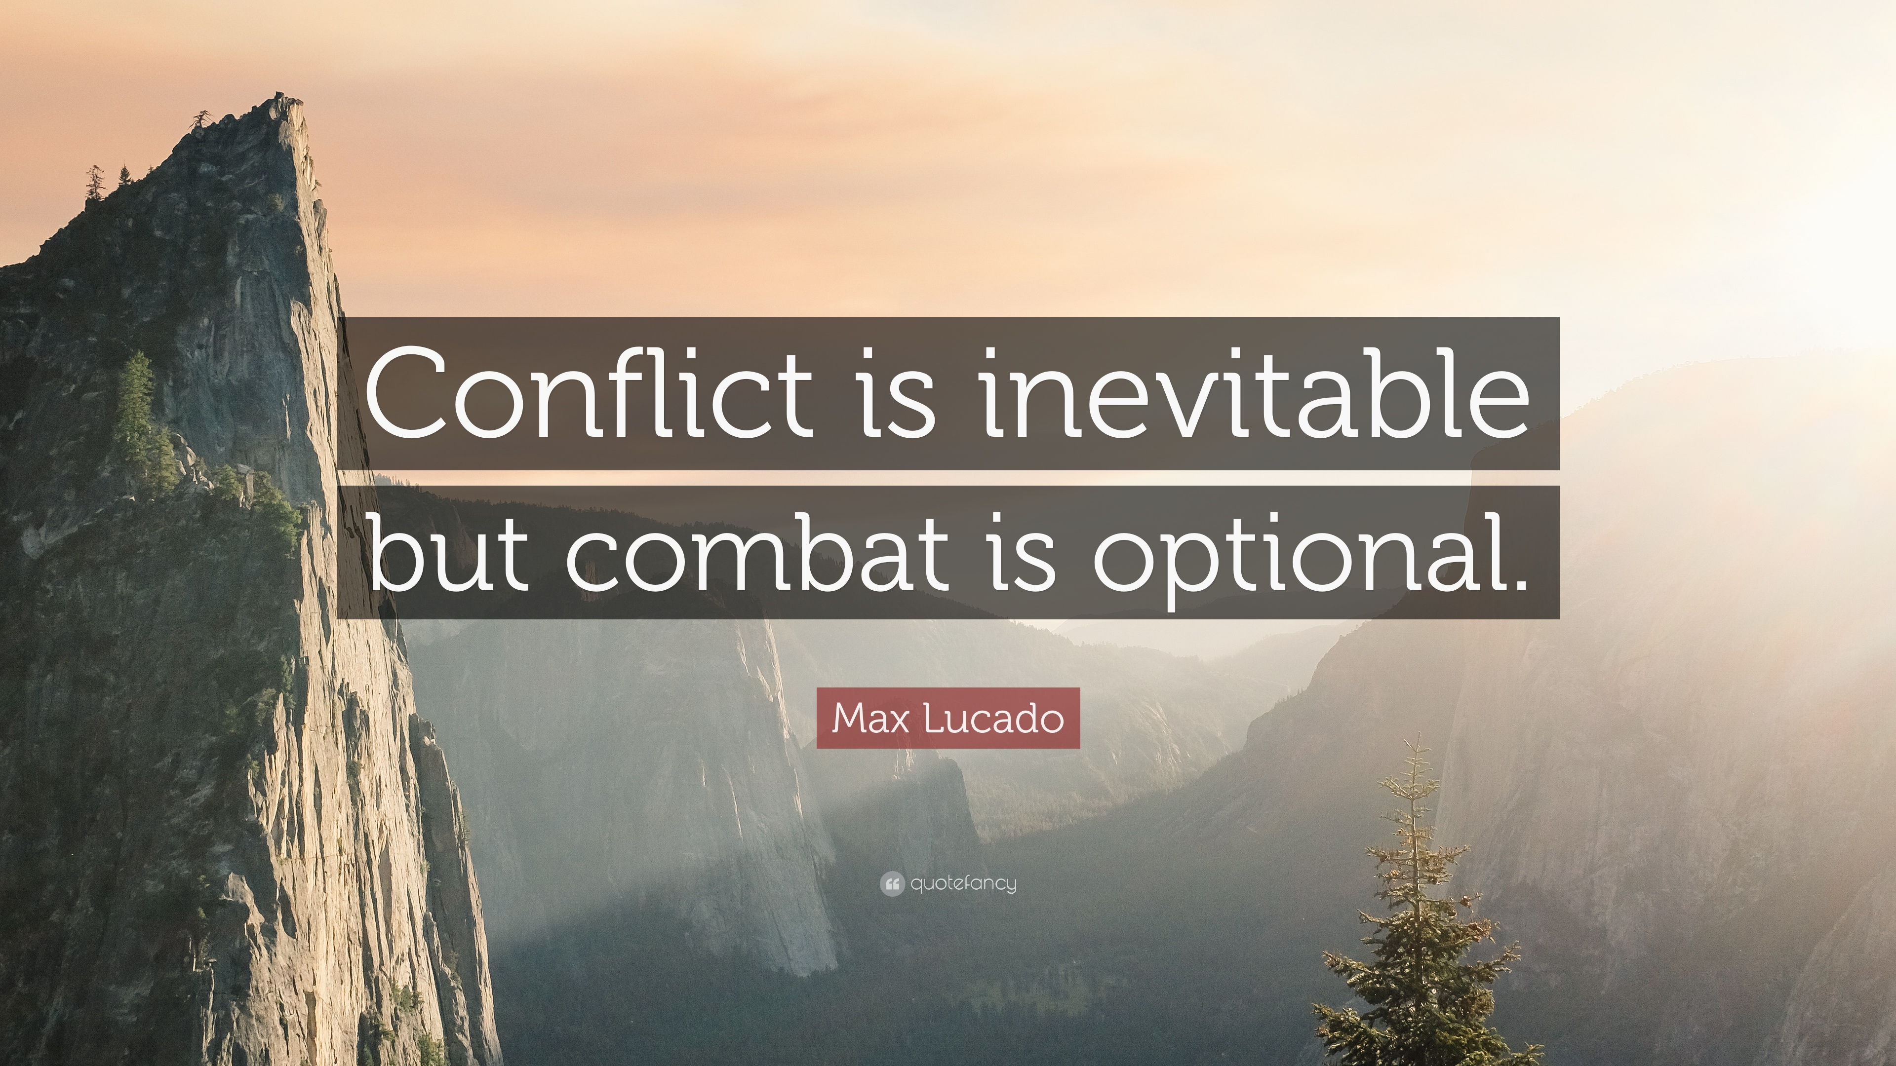
Insert Slide Title Here

Slide 11
Conflict Management Styles
Avoiding
Accommodating
Competing
Compromising
Collaborating

Slide 12
Keys to Successful Conflict Management
Do Some Self-Analysis
Defuse Tension
Make the Relationship a Priority
Focus on the Situation
Engage in Positive Communication
Agree on Action and Evaluate Progress

Slide 13
Do Some Self-Analysis
What was your role in creating the conflict?
What mistakes did you make?
What could you have done better?

Slide 14
Defuse Tension
Choose a private location
Time the confrontation as closely as possible to the inappropriate behavior
If necessary, cool off before confronting – take a short break
Relax and breathe
Stay calm and control your emotions

Slide 15
Make the Relationship a Priority
Establish an atmosphere of partnership – work together for a solution
  “I feel that we have a problem and I want to work this out together with you.”
  “I want to understand your feelings about the situation.”
  “I am confident that we can work out a solution that is mutually beneficial.”
Communicate openness
Affirm belief in a positive, mutually beneficial agreement

Slide 16
Make the Relationship a Priority
Be willing to forgive
Pick your battles – is it worth the energy?
Know when to let it go

Slide 17
Focus on the Situation
Don’t bring up past conflicts
Talk about the behavior, don’t attack or criticize the person
Don’t allow avoidance or shift of responsibility
Be willing to talk about the problem and what can be done
Keep the conversation focused on the problem

Slide 18
Engage in Positive Communication
Don’t avoid the person
Show respect for the person
Give the person your full attention – avoid distractions
Listen to their perspective (and try to understand it)
Don’t interrupt

Slide 19
Engage in Positive Communication
Avoid becoming defensive or judgmental
Watch body language
Restate what you hear
Be specific about the problem and what is bothering you
Express yourself and your viewpoint clearly and carefully

Slide 20
Engage in Positive Communication
Don’t place blame
Don’t drag others into the conflict
Use active listening and give feedback
Look at the conflict through their eyes
Try to understand the factors that are influencing that person

Slide 21
Engage in Positive Communication
Ask questions to clarify and understand
Pay attention to the feelings being expressed
Don’t dismiss the other person’s feelings
Be aware and respectful of differences
Don't generalize. Avoid words like "never" or "always."

Slide 22
Agree on Action and Evaluate Progress
Obtain a commitment for change
Be firm in the standards you set
Predetermine a date and time to evaluate progress toward the commitment
Follow through on any agreements made
Give solutions time to work
Support the individual's attempts to change
Offer praise and positive feedback for successes

Slide 23
Format for Communicating Disagreement
1. State your feelings candidly, taking responsibility for your emotions, by using “I” statements.
  “I get frustrated when…”
  “I get angry when…”
2. Describe the specific event or specific behavior that triggers this emotion.
  “…your reports to me are late…”
  “…you criticize my performance to peers…”

Slide 24
Format for Communicating Disagreement
3. Identify the negative impact of the behavior.
  “…because without timely information, I cannot complete my reports on time.”
  “…because it undermines my credibility with people who depend on me.”
4. Express a willingness to resolve the disagreement cooperatively.
  “Can you tell me your perception of this issue?”
  “How can we resolve this issue together?”

Slide 25
Practice
Your co-worker constantly brings in tuna and broccoli for lunch and it creates quite a stink in the office.
I Statement
Specific Behavior
Negative Impact
Cooperative Resolution

Slide 26
Practice
You and your co-worker have been assigned a project but they do not seem to take it seriously. They have missed several meetings and have not contributed any work to the project so far. Your supervisor is asking for a progress report.
I Statement
Specific Behavior
Negative Impact
Cooperative Resolution

Slide 27
Practice
Your co-worker has been coming in late and leaving early and bragging about how the boss won’t do anything because they are too valuable to the office.
I Statement
Specific Behavior
Negative Impact
Cooperative Resolution

Slide 28
Practice
It seems that a co-worker has been giving you the cold shoulder lately. You have also heard rumors that this same person has been talking badly about you to other colleagues.
I Statement
Specific Behavior
Negative Impact
Cooperative Resolution

Slide 29
If You Need Help from HR or 3rd Party
Collect Your Thoughts
Set Expectations and Location
Talk to the Parties Together
Gather Information
Listen Carefully to Both Sides
Get Agreement that Conflict Exists
Speak Impartially
Brainstorm and Explore Options
Negotiate the Solution
Follow Up

Slide 30
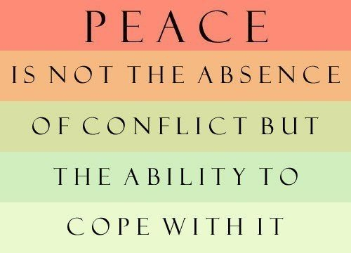
Insert Slide Title Here

Slide 31
Questions?

Slide 32
Thank You!

