Slide 1



CTRL-ALT-DEL:
Self-empowerment
in the workplace

Slide 2

Why this topic?
Adopted problematic habits
Accepted my habits, became complacent
Seized an opportunity to reinvent myself professionally
Embraced a new identity by taking charge

Slide 3
Goal for today
Gain a strong understanding of self-empowerment
Discover how our inputs determine our outputs
Develop tools to gain power over our habits

Slide 4
Not the goal for today
Offend anyone
Draw comparisons to Tony Robbins
Get too sweaty up here

Slide 5
What is self-empowerment?
Making a conscious decision to take charge of your destiny.

Slide 6
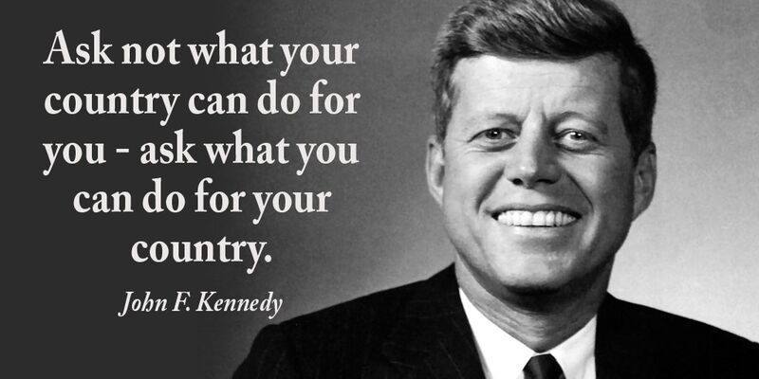
John F. Kennedy

Slide 7
Workplace/life version
boss, HR, colleagues
YOURSELF!
- Gandhi (jk)

Slide 8
Self-empowerment through habits
What is a habit?
A settled or regular tendency or practice, especially one that is hard to give up.

Slide 9
Positive Workplace Habit examples
Punctuality – “I’m always on time”
Organization – Preparing agendas, following a schedule, etc.
Respect – Being on time to meetings, following policies, etc.
Teamwork – “How can I help?”

Slide 10
Negative Workplace Habit examples
Punctuality – “I’m going to be 5 mins late”
Organization – “My desk is a disaster!”
Respect – Being distracted in meetings
Procrastination – “I’ll get to that tomorrow”
Isolation – “That’s not my job”

Slide 11
Workplace habits exercise
List one of your positive habits - CTRL
List a habit you are working on - ALT
List one of your negative habits - DELETE
Habit defined: A settled or regular tendency or practice, especially one that is hard to give up.

Slide 12

The Atomic Habits mindset
Atoms are the building blocks
of matter. They are often known
to be the smallest particles in
the universe. Not true but they
are TINY.
What’s your point, bruh?

Slide 13



The Atomic Habits mindset
Think about a flight path
in terms of incremental
change.
A 1 degree adjustment
would take you to an
entirely different place.
What could a 1% change
in habits do to your life?

Slide 14
Why changing habits is so hard
We often try to fix poor habits by setting new goals.
Example:
We grow frustrated with our health so we may set a goal to lose weight

Slide 15
You are not the problem
Clear: you aren’t the problem for setting goals. The problem where you place your focus.
We focus mostly on the outputs (goal) without properly addressing the inputs (steps to get there)

Slide 16
Addressing the inputs – table talk
Let’s use being late as our example. You’ve just set a new goal to be at work by 8:00 AM daily.
With your neighbor - what are some inputs we could change to have this goal be changed in the short term?

Slide 17
The role of identity
My initial professional identity – quirky, silly, frequently late, unorganized, procrastinator
Clear: the biggest barrier to change is identity conflict
My first SCHEELS review
Habits are only temporary until they become who you are.

Slide 18
My 1% correction
Who I was:
  “I struggle with organization and often fail to accomplish everything I hoped to.”
Who I am:
  “I am an organized professional who gets things done.”

Slide 19
Take charge
Two steps to changing your identity:
  Decide who you want to be
  Prove it to yourself with small wins (incremental change)

Slide 20
What will your first small win be?
Write down your first small win (what habit will you alter or delete?)
What inputs do you need to address?
How will your identity change as a result?

Slide 21
Thank you!

