Slide 1

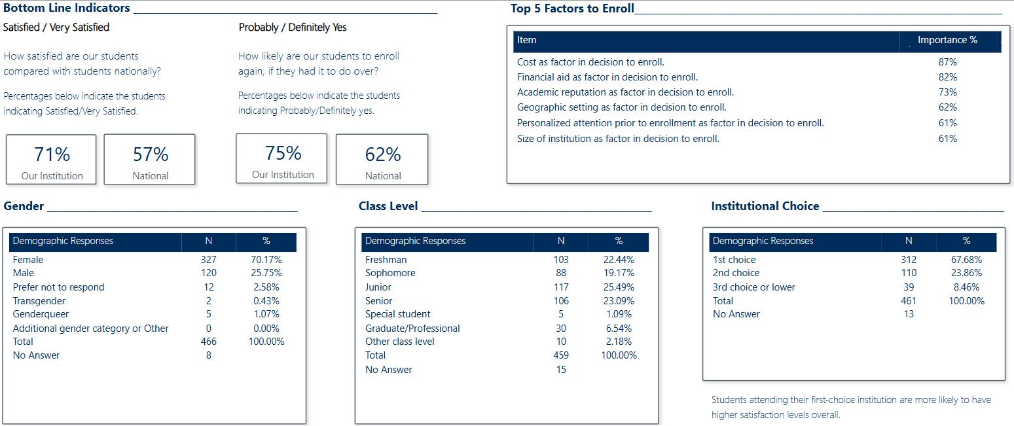
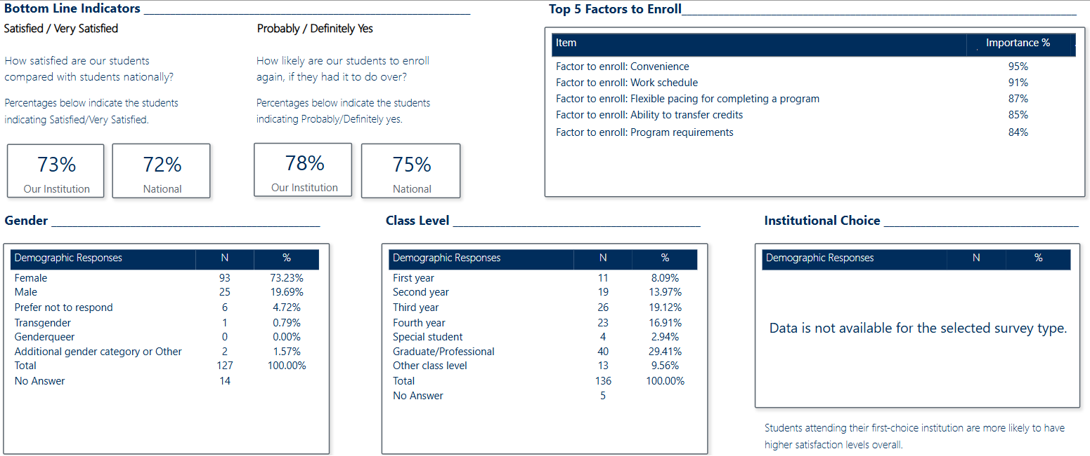
RNL Satisfaction Priorities Survey Results Student Satisfaction Inventory

Slide 2

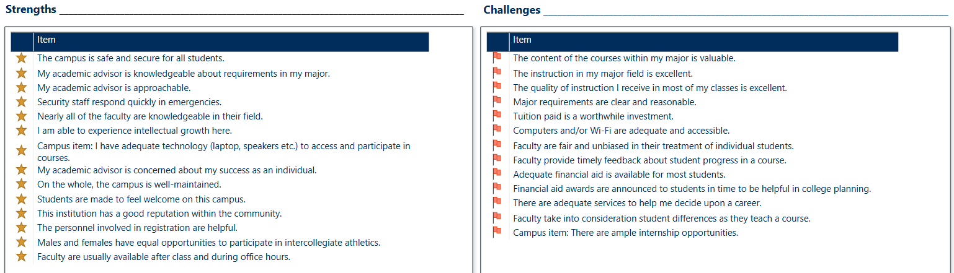
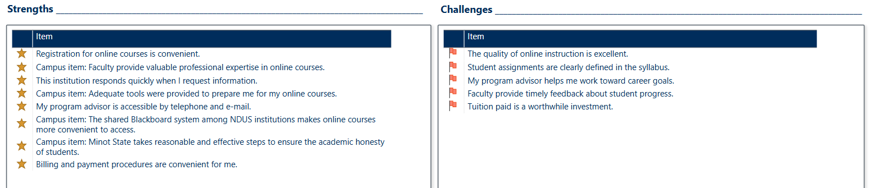
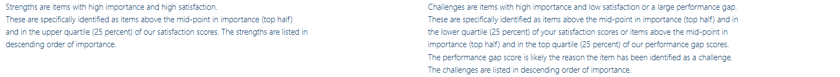
RNL Satisfaction Priorities Survey Results Student Satisfaction Inventory

Slide 3
RNL Satisfaction Priorities Survey Results Priorities Survey for Online Learners

Slide 4
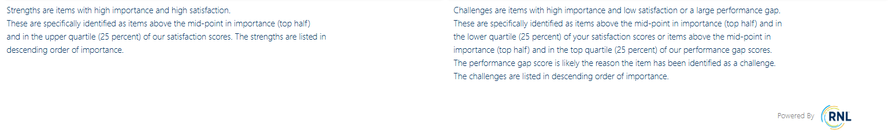
RNL Satisfaction Priorities Survey Results Priorities Survey for Online Learners

