Slide 1

General Education Program Changes and Assessment
Spring Assessment Day
2022

Slide 2


Agenda
Assessment
Program Changes
Fall 20, Spring 21, Fall 21 Cycle
IP2 Pilot
New Competency Model Transition
Be seen. Be heard. BE INSPIRED.

Slide 3
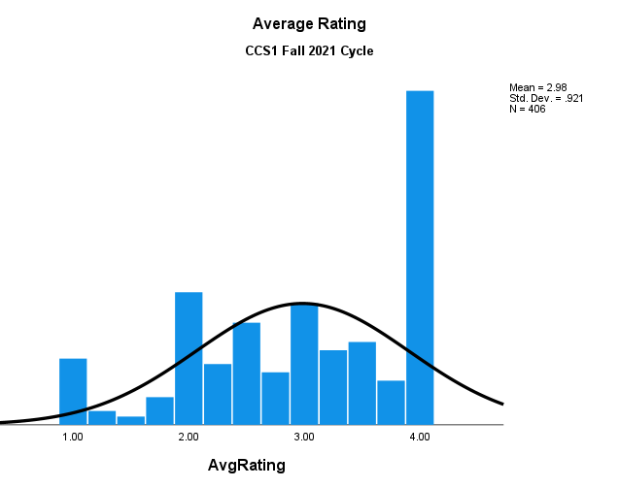
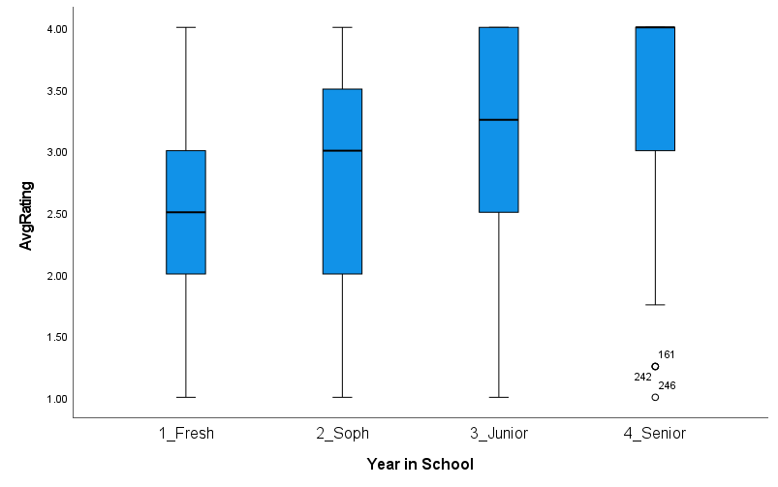
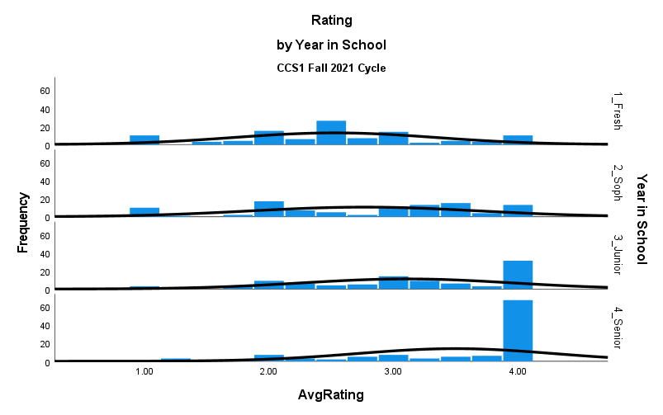
CCS 1 Analysis
Both parametric (unequal variance assumed) and non-parametric tests agreed:
Significant difference between senior and freshman groups at p < .05

Slide 4
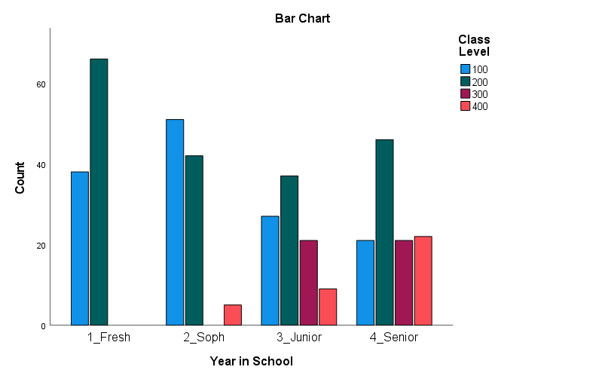
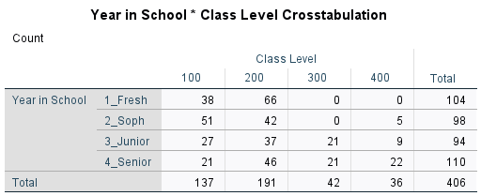
CCS 1 Analysis
Nathan created an assessment dashboard:
Gen Ed Assessment Dashboard

Slide 5
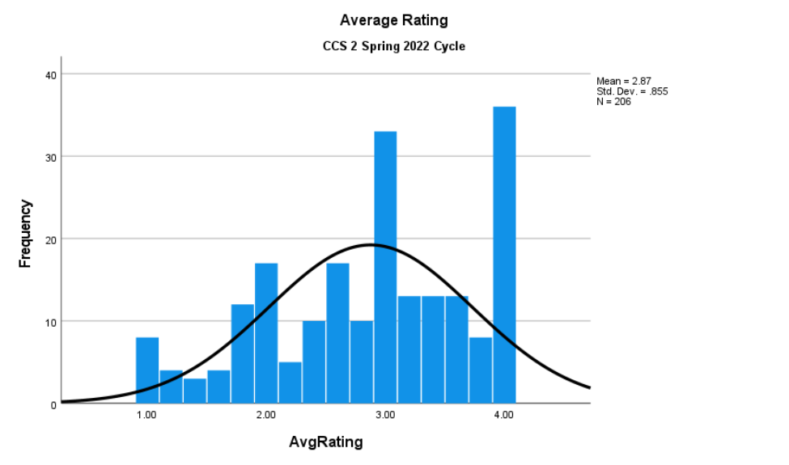
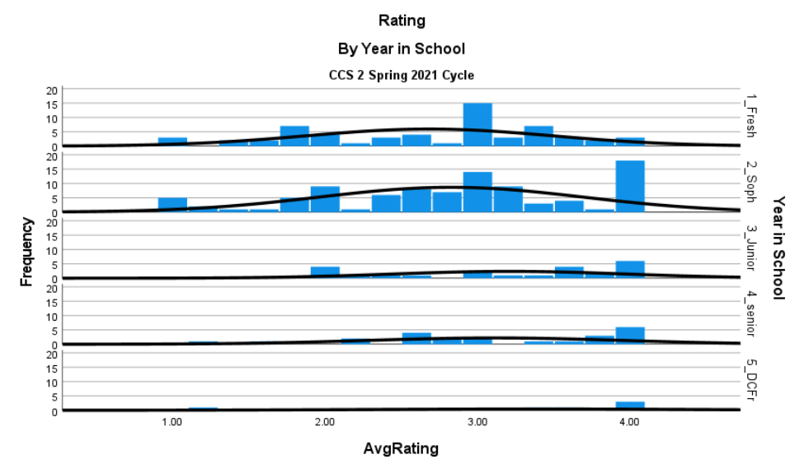
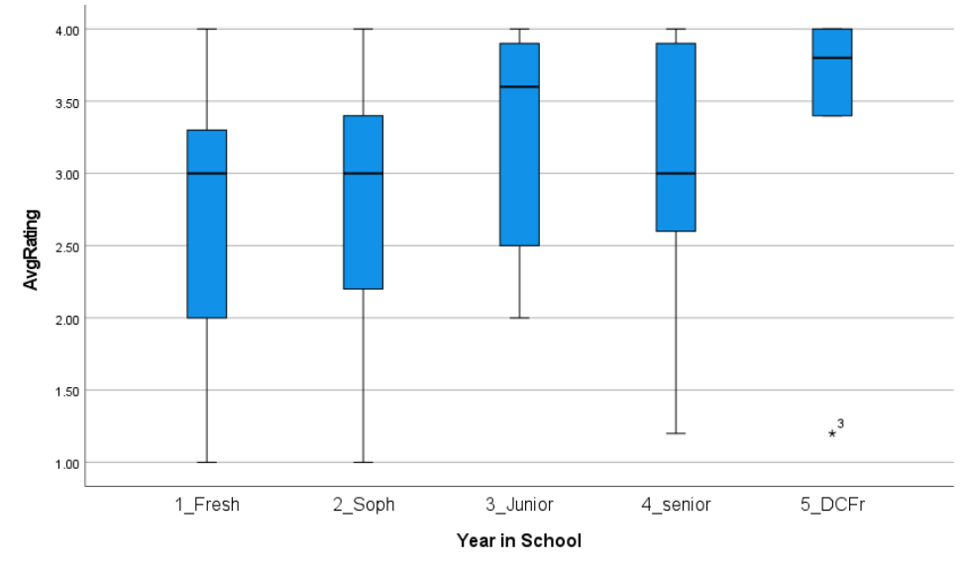
CCS 2 Analysis
Both parametric (equal variance assumed) and non-parametric tests agreed:
Significant difference between senior and freshman groups at p < .05

Slide 6
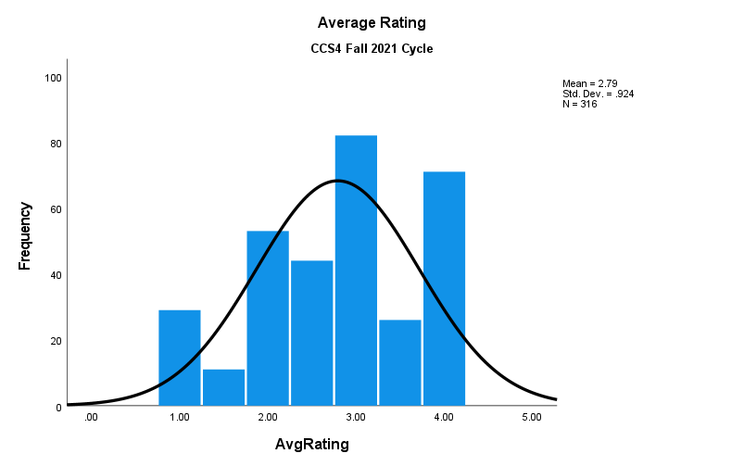
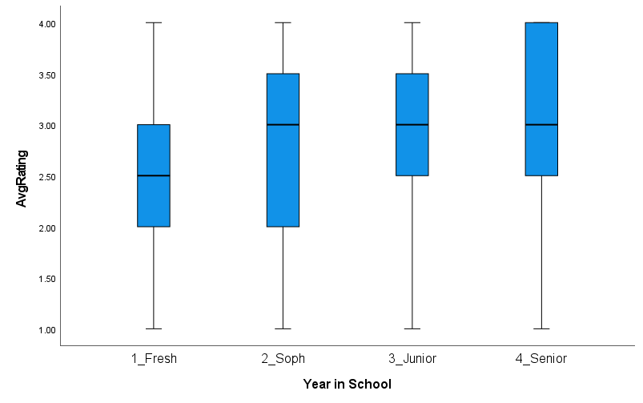
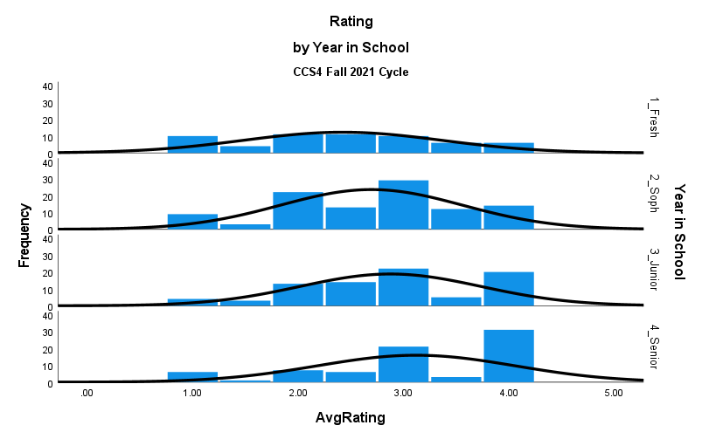
CCS 4 Analysis
Both parametric (equal variance assumed) and non-parametric tests agreed:
Significant difference between senior and freshman groups at p < .05

Slide 7
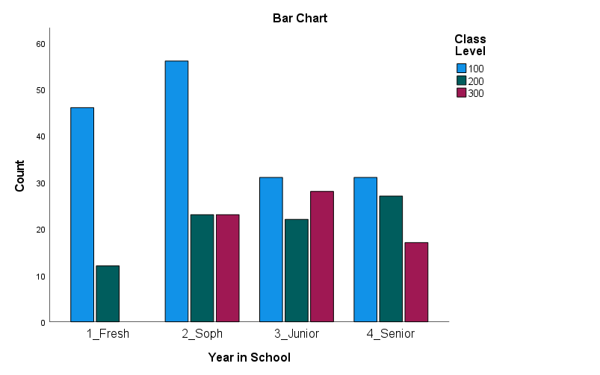
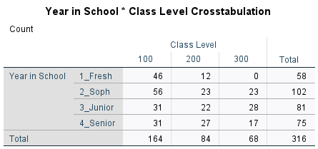
CCS 4 Analysis
Our assessment dashboard:
Gen Ed Assessment Dashboard

Slide 8
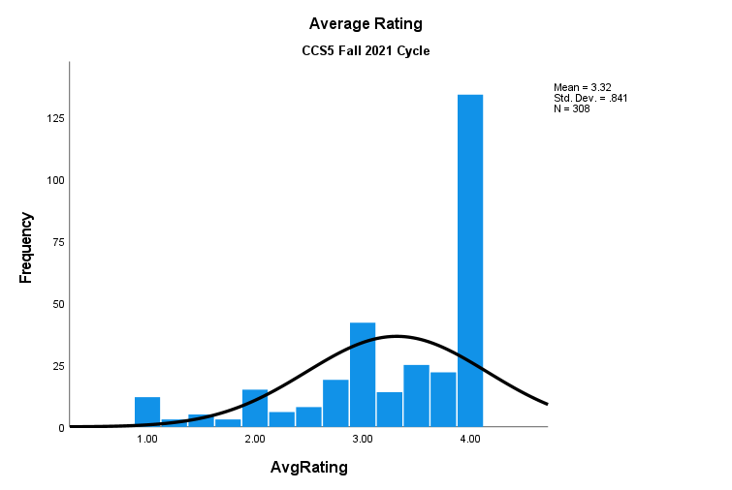
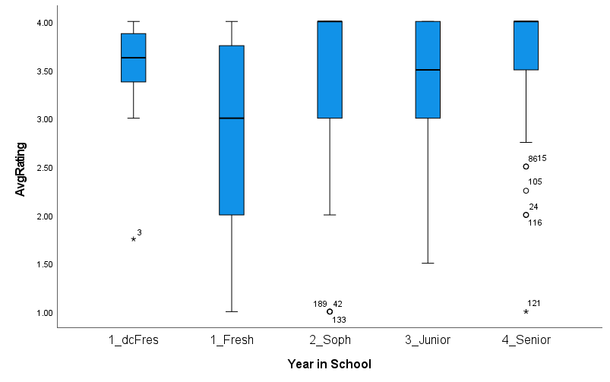
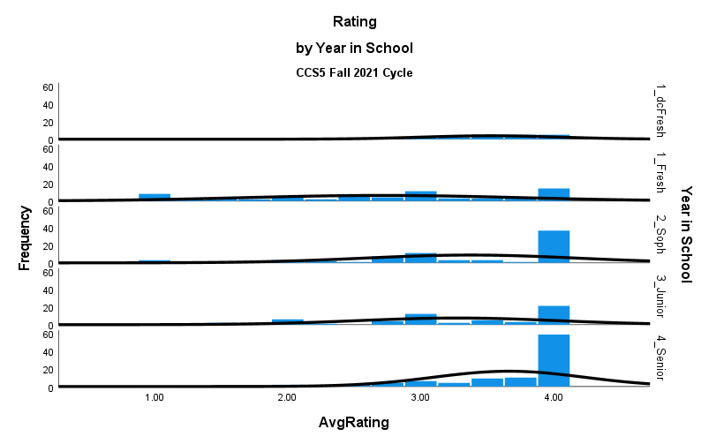
CCS 5 Analysis
Both parametric (unequal variance assumed) and non-parametric tests agreed:
Significant difference between senior and freshman groups at p < .05

Slide 9
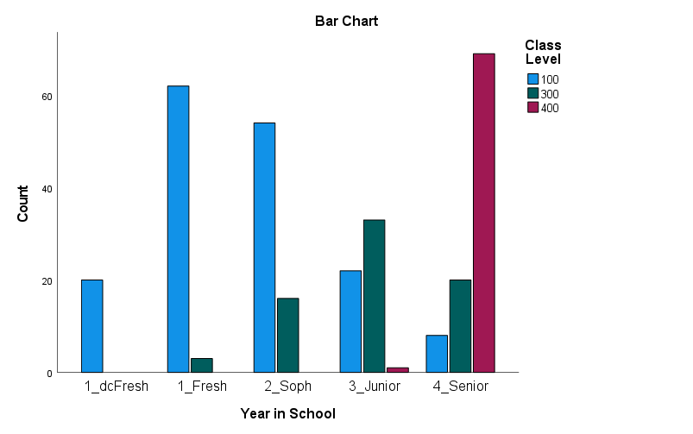
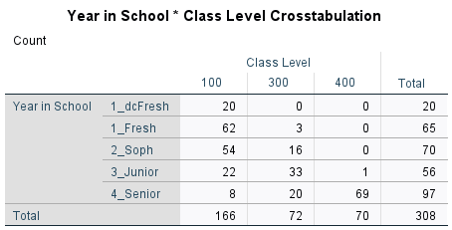
CCS 5 Analysis
Our assessment dashboard:
Gen Ed Assessment Dashboard

Slide 10
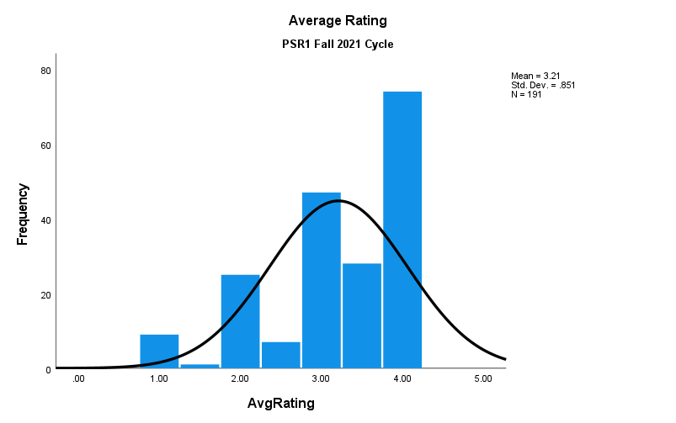
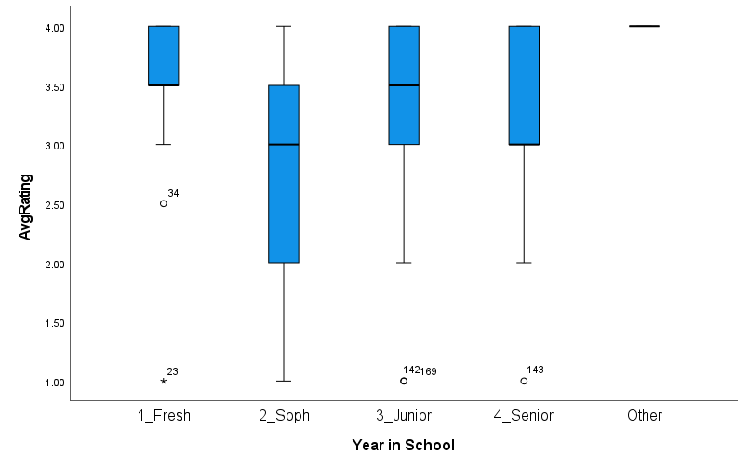
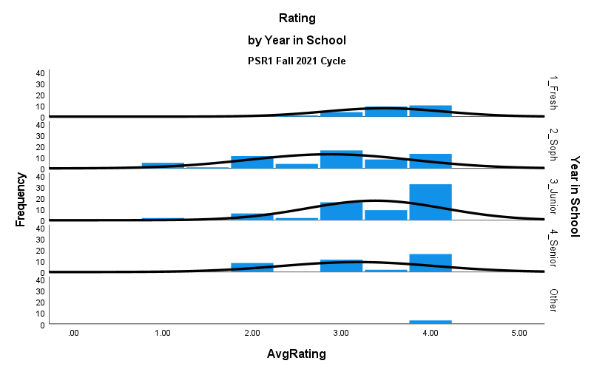
PSR 1 Analysis
Both parametric (unequal variance assumed) and non-parametric tests agreed:
Insignificant difference between senior and freshman groups at p < .05

Slide 11
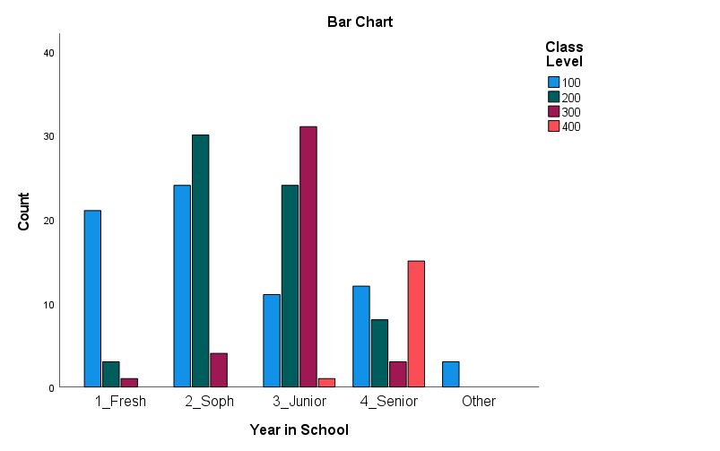
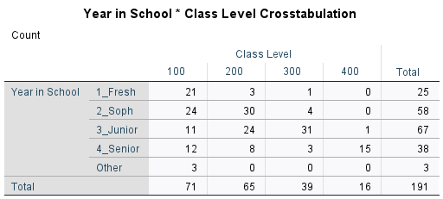
PSR 1 Analysis
Our assessment dashboard:
Gen Ed Assessment Dashboard

Slide 12
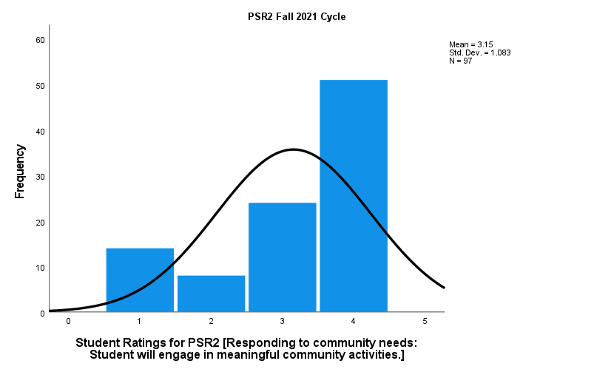
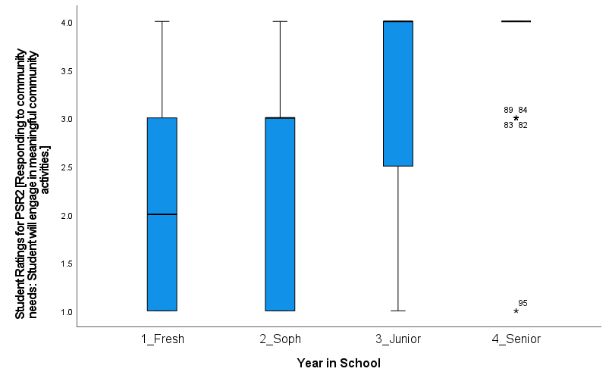
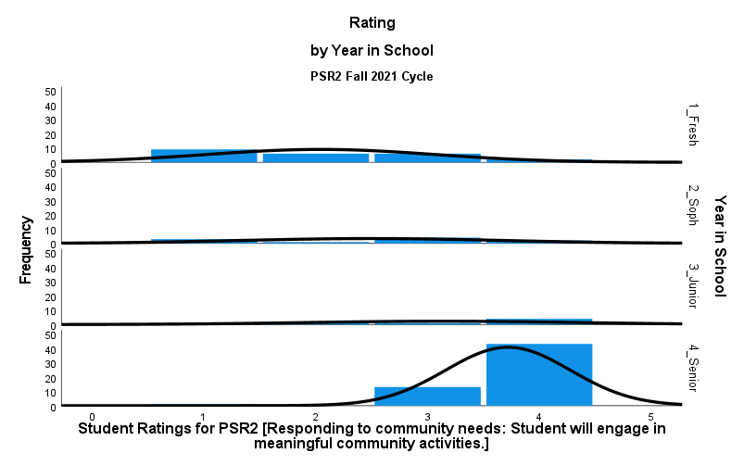
PSR 2 Analysis
Both parametric (unequal variance assumed) and non-parametric tests agreed:
Significant difference between senior and freshman groups at p < .05

Slide 13
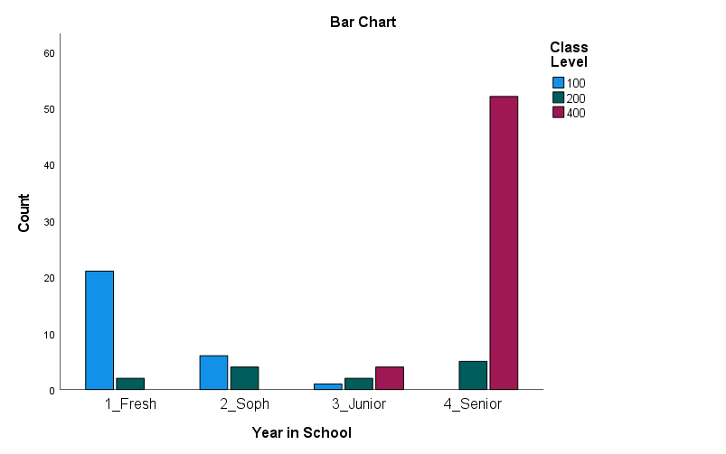

PSR 2 Analysis
Our assessment dashboard:
Gen Ed Assessment Dashboard

Slide 14
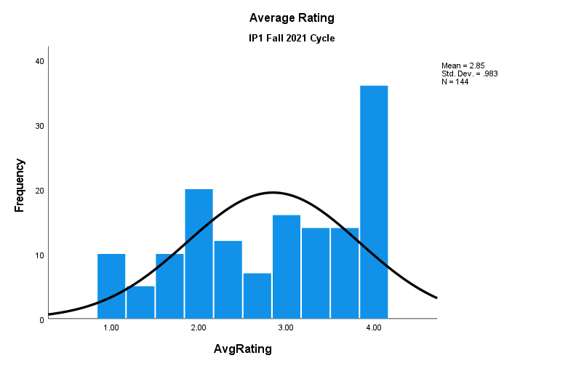
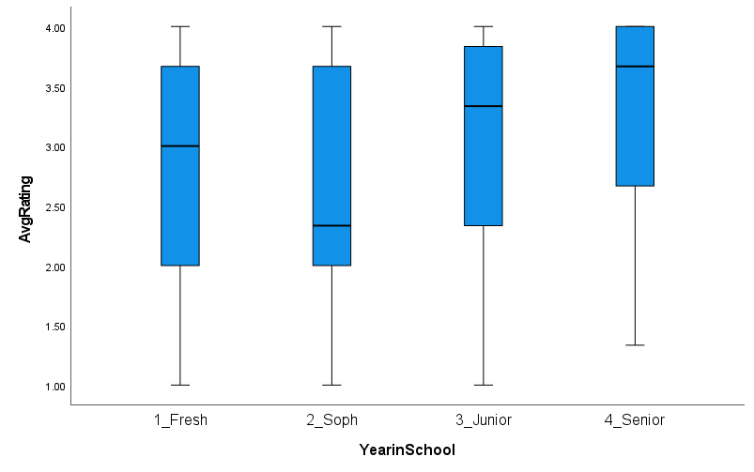
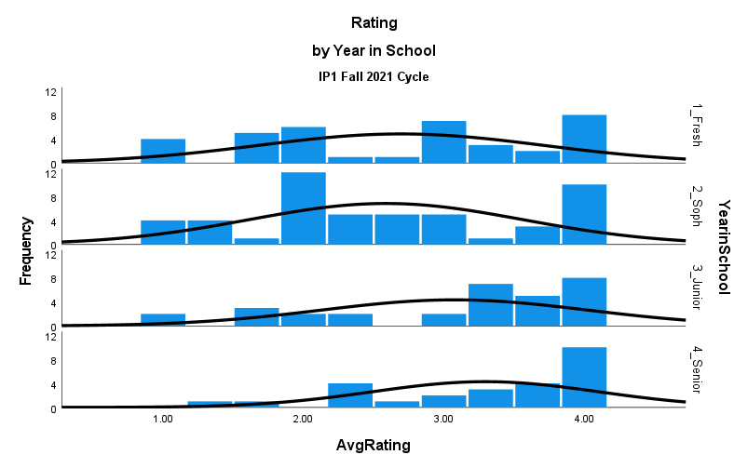
IP 1 Analysis
Both parametric (equal variance assumed) and non-parametric tests agreed:
Significant difference between senior and freshman groups at p < .05

Slide 15
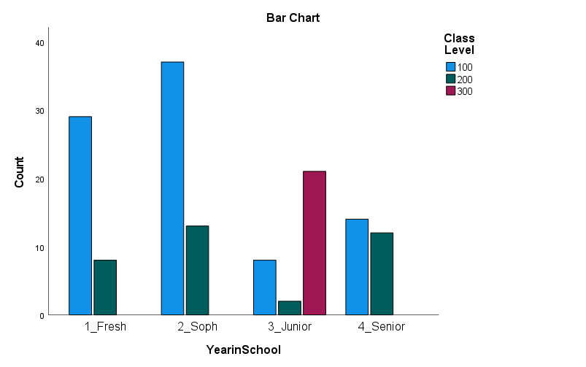
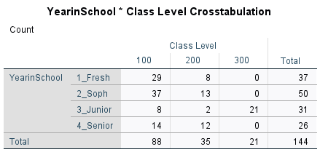
IP 1 Analysis
Our assessment dashboard:
Gen Ed Assessment Dashboard

Slide 16
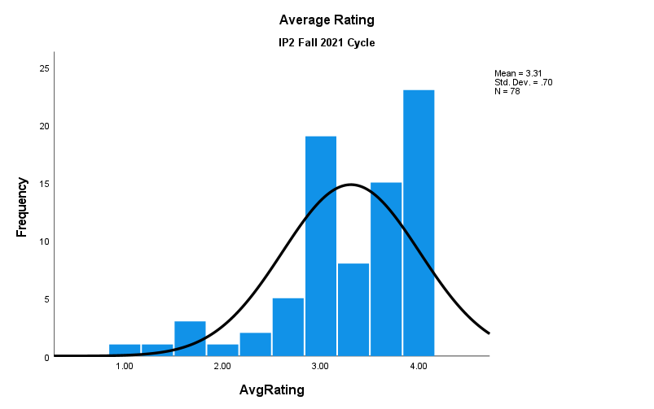
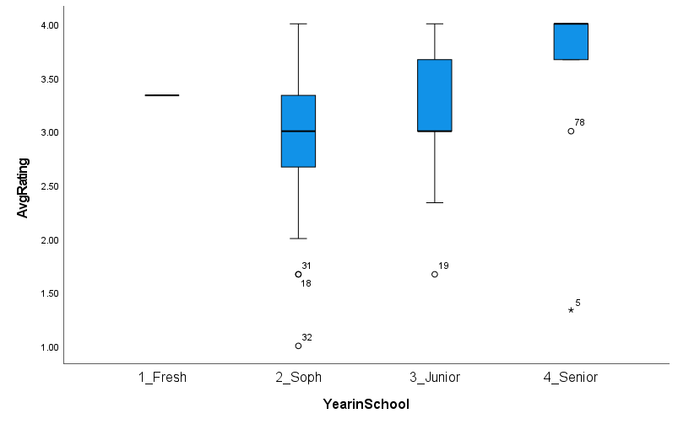
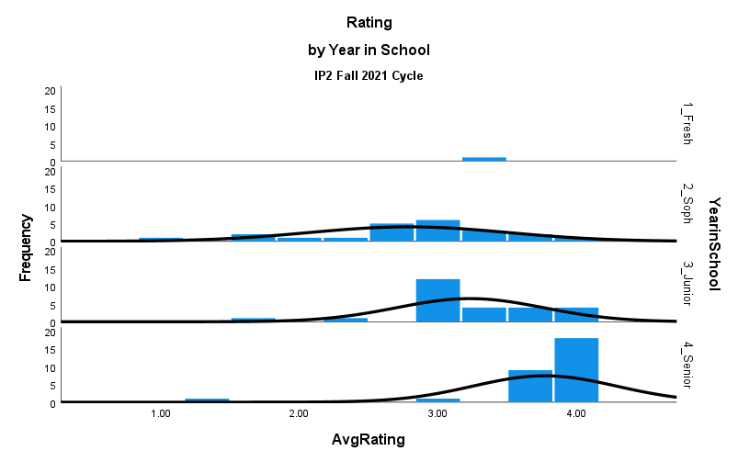
IP 2 Analysis
Insufficient freshman sample size for comparison between senior and freshman groups.
Non-parametric test found significant difference between senior and sophomore groups at p < .05

Slide 17
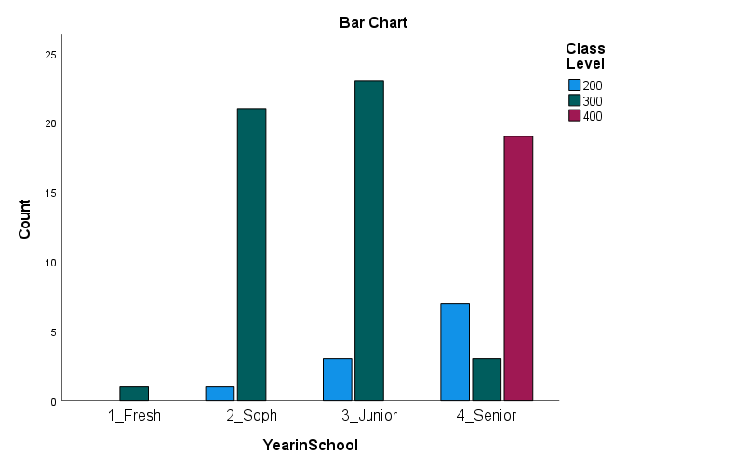
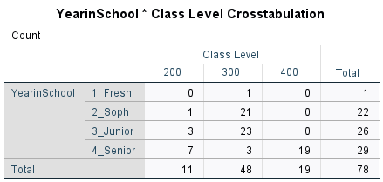
IP 2 Analysis
Our assessment dashboard:
Gen Ed Assessment Dashboard

Slide 18


Slide 19
IP2 Pilot Fall 2021
Scoring
Raters individually determined an overall rubric score
current rubric is created for one specific assignment
Preparation
74 samples provided to raters
73 rated by all 4 raters
72 include student ID
Close scores count as agreement
Fullest majority from all measures of central tendency
Outlier Rater?
Number of unlike responses
Rater W = 7, X = 7, Y = 22, Z = 16
Percent of Agreement = 81.85
(4 raters, 3 ranks)

Slide 20
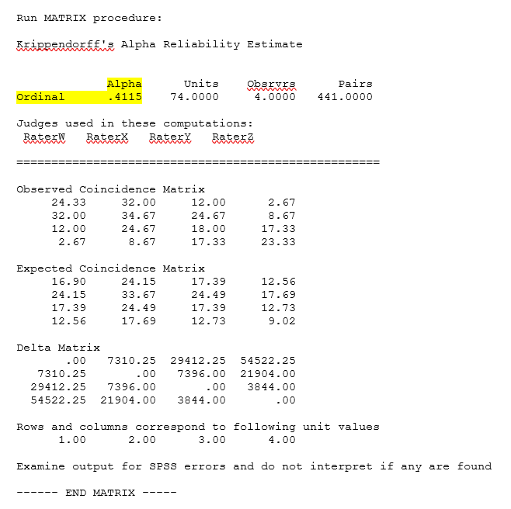
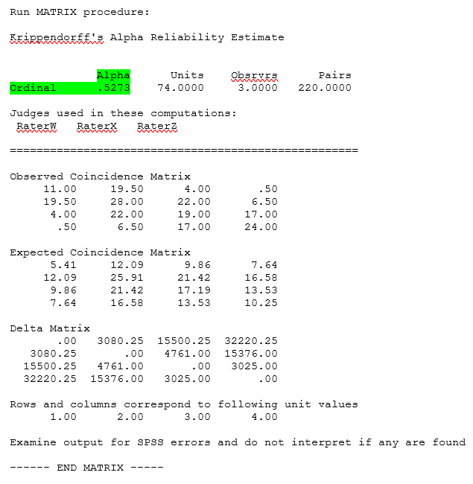
IP2 Pilot Analysis Fall 2021
Krippendorff's Alpha – 4 Raters
Krippendorff's Alpha – 3 Raters

Slide 21
Tentative conclusions
Next Steps
Adjust rubric to accommodate multiple assignments
Or
Adjust assignments to accommodate the current rubric
Add agreed-upon scored examples as a guideline for any coder
Functions like a set of instructions
Benchmark
Krippendorff's α ≥ .667
α ≥ .800
And
Share examples during Assessment Day

Slide 22
IP2 Pilot Examples
Prompt:
A four-year-old throws a temper tantrum. A 20-year-old starts a fistfight. A 75-year-old with Alzheimer’s disease becomes combative.
1. What might these reactions have in common?
2. How would you react in a situation with one of the three individuals above?
Response:
"Each person in the scenarios are ready to fight. If I were in a situation with one of these individuals, I would ask them what I can to [sic] in order to help them feel better. However, my initial reaction would be nervous. It might take me a couple seconds to think and to step into action."

Slide 23
IP2 Pilot Examples
Response:
1. "These reactions all involve mental impulsivity due to brain immaturity or decline. A four-year old’s brain isn’t developed enough to appropriately process his/her feelings or the stimulation, especially if overwhelming, in his/her environment. A 20-year-old’s brain’s prefrontal cortex isn’t developed for another 5 years. Therefore, executive decision-making and impulse control are difficult. A 75-year-old’s brain’s function is naturally declining due to the aging process. Like the others, impulses and higher-function thinking capability are harder to control and complete."
2. "I would get on the individual’s level and meet them where they’re at. I would listen to their thoughts and feelings and attempt to de-escalate the situation by expressing empathy. Then I would offer a distraction or another activity suggestion in order to move on from the trigger/situation that started the response in the first place."
Prompt:
A four-year-old throws a temper tantrum. A 20-year-old starts a fistfight. A 75-year-old with Alzheimer’s disease becomes combative.
1. What might these reactions have in common?
2. How would you react in a situation with one of the three individuals above?

Slide 24
Transition to Critical Competency Gen Ed
Implementing this model is tied to the establishment of a recertification process.
Relevant faculty will reapply their courses for these competencies:
PSR 1/IP 1 → CC 7 (Reapply Fall 2022)
PSR 2/IP 2 → CC 8 (Reapply Spring 2023)
CC 7 and CC 8 courses will be available Fall 2023
Remaining courses will be available Fall 2023
CCS 1 → CC 1 CCS 2 → CC 2
CCS 3 → CC 3 CCS 4 → CC 4
CCS 5 → CC 5 CCS 6 → CC 6
PSR 3 → CC 9
Be seen. Be heard. BE INSPIRED.
Notes:
The campus elected to implement a Critical Competency Model for our General Education Program. Transition to this model is tied to the establishment of a recertification process.

Slide 25
Transition to Critical Competency Continued
General Education Committee will continue course review
Two competencies per semester
Relevant faculty reapply their courses for those competencies.
Over two years, each competency will have its courses recertified.
Subsequently, each competency will have its courses recertified every five years.
Campus Connection can handle concurrent GE programs
Students follow requirement report of their catalog year
Be seen. Be heard. BE INSPIRED.
Notes:
Possible question answer: Five-year recertification follows semester rotation of initial review, beginning Fall 2022 with CC 7

Slide 26
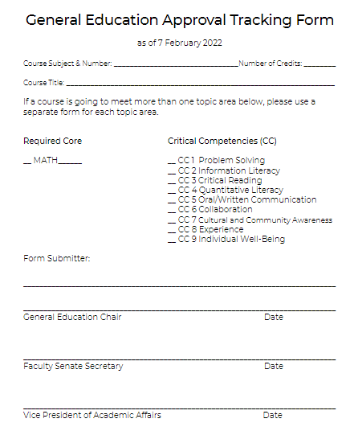







New Processes
Approving courses for Critical Competency Model only
since Fall 2022
Now available - Updated Application Forms
CC 1
CC 2
CC 3
CC 4
CC 5
CC 6
CC 7
CC 8
CC 9
Be seen. Be heard. BE INSPIRED.
Notes:
Remember to look for email regarding CC 8.

Slide 27
Significant Learning (Fink, 2013)
"Learning that makes a difference in how people live—and the kind of life they are capable of living" (p. 7).​
Task: Course-Design Activity
Purpose: Identify significant learning, learning beyond our courses. Identify applicable general education learning outcomes in courses. Align assessment with learning activities and learning intentions.
Skills: Collaborate to build upon and clarify important learning in courses. Align assessment with learning activities and learning intentions.
Success Criteria: I can align assessment with learning activities and learning intentions.

Slide 28

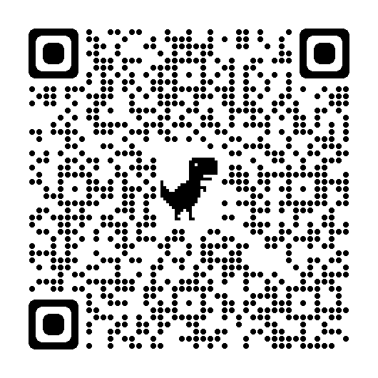
Dreaming Exercise (Fink, 2013)
"Question: In your deepest, fondest dreams, what kind of impact would you most like to have on your students? That is, when the course is over and it is now one or two years later, what would you like to be true about students who have participated in your courses that is not true of others? What is the distinctive educational impact you would like for your teaching and your courses to have on your students?" (p. 10).
Response Whiteboard
Notes:
risk failure to achieve their goals and find reward in unleashing their potential.

Slide 29
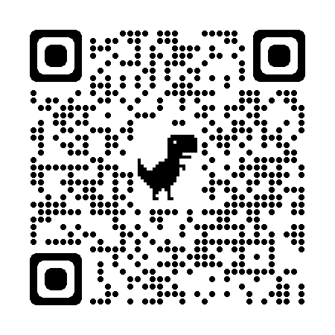
Live Your Dreams
Assessment Question: What thinking, or actions, would students need to make visible to convince you and themselves that they have successfully met criteria of the educational impact you wish to make?
Assessment Whiteboard
Activity Question: During the course, what activities would provide students opportunities to learn your success criteria?
You can include applicable general education learning outcomes.

Slide 30
References
Fink, L. D. (2013). Creating significant learning experiences: An integrated approach to designing college courses. Jossey-Bass.
Finley, A. P. (2011). How reliable are the VALUE rubrics? [PDF]. Peer Review, 13(4), 31-33.
Krippendorff, K. (2004). Reliability in content analysis: Some common misconceptions and recommendations. Human Communication Research, 30(3), 411-433. https://doi.org/10.1111/j.1468-2958.2004.tb00738.x
Krippendorff, K. (2011). Computing Krippendorff's alpha-reliability [PDF]. Scholarly Commons. https://repository.upenn.edu/asc_papers/43
Krippendorff, K. (2016). Misunderstanding reliability [PDF]. Methodology, (European Journal of Research Methods for the Behavioral and Social Sciences) 12(4), 139-144. https://doi.org/10.1027/1614-2241/a000119
Siefert, L. (2011). Assessing general education learning outcomes [PDF]. Peer Review, 13(4), 9-11.

Slide 31

Enjoy your day!

