Slide 1
Administrative Assistants Mtg Funds & reports August 8, 2024

Slide 2
AGENDA
New Department numbers
Running Reports
Questions for Business Office
Future Meeting

Slide 3
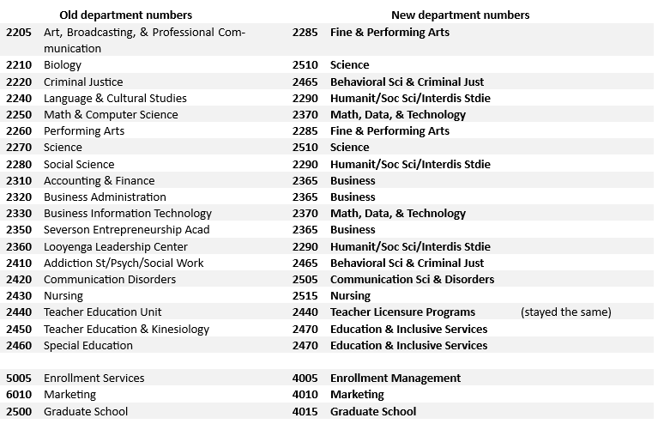
New Department Funds

Slide 4
Running Monthly budget reports for departments

Slide 5
Running Reports
The monthly reports to be run each month
Budget Status
Budget Transaction Detail
Gross and Fringe
Additional reports
General Ledger Summary
Budget Overview
Trial Balance

Slide 6
Budget Status & Budget Transaction Report
Information on How to Run Budget Status Report HERE
Information on How to Run Budget Transaction Detail Report HERE
Information on How to Run Gross & Fringe Report HERE

Slide 7
General Ledger Summary, & Trial Balance report
How to Run General Ledger Summary HERE
How to Run Trial Balance Sheet HERE

Slide 8
Q & A Questions for Business Office

Slide 9
THANK YOU
Celeste Simmons
701-858-3310
Celeste.simmons@minotstateu.edu

