Slide 1


Yearly Program Assessment Training – Report YPA SLO Findings and Narrative Results in SPOL
Nathan Anderson
Director of Institutional Assessment
2023

Slide 2

Objectives
Enter assessment findings for student learning outcomes (SLOs)
Explain assessment results of SLOs
Run assessment reports in SPOL

Slide 3

Target Audience
Academic and co-curricular program Yearly Program Assessment (YPA) authors and other personnel supporting the YPA process
Prerequisite
  YPA plan has been entered in SPOL
  Data are available in a suitable format for reporting in SPOL

Slide 4
Background - Accreditation
HLC Criterion 4, Teaching and Learning: Evaluation and Improvement, pertains to program assessment.
  Core Component 4.B states, “The institution engages in ongoing assessment of student learning as part of its commitment to the educational outcomes of its students” (p. 35).
    Evidence item 1 states, “The institution has effective processes for assessment of student learning and for achievement of learning goals in academic and cocurricular offerings”

Slide 5
Background – MiSU YPA
Yearly Program Assessment (YPA)
  Annual documentation of a program's assessment plan, results, and utilization of results

Slide 6
Background – SPOL
Strategic Planning Online (SPOL)
Institutional Effectiveness Software
Planning, Budget, Assessment, Credentialing, Accreditation
No cost to MiSU through existing contract between NDUS and SPOL

Slide 7
YPA Essential Elements
Mission statement
Student learning goals (SLGs)
Student learning outcomes (SLOs)
Operational goals (OGs)
Operational outcomes (OOs)
Measures
Criteria
Findings
Explanation of Results
  Intended Results, Actual Results, Use of Results

Slide 8
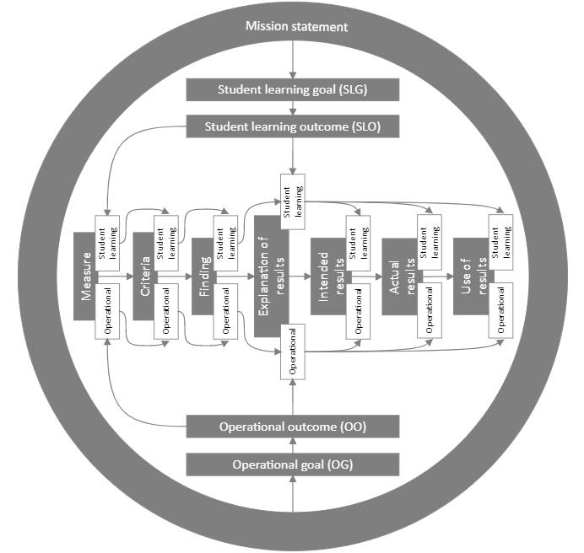

Slide 10
Log in to SPOL

Slide 11
Co-Curricular Assessment Page

Slide 12
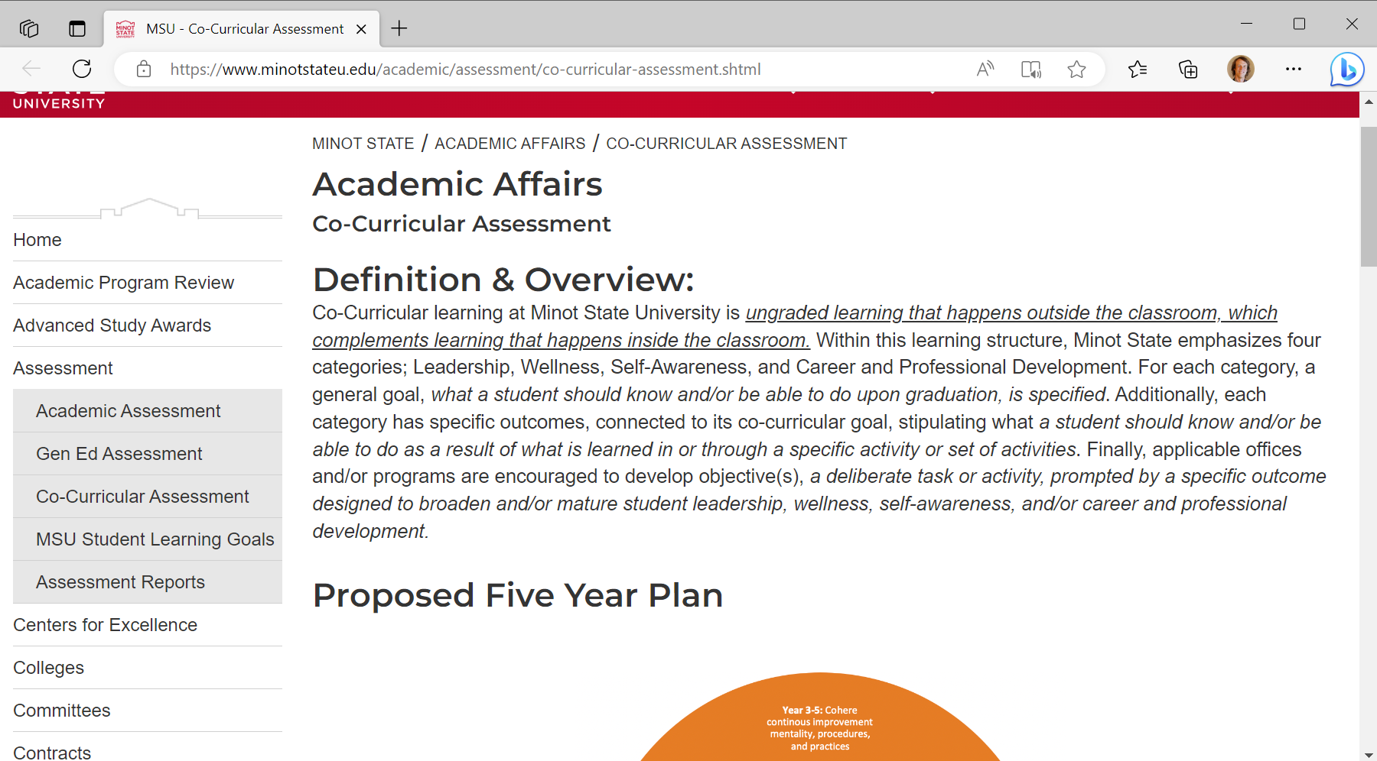
Go to the Co-Curricular Assessment page. Scroll down.

Slide 13
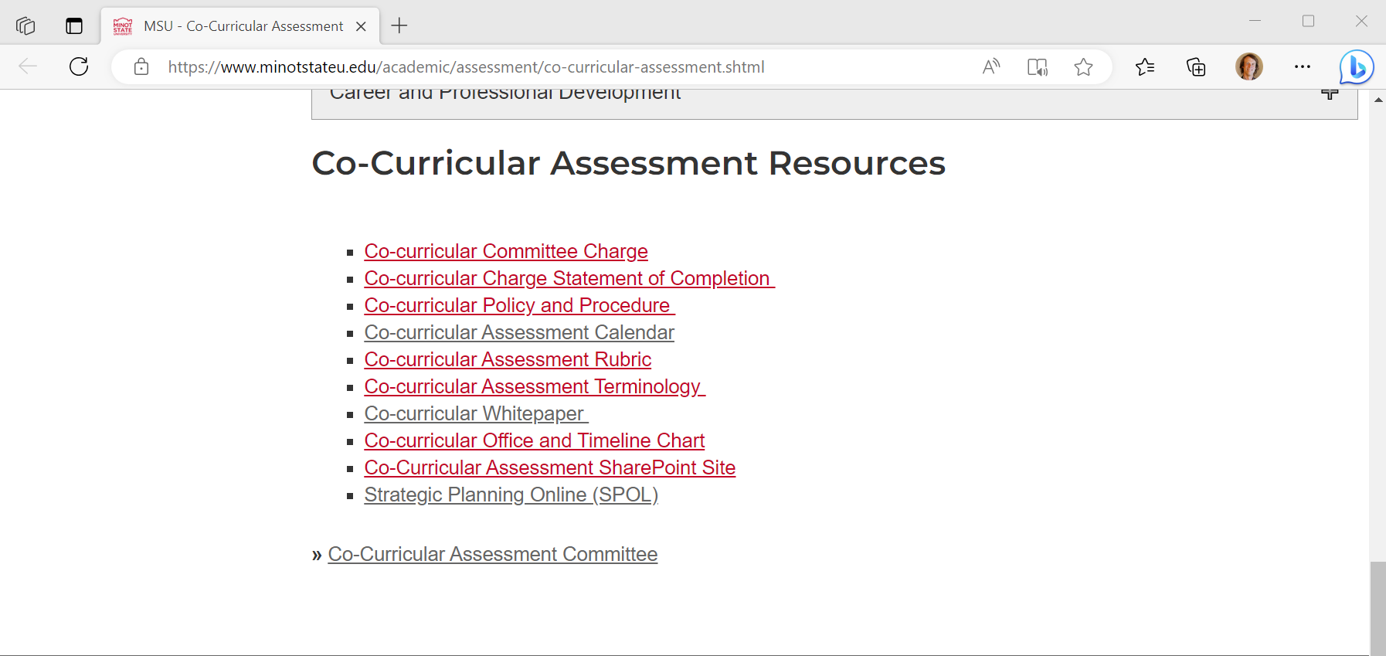
Click Strategic Planning Online (SPOL) in the Co-Curricular Assessment Resources section

Slide 14
Academic Assessment Page

Slide 15
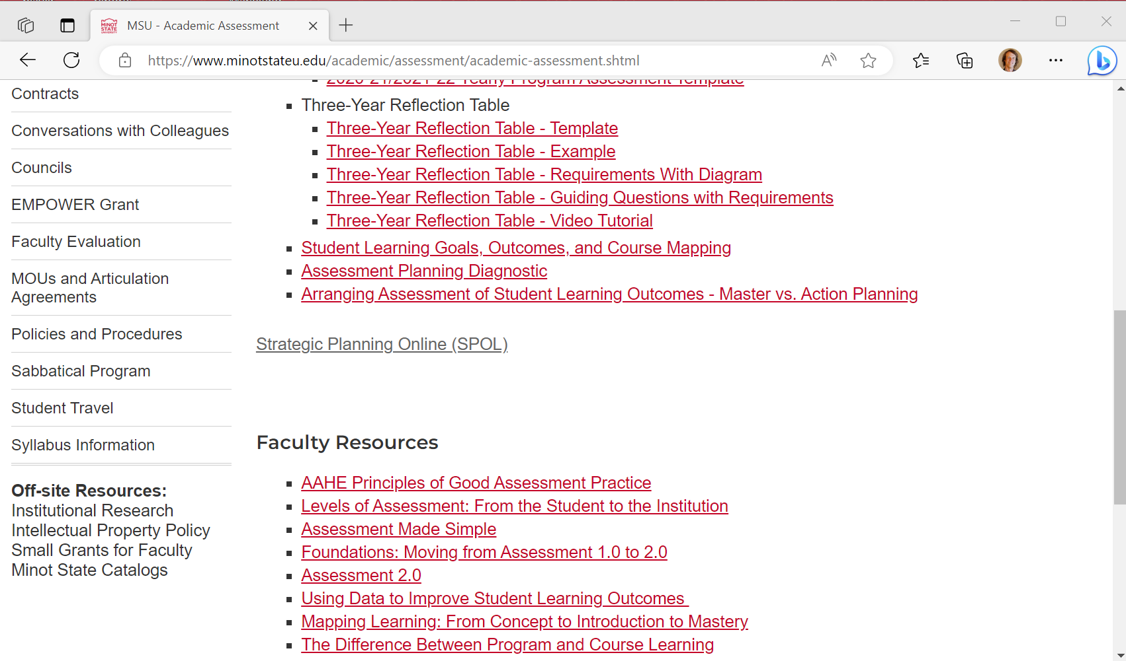
Click Strategic Planning Online (SPOL)

Slide 16
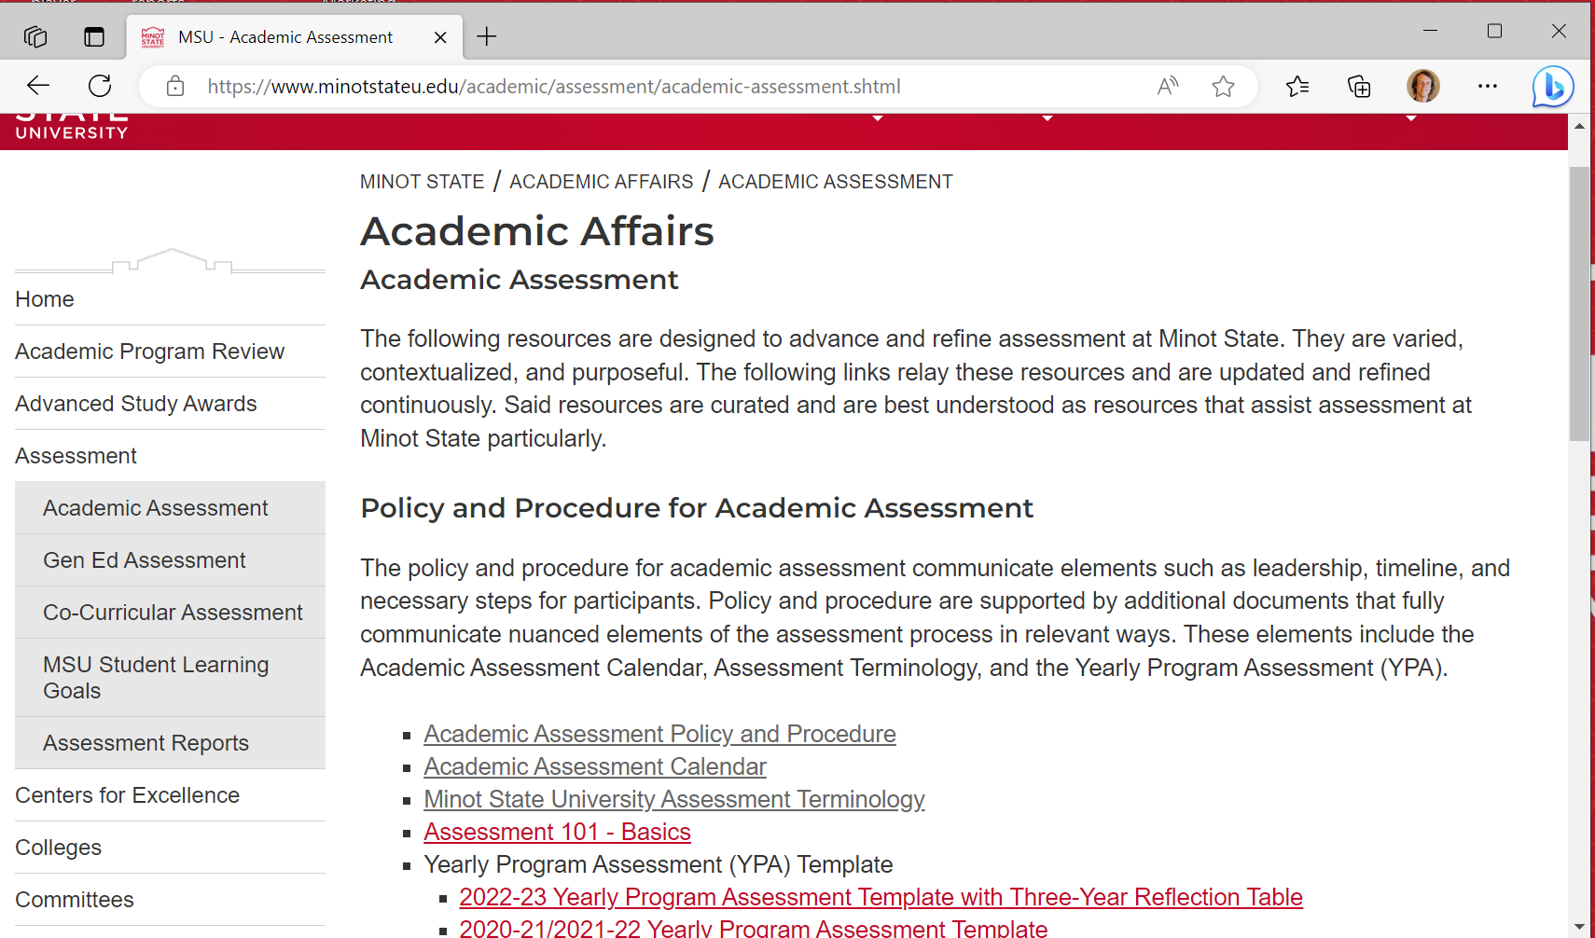
Go to the Academic Assessment page. Scroll down.

Slide 17
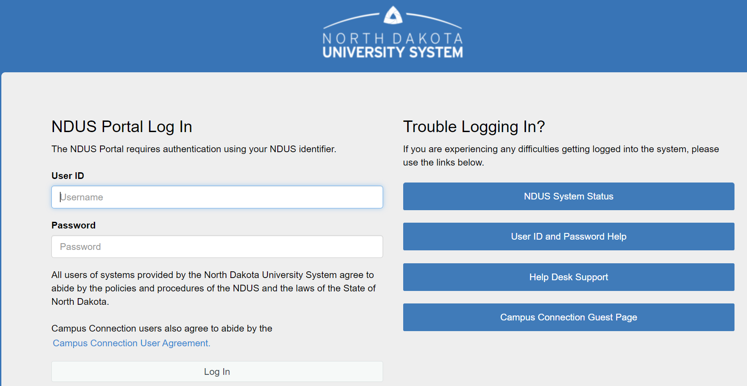
Log In with your NDUS User ID and Password

Slide 18
Enter Assessment Findings for SLOs

Slide 20
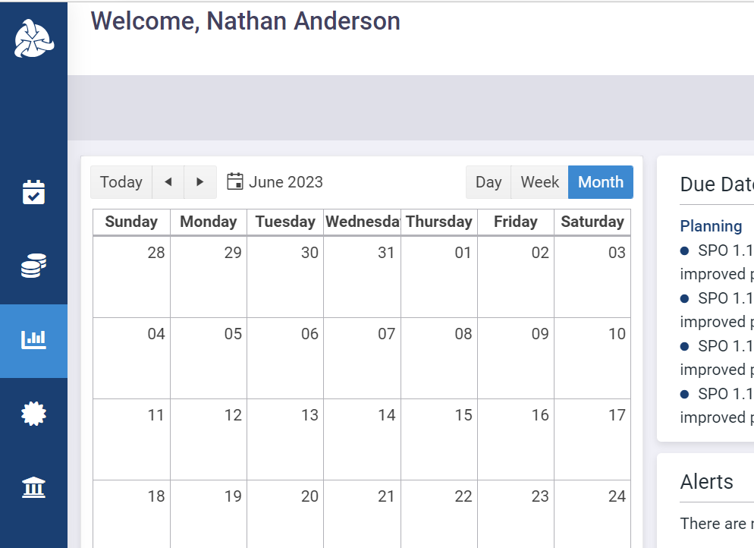
Click the Assessment icon in the left sidebar

Slide 21
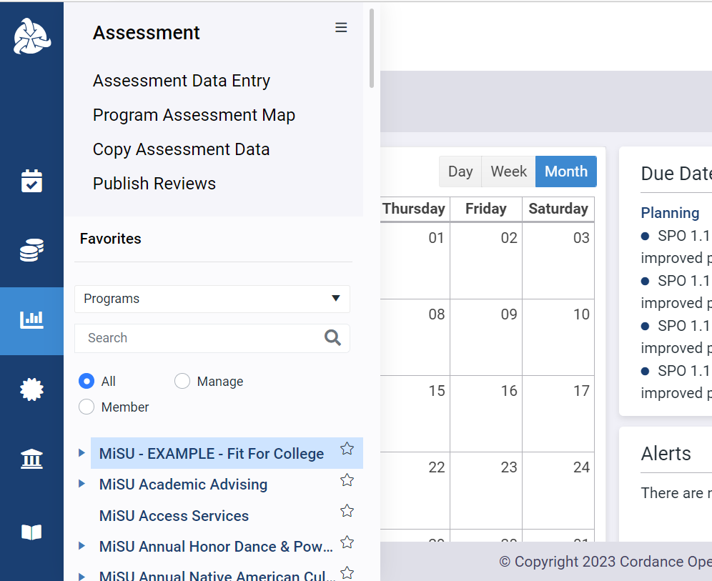
Click the desired program name in the expanded sidebar

Slide 22
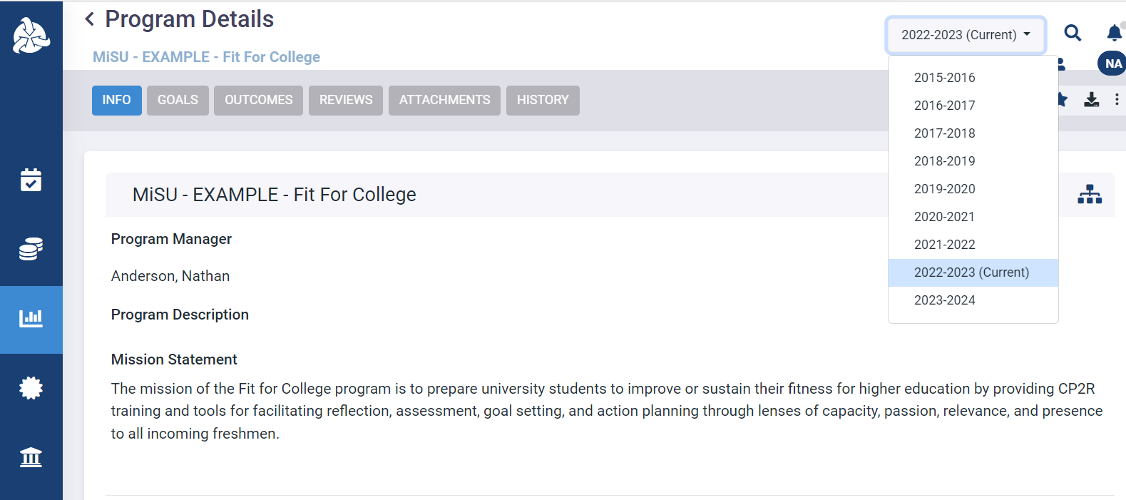
Select the desired year from the planning year dropdown menu in the upper right corner

Slide 23
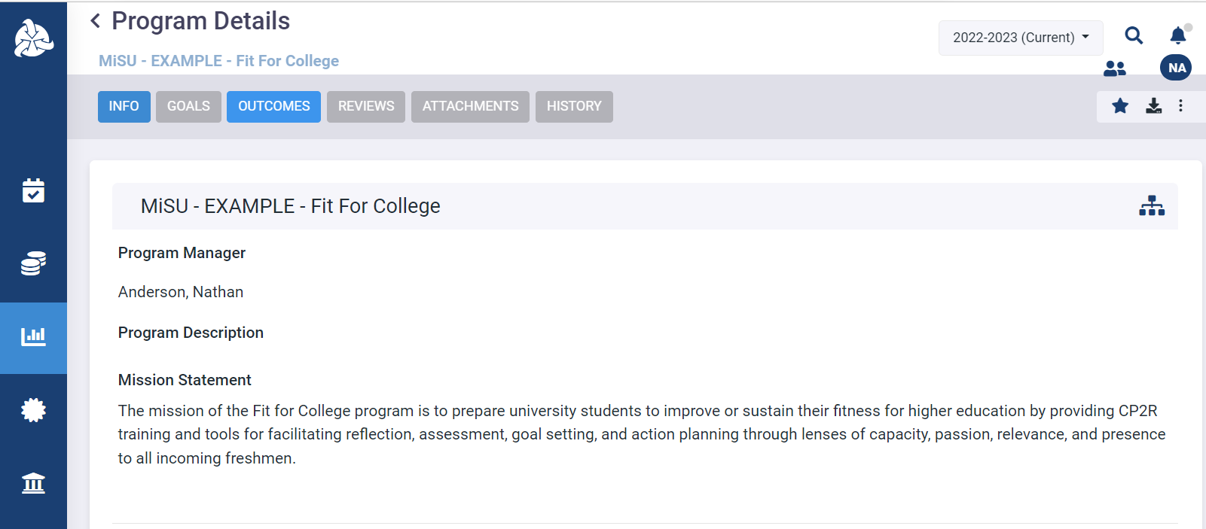
Click the Outcomes tab

Slide 24
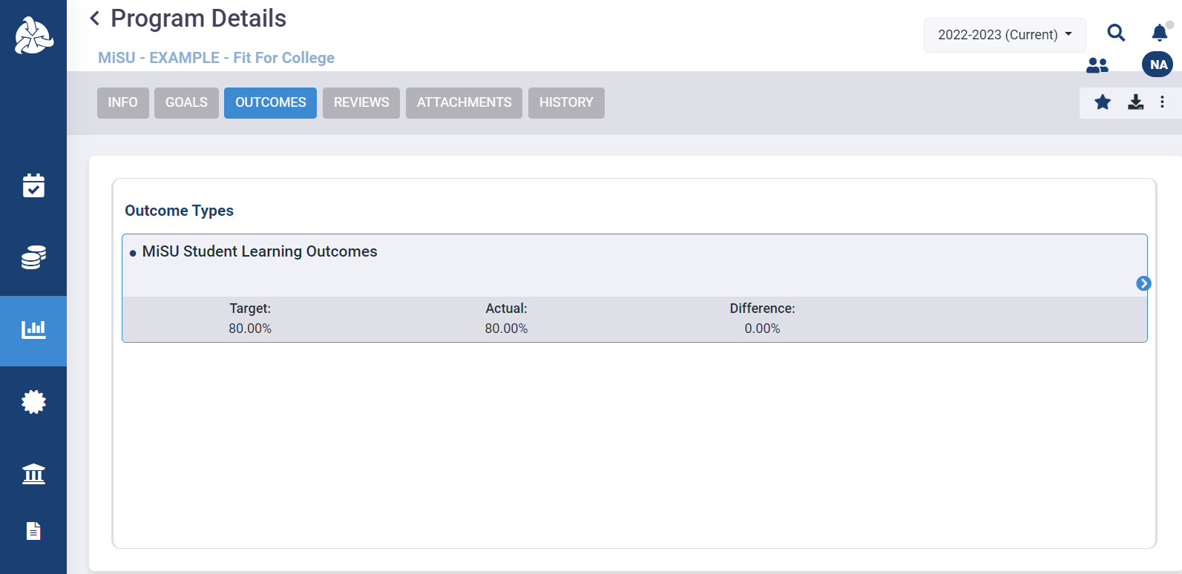
Hover over the MiSU Student Learning Outcomes outcome type. Click the blue arrow that appears on the right to open the Program Outcomes pane.

Slide 25
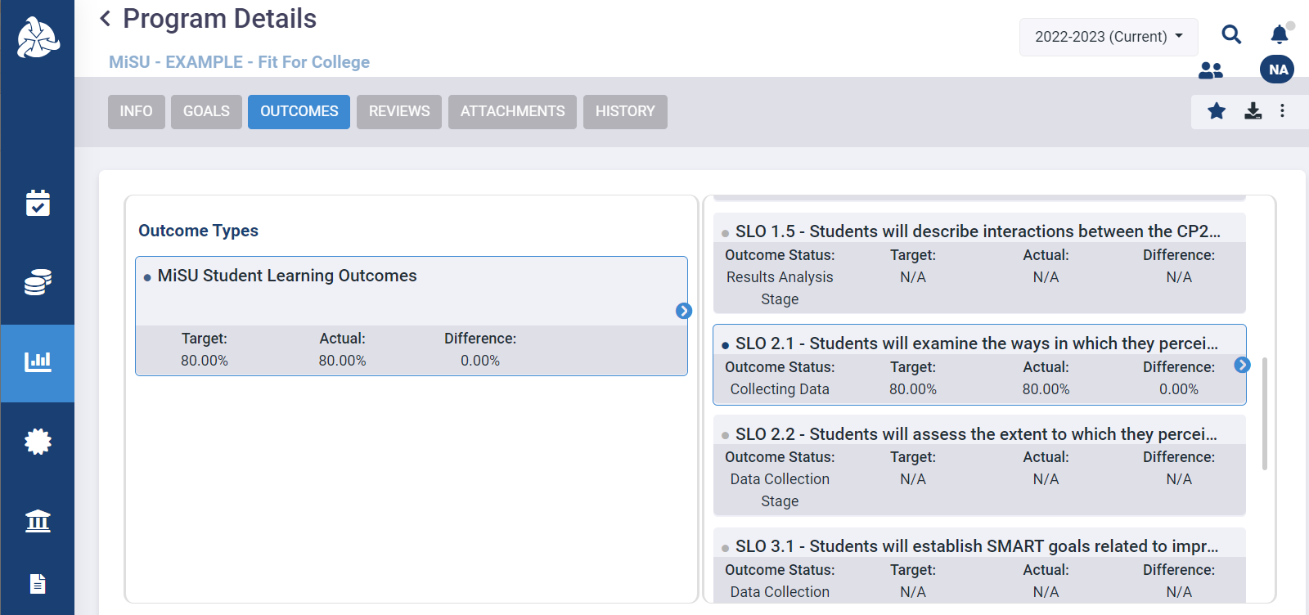
Hover over the desired SLO. Click the blue arrow that appears on the right to open the Measures pane.

Slide 26
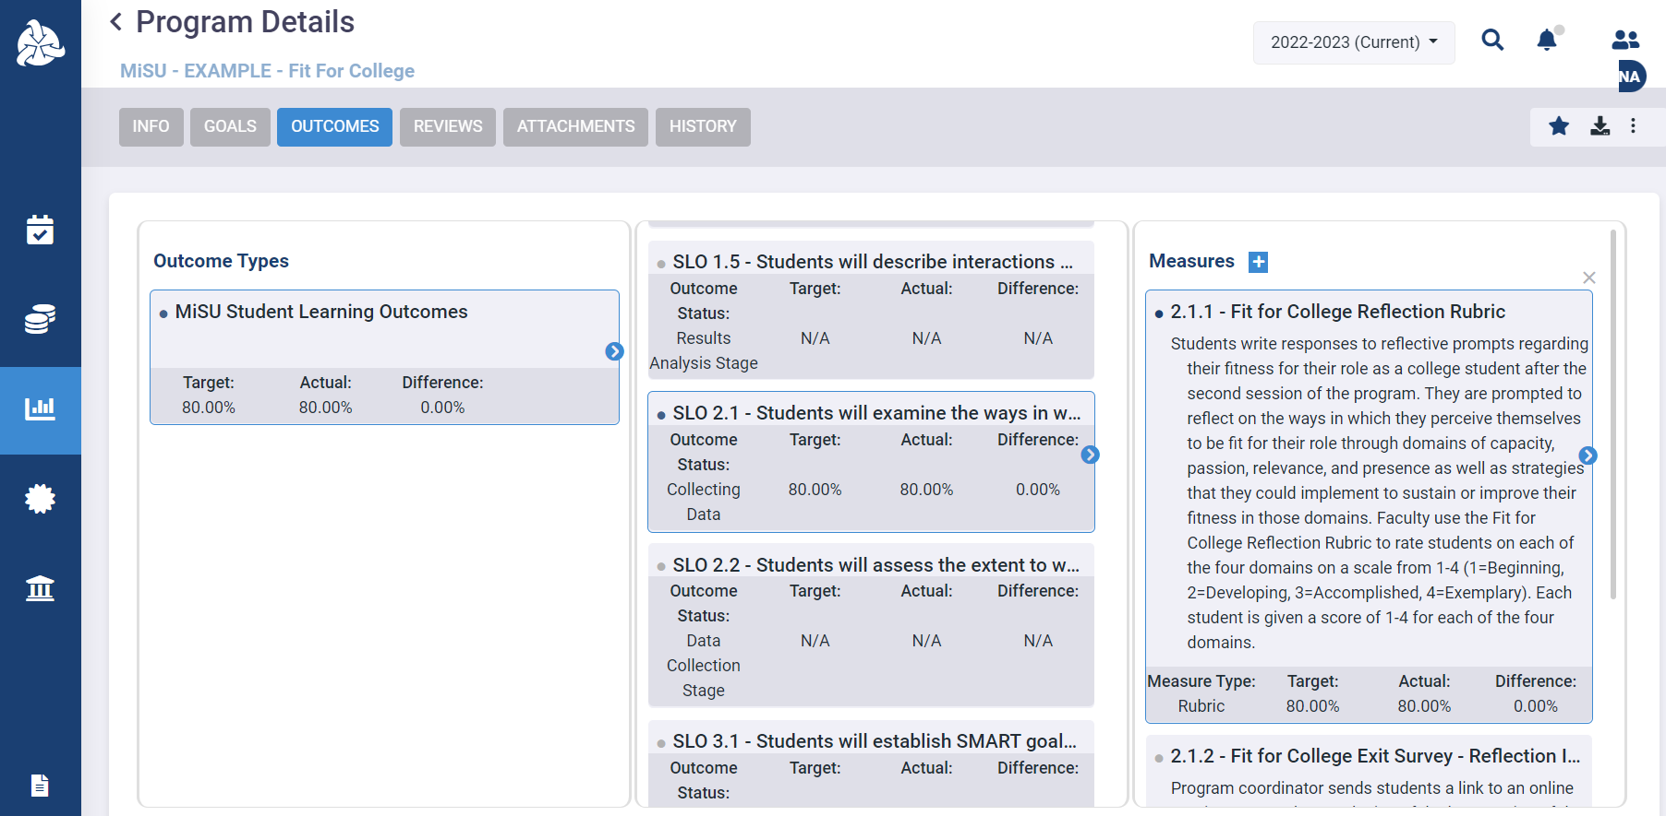
Hover over the desired Measure. Click the blue arrow that appears on the right to open the Criteria pane.

Slide 27
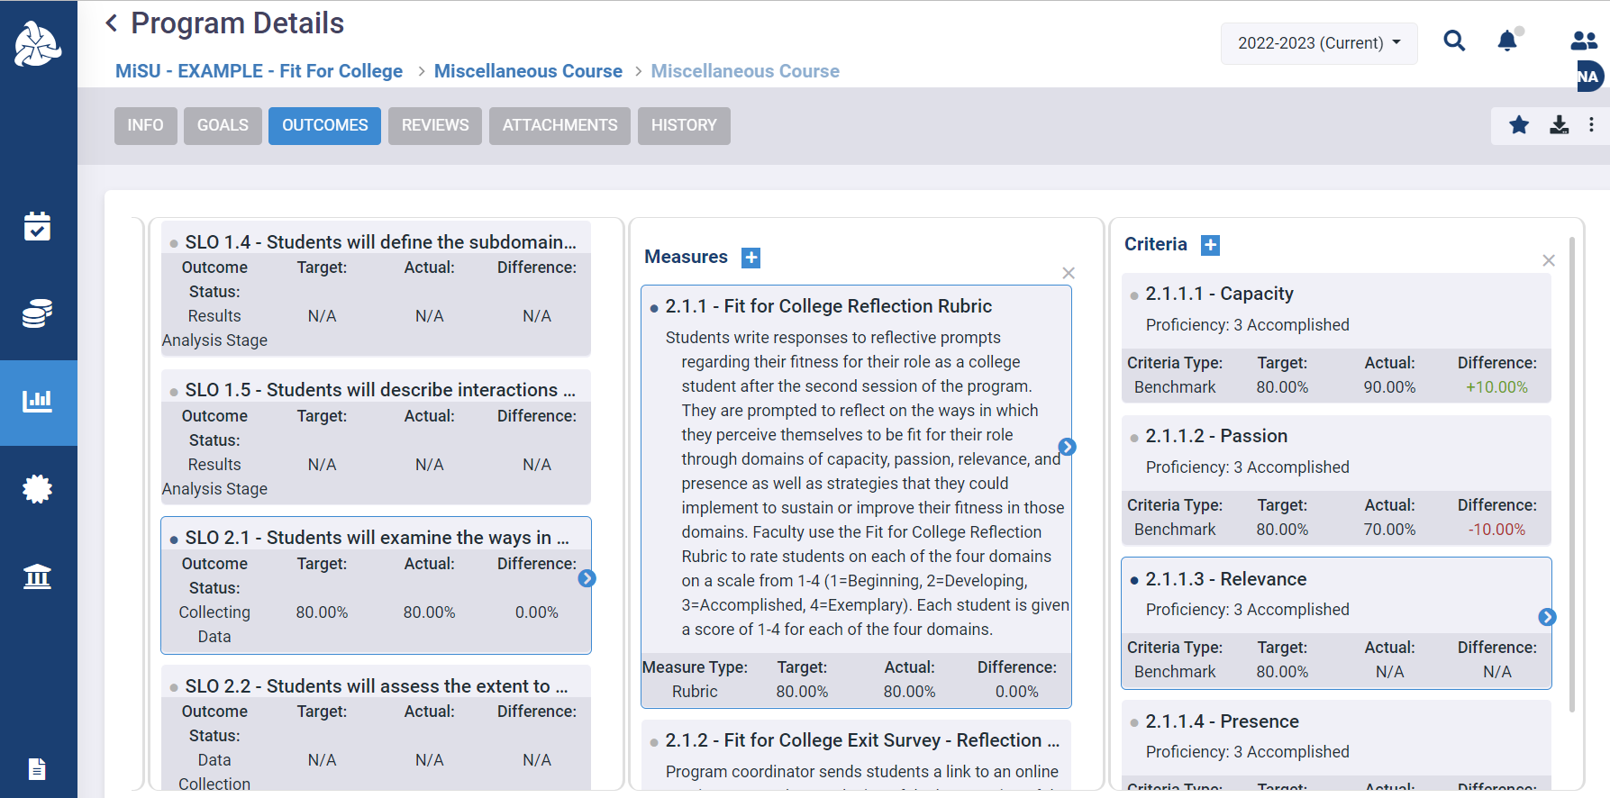
Hover over the desired Criteria. Click the blue arrow that appears on the right to open the Findings pane.

Slide 28
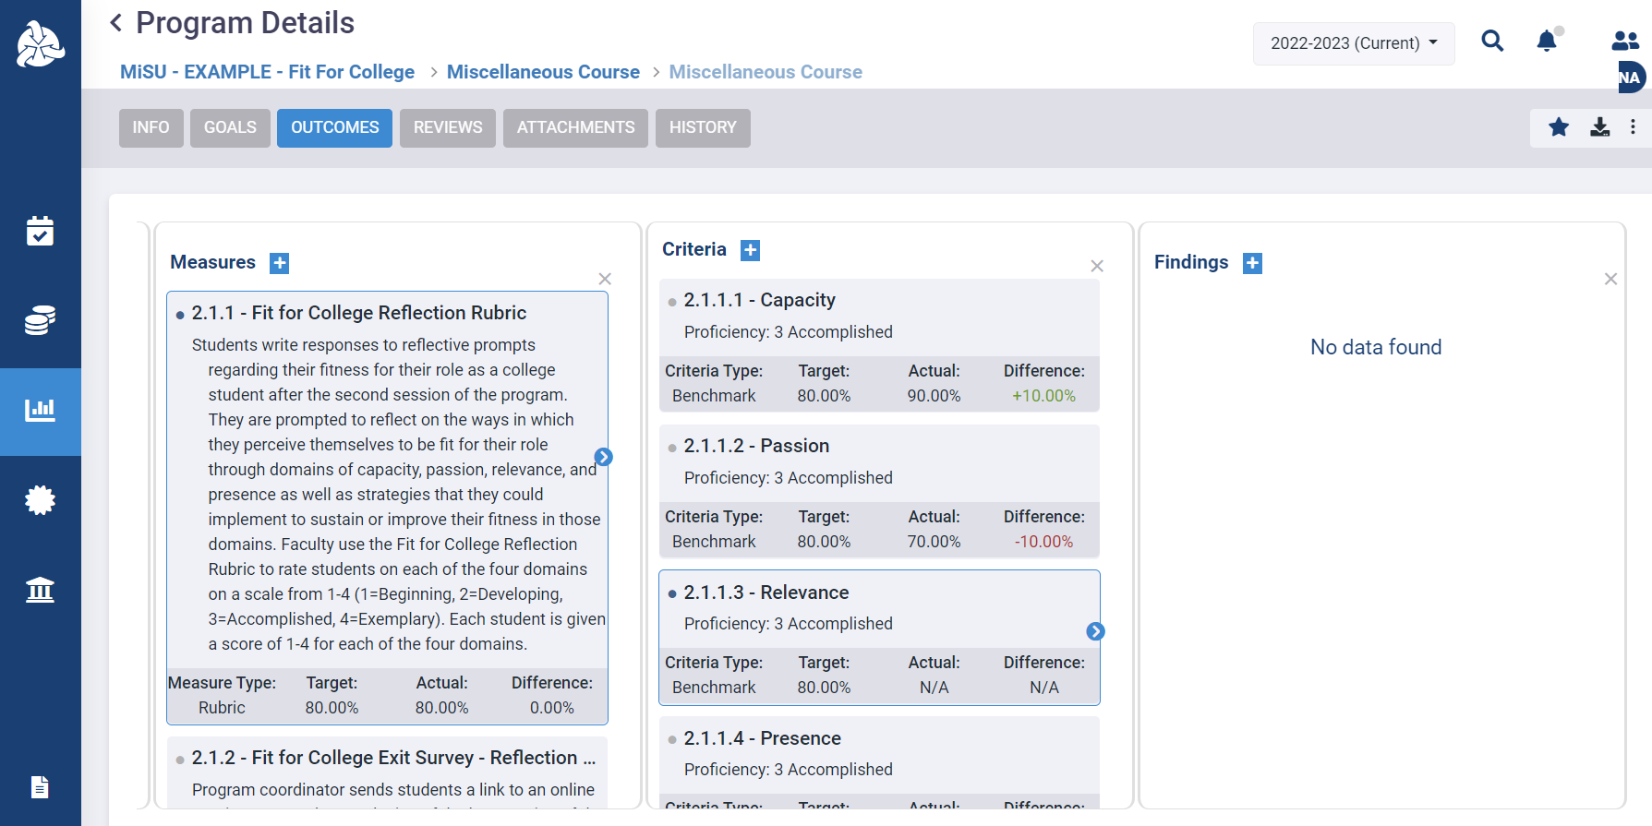
Click the plus (+) icon next to Findings to open the New Finding window.

Slide 29
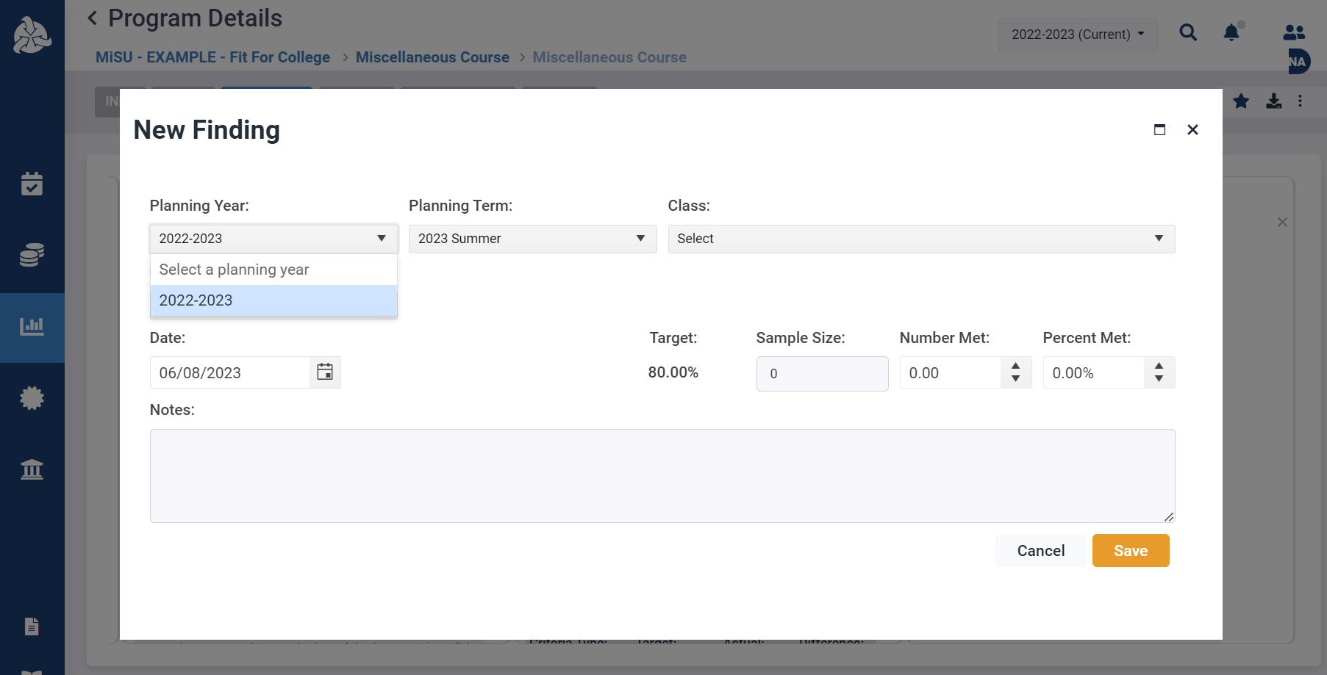
Select the desired Planning Year.

Slide 30
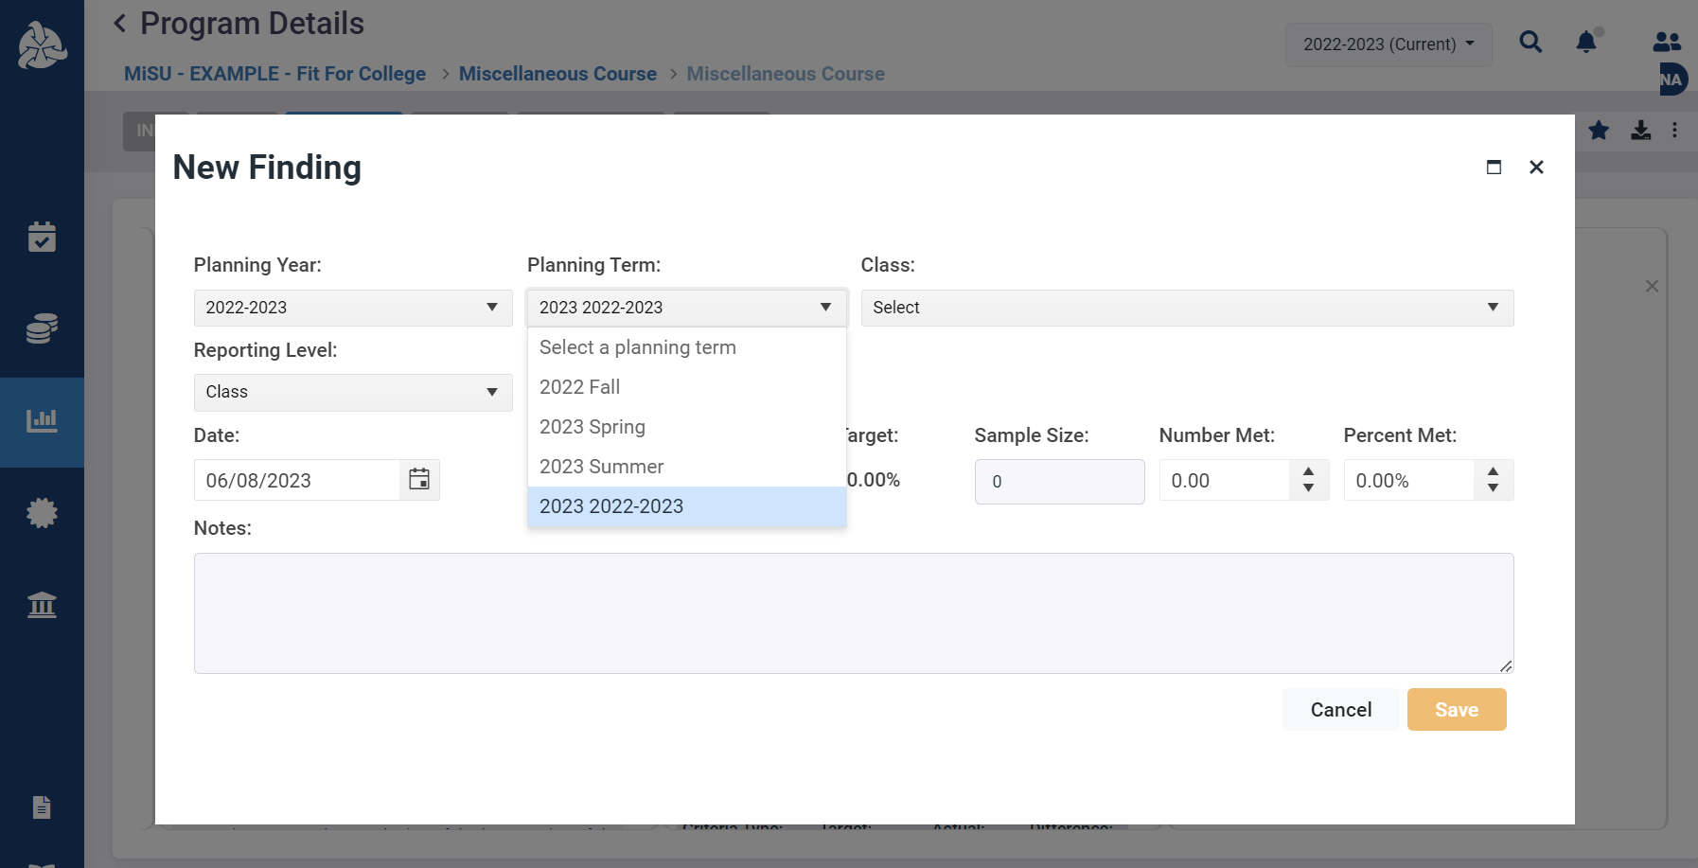
Select the Planning Term that represents the complete academic year.

Slide 31
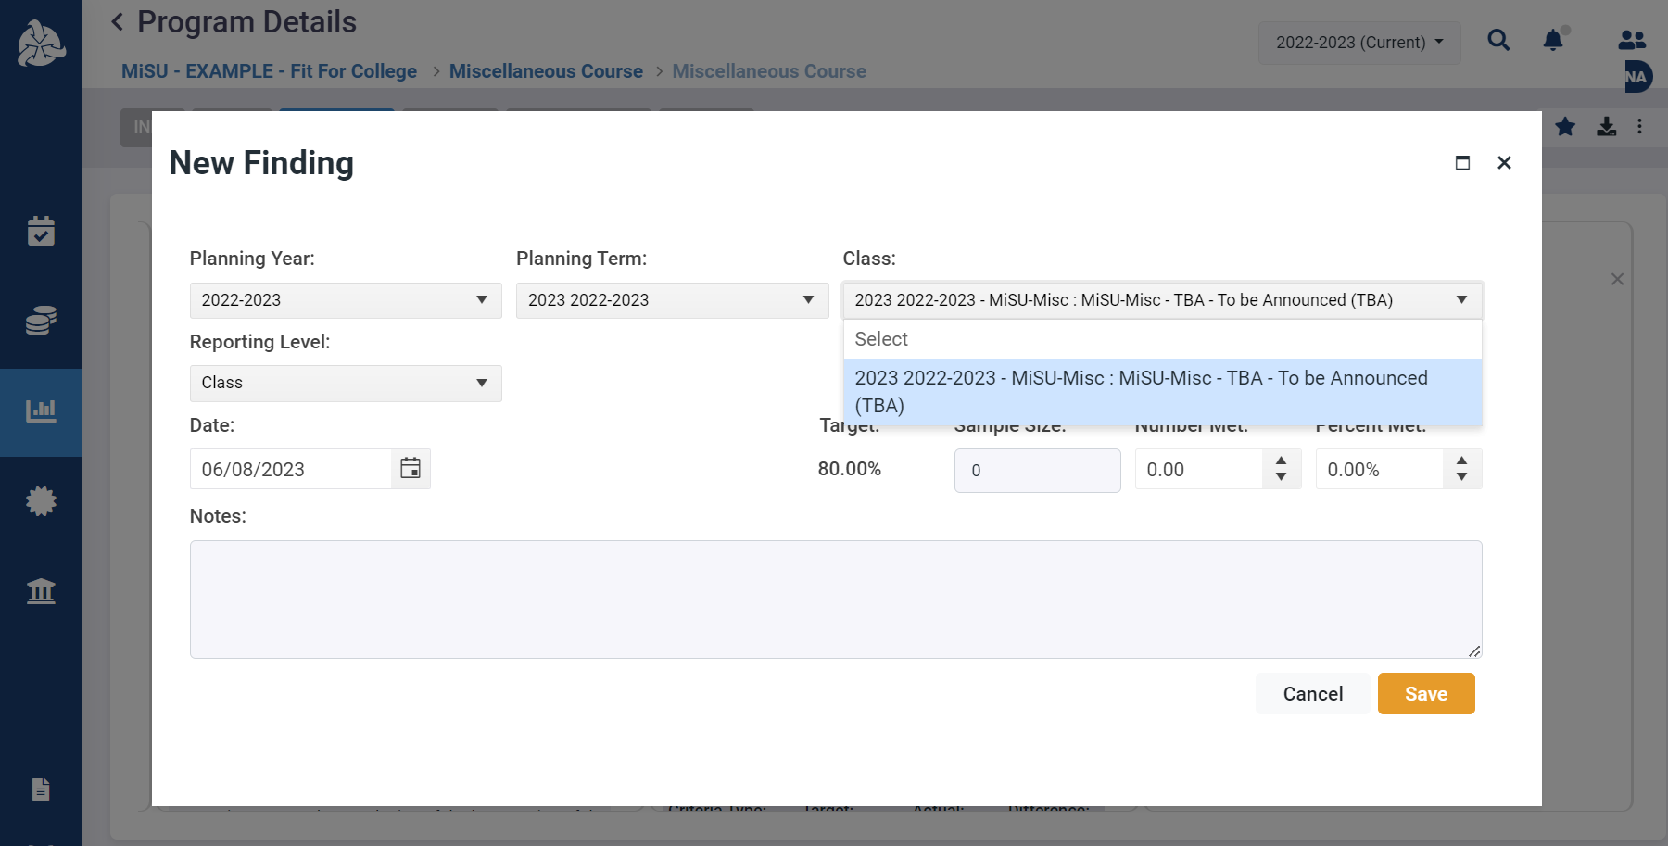
Select the desired class

Slide 32
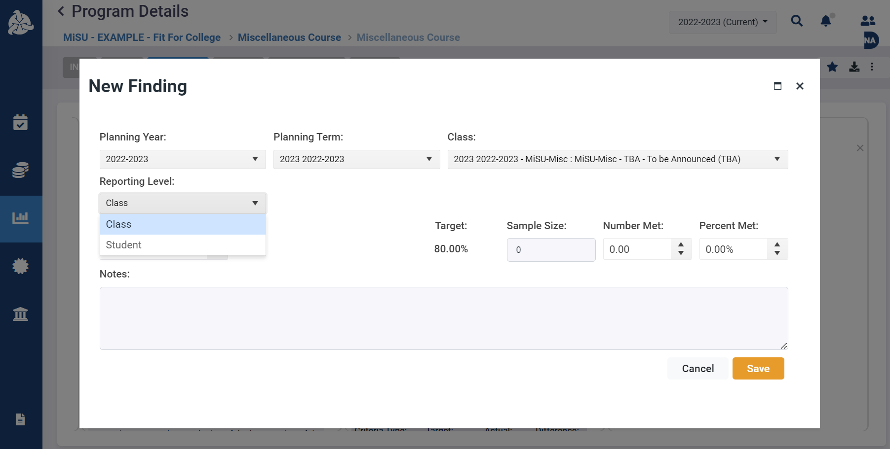
Select the Class reporting level

Slide 33
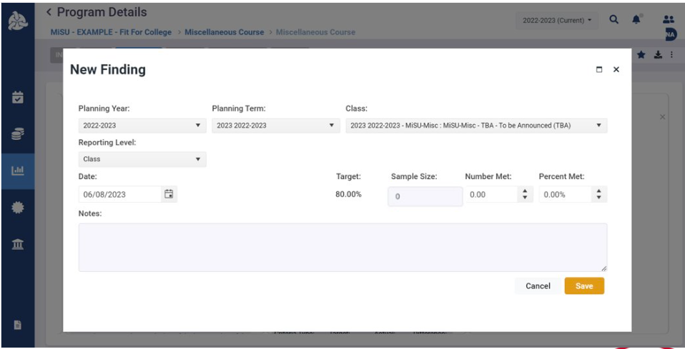
Enter the Date that the finding is entered

Slide 34
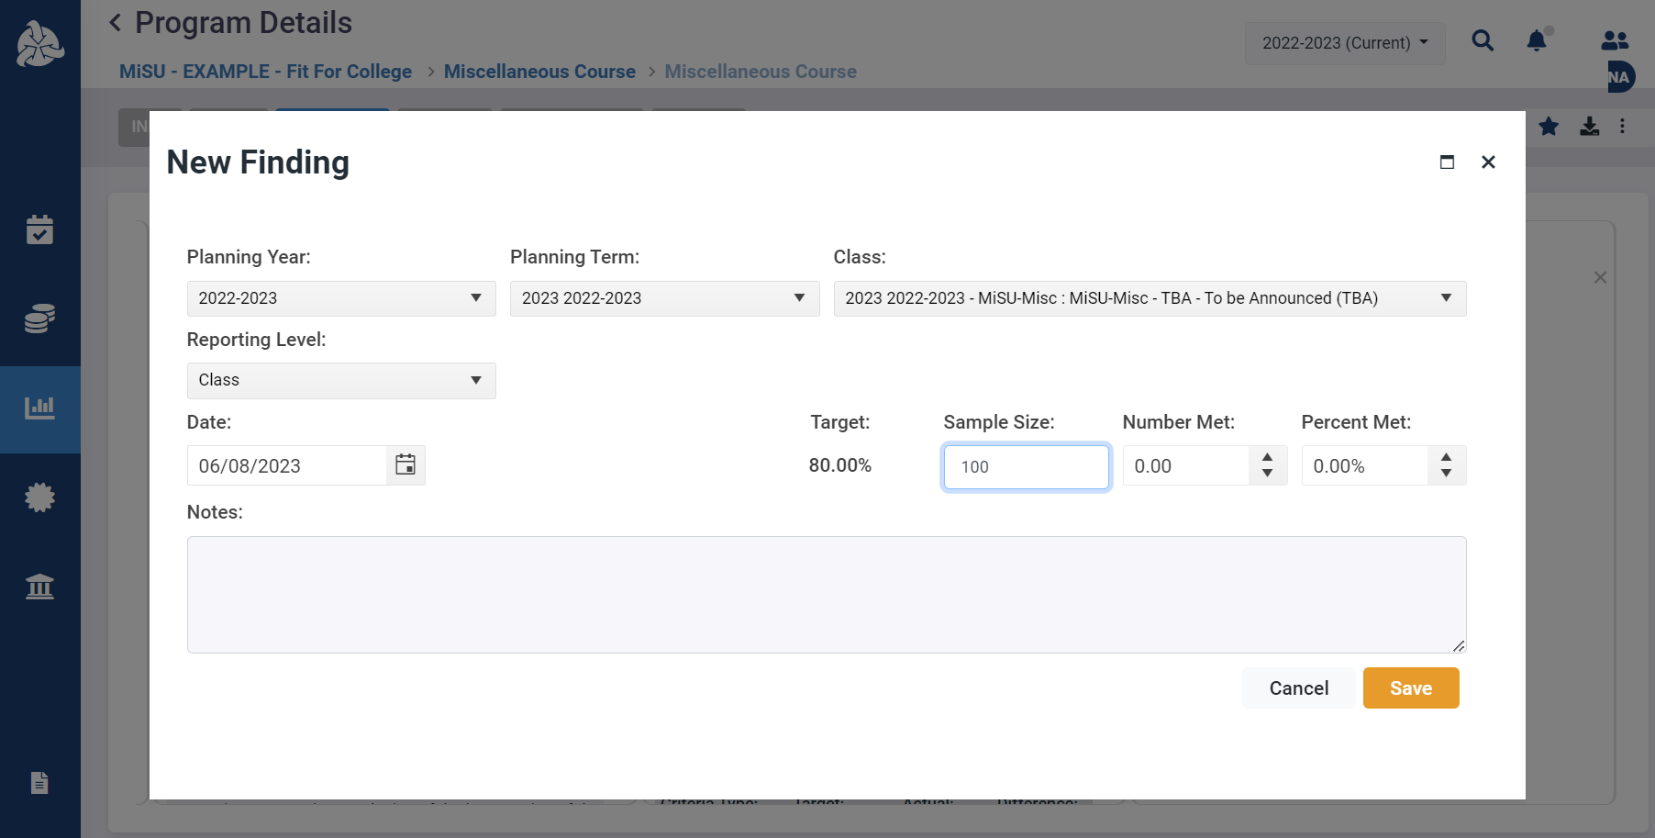
Enter the sample size

Slide 35

Enter the Number Met or Percent Met. Upon entry of one value, the other value is automatically calculated.
OR

Slide 36
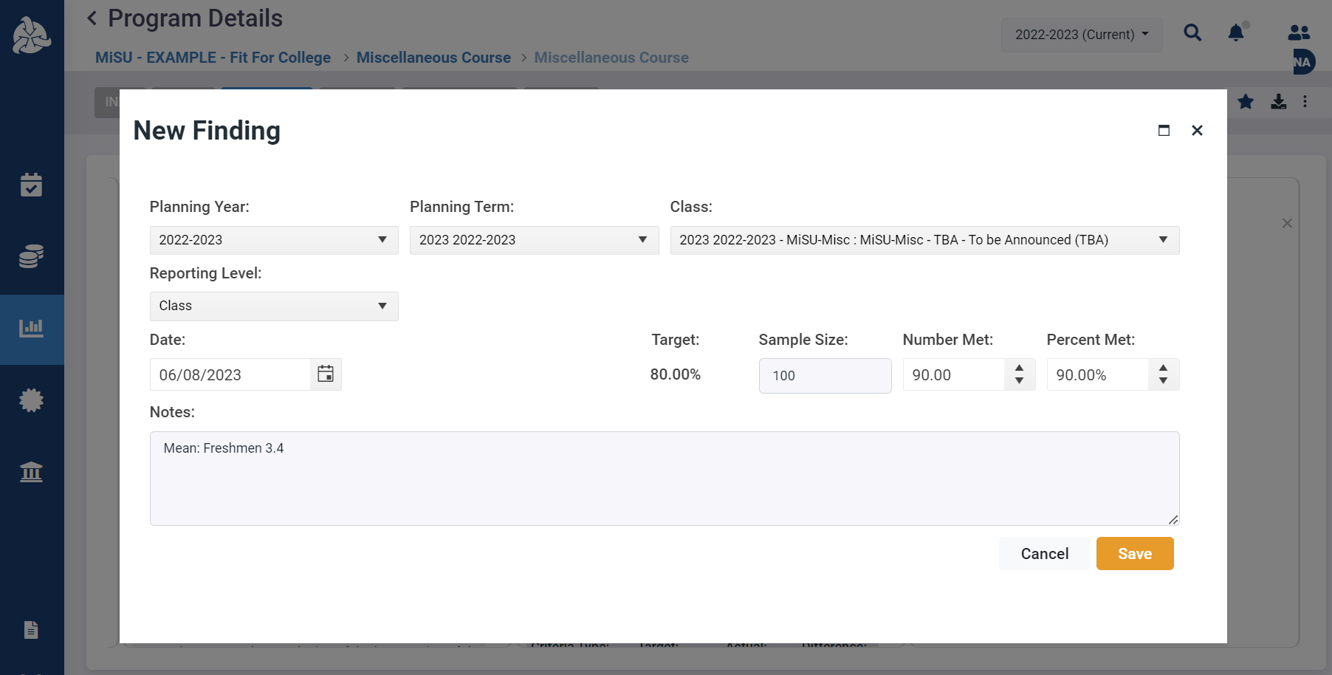
Enter optional Notes

Slide 37
Click Save

Slide 38
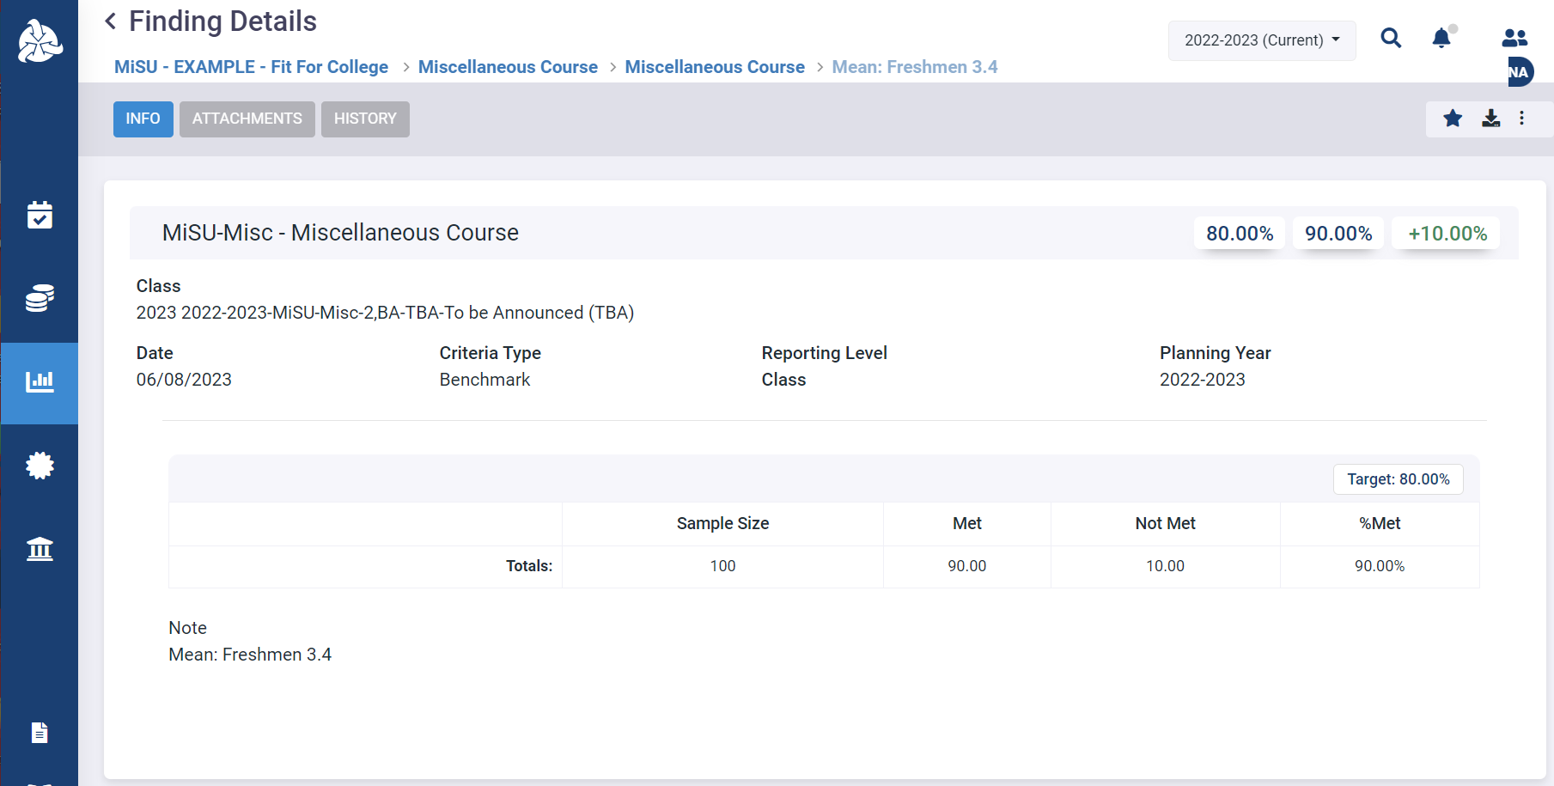
The new finding is displayed on the Finding Details page.

Slide 39
Click the back arrow next to Finding Details to return to the Program Details page.

Slide 40
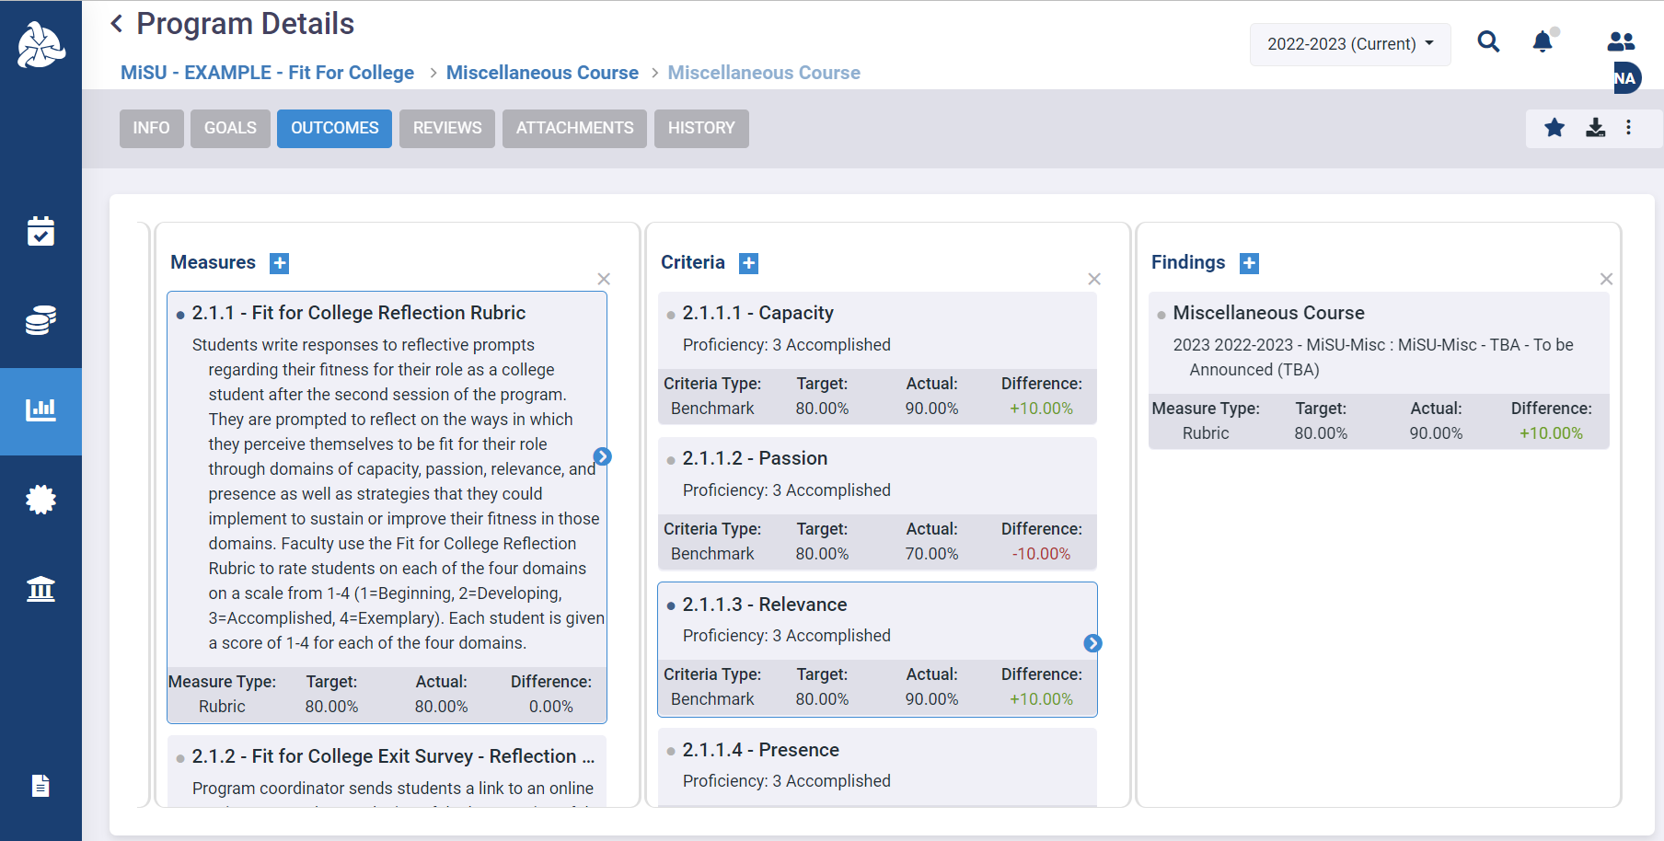
Click the blue arrows to expand or collapse the panes as desired

Slide 41
Explain Assessment Results of SLOs

Slide 43
Click the Assessment icon in the left sidebar

Slide 44
Click the desired program name in the expanded sidebar

Slide 45
Select the desired year from the planning year dropdown menu in the upper right corner

Slide 46
Click the Outcomes tab

Slide 47
Hover over the MiSU Student Learning Outcomes outcome type. Click the blue arrow that appears on the right.

Slide 48
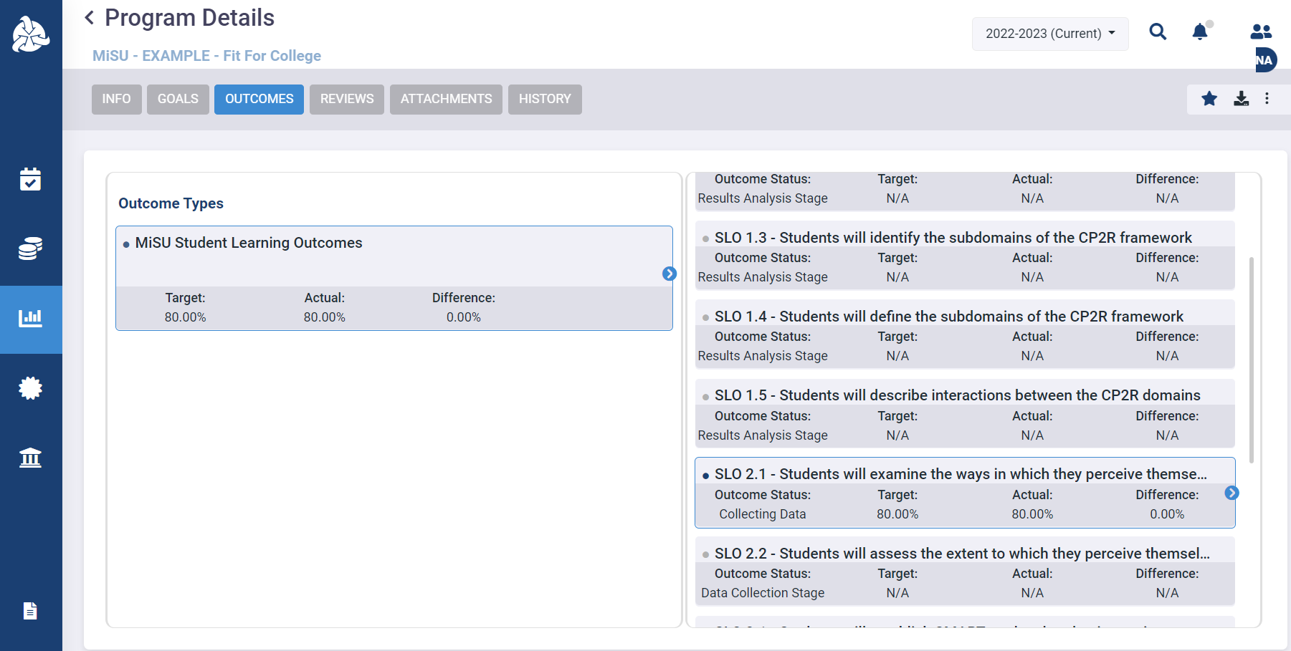
Click the top portion (i.e., SLO number and title) of the desired SLO to open the Program Outcome Details page. Note: Clicking the blue arrow or the details below the SLO number and title will not open the correct page.

Slide 49
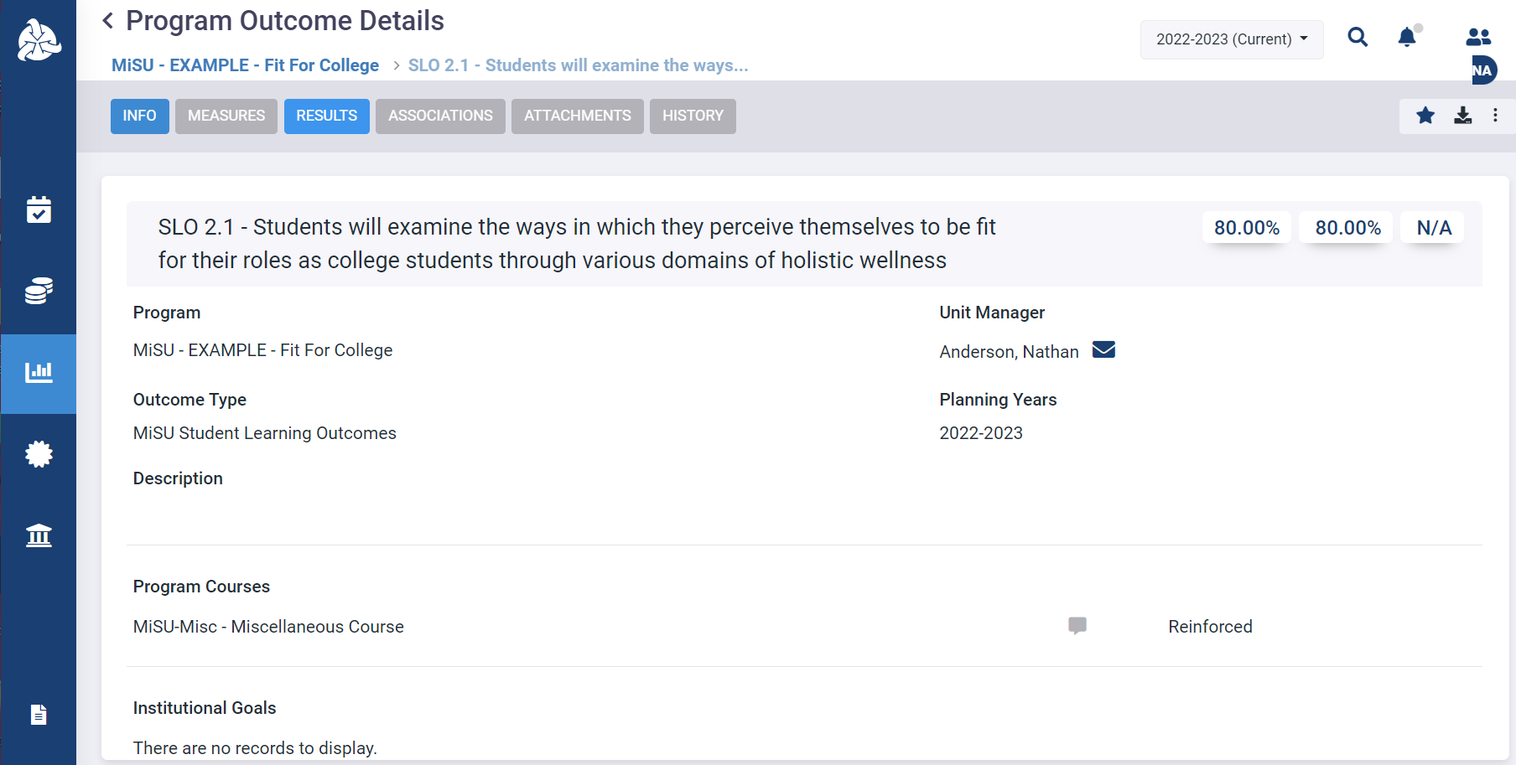
Click the Results tab

Slide 50
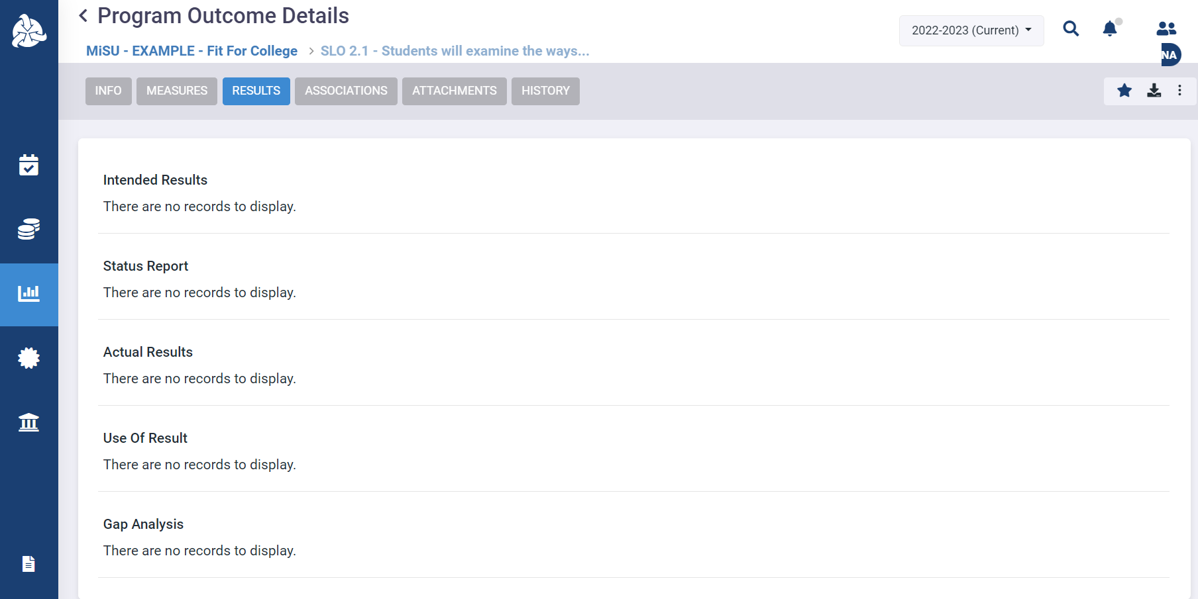
The Program Outcome Details page appears. Guidance is only provided on the Intended Results, Actual Results, and Use of Results sections; however, the Status Report and Gap Analysis sections are available to use if desired.
Optional
Optional

Slide 51
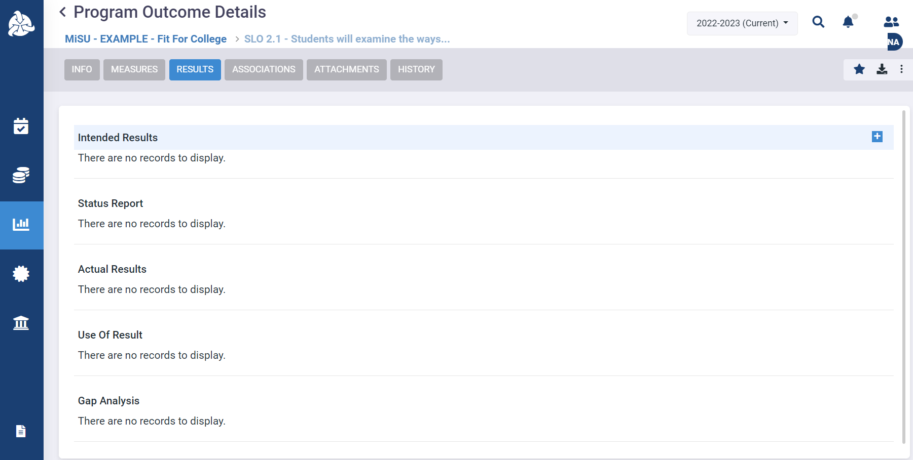
Click the plus (+) icon next to Intended Results to add an Intended Result narrative.

Slide 52
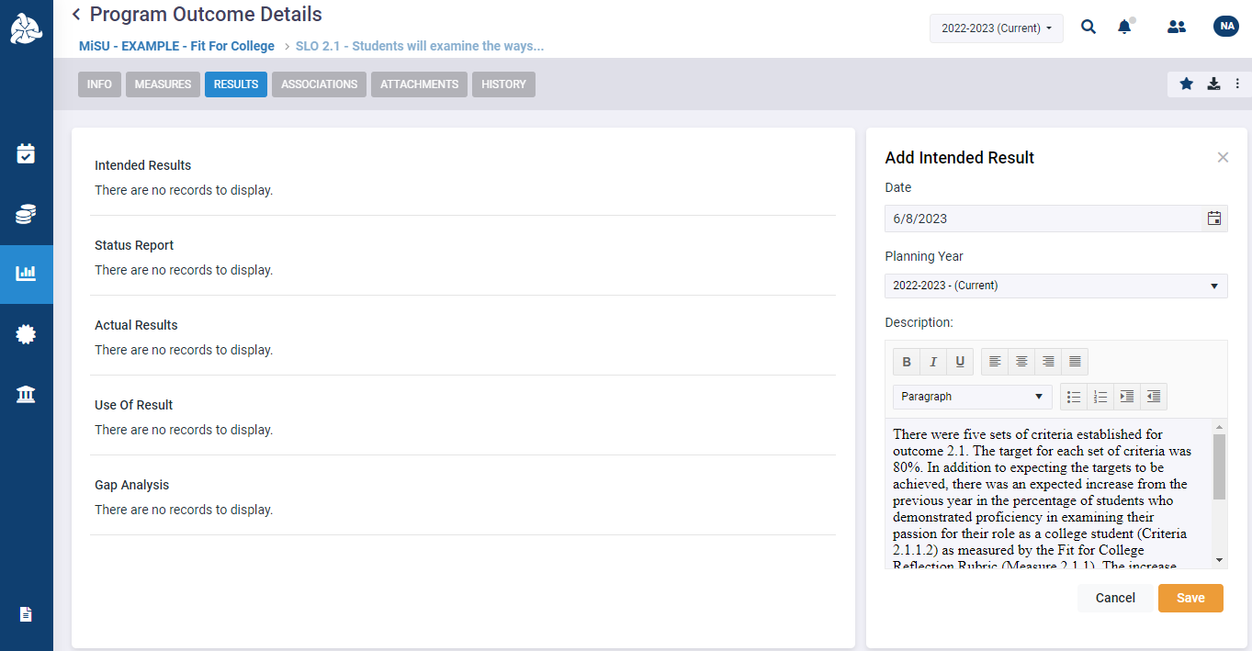
Add the Date, Planning Year, and Description of the Intended Result. Click Save.

Slide 53
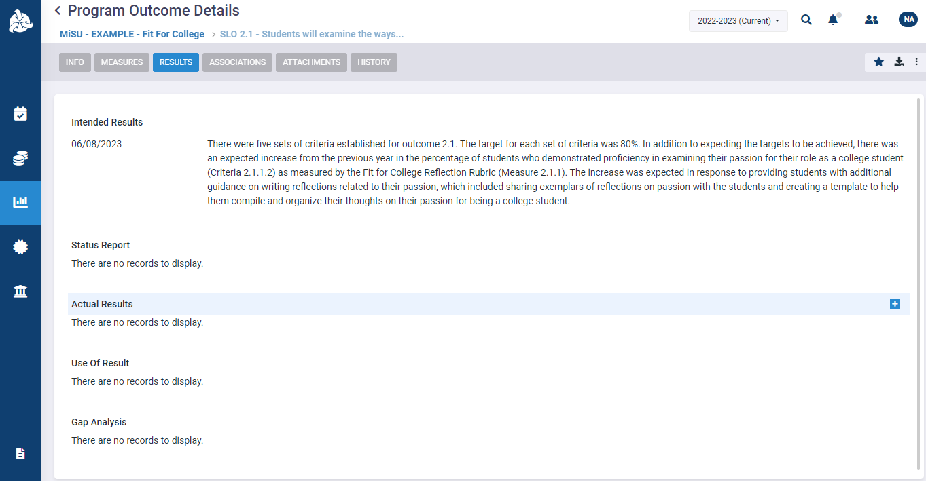
Click the plus (+) icon next to Actual Results to add an Actual Result narrative.

Slide 54
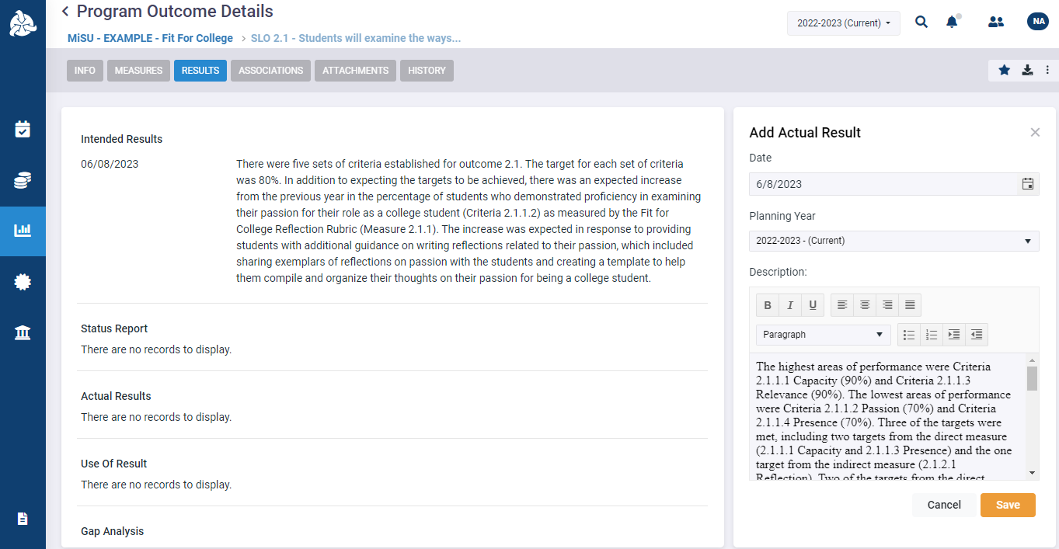
Add the Date, Planning Year, and Description of the Actual Result. Click Save.

Slide 55
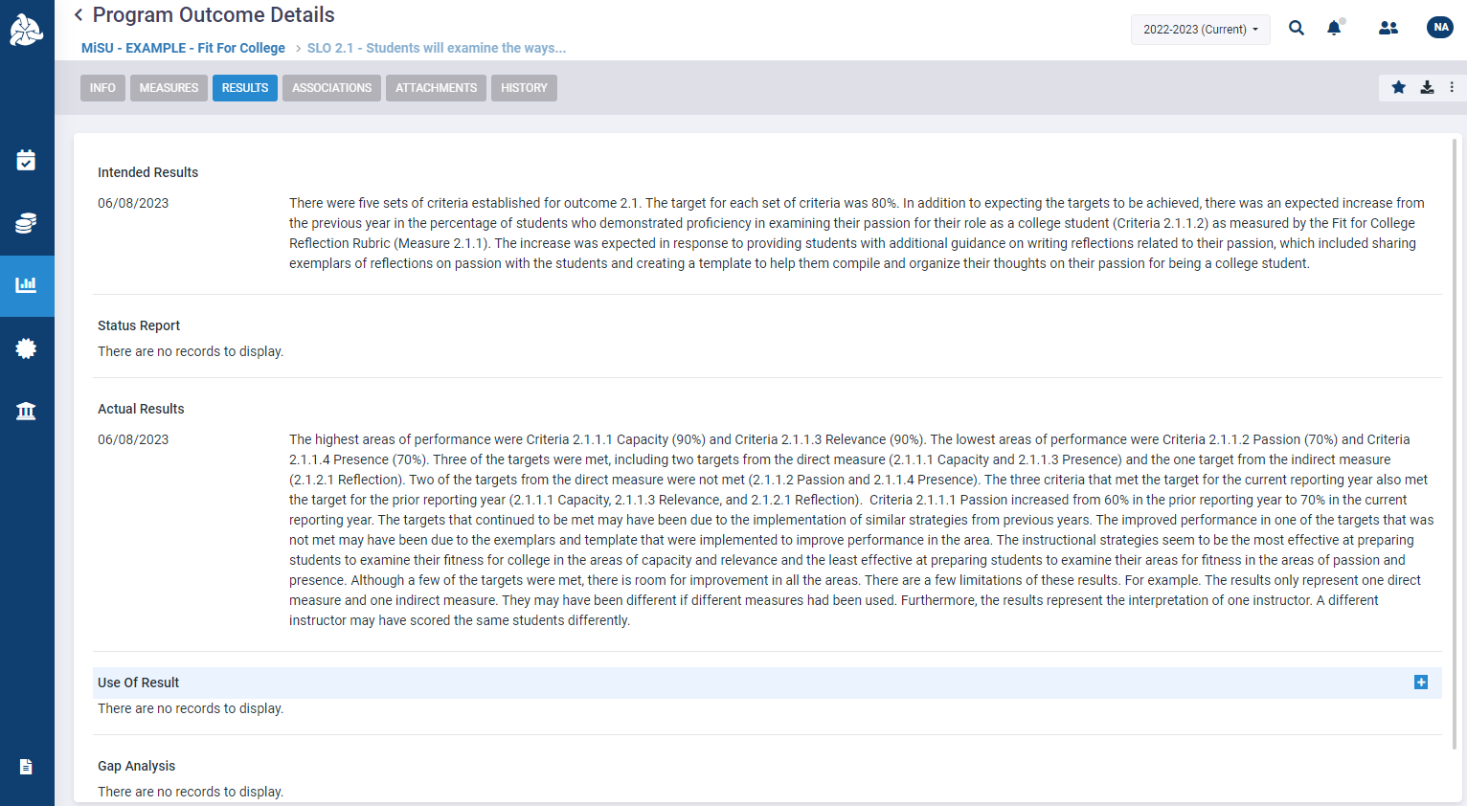
Click the plus (+) icon next to Use of Result to add a Use of Result narrative.

Slide 56
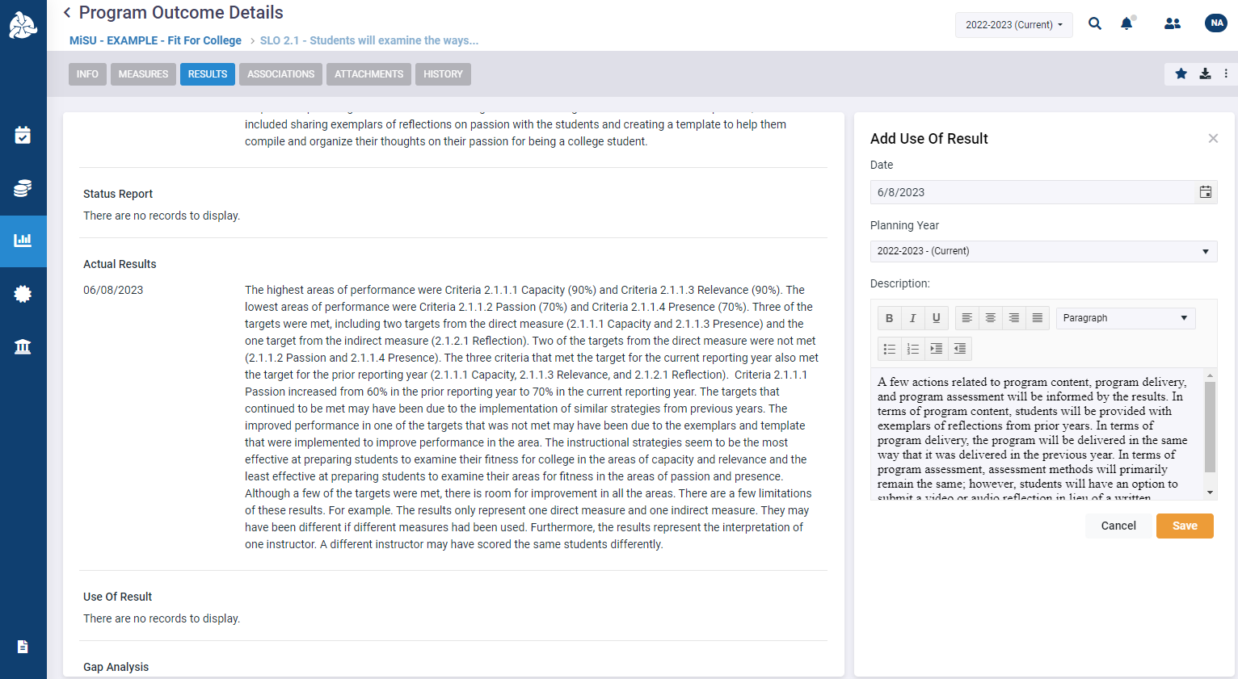
Add the Date, Planning Year, and Description of the Use of Result. Click Save.

Slide 57
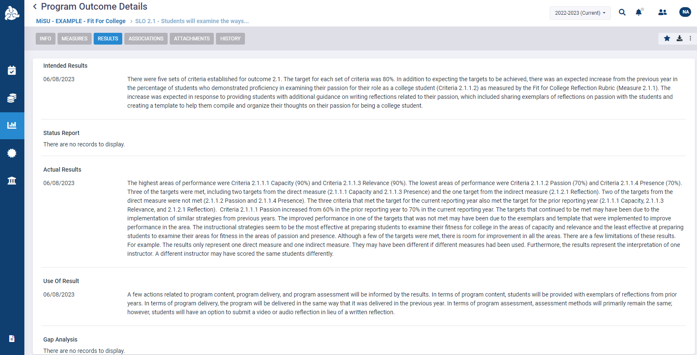
The Intended Results, Actual Results, and Use of Results narratives appear on the Program Outcome Details Page. The narratives may be edited, or additional narratives may be added to each section as needed.

Slide 58
Run Assessment Reports in SPOL

Slide 59
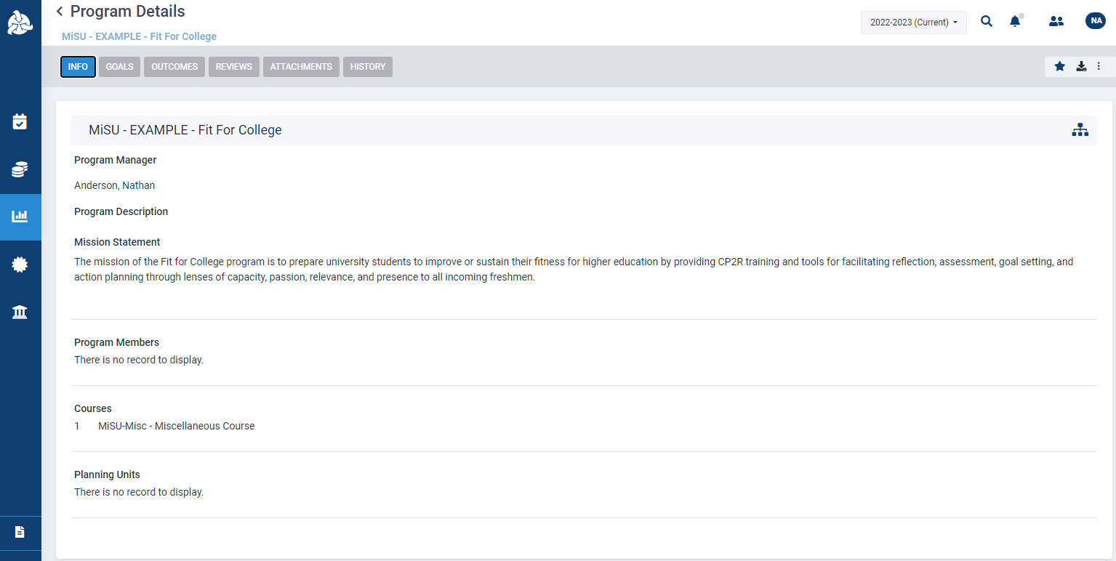
Click the Reports icon in the left sidebar

Slide 60
Outcome Details by Program Report

Slide 61
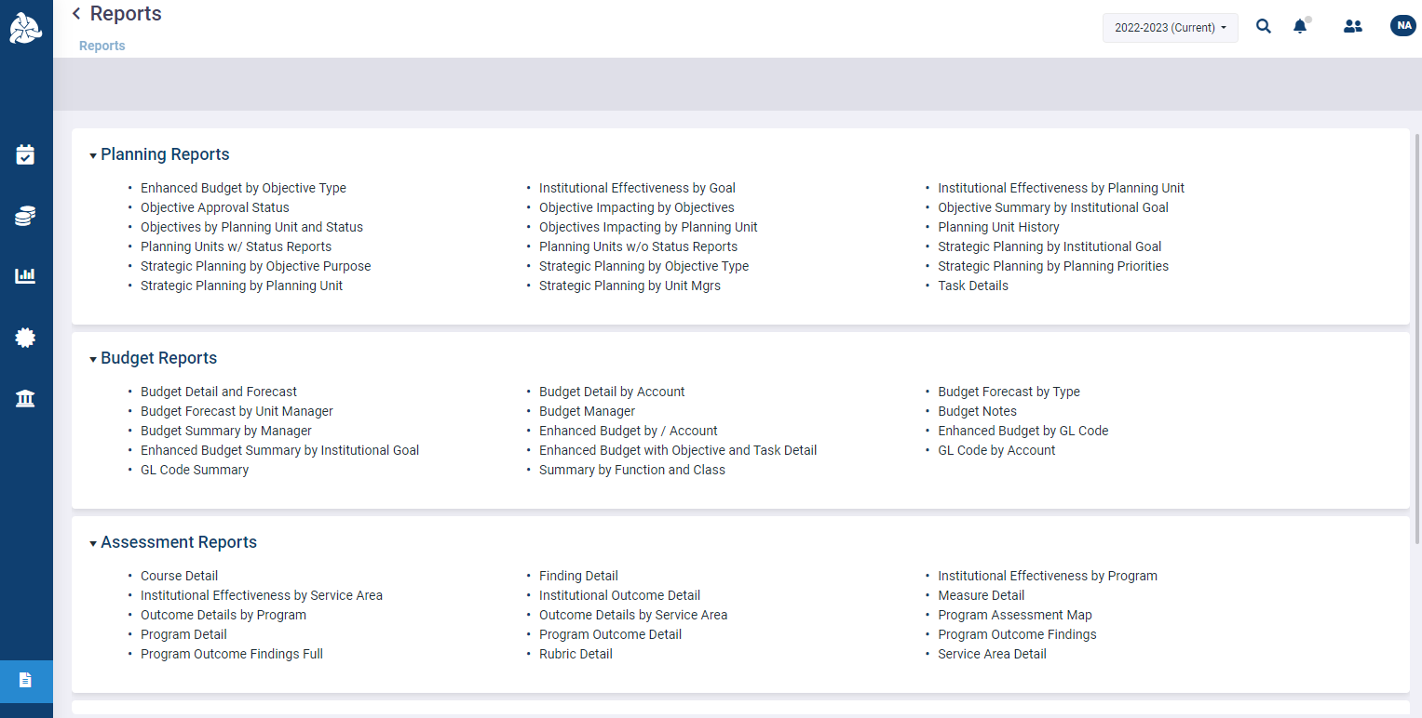
Click Outcome Details by Program in the Assessment Reports section

Slide 62
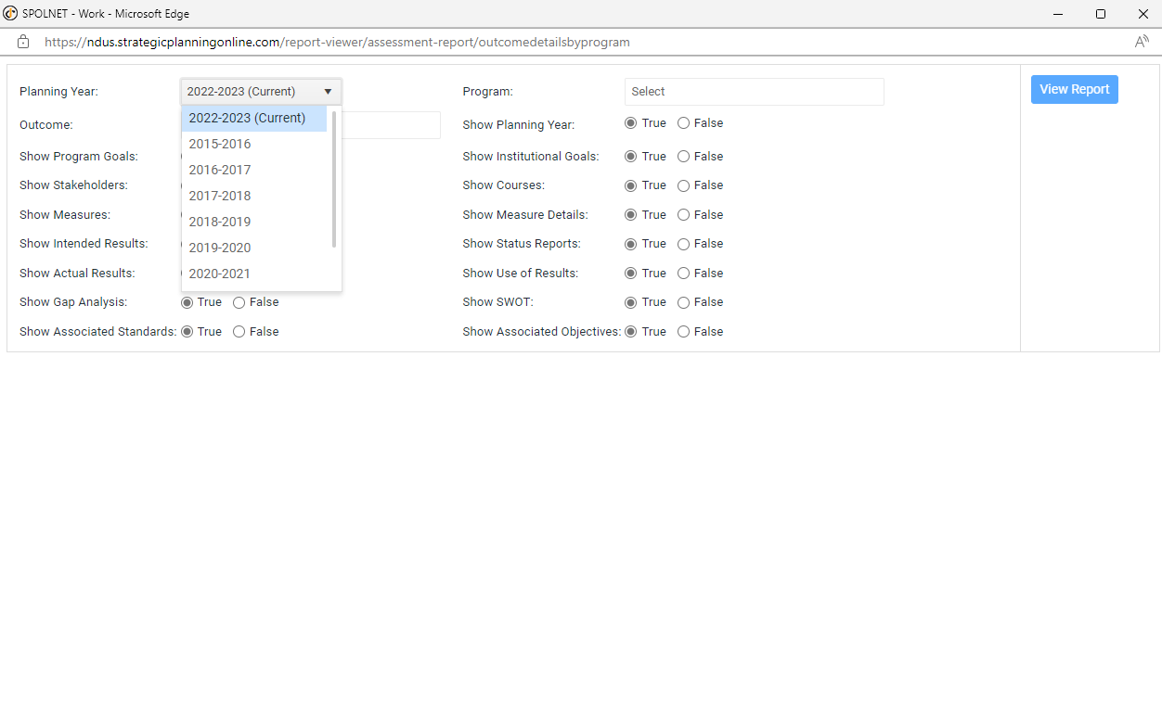
Select the desired Planning Year

Slide 63
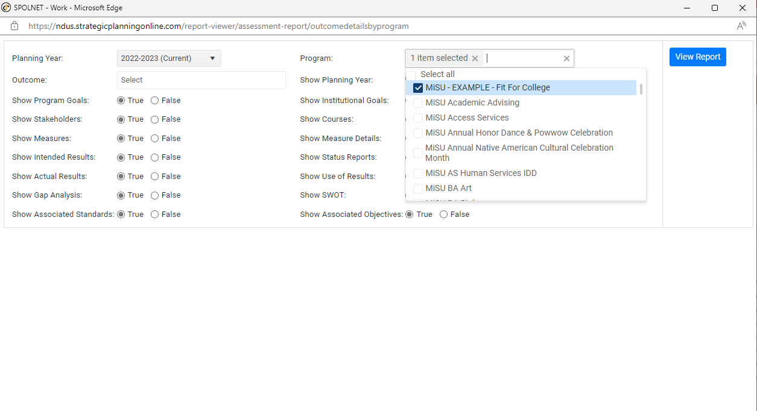
Select the desired Program

Slide 64
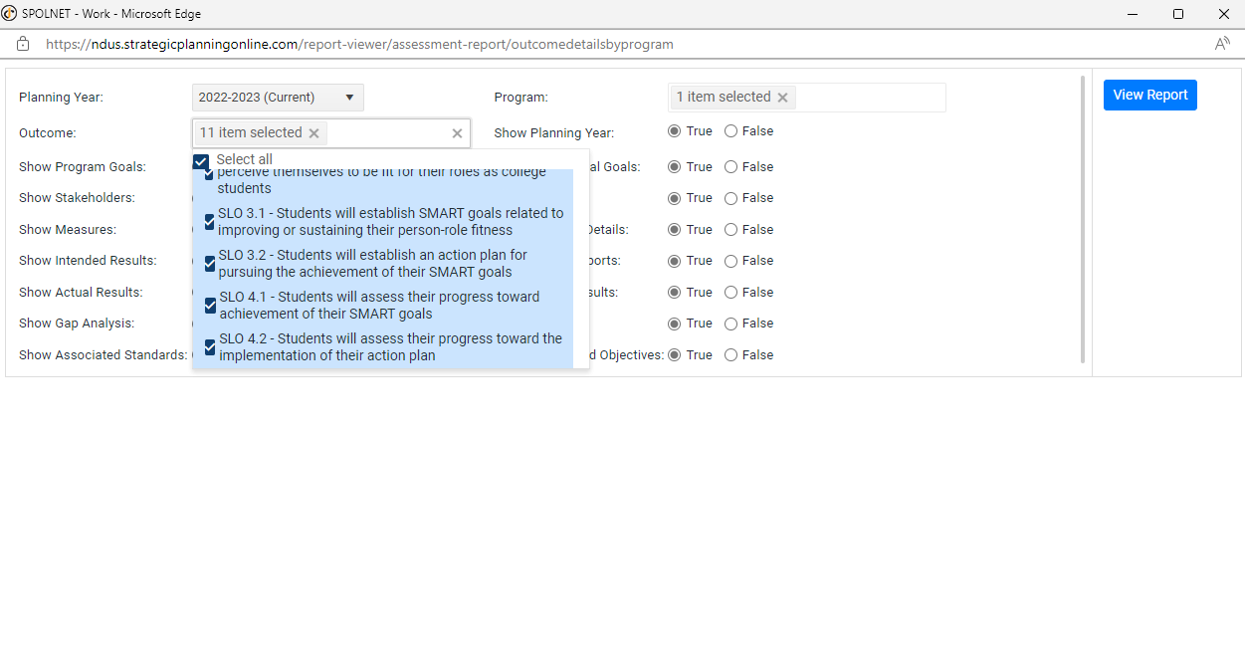
Select the desired Outcomes

Slide 65
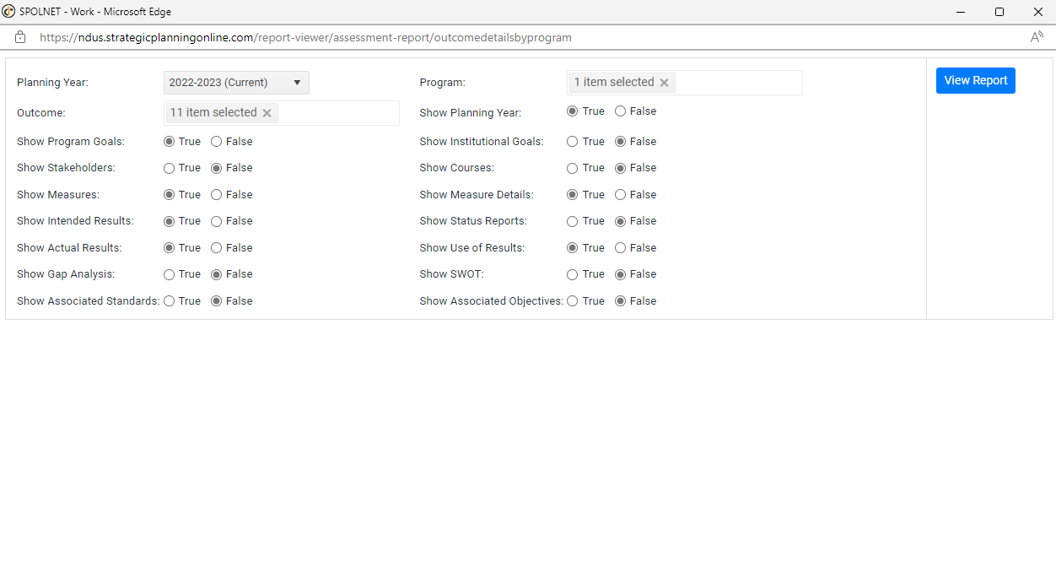
Select True for the details that are intended to be included in the report and False for the details that are intended to be excluded from the report.

Slide 66
Click View Report

Slide 67
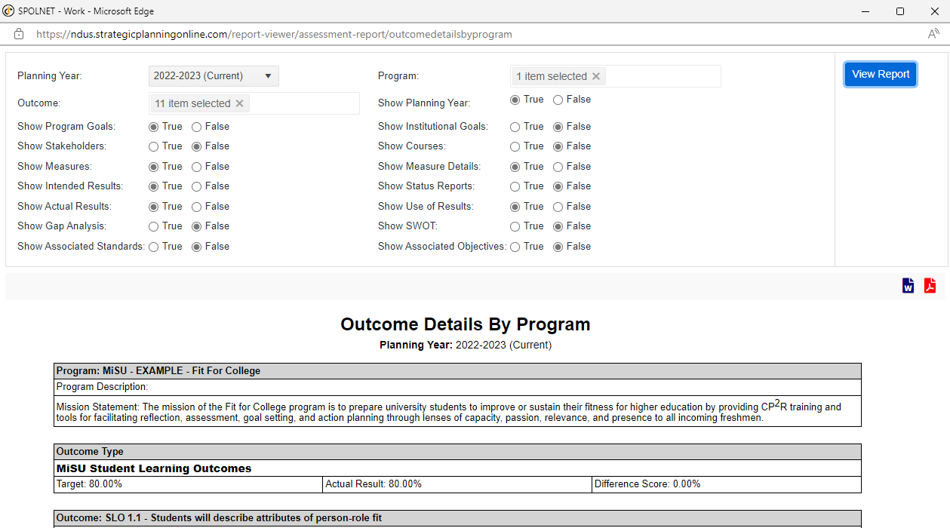
The report appears below the parameters. Scroll vertically to view the report in the window. Click the Word or PDF icon at the top right of the report to make a request for the report to be emailed to you.

Slide 68
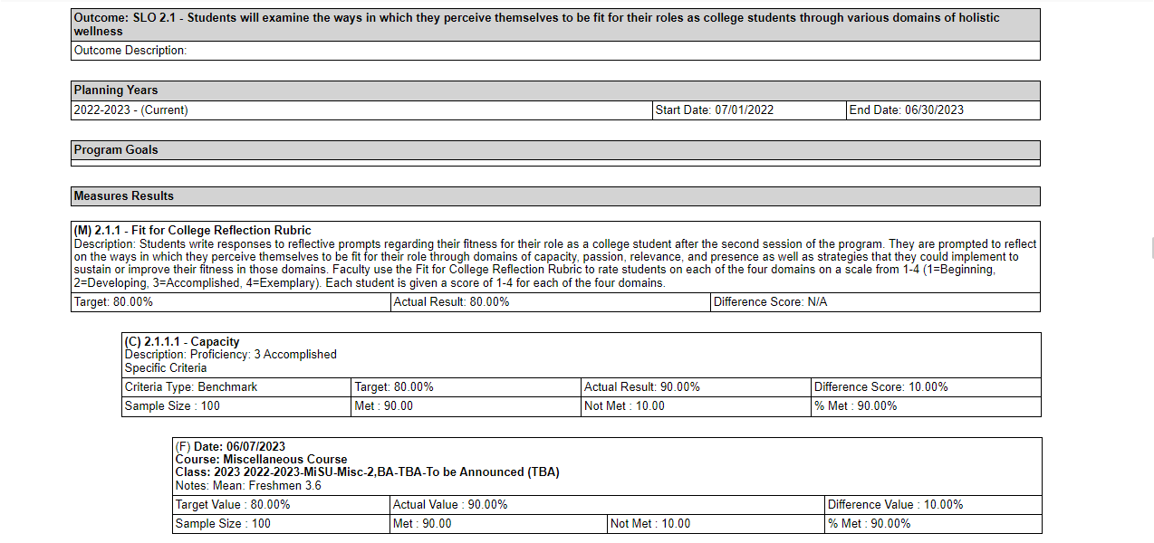
Based on the selected parameters, the report displays the Measures, Criteria, and Findings for each SLO

Slide 69
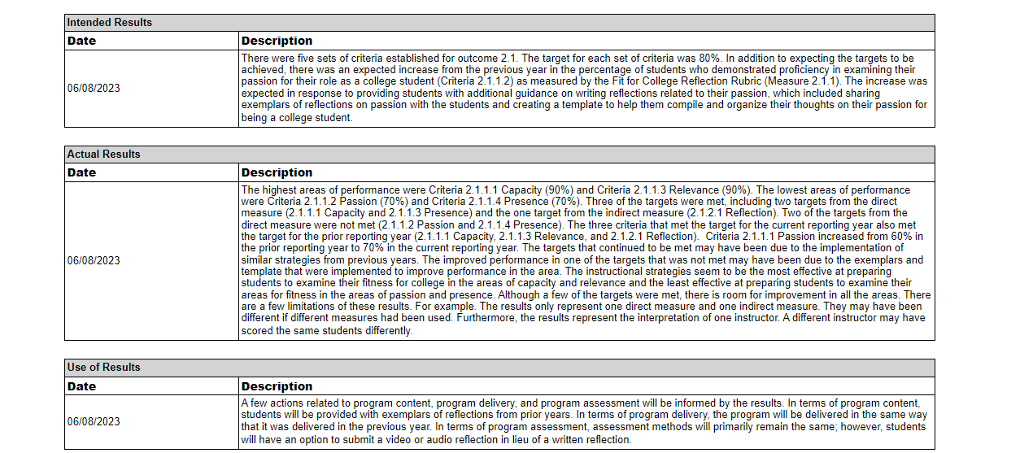
Based on the selected parameters, the report also displays the Intended Results, Actual Results, and Use of Results for each SLO

Slide 70
Institutional Effectiveness by Program Report

Slide 71
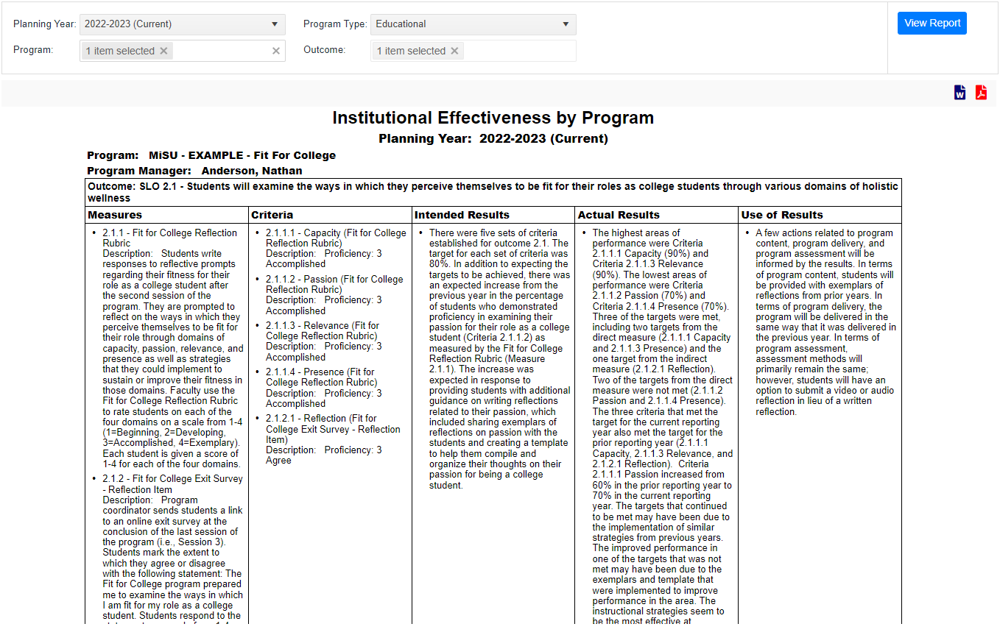
This report displays Measures, Criteria, and narrative descriptions of Intended Results, Actual Results, and Use of Results for each Outcome

Slide 72
Review of Objectives
Enter assessment findings for student learning outcomes (SLOs)
Explain assessment results of SLOs
Run assessment reports SPOL

Slide 74
Thank You!

