Slide 1
Yearly Program Assessment Training – Enter a YPA Plan in SPOL
Nathan Anderson
Director of Institutional Assessment
2023

Slide 2
Objectives
Enter a student learning goal (SLG)
Enter a student learning outcome (SLO)
Enter a measure
Enter a set of criteria

Slide 3
Target Audience
Academic and co-curricular program Yearly Program Assessment (YPA) authors and other personnel supporting the YPA process
Prerequisites
Program has been created in SPOL
YPA plan is available in a format that is suitable for entering in SPOL

Slide 4
Background - Accreditation
HLC Criterion 4, Teaching and Learning: Evaluation and Improvement, pertains to program assessment.
Core Component 4.B states, “The institution engages in ongoing assessment of student learning as part of its commitment to the educational outcomes of its students” (p. 35).
Evidence item 1 states, “The institution has effective processes for assessment of student learning and for achievement of learning goals in academic and cocurricular offerings”

Slide 5
Background – MiSU YPA
Yearly Program Assessment (YPA)
Annual documentation of a program's assessment plan, results, and utilization of results

Slide 6
Background – SPOL
Strategic Planning Online (SPOL)
Institutional Effectiveness Software
Planning, Budget, Assessment, Credentialing, Accreditation
No cost to MiSU through existing contract between NDUS and SPOL

Slide 7
YPA Essential Elements
Mission statement
Student learning goals (SLGs)
Student learning outcomes (SLOs)
Operational goals (OGs)
Operational outcomes (OOs)
Measures
Criteria
Findings
Explanation of Results
Intended Results, Actual Results, Use of Results

Slide 8
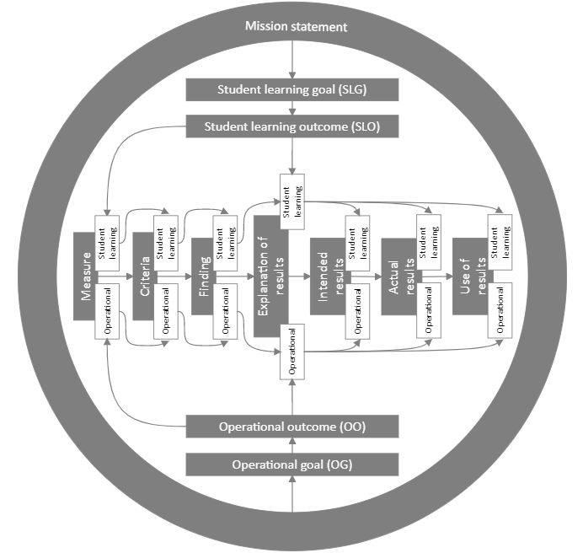

Slide 10
Log in to SPOL

Slide 11
Co-Curricular Assessment Page

Slide 12
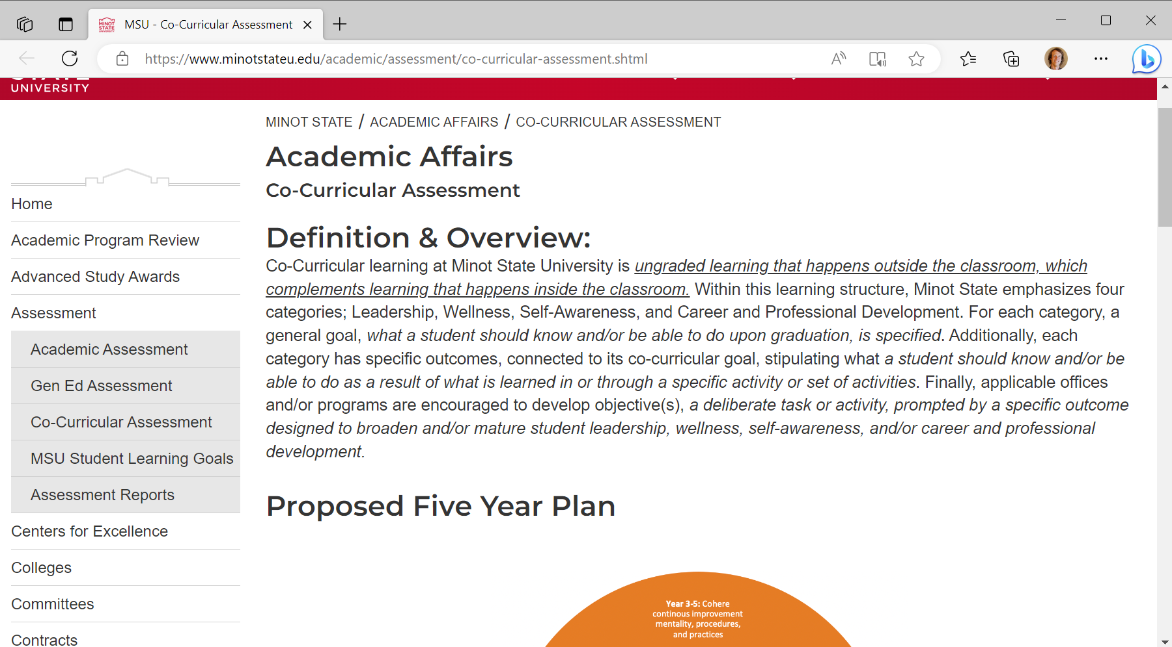
Go to the Co-Curricular Assessment page. Scroll down.

Slide 13
Click Strategic Planning Online (SPOL) in the Co-Curricular Assessment Resources section

Slide 14
Academic Assessment Page

Slide 15
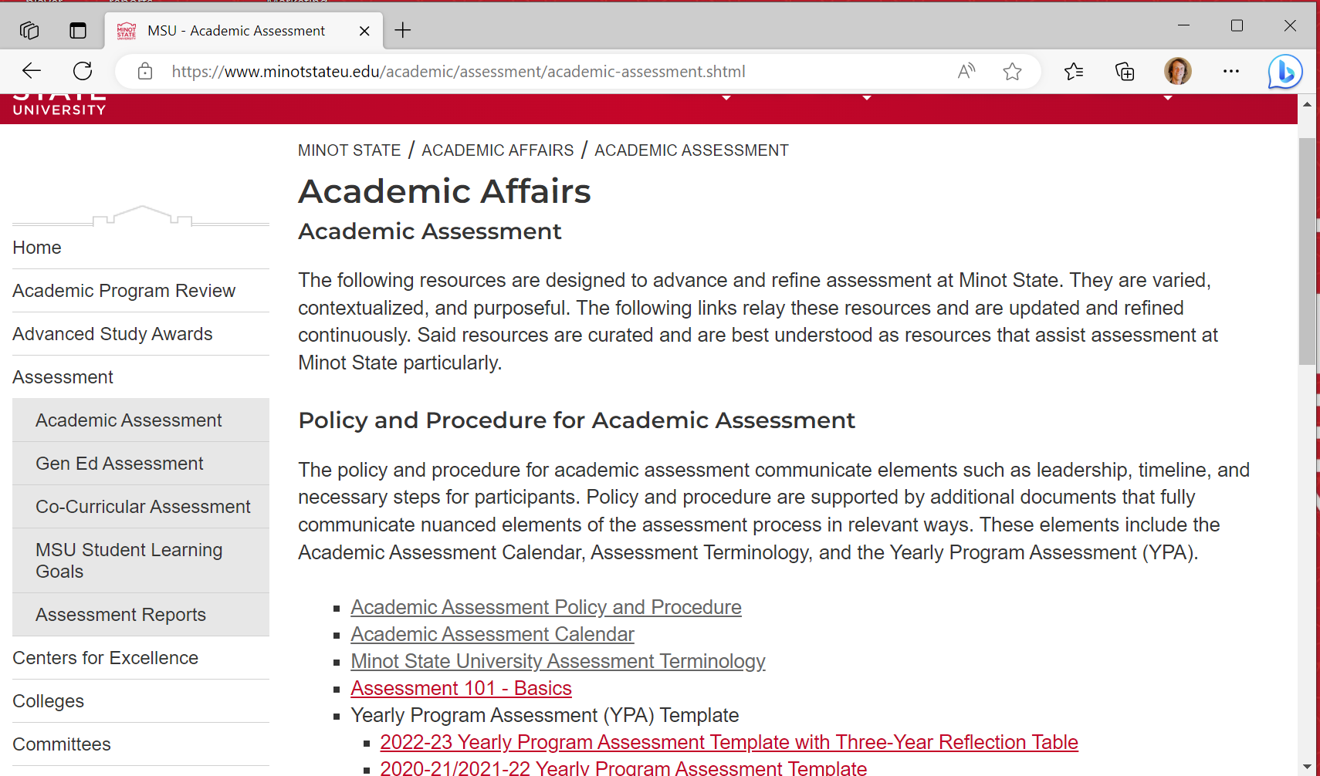
Go to the Academic Assessment page. Scroll down.

Slide 16
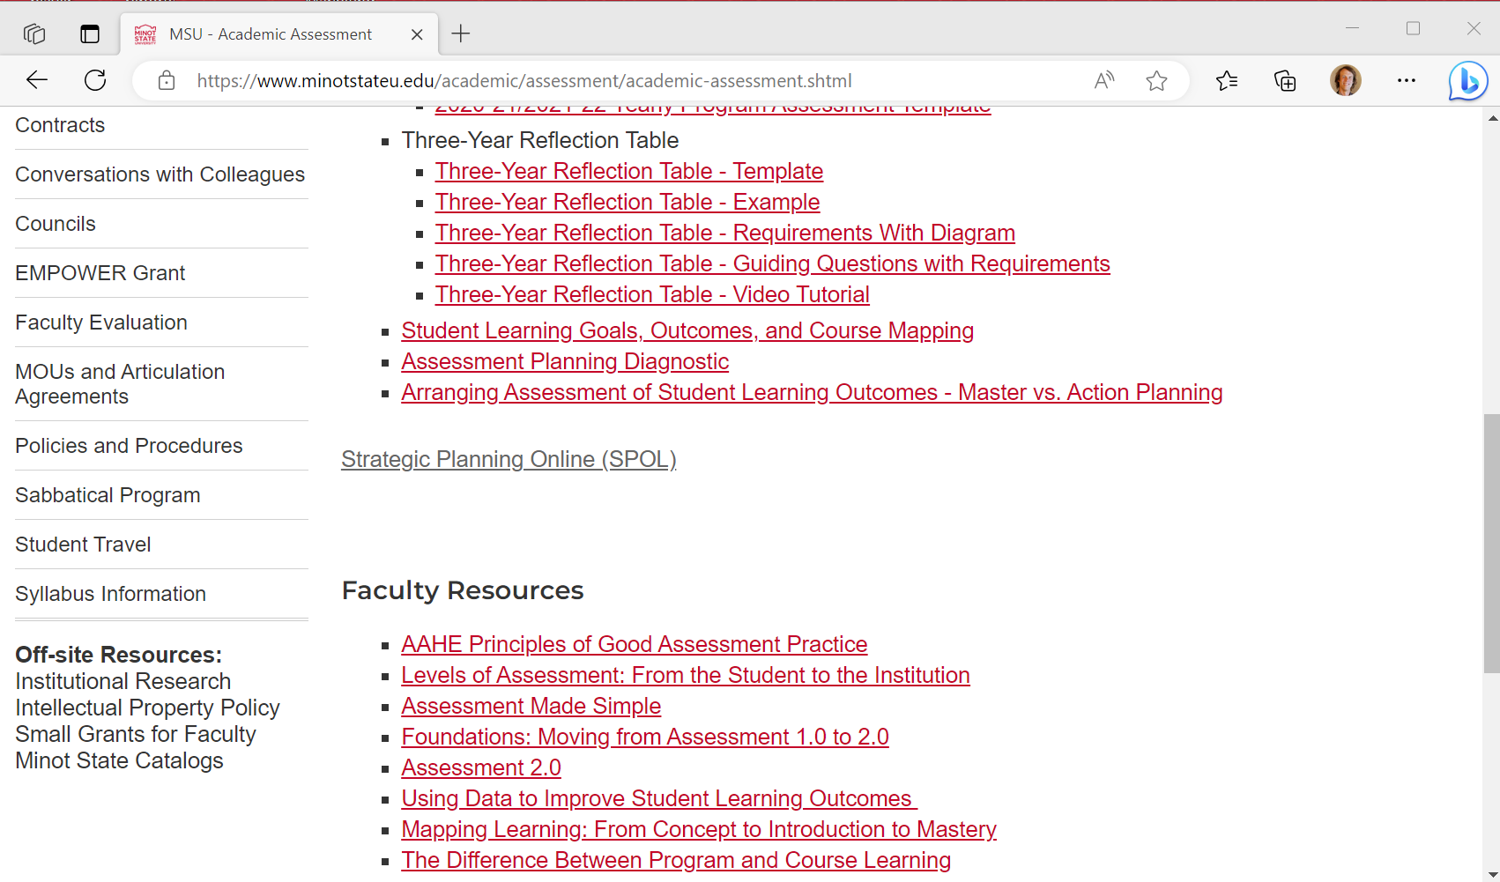
Click Strategic Planning Online (SPOL)

Slide 17
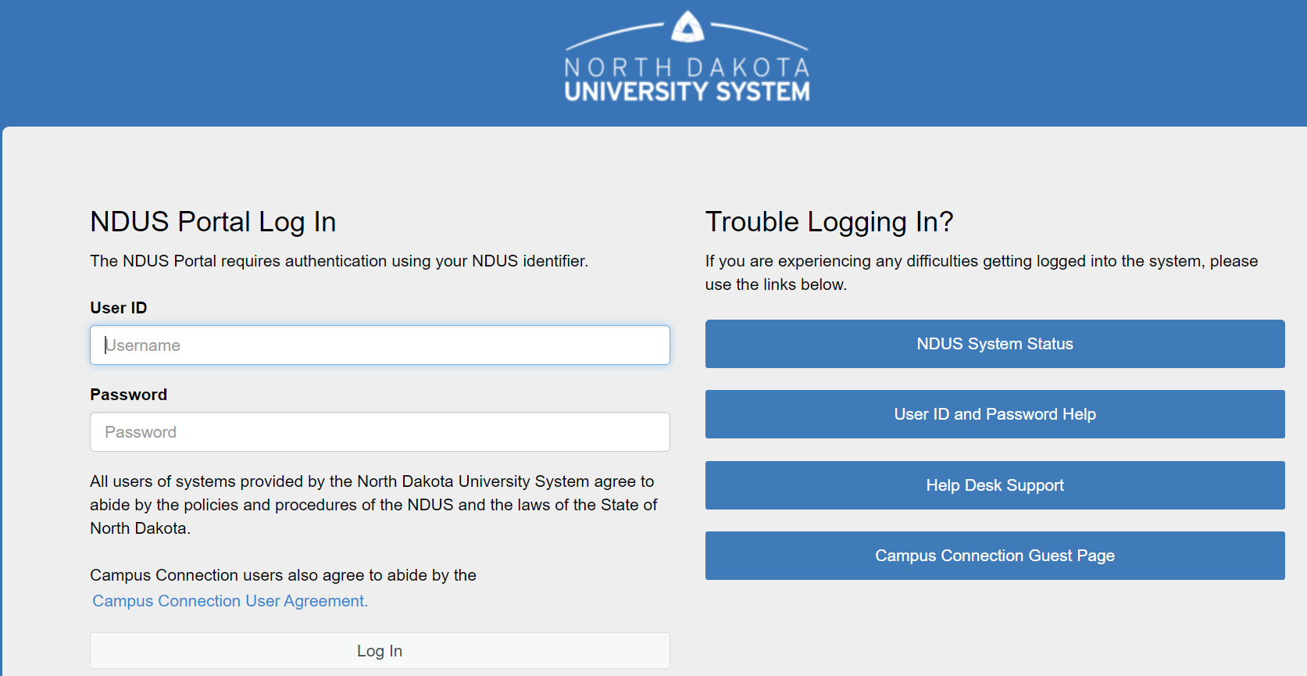
Log In with your NDUS User ID and Password

Slide 18
Enter an SLG

Slide 20
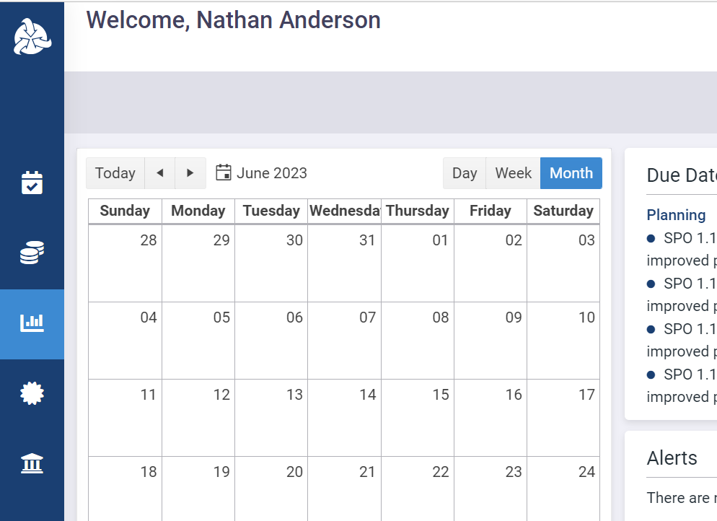
Click the Assessment icon in the left sidebar

Slide 21
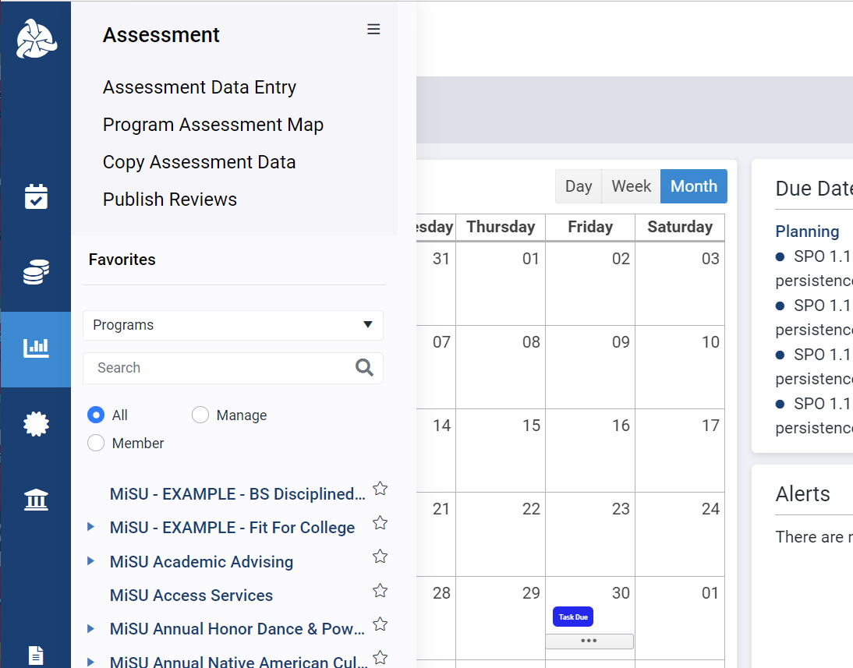
Click the desired program name in the expanded sidebar

Slide 22
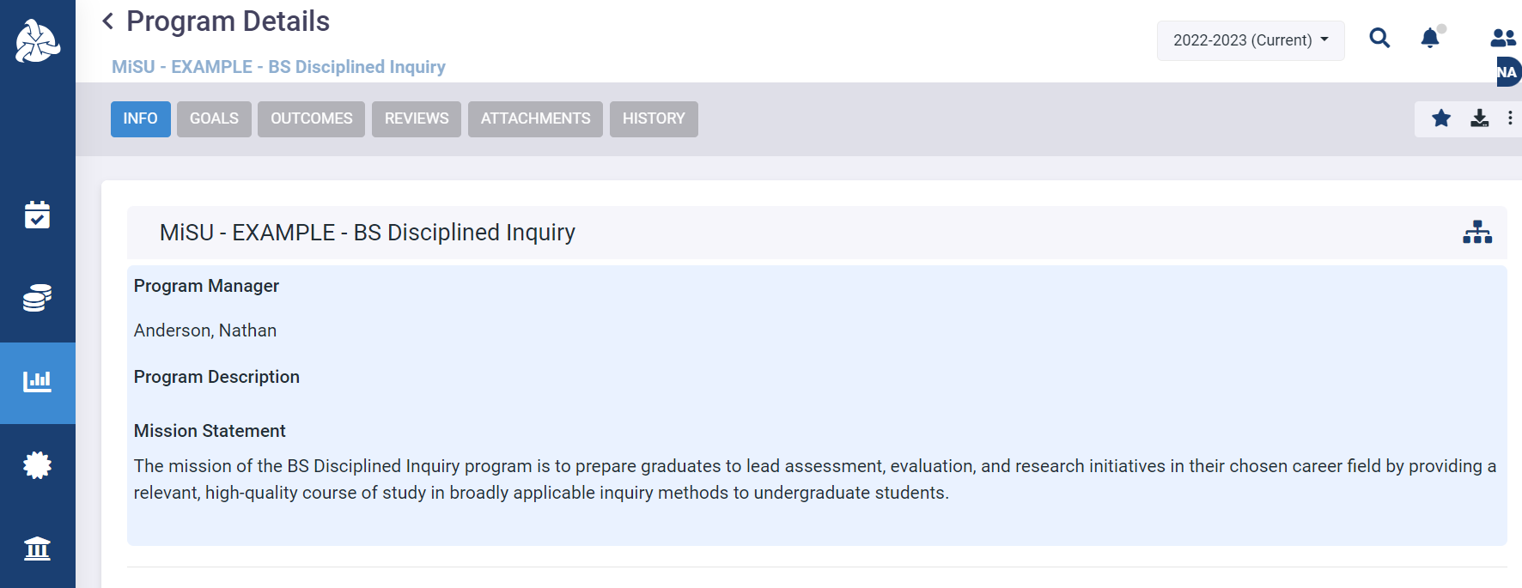
Select the desired year from the planning year dropdown menu in the upper right corner

Slide 23
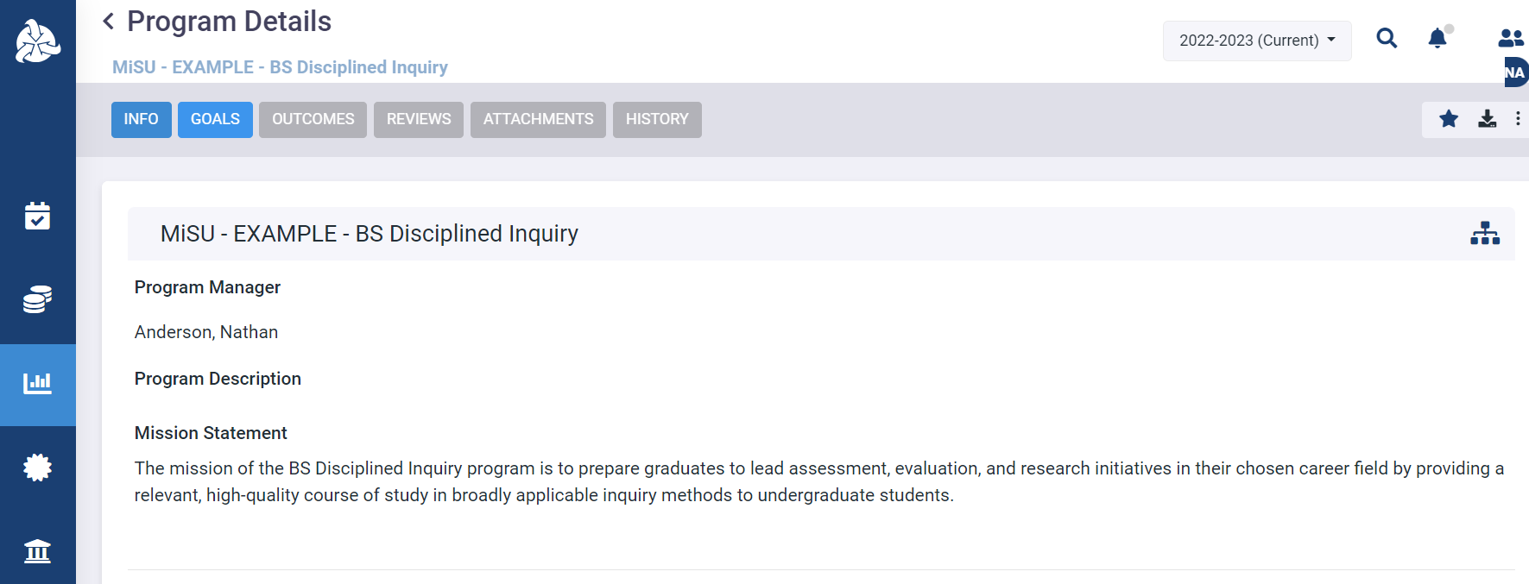
Click the Goals tab

Slide 24
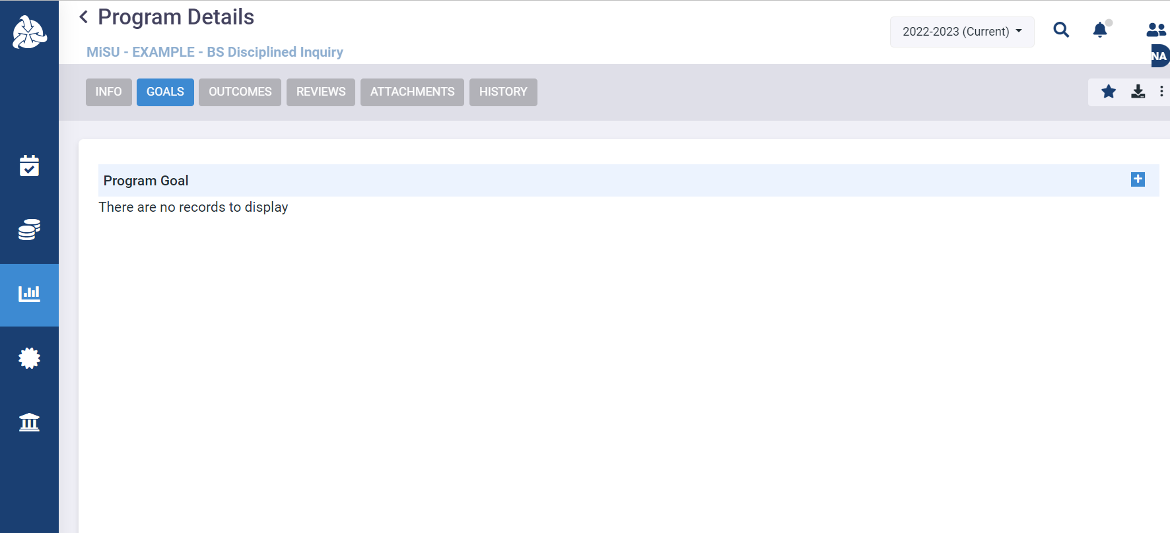
Click the plus (+) icon next to Program Goal to open the Program Goal pane.

Slide 25
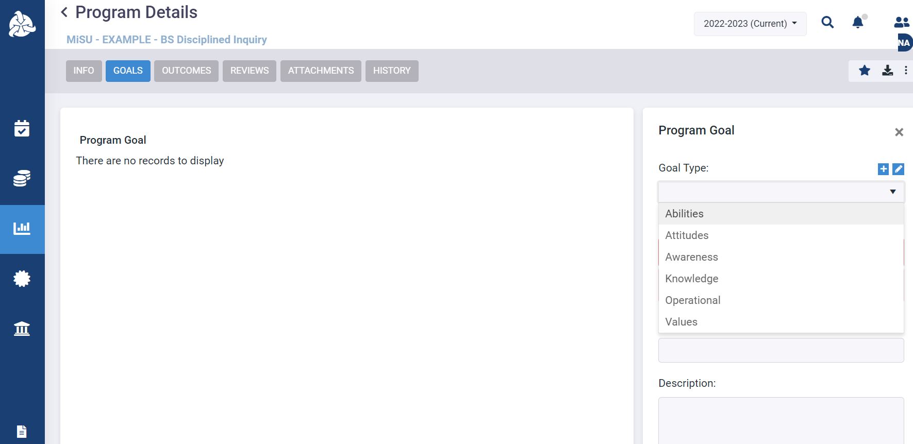
Select the Goal Type from the dropdown menu

Slide 26
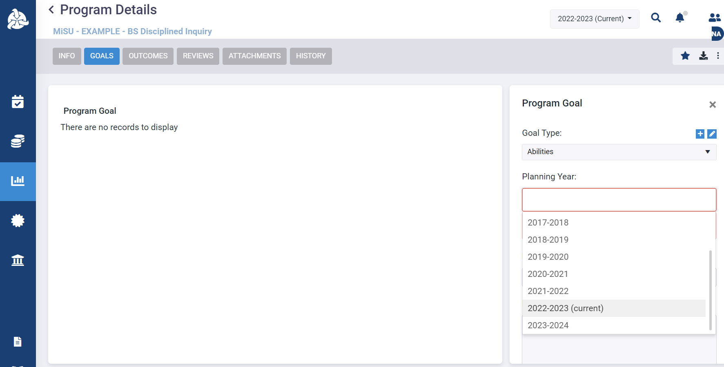
Select one or more Planning Years from the dropdown menu

Slide 27
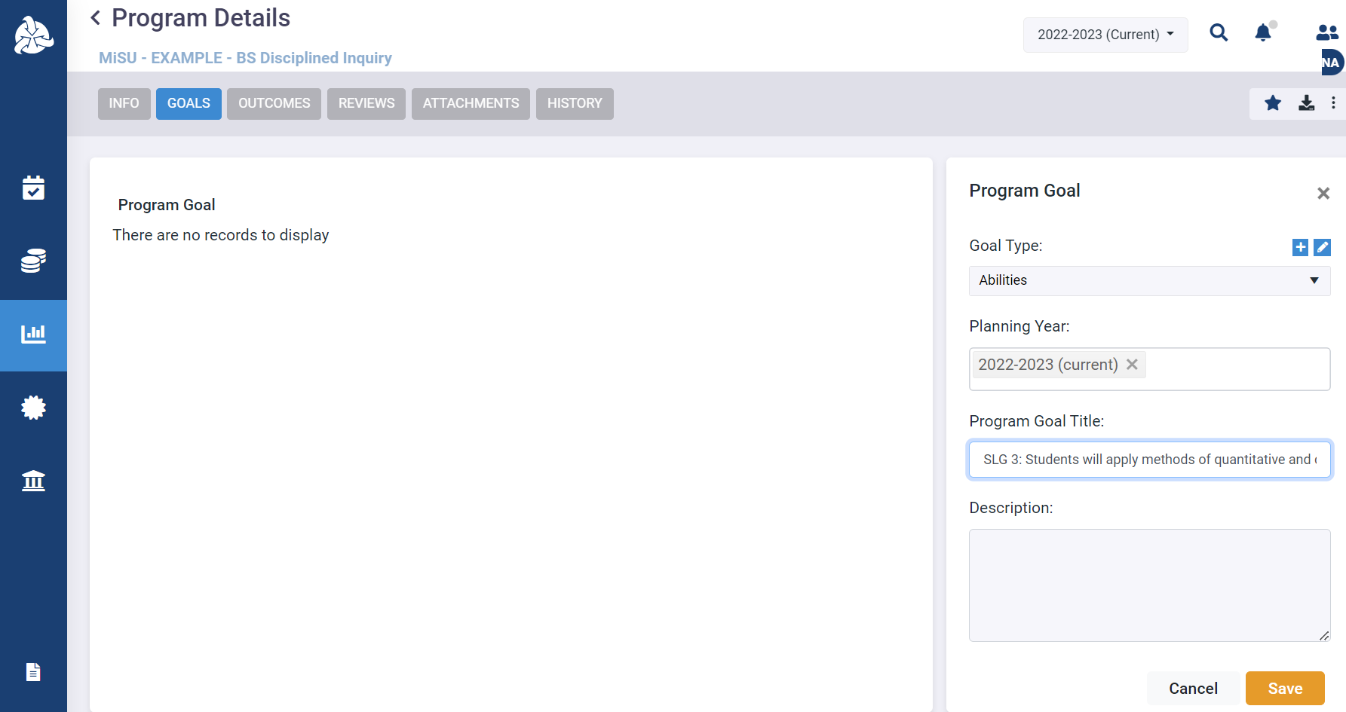
Enter the Program Goal Title

Slide 28
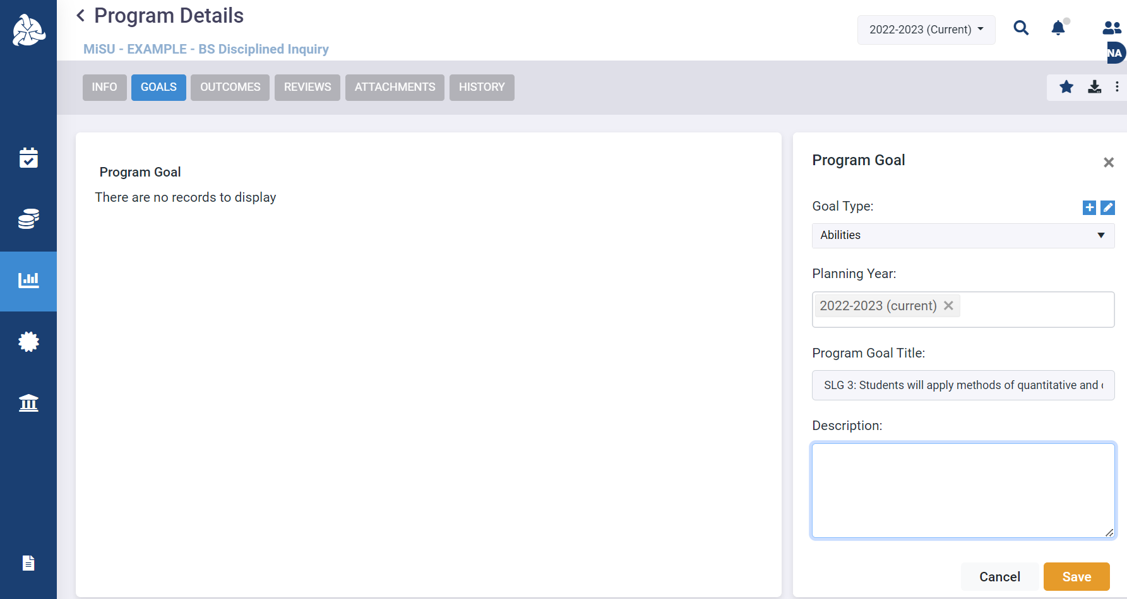
Enter an optional Description if desired

Slide 29
Click Save

Slide 30
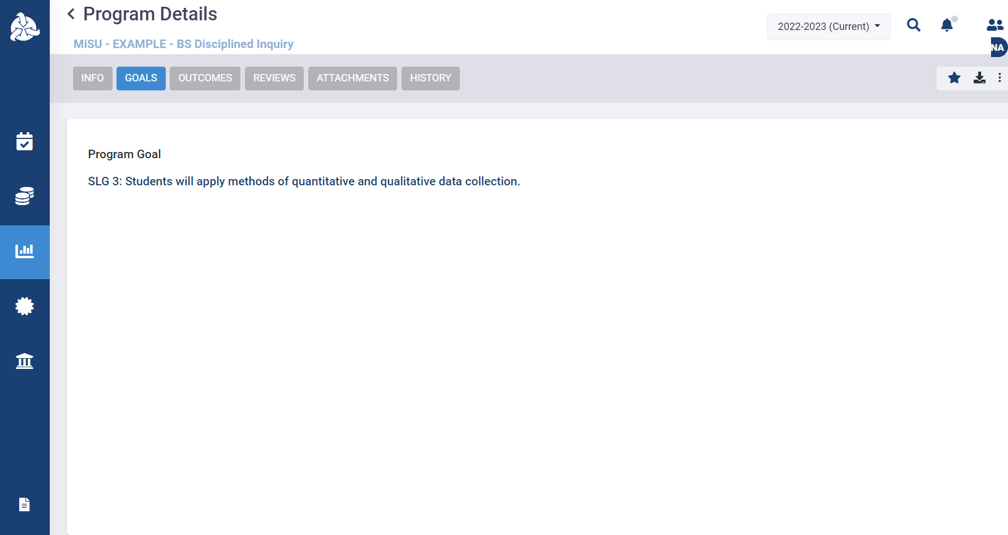
The new Program Goal appears under the Goals tab in the Program Details window

Slide 31
Enter an SLO

Slide 33
Click the Assessment icon in the left sidebar

Slide 34
Click the desired program name in the expanded sidebar

Slide 35
Select the desired year from the planning year dropdown menu in the upper right corner

Slide 36
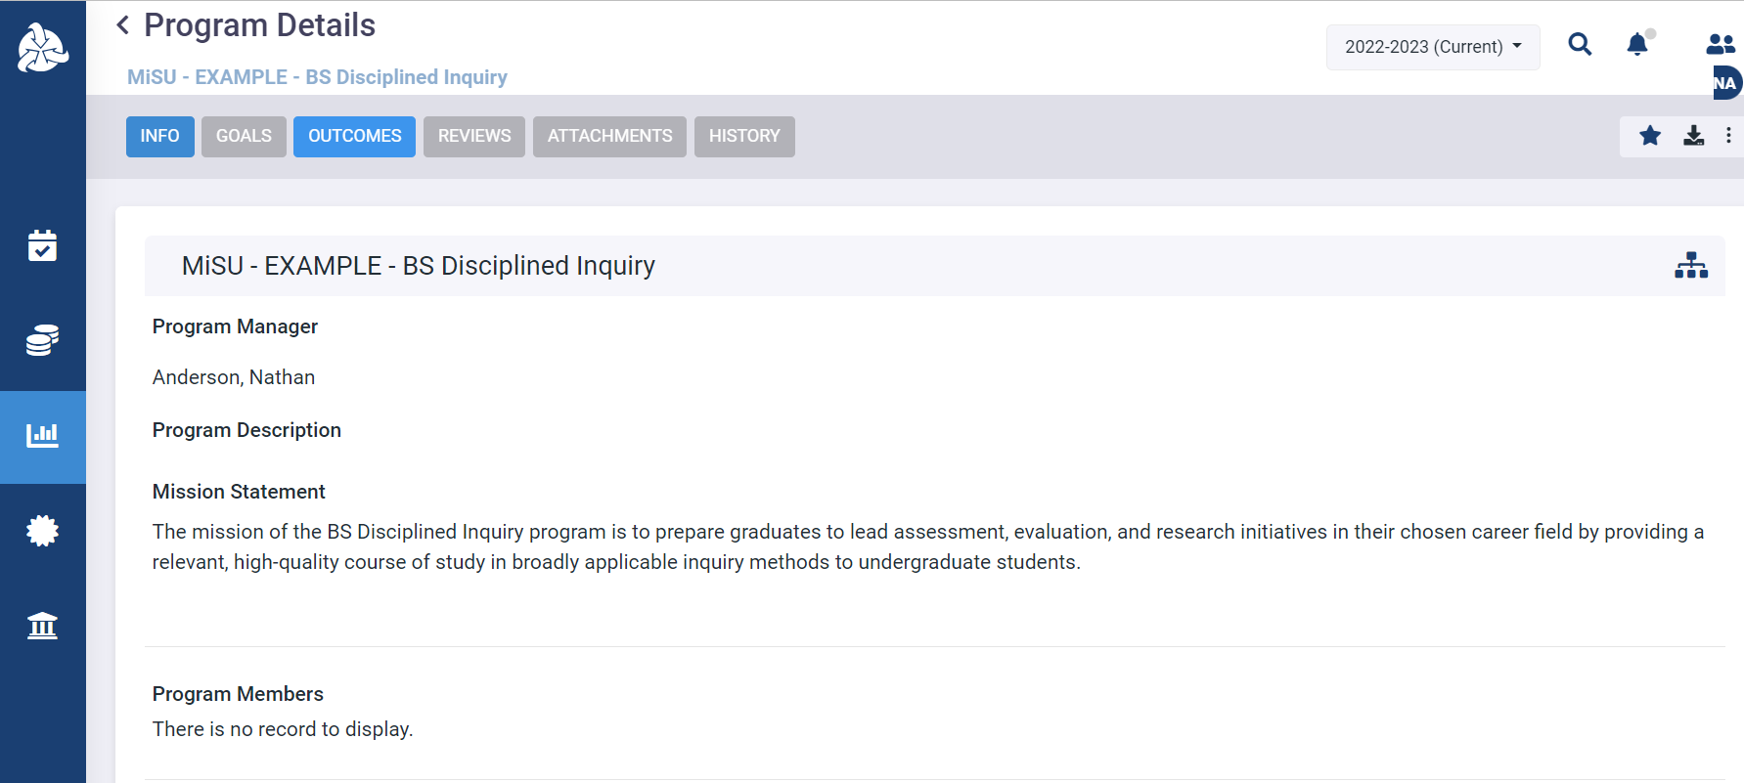
Click the Outcomes tab

Slide 37
Click the three vertical dots in the upper right corner

Slide 38
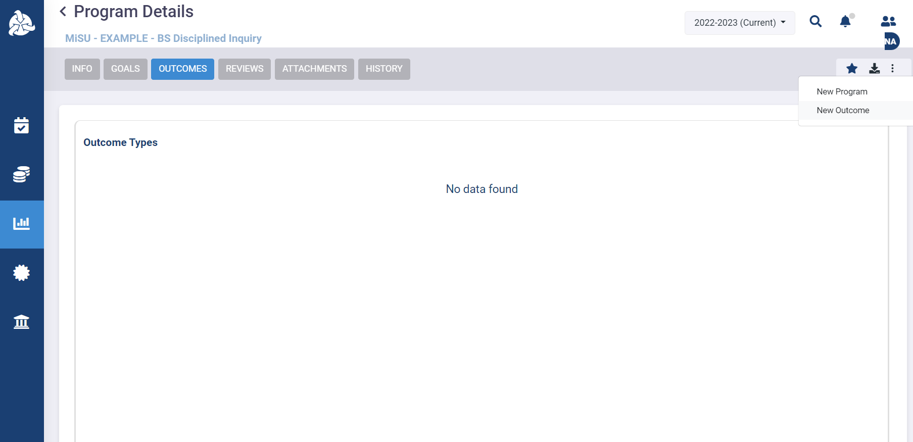
Select New Outcome from the popup menu to open the Create Outcome window

Slide 39
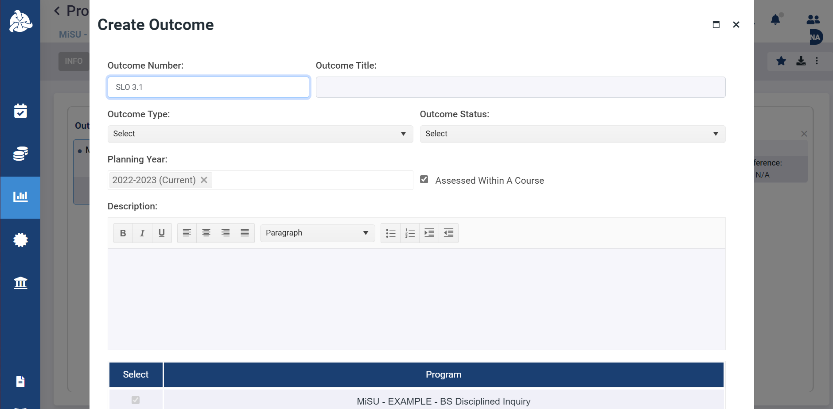
Enter the Outcome Number

Slide 40
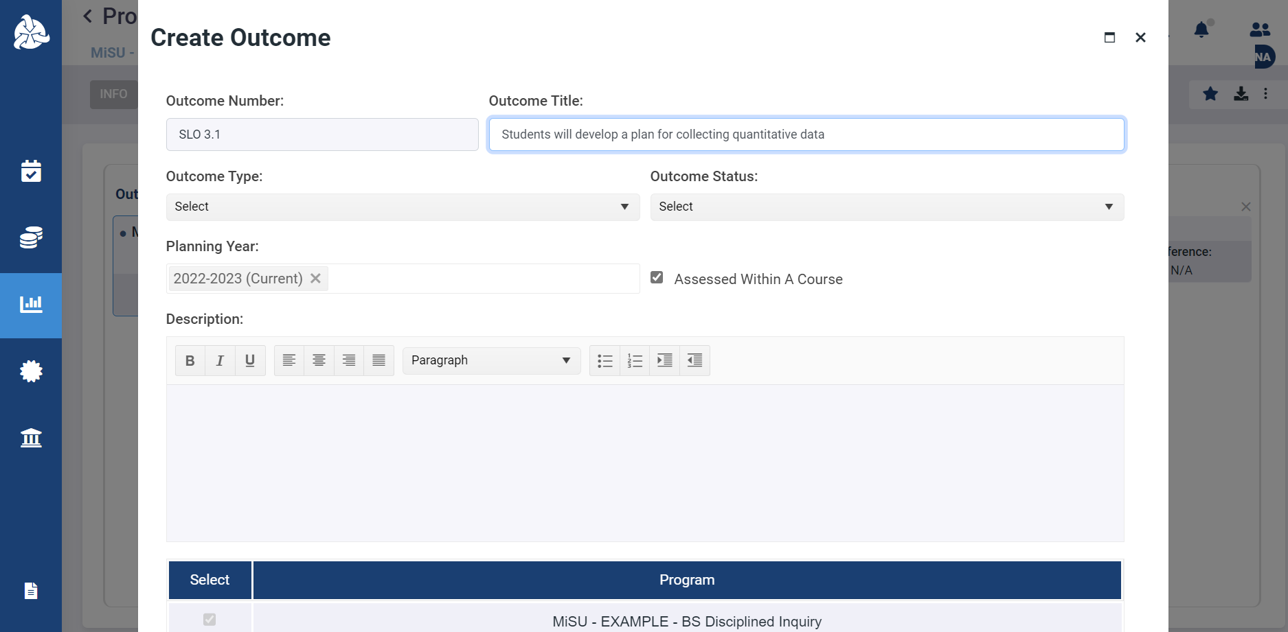
Enter the Outcome Title

Slide 41
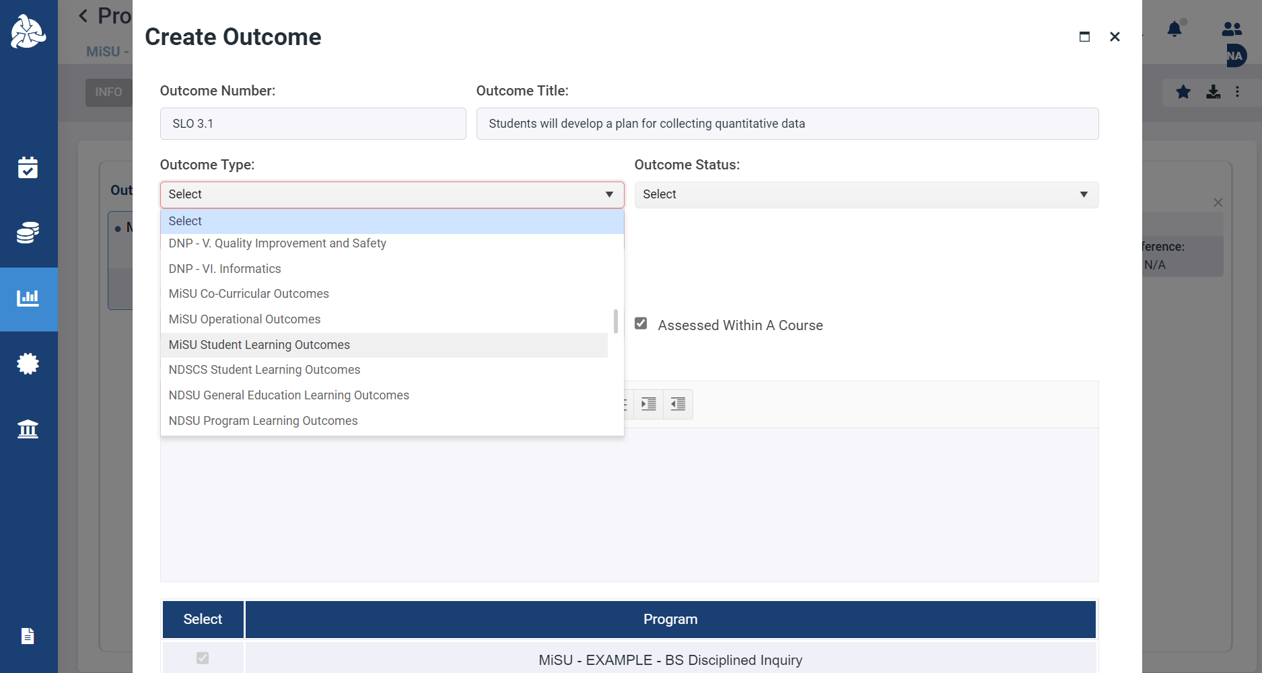
Select MiSU Student Learning Outcomes from the Outcome Type dropdown menu

Slide 42
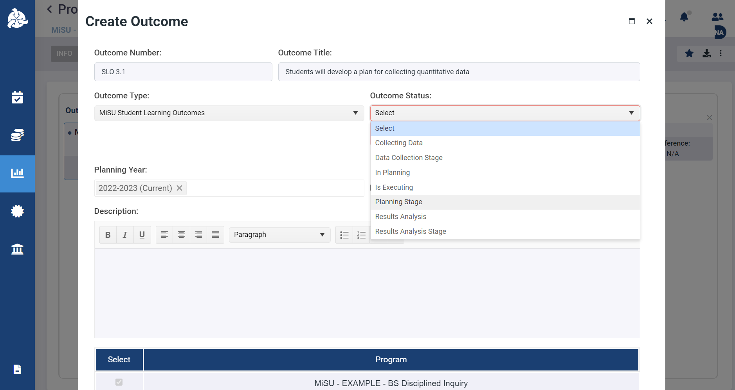
Select an Outcome Status from the dropdown menu

Slide 43
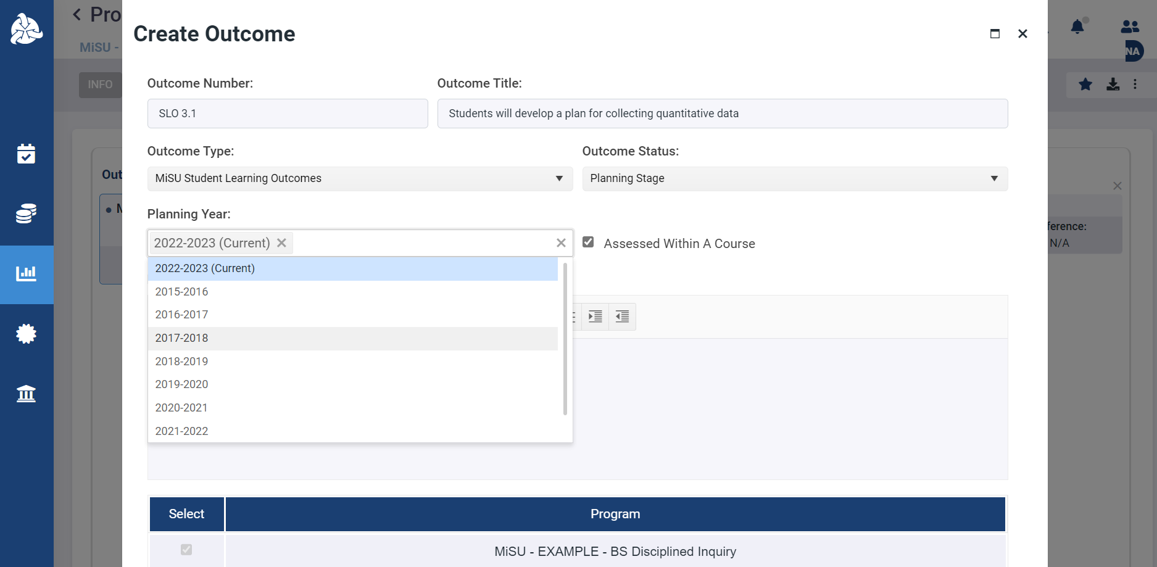
Select the Planning Year from the dropdown menu

Slide 44
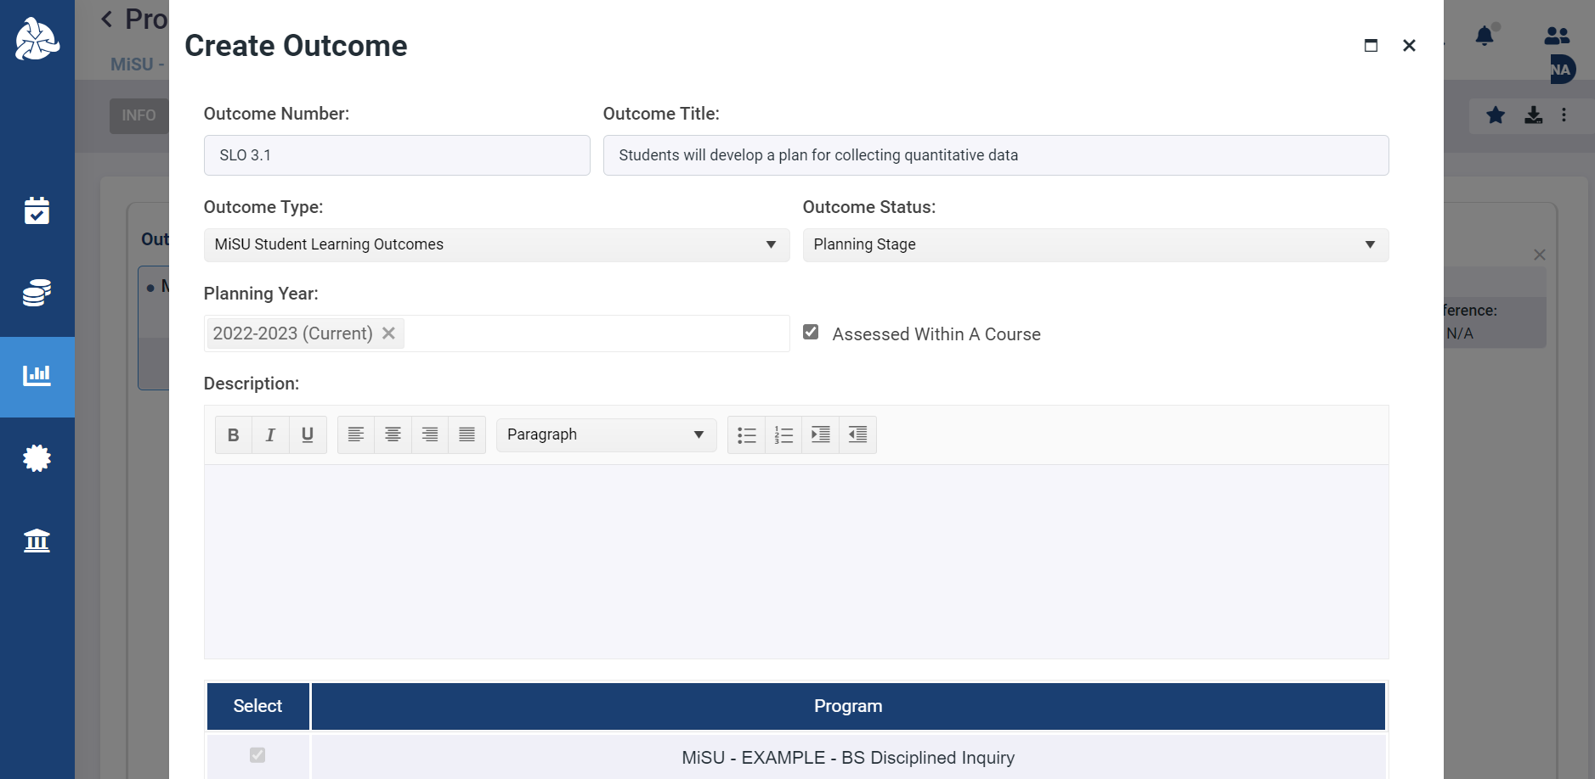
Select the Assessed Within A Course Checkbox

Slide 45
Add an optional Description if desired

Slide 46
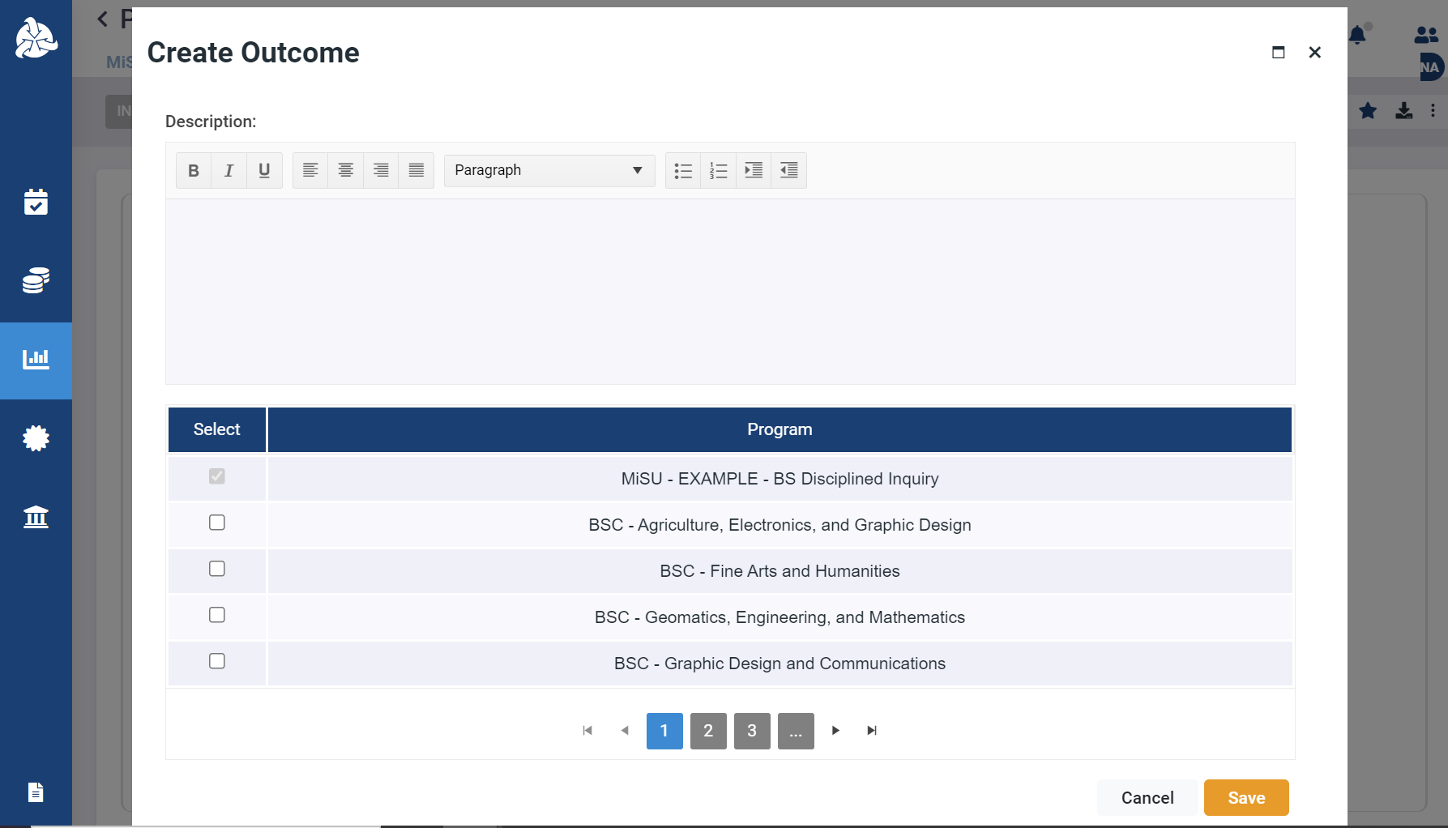
Verify that the correct program is selected

Slide 47
Click Save

Slide 48
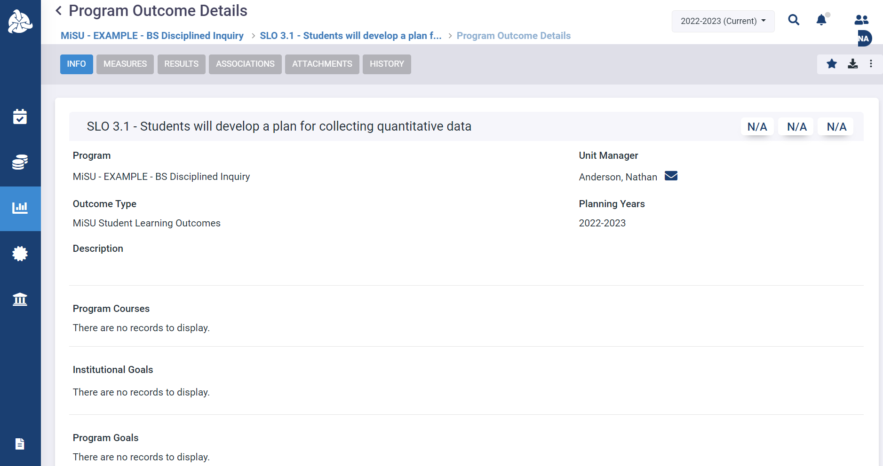
The new outcome appears under the Info tab in the Program Outcome Details window

Slide 49
Identify program courses

Slide 50
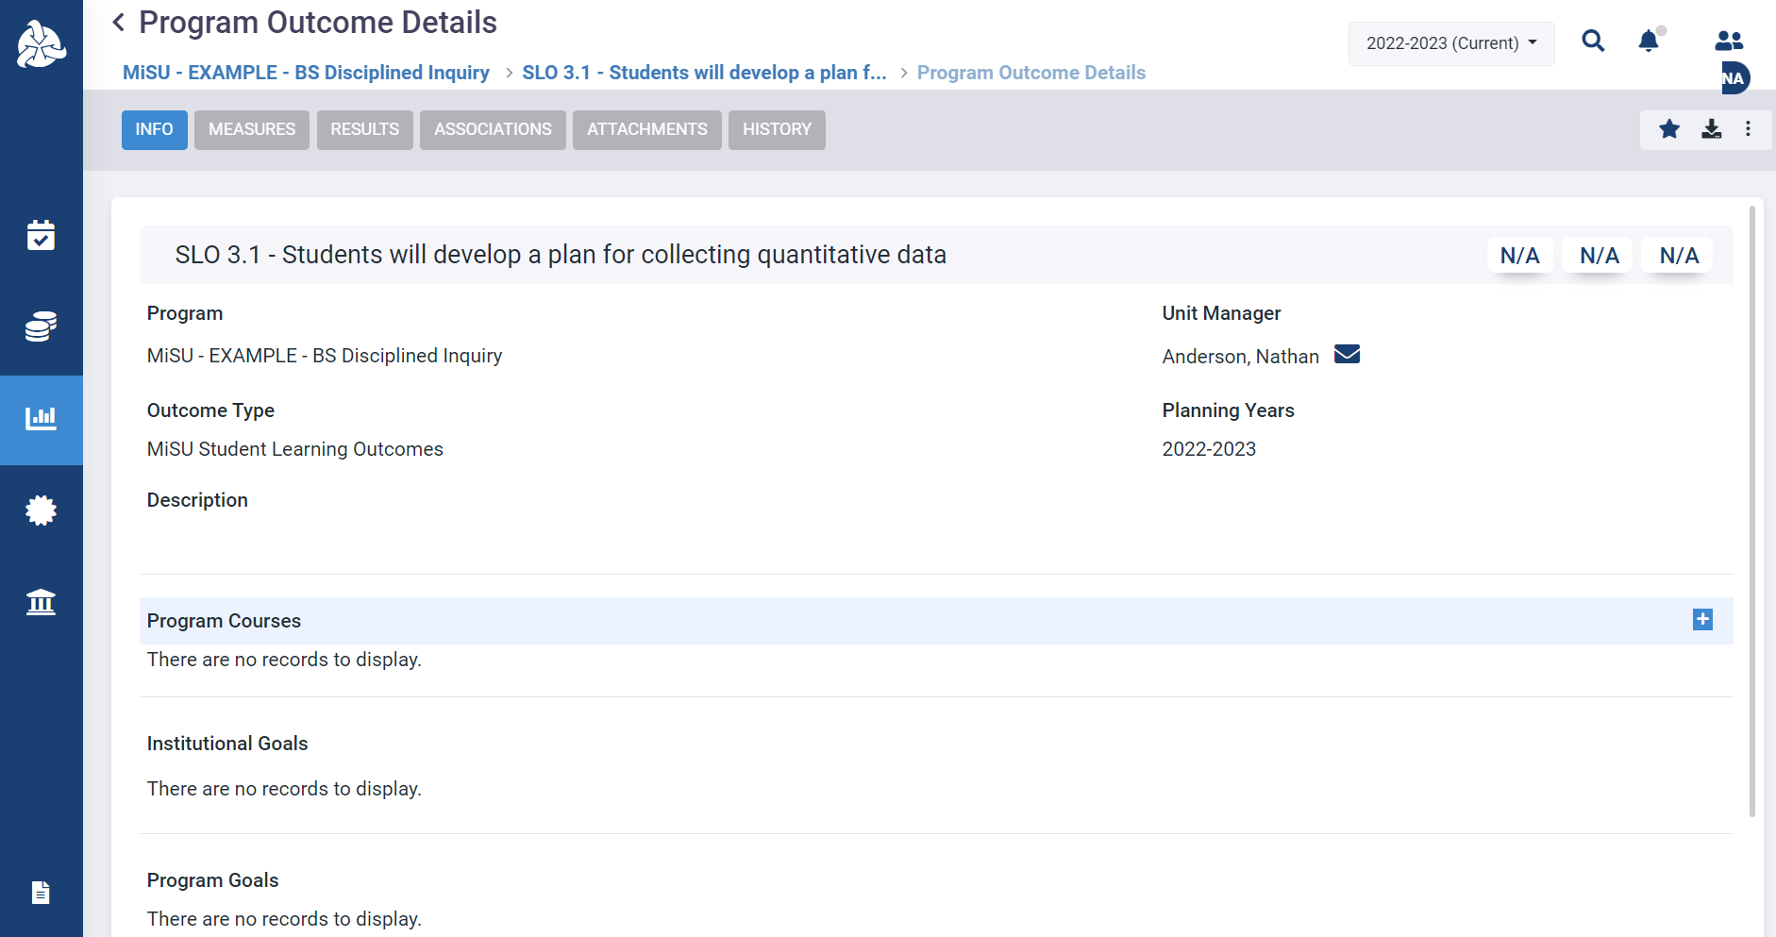
Click the plus (+) icon next to Program Courses to open the Program Courses pane

Slide 51
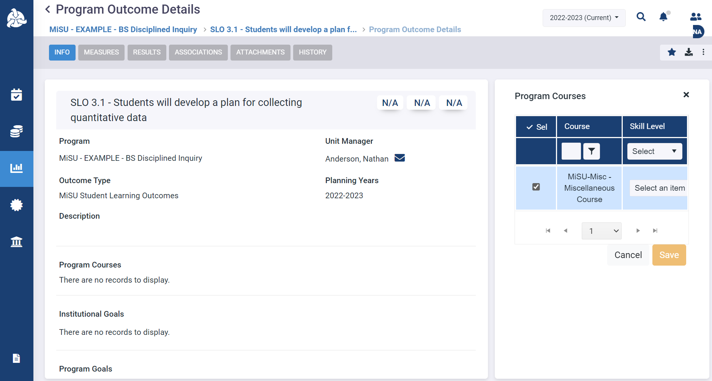
Select all courses in the program where the outcome is assessed or otherwise covered. A course will be available to select in this pane if it is selected as a course at the program level.

Slide 52
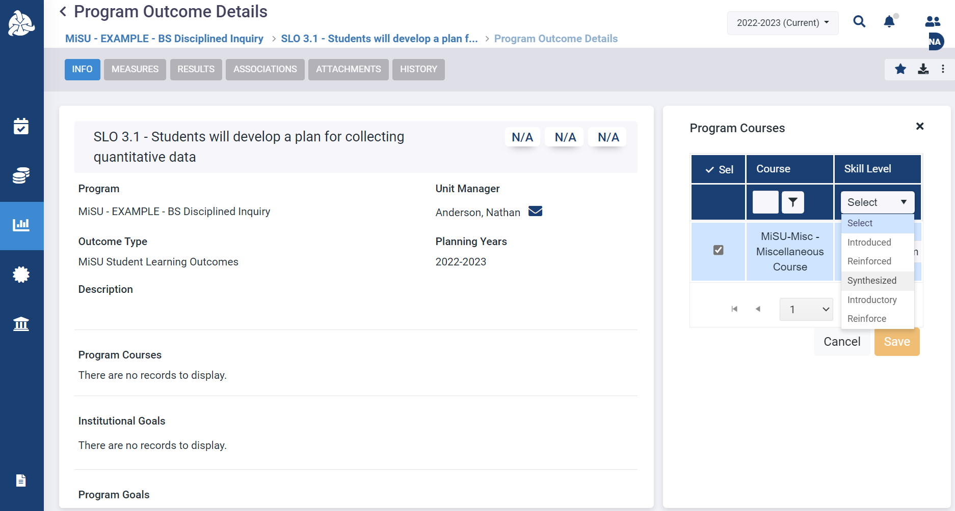
Select the Skill Level of the outcome for each course from its dropdown menu

Slide 53
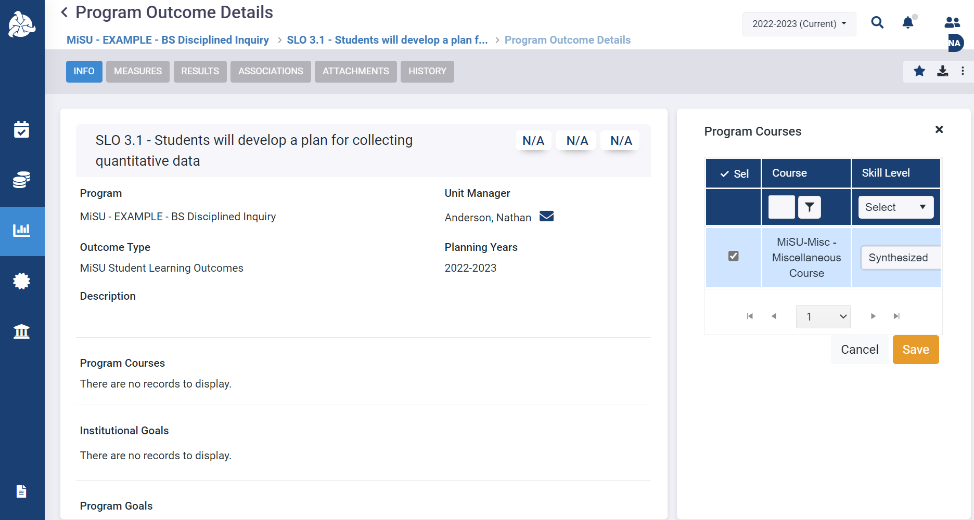
Click Save

Slide 54
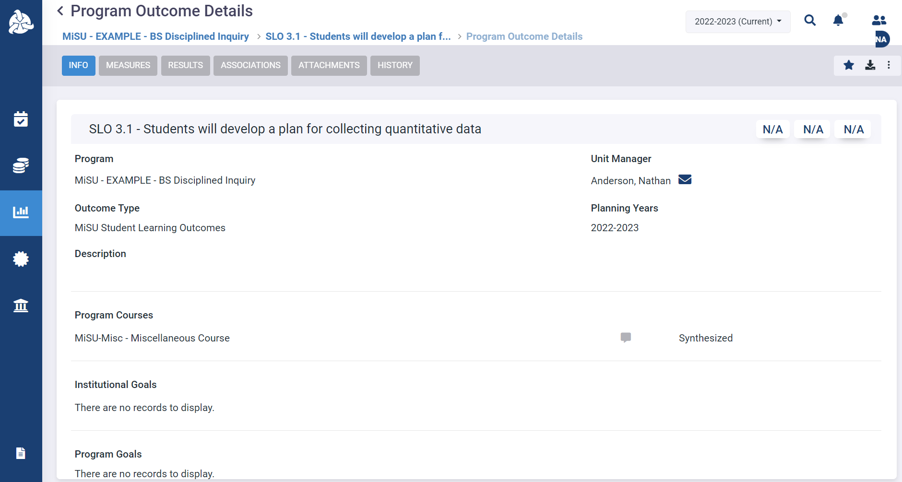
The selected courses and corresponding skill levels appear in the Program Courses section

Slide 55
Identify associated program goals

Slide 56
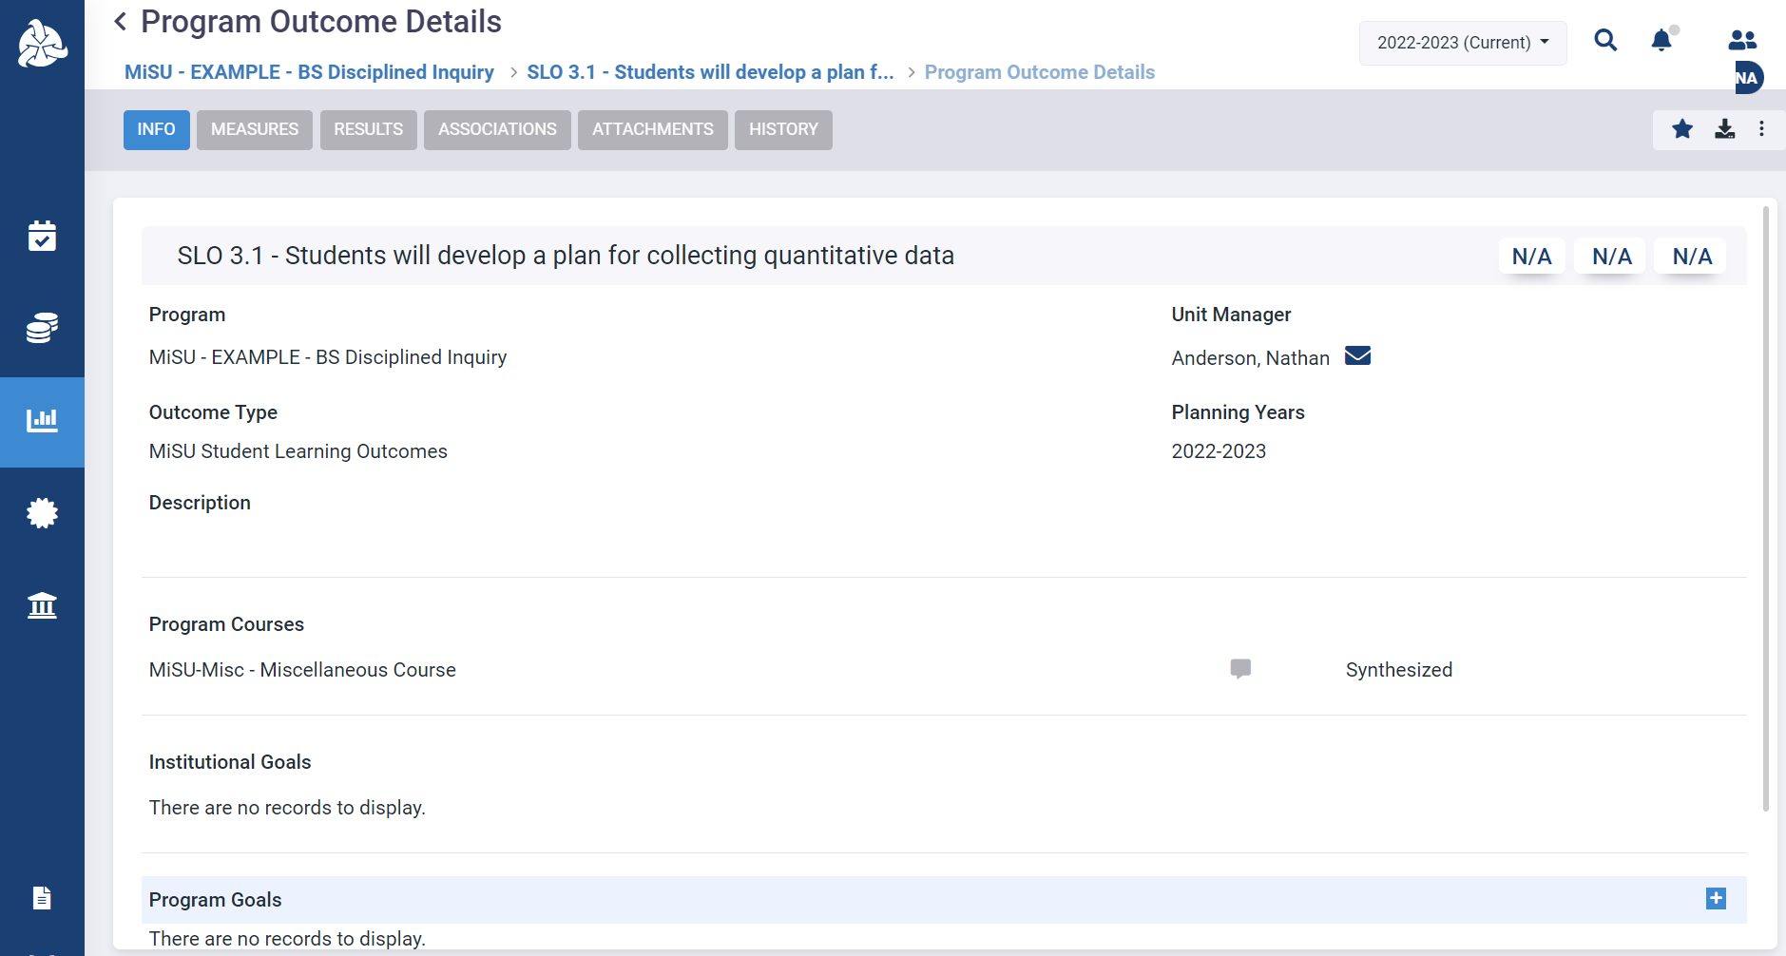
Click the plus (+) icon next to Program Goals to open the Program Goals pane

Slide 57
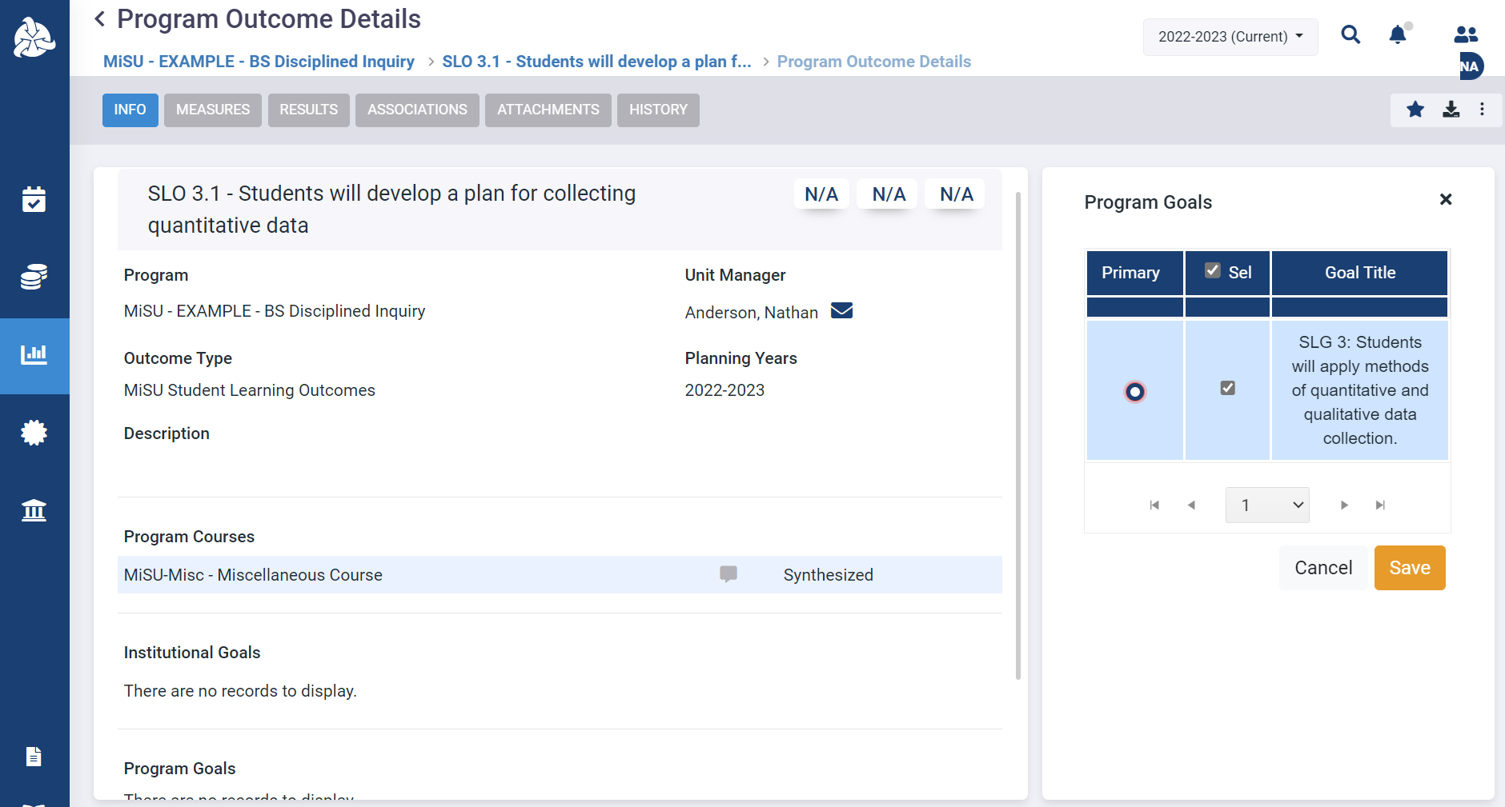
Select the Program Goal(s) that the outcome represents

Slide 58
Click Save

Slide 59
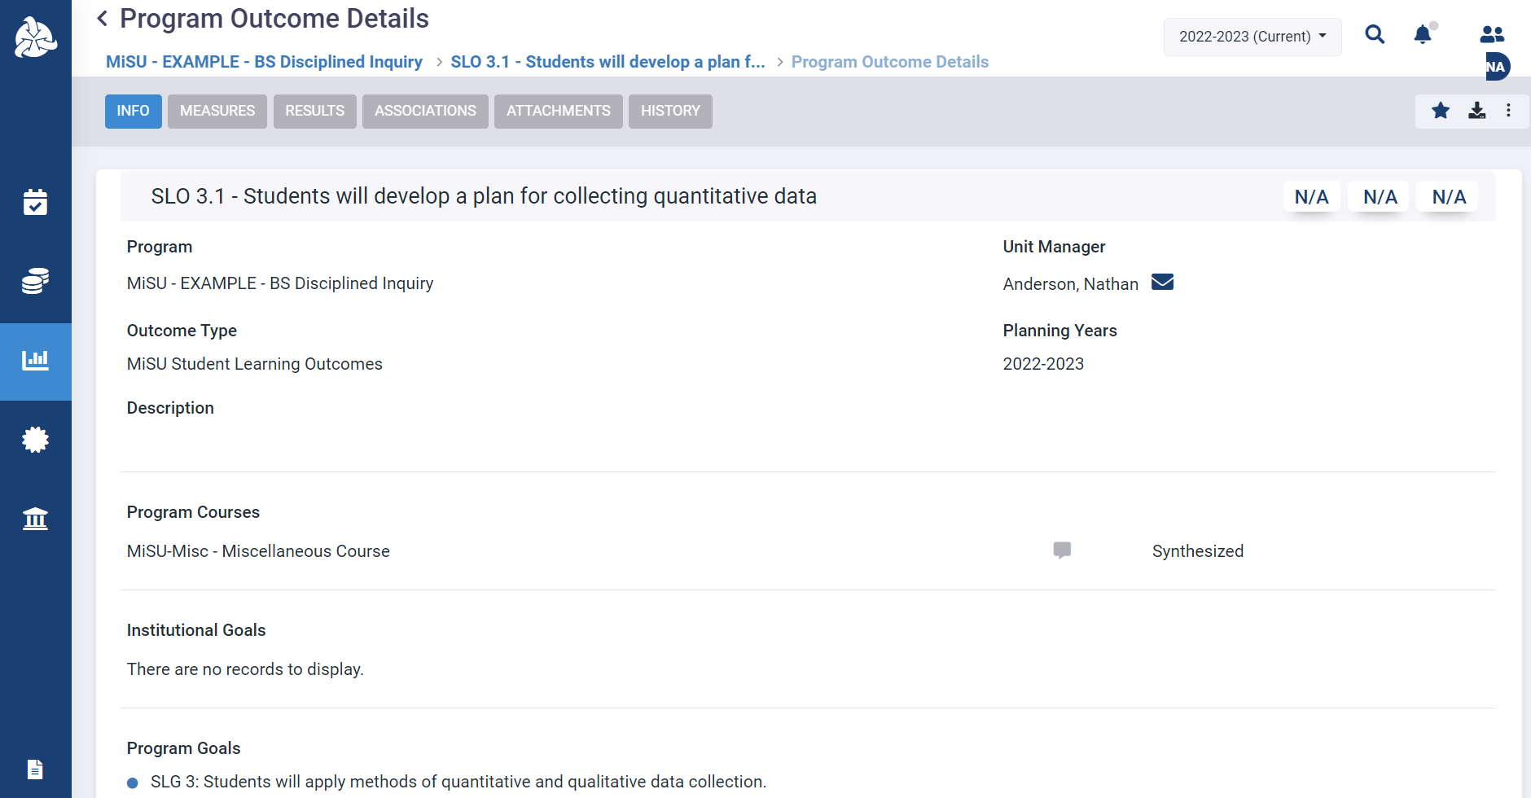
The selected goal(s) appear in the Program Goals section

Slide 60
Enter a Measure

Slide 62
Click the Assessment icon in the left sidebar

Slide 63
Click the desired program name in the expanded sidebar

Slide 64
Select the desired year from the planning year dropdown menu in the upper right corner

Slide 65
Click the Outcomes tab

Slide 66
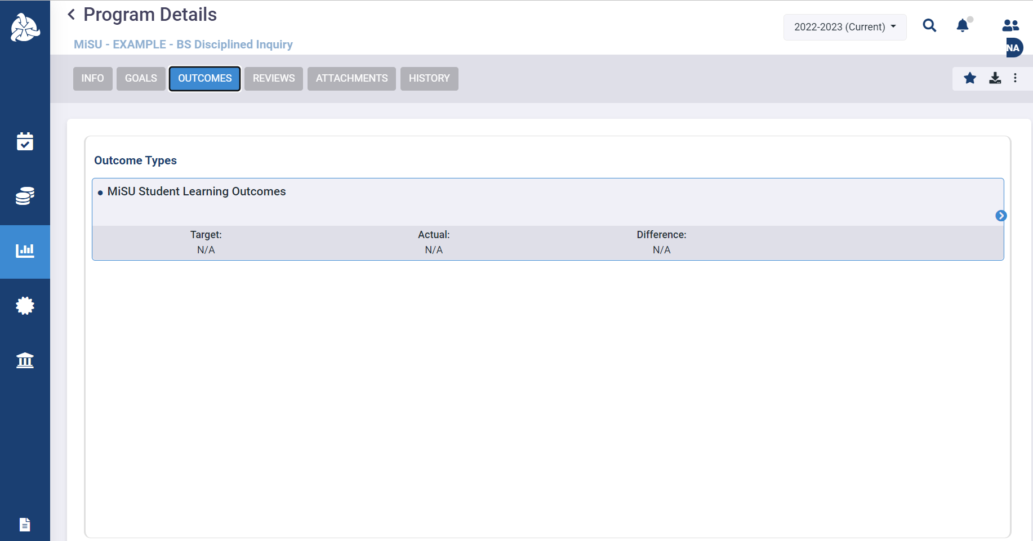
Hover over the MiSU Student Learning Outcomes outcome type. Click the blue arrow that appears on the right to open the Program Outcomes pane.

Slide 67
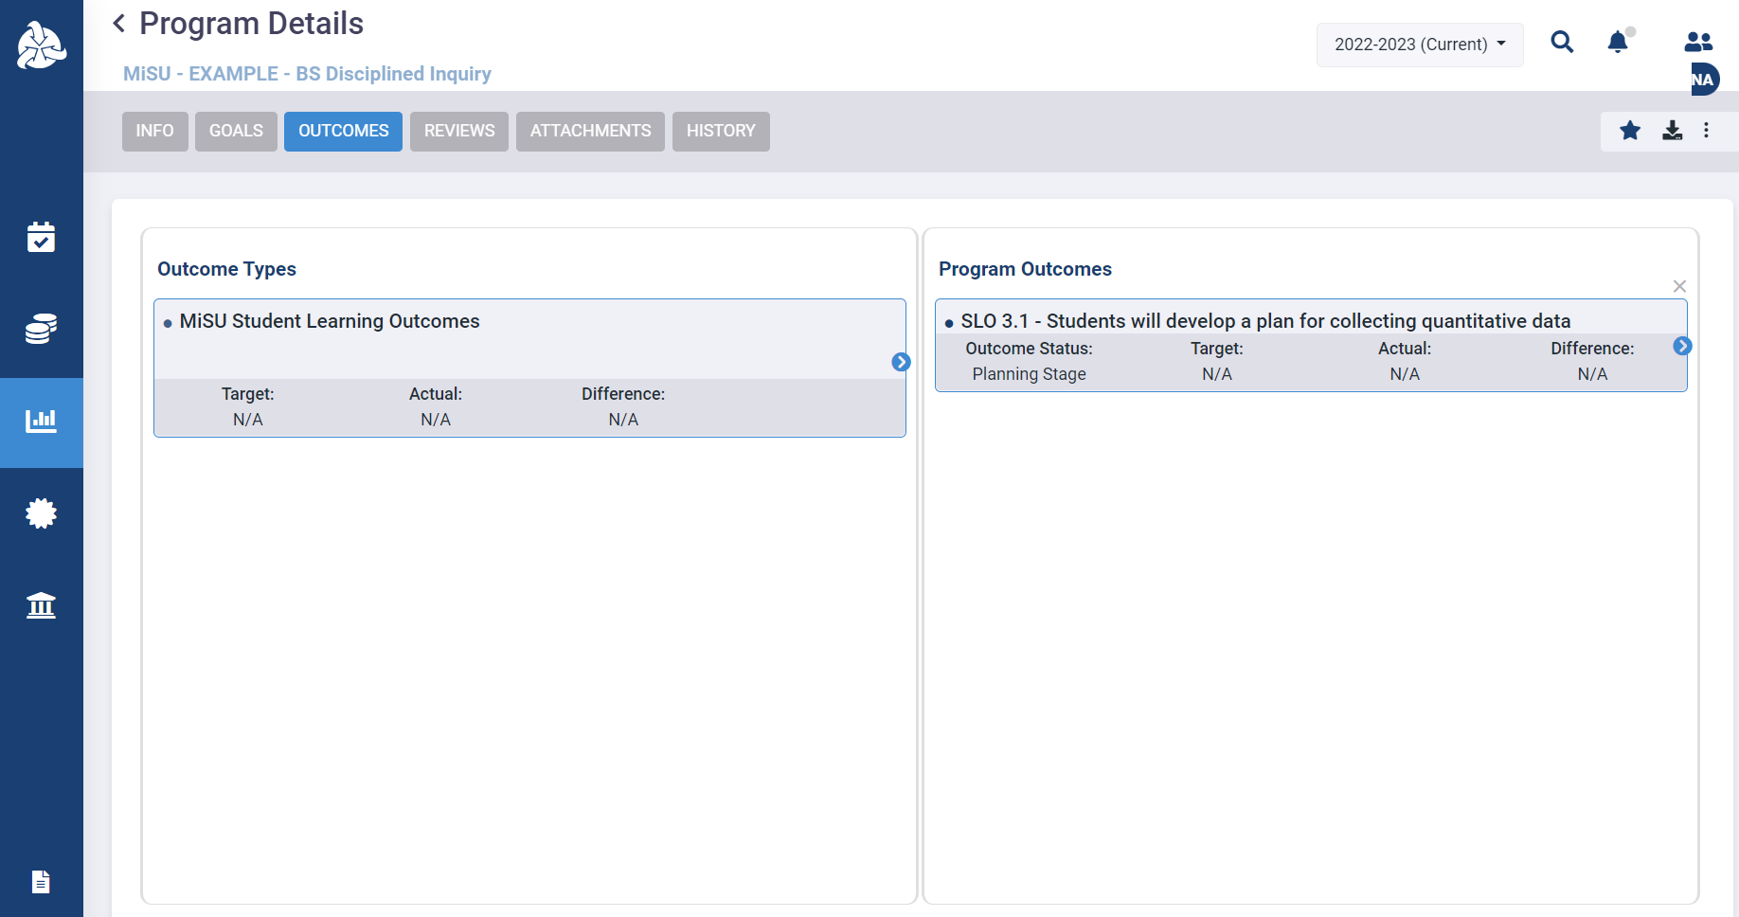
Hover over the desired SLO. Click the blue arrow that appears on the right to open the Measures pane.

Slide 68
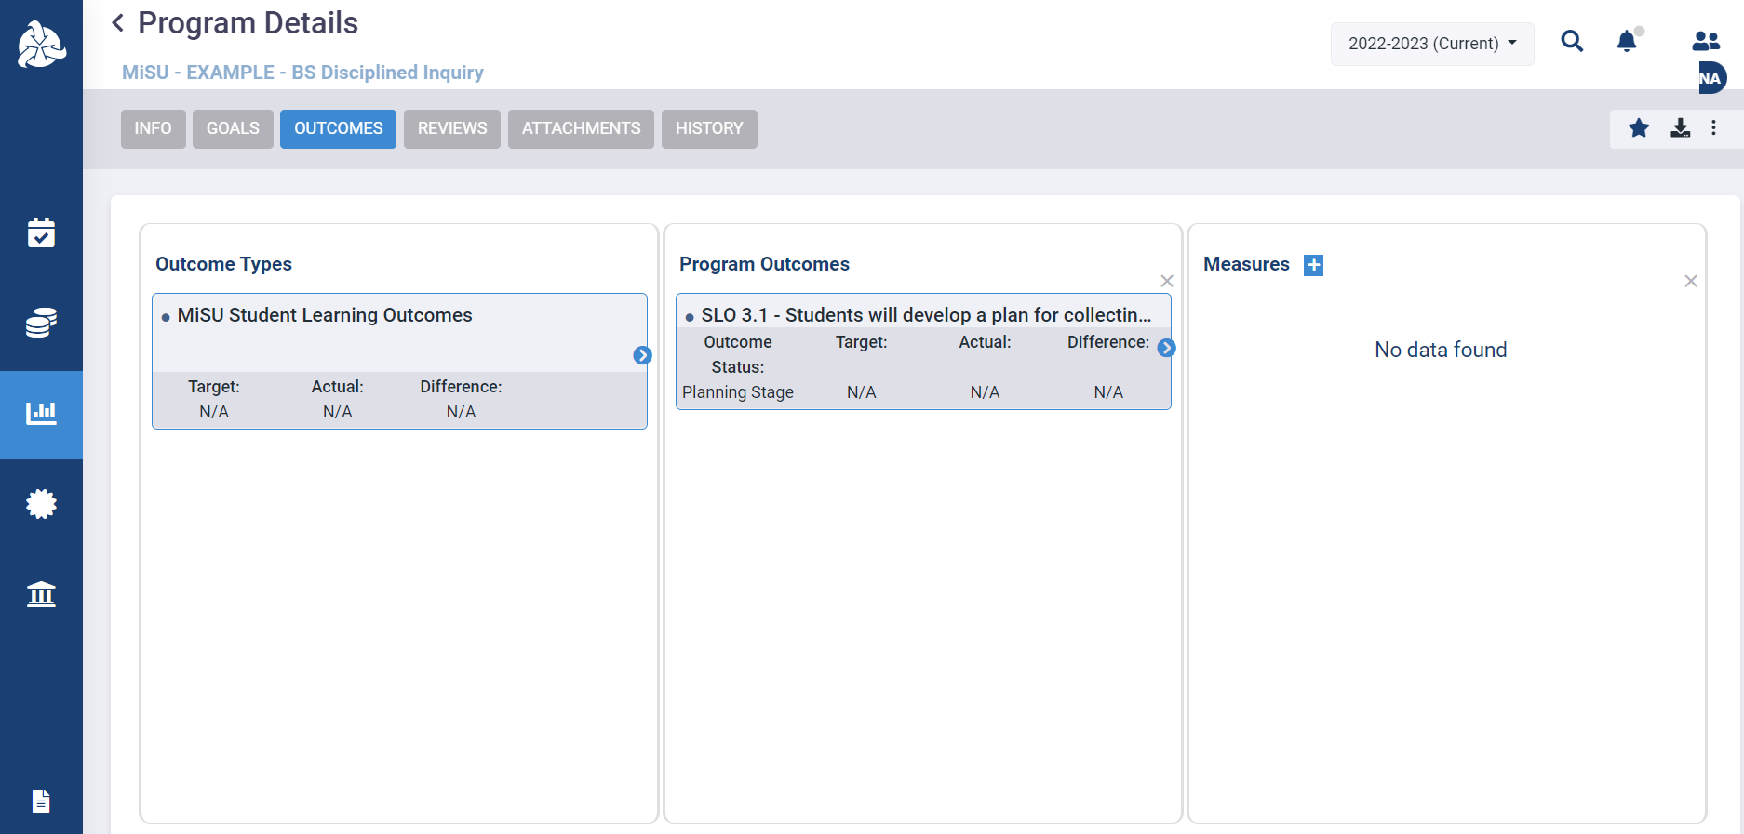
Click the plus (+) icon next to Measures to open the New Measure window

Slide 69
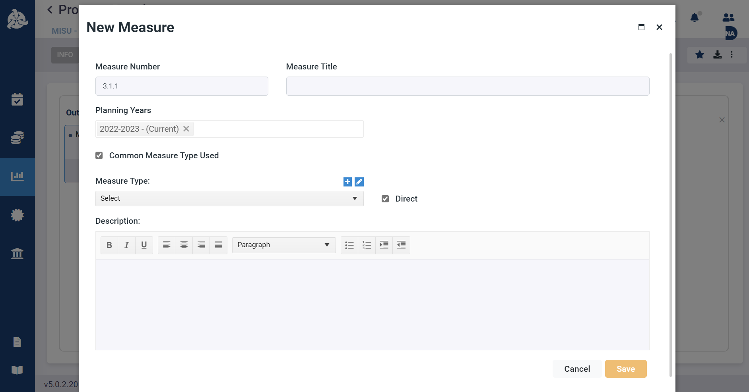
Enter the Measure Number

Slide 70
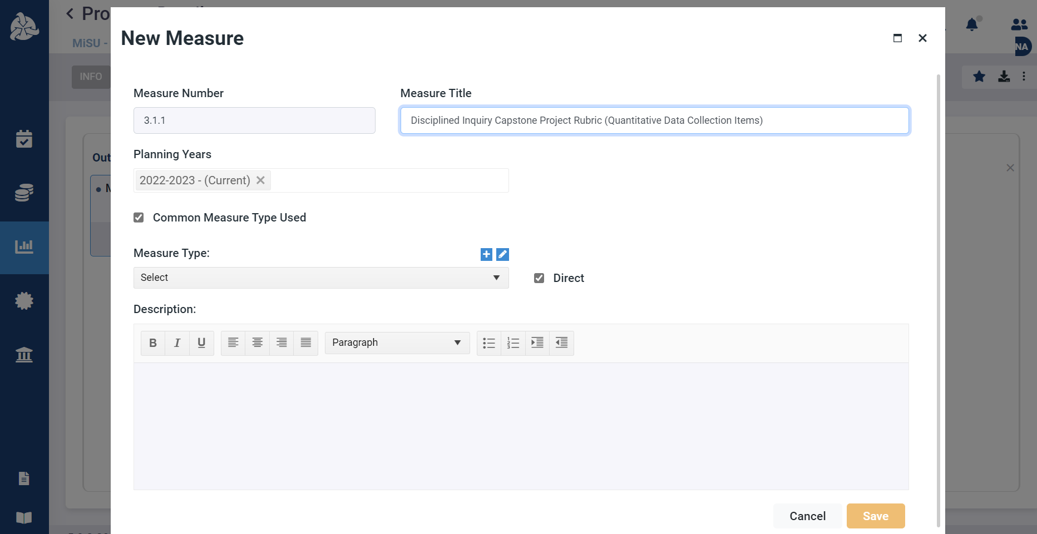
Enter the Measure Title

Slide 71
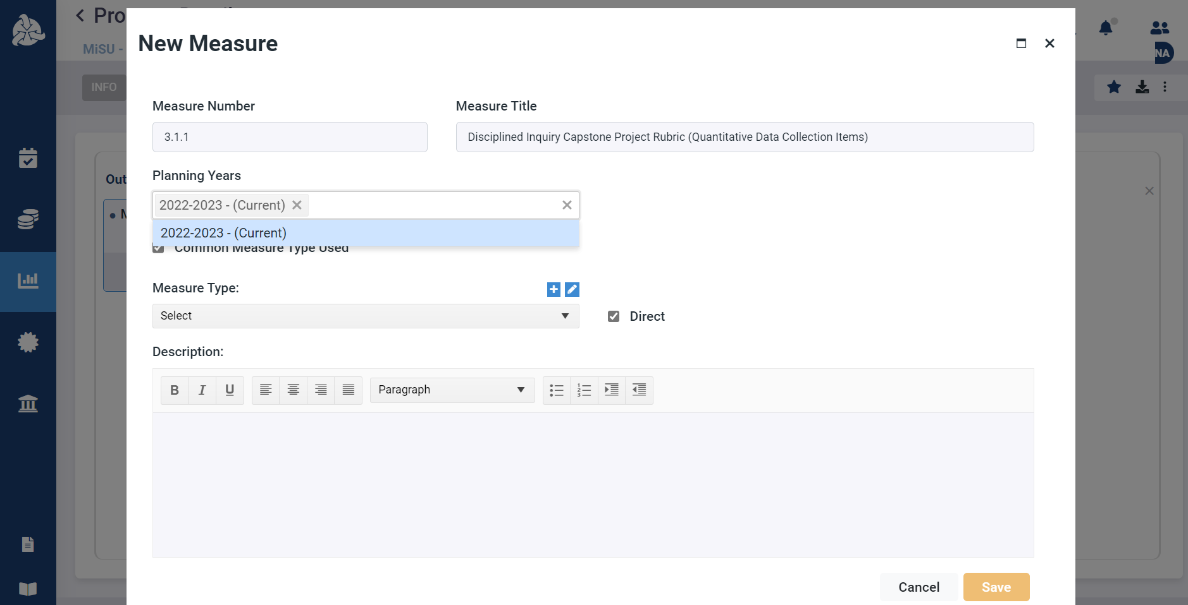
Select the Planning Year from the dropdown menu

Slide 72
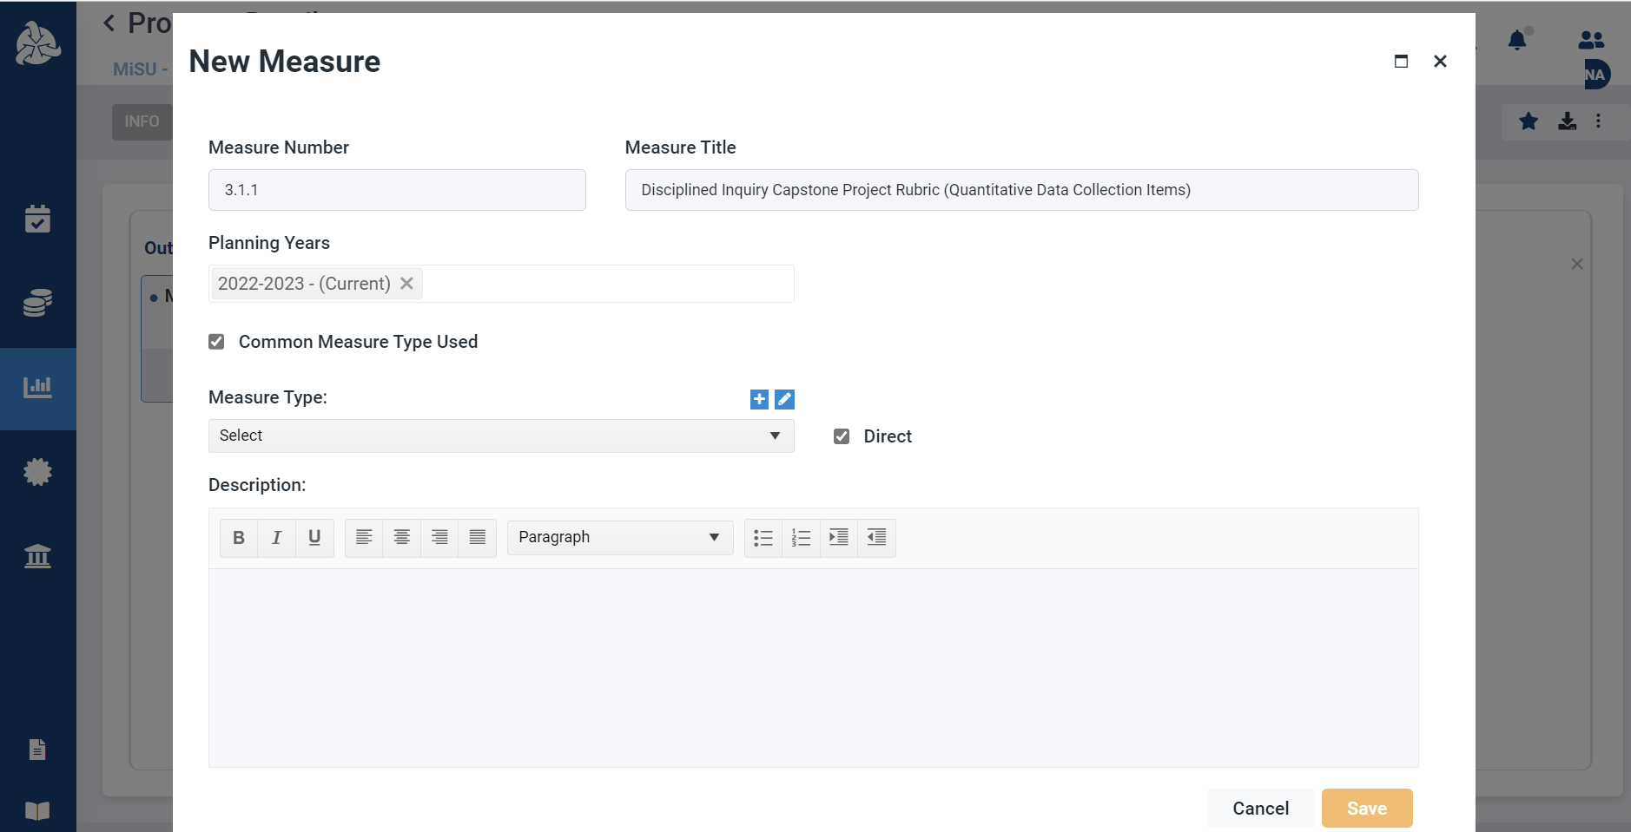
Select the Common Measure Type Used checkbox

Slide 73
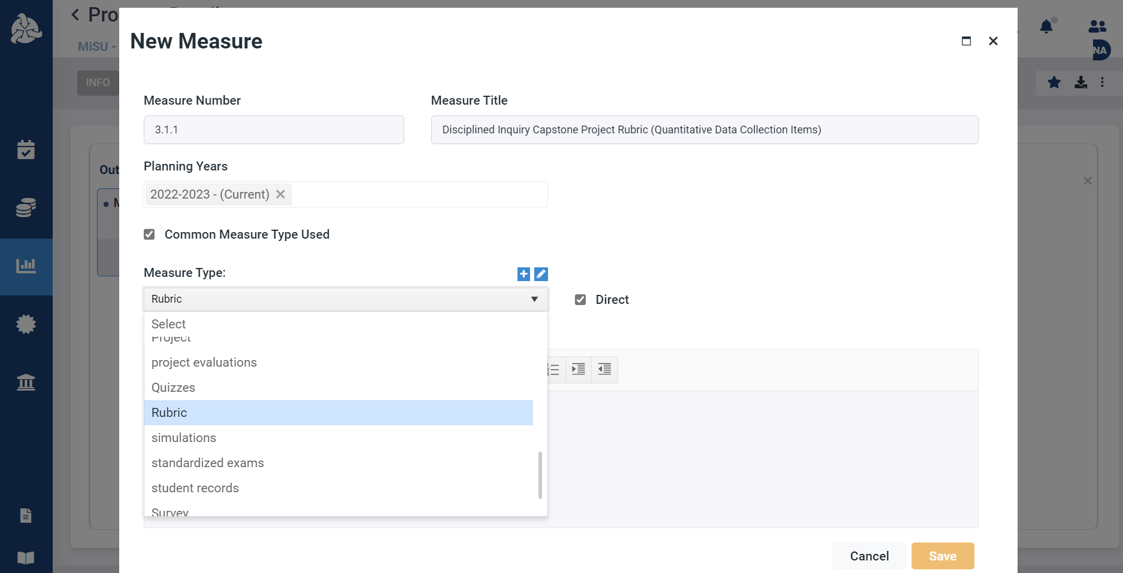
Select the Measure Type from the dropdown menu

Slide 74
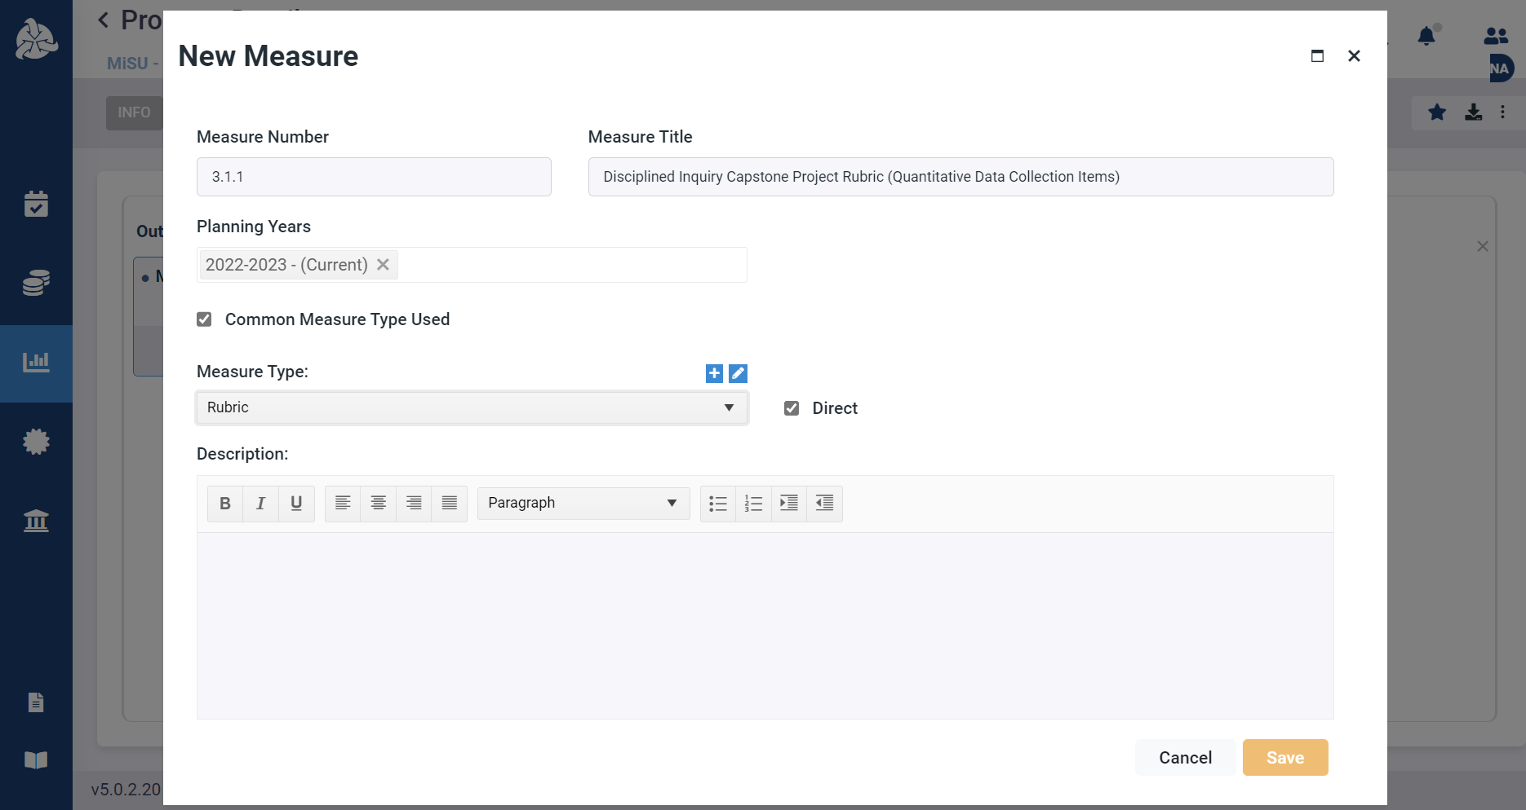
Select the Direct checkbox if it is a direct measure. Leave the box unselected if it is an indirect measure.

Slide 75
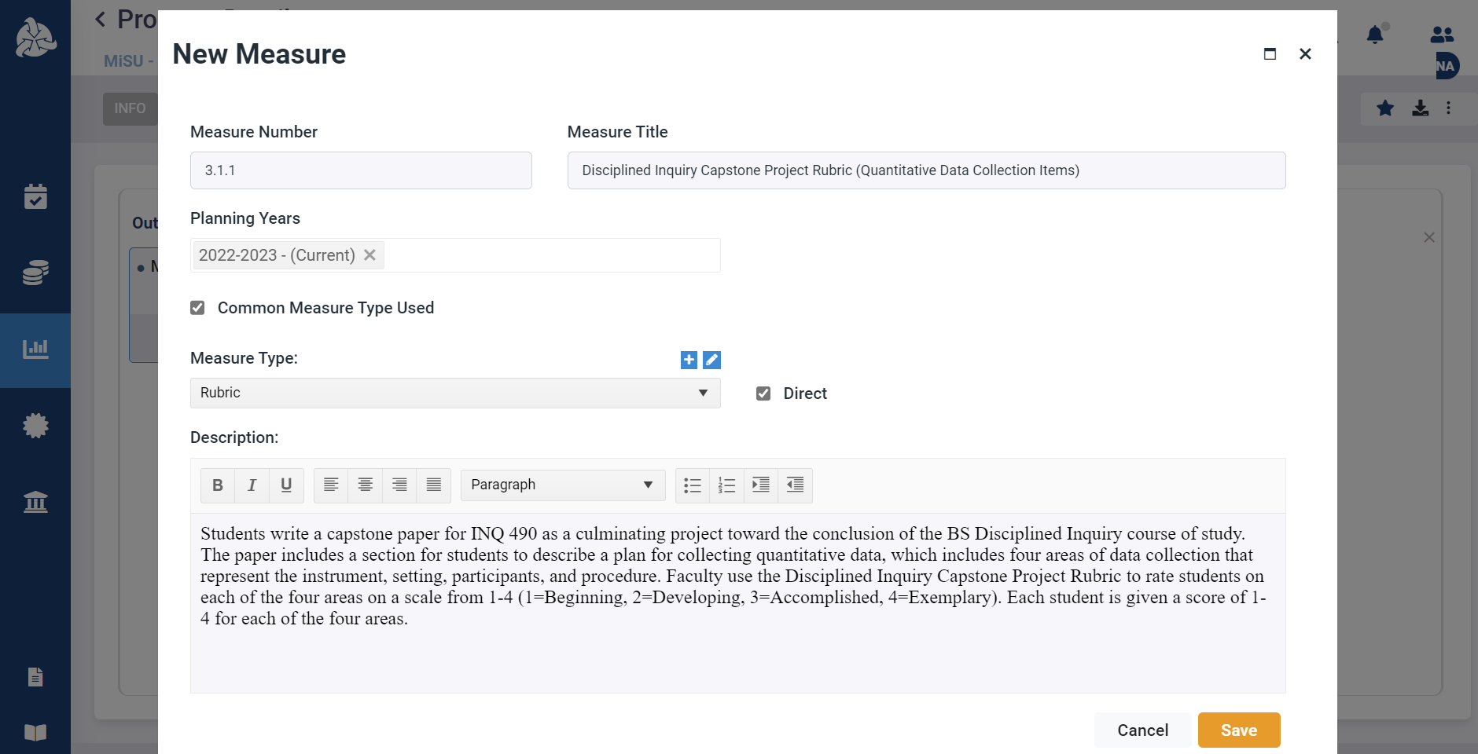
Enter a description of the measure

Slide 76
Click Save

Slide 77
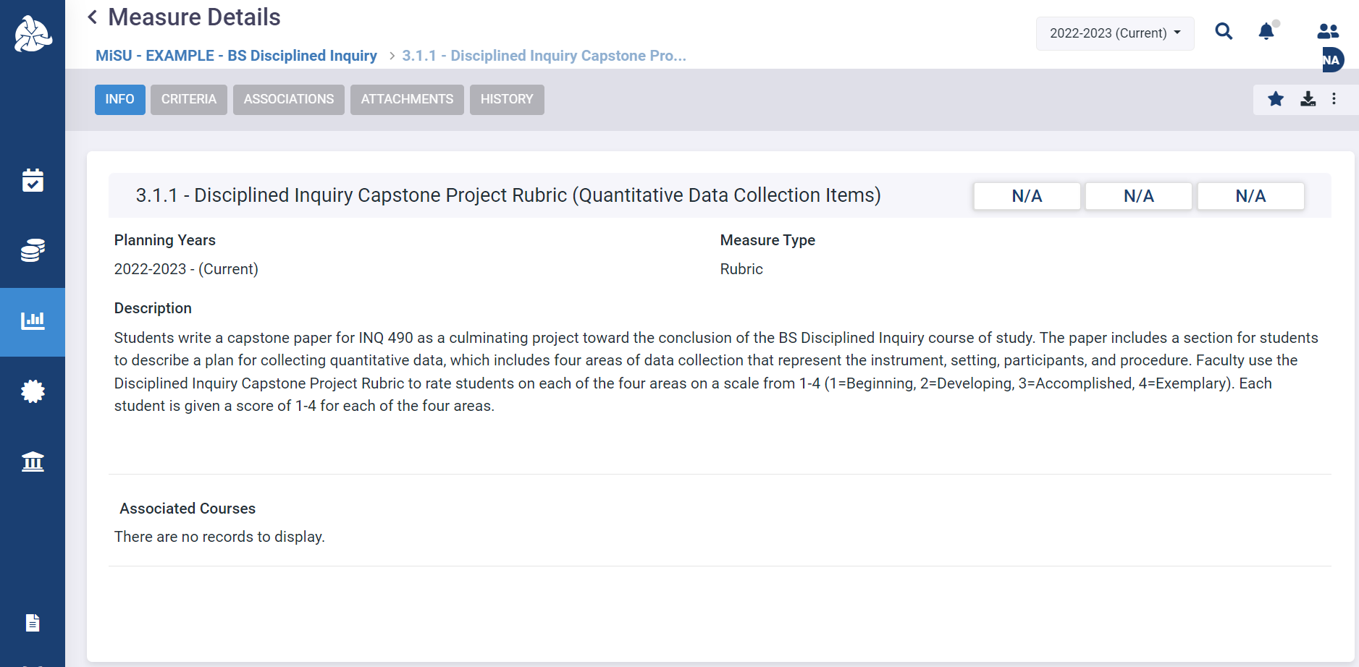
The new measure appears in the Measure Details window

Slide 78
Identify associated courses

Slide 79
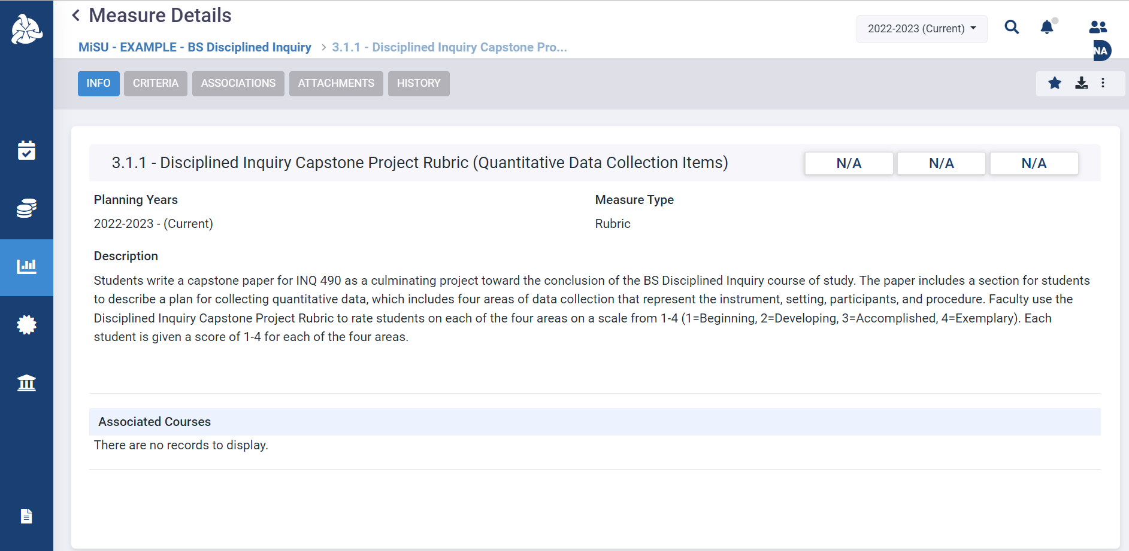
Click on Associated Courses to open the Associated Courses pane

Slide 80
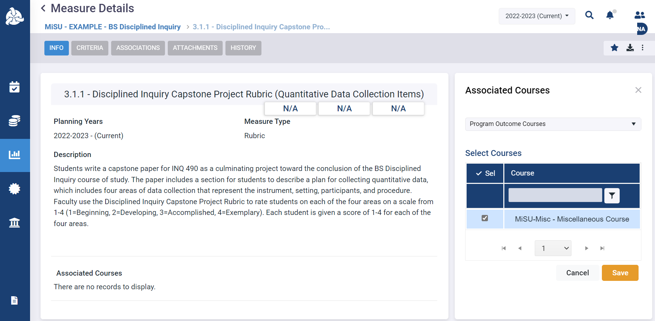
Select all courses that are associated with the measure. A course will be available to select in this pane if it is selected as a course at the outcome level.

Slide 81
Click Save

Slide 82
The selected courses appear in the Associated Courses section

Slide 83
Identify associated outcomes

Slide 84
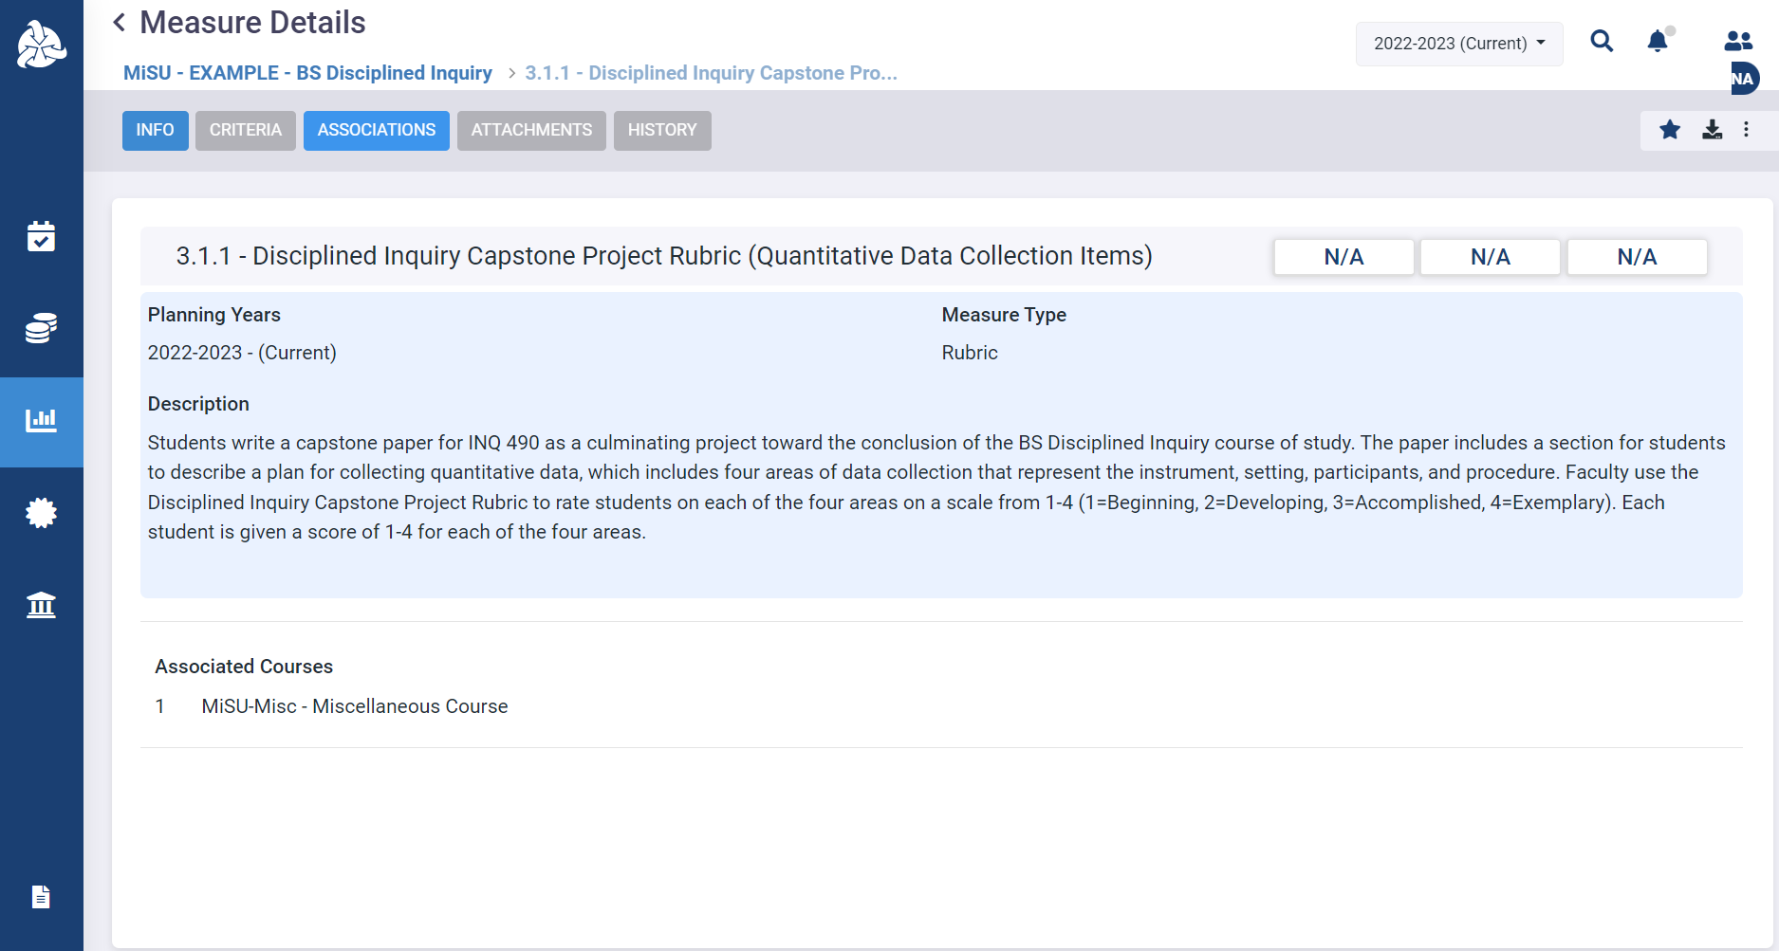
Click the Associations tab in the Measure Details window

Slide 85
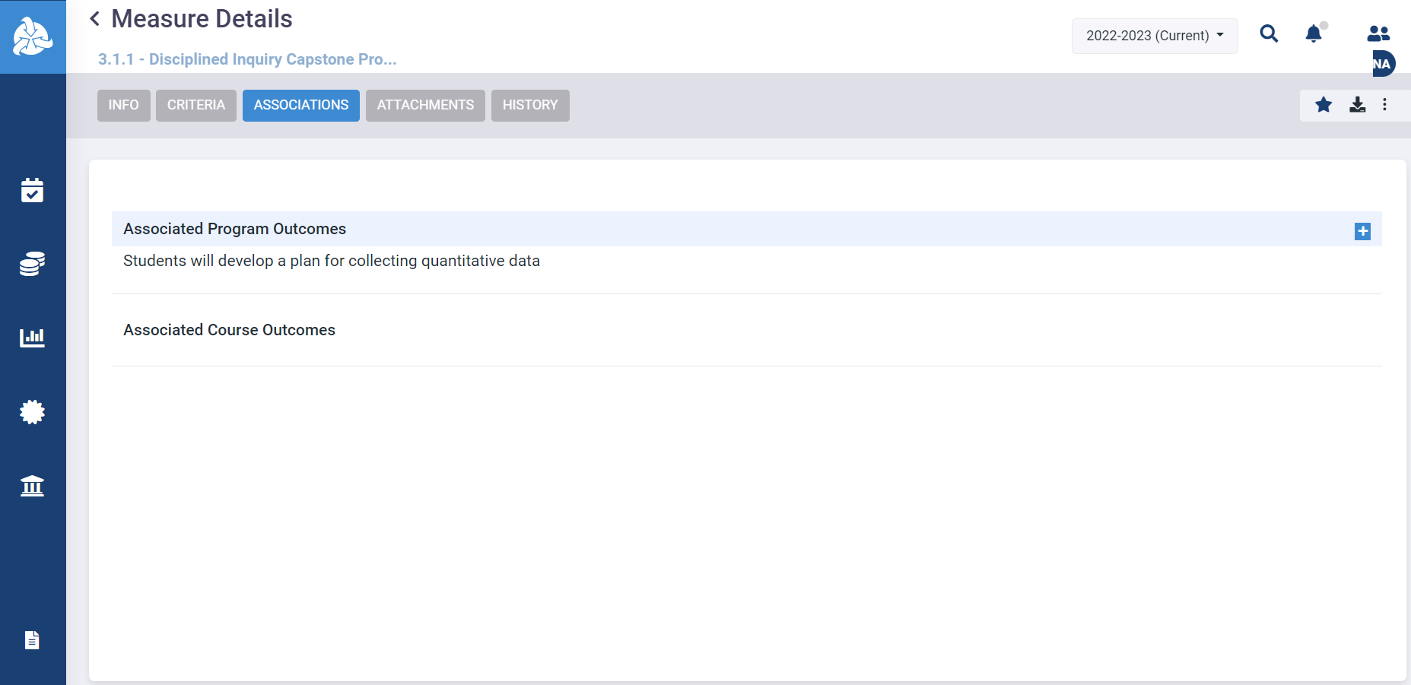
Click the plus (+) icon next to Associated Program Outcomes to open the Associated Program Outcomes pane

Slide 86
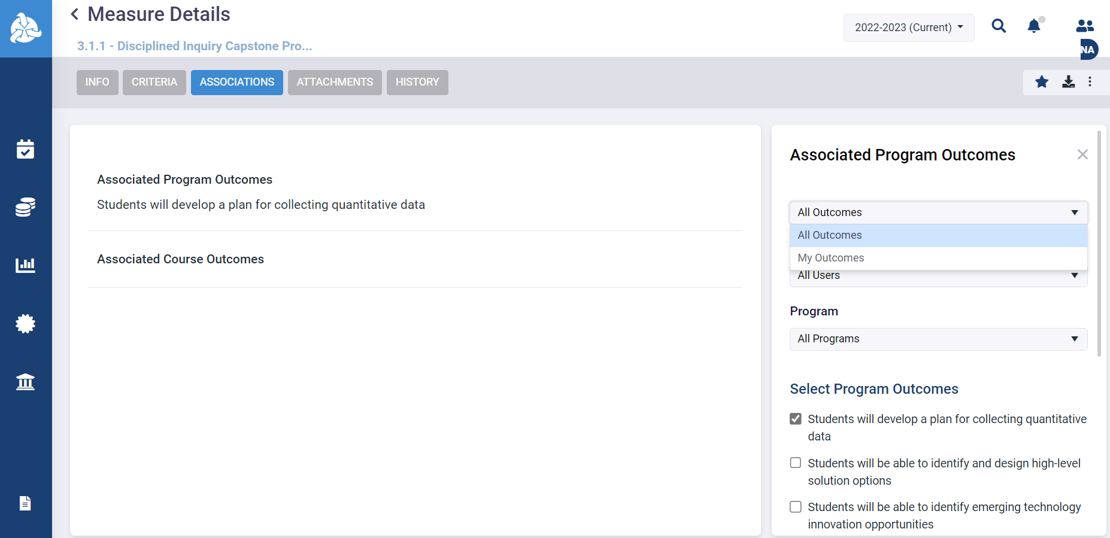
Select All Outcomes from the first dropdown menu

Slide 87
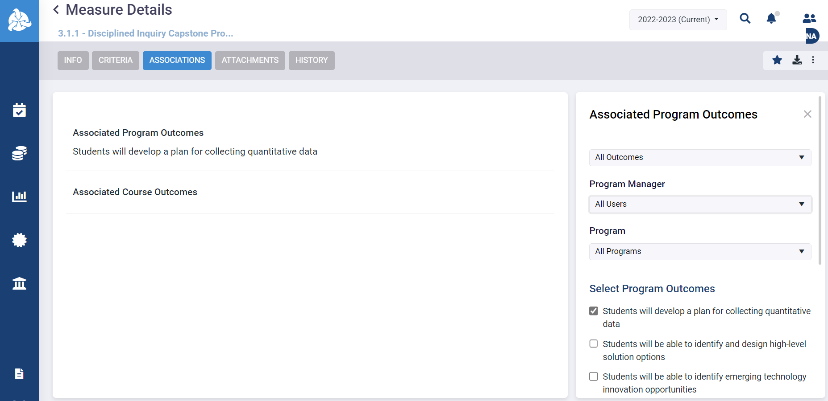
Select All Users from the Program Manager dropdown menu

Slide 88
Select the desired program from the Program dropdown menu

Slide 89
Select the checkbox(es) of the desired outcome(s) in the Select Program Outcomes list

Slide 90
Click Save

Slide 91
Click Save

Slide 92
The selected outcome(s) appear in the Associated Program Outcomes section. The findings that are reported for the measure will automatically feed the results of each listed outcome.

Slide 93
Enter a Set of Criteria

Slide 95
Click the Assessment icon in the left sidebar

Slide 96
Click the desired program name in the expanded sidebar

Slide 97
Select the desired year from the planning year dropdown menu in the upper right corner

Slide 98
Click the Outcomes tab

Slide 99
Hover over the MiSU Student Learning Outcomes outcome type. Click the blue arrow that appears on the right to open the Program Outcomes pane.

Slide 100
Hover over the desired SLO. Click the blue arrow that appears on the right to open the Measures pane.

Slide 101
Hover over the desired Measure. Click the blue arrow that appears on the right to open the Criteria pane.

Slide 102
Click the plus (+) icon next to Criteria to open the New Criteria window

Slide 103
Select the Planning Year from the dropdown menu

Slide 104
Enter the Criteria Number

Slide 105
Enter the Criteria Title

Slide 106
Enter a Description

Slide 107
Select Benchmark from the Criteria Type dropdown menu

Slide 108
Enter the desired Target percentage

Slide 109
Click Save

Slide 110
The new criteria appears in the Criteria Details window

Slide 111
Review of Objectives
Enter a student learning goal (SLG)
Enter a student learning outcome (SLO)
Enter a measure
Enter a set of criteria

Slide 113
Thank You!

