Slide 1


Yearly Program Assessment Training – Create Program Assessment Plan
Nathan Anderson
Director of Institutional Assessment
2023

Slide 2

Objectives
Write a mission statement
Write a student learning goal (SLG)
Write a student learning outcome (SLO)
Describe a measure of an SLO
Describe criteria for success on a measure

Slide 3

Target Audience
Academic and co-curricular program Yearly Program Assessment (YPA) authors and other personnel supporting the YPA process
Prerequisites
  Program is responsible for submitting a YPA

Slide 4
Background - Accreditation
HLC Criterion 4, Teaching and Learning: Evaluation and Improvement, pertains to program assessment.
  Core Component 4.B states, “The institution engages in ongoing assessment of student learning as part of its commitment to the educational outcomes of its students” (p. 35).
    Evidence item 1 states, “The institution has effective processes for assessment of student learning and for achievement of learning goals in academic and cocurricular offerings”

Slide 5
Background – MiSU YPA
Yearly Program Assessment (YPA)
  Annual documentation of a program's assessment plan, results, and utilization of results

Slide 6
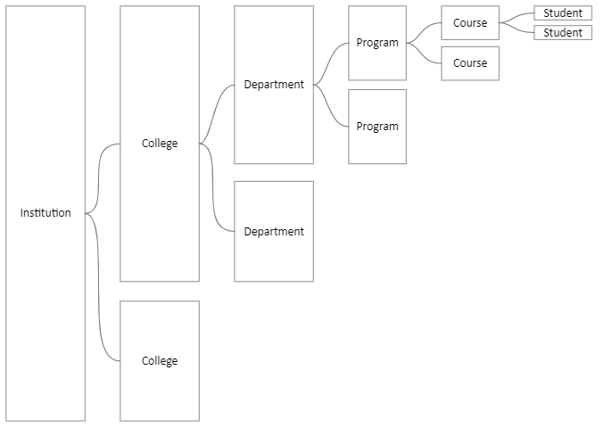
Background – Levels of Assessment
Notes:
MiSU defines assessment as “the systematic collection and analysis of information for improvement purposes” (Director of Assessment, 2019, p. 1). Assessment within an institution of higher education may be implemented at multiple levels of its hierarchical structure (Miller & Leskes, 2005; Peregrine Pathways, 2022), including at student-, course-, program-, department-, college-, and institution-levels (Figure 1). A single institution may include multiple colleges. A single college may include multiple departments (or divisions). A single department may include multiple programs. A single program may include multiple courses. A single course may include multiple students. There may be other levels of assessment at an institution that are not depicted in the diagram.

Slide 7
Background – SPOL
Strategic Planning Online (SPOL)
Institutional Effectiveness Software
Planning, Budget, Assessment, Credentialing, Accreditation
No cost to MiSU through existing contract between NDUS and SPOL

Slide 8
YPA Essential Elements
Mission statement
Student learning goals (SLGs)
Student learning outcomes (SLOs)
Operational goals (OGs)
Operational outcomes (OOs)
Measures
Criteria
Findings
Explanation of Results
  Intended Results, Actual Results, Use of Results

Slide 9
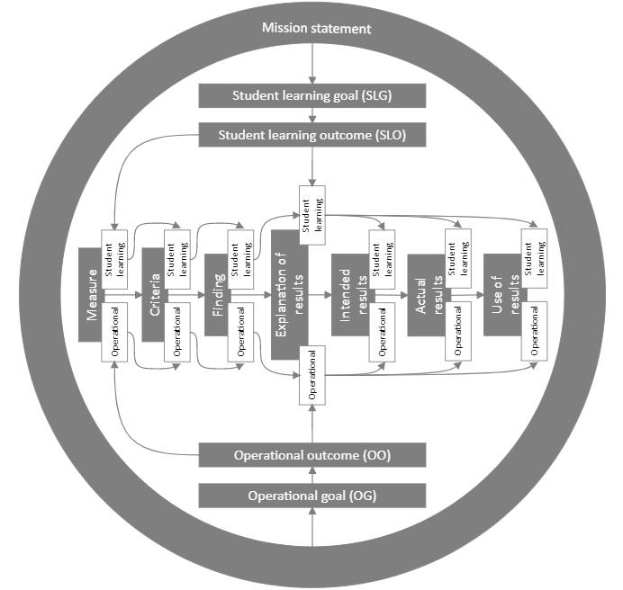
Notes:
This is a diagram of the YPA essential elements

Slide 10
Notes:
The arrows in this diagram point to the YPA essential elements that are addressed in this presentation.

Slide 11
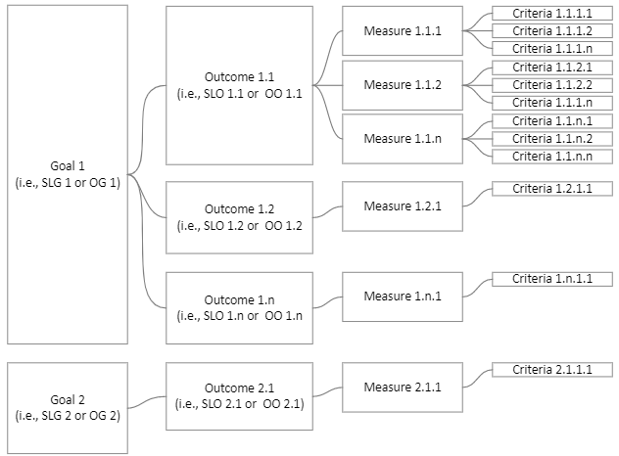

Slide 12
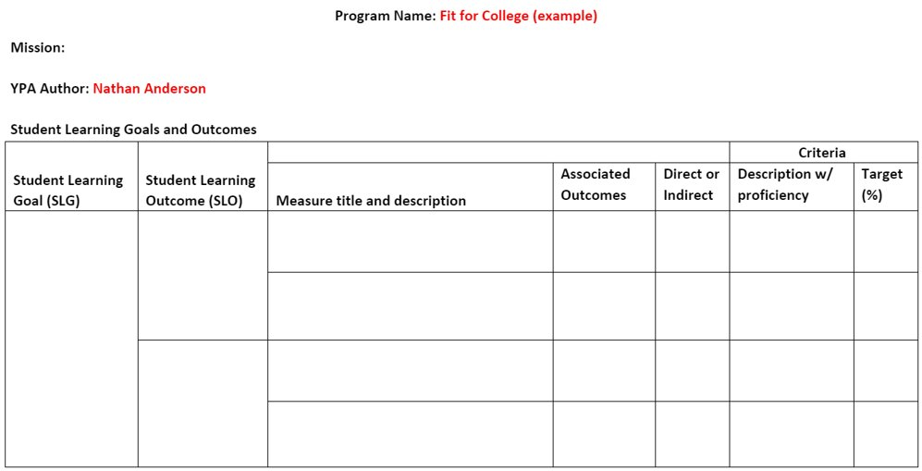
Notes:
This template will be used throught these slides to compile YPA plan details for the Fit for College hypothetical co-curricular program.

Slide 13
Log in to SPOL

Slide 14
Co-Curricular Assessment Page

Slide 15
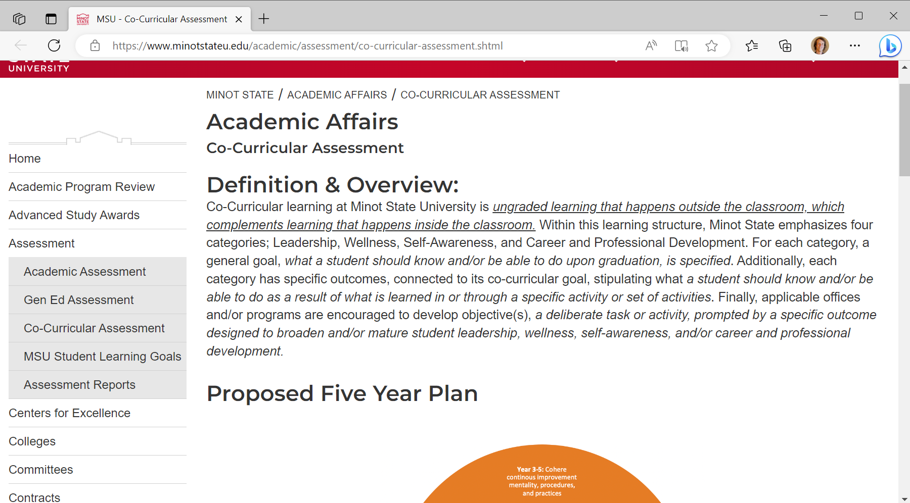
Go to the Co-Curricular Assessment page. Scroll down.

Slide 16
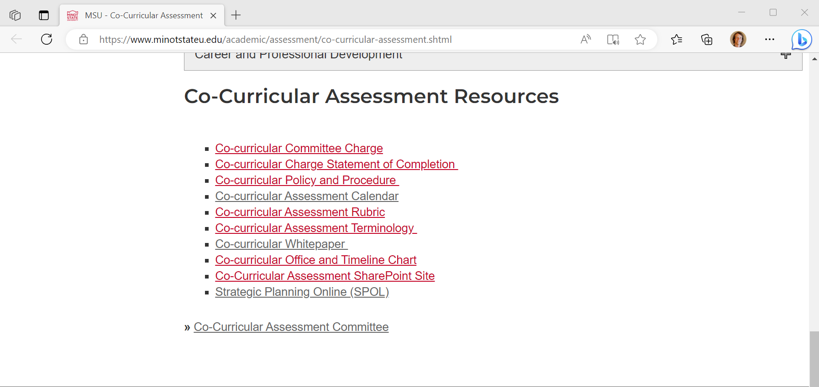
Click Strategic Planning Online (SPOL) in the Co-Curricular Assessment Resources section

Slide 17
Academic Assessment Page

Slide 18
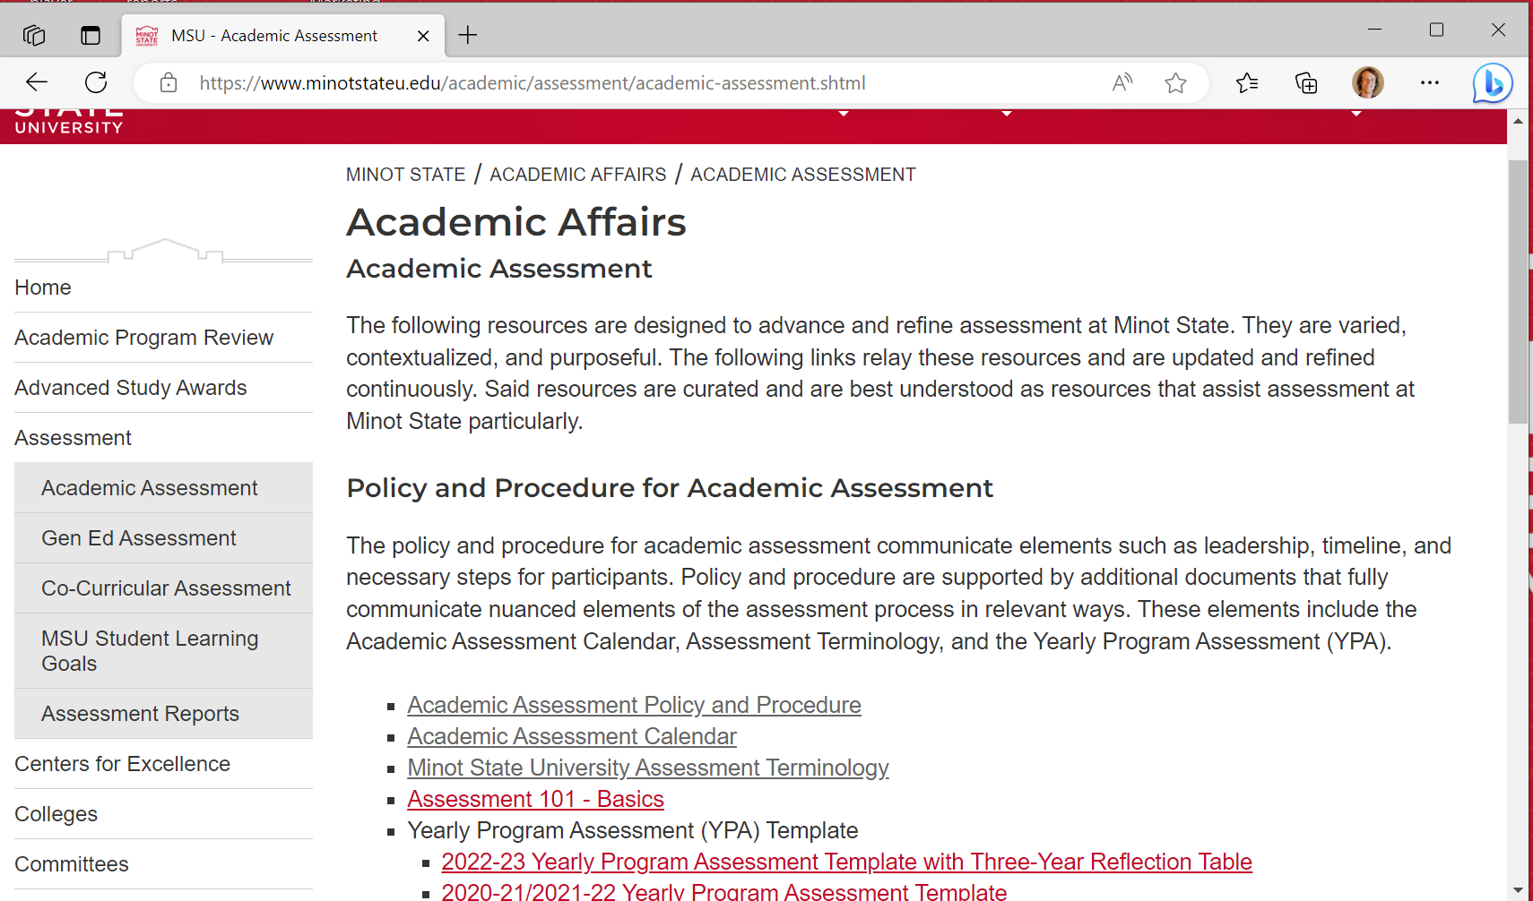
Go to the Academic Assessment page. Scroll down.

Slide 19
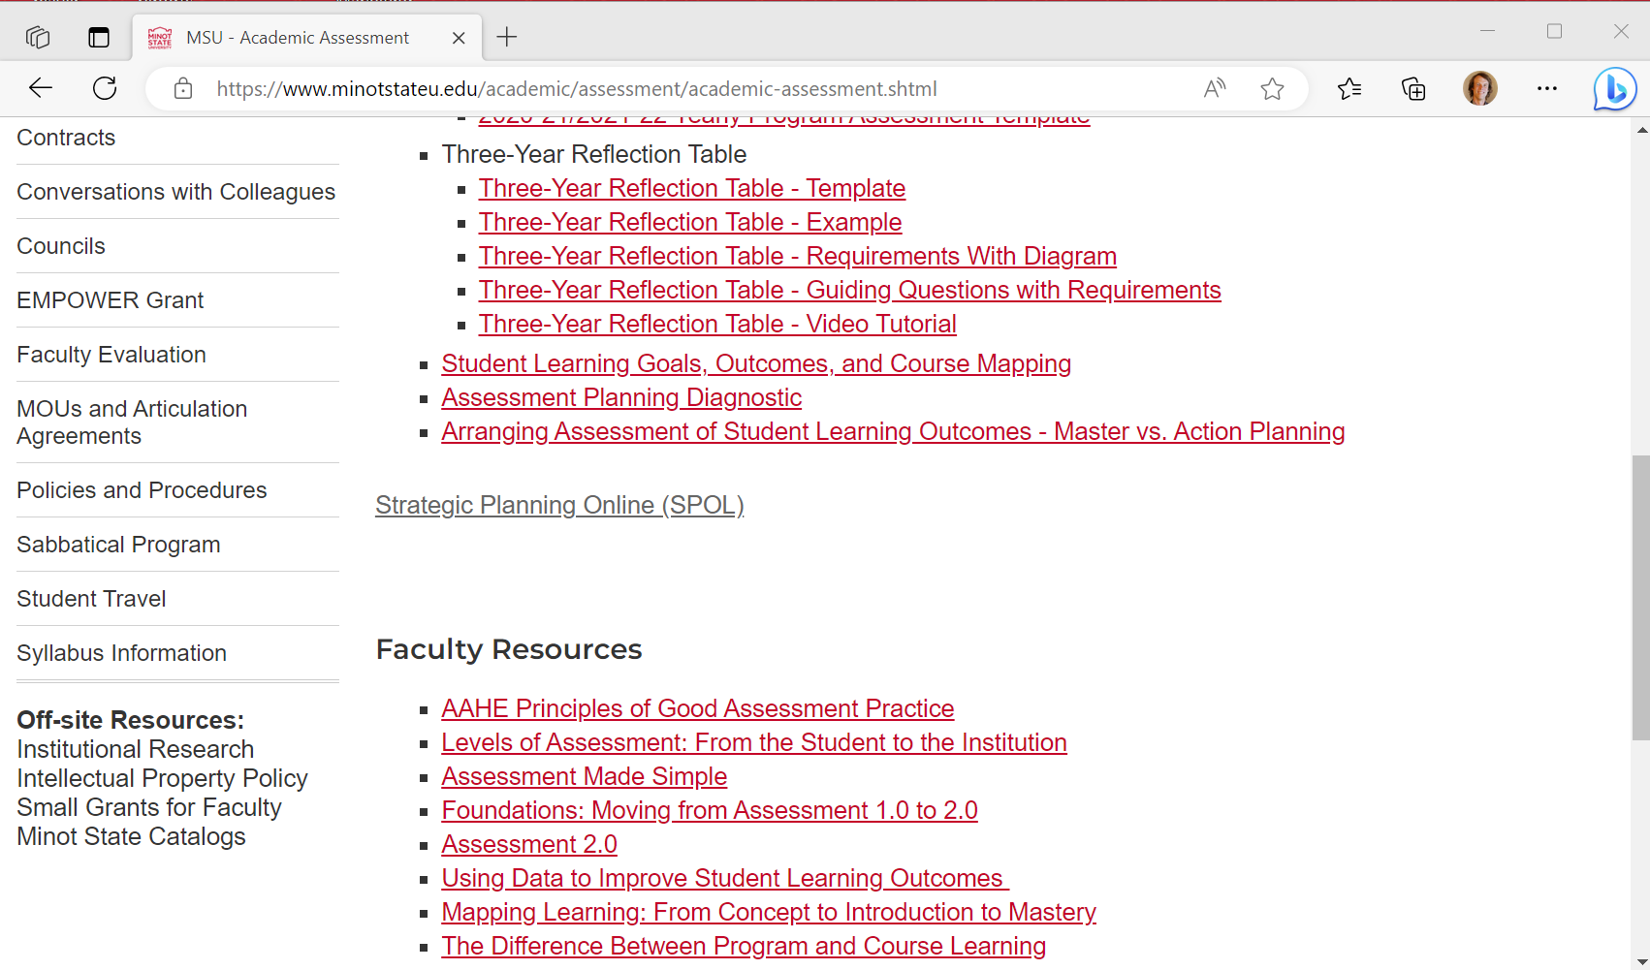
Click Strategic Planning Online (SPOL)

Slide 20
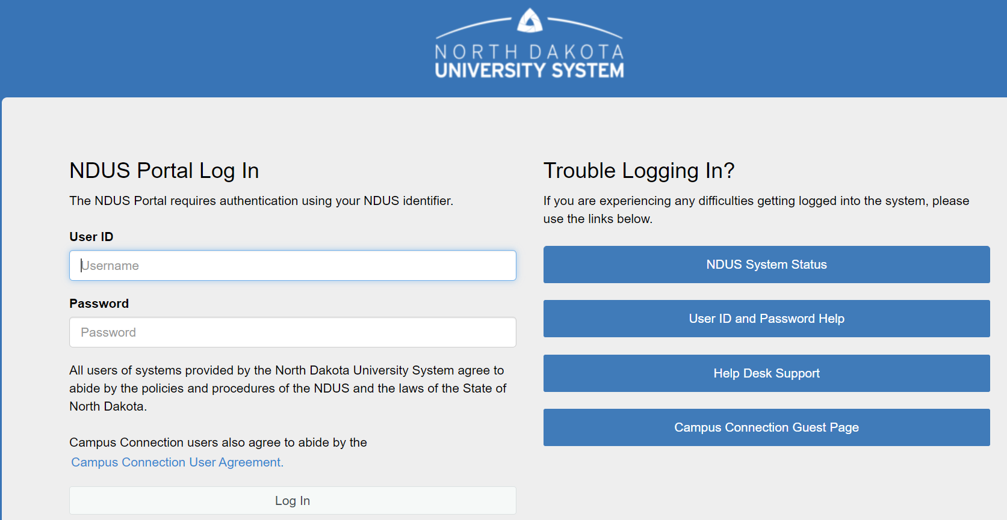
Log In with your NDUS User ID and Password

Slide 21
Write a Mission Statement

Slide 23
Definition
Mission Statement
Describes a program's primary purpose, functions, and stakeholders served
Distinctly represents the program and is related to the institution
Notes:
A mission statement is a statement describing a program’s primary purpose, functions, and stakeholders served. The mission should distinctly represent the program and be related to the mission of the institution.

Slide 24
Key components
Component of Mission | Response
Name of the program
Purpose of the program (i.e., the reasons why it performs its operations)
Primary functions or activities of the program
Stakeholders served by the program (i.e., the stakeholders that are expected to participate in or otherwise benefit from the program)
Notes:
Key components of a mission statement include the name of the program, purpose of the program, primary activities or functions of the program, and stakeholders served by the program.

Slide 25
Template
The mission of the [NAME OF THE PROGRAM] program
is to [PURPOSE OF THE PROGRAM]
by providing [PRIMARY FUNCTIONS OR ACTIVITIES OF THE PROGRAM]
to [STAKEHOLDERS SERVED BY THE PROGRAM]
Notes:
Responses to the key components may be synthesized to formulate a mission statement using the following mission statement template. The mission of the (Name of the Program) program is to (purpose of the program) by providing (primary functions or activities of the program) to (stakeholders served by the program).

Slide 26
Key Components - Example
Component of Mission | Response
Name of the program | Fit for College
Purpose of the program (i.e., the reasons why it performs its operations) | prepare university students to improve or sustain their fitness for higher education
Primary functions or activities of the program | CP²R training and tools for facilitating reflection, assessment, goal setting, and action planning through lenses of capacity, passion, relevance, and presence
Stakeholders served by the program (i.e., the stakeholders that are expected to participate in or otherwise benefit from the program) | all incoming freshmen
Notes:
This table depicts an example of how a hypothetical co-curricular program, Fit for College, addresses the key components of a mission statement.

Slide 27
Mission Statement Example
The mission of the Fit for College program is to prepare university students to improve or sustain their fitness for higher education by providing CP²R training and tools for facilitating reflection, assessment, goal setting, and action planning through lenses of capacity, passion, relevance, and presence to all incoming freshmen.
Notes:
Here is a sample mission statement for the hypothetical Fit for College program based on the mission statement template. The mission of the Fit for College program is to prepare university students to improve or sustain their fitness for higher education by providing CP2R training and tools for facilitating reflection, assessment, goal setting, and action planning through lenses of capacity, passion, relevance, and presence to all incoming freshmen.

Slide 28
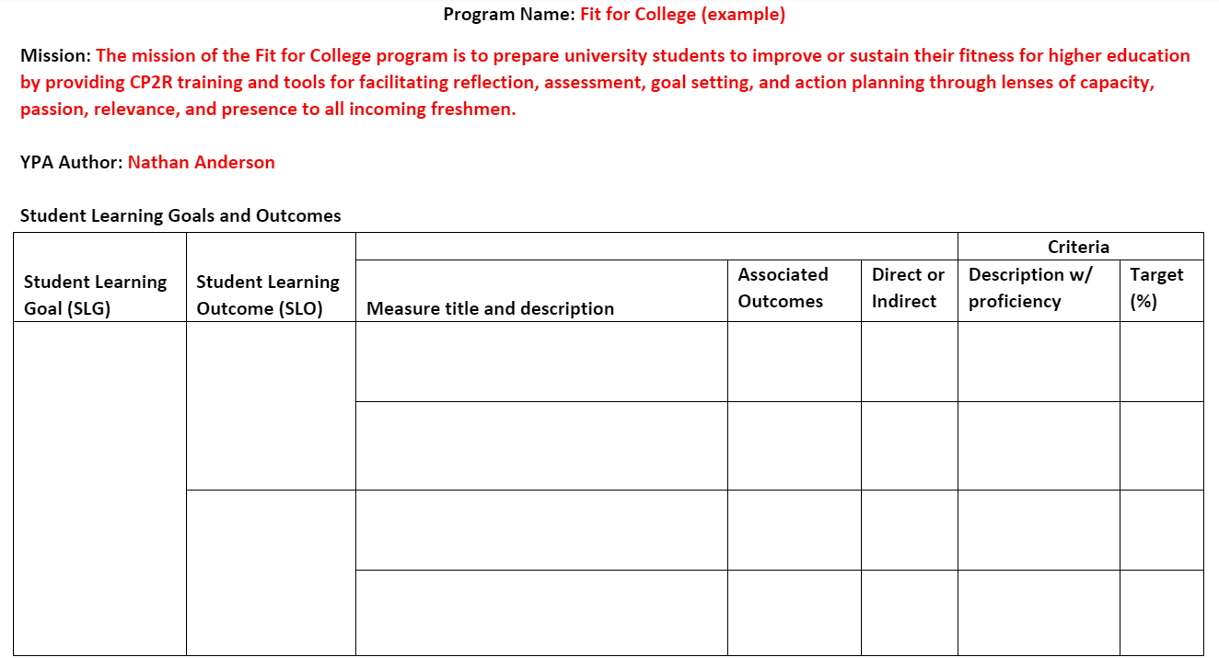
Notes:
Here is the sample mission statement in the YPA plan template.

Slide 29
Write a Student Learning Goal (SLG)

Slide 31
Definition
Student Learning Goal (SLG)
General statement of learning that students are expected to achieve through participation in a program.
Bridge between mission and Student Learning Outcomes (SLOs)
Recommend 3-5 SLGs per program
Notes:
Student Learning Goals (SLGs) are general statements of learning that students are expected to achieve through participation in a program. They should be reflected in the curriculum and serve as a bridge between the program’s broad mission statement and its more detailed SLOs. Each SLG should subsume at least one SLO. Since the mission of the program should support the mission of the institution, the program-level SLGs should naturally also support the institution’s mission. To keep assessment manageable, each program is advised to have around three to five SLGs (e.g., Appalachian State University, n.d.; COBA, 2019; Los Positas Community College, 2016; Peregrine Pathways, 2022). There are no strict rules on the number of SLGs that a program should assess, however, and a program may determine that more or fewer goals would be appropriate to assess annually and report on their YPA.

Slide 32
Key components
Component of SLG | Response
SLG number
Learner description
Observable action verb
Statement of learning to be demonstrated
Notes:
Key components of an SLG include an SLG number, learner description, observable action verb, and statement of learning to be demonstrated

Slide 33
Bloom's Taxonomy Action Verbs
One observable action verb per SLG
Examples
  Identify, select, define, describe, explain, summarize, review, compute, demonstrate, apply, write, analyze, solve, create, design, compose, synthesize, tell, recommend, defend, judge
Notes:
Each SLG should include only one observable action verb. Programs are encouraged to choose action verbs for their SLGs based on Bloom’s Taxonomy of Educational Objectives (Anderson & Krathwohl, 2001; Bloom, 1956). A few of the many action verbs that programs may choose from when they write SLGs include identify, select, define, describe, explain, summarize, review, compute, demonstrate, apply, write, analyze, solve, create, design, compose, synthesize, tell, recommend, defend, judge. Programs may use other action verbs for their SLGs that are not listed here.

Slide 34
Template
[SLG NUMBER]:
[LEARNER DESCRIPTION] will
[OBSERVABLE ACTION VERB]
[STATEMENT OF LEARNING TO BE DEMONSTRATED]
Notes:
Responses to the key components may be synthesized into an SLG statement using the following template. (SLG Number): (Learner description) will (observable action verb) (statement of learning to be demonstrated)

Slide 35
Key Components - Example
Component of SLG | Response ​
SLG number​ ​ | ​SLG 2
Learner description​ ​ | ​Students ​
Observable action verb​ | ​explore ​
Statement of learning to be demonstrated​ | ​areas of their fitness for their role as a college student ​
Notes:
This table depicts an example of how the hypothetical Fit for College addresses the key components of an SLG.

Slide 36
SLG Example
SLG 2: Students will explore areas of their fitness for their roles as college students.
Notes:
Here is a sample SLG statement for the hypothetical Fit for College program based on the SLG template. SLG 2: Students will explore areas of their fitness for their roles as college students.

Slide 37
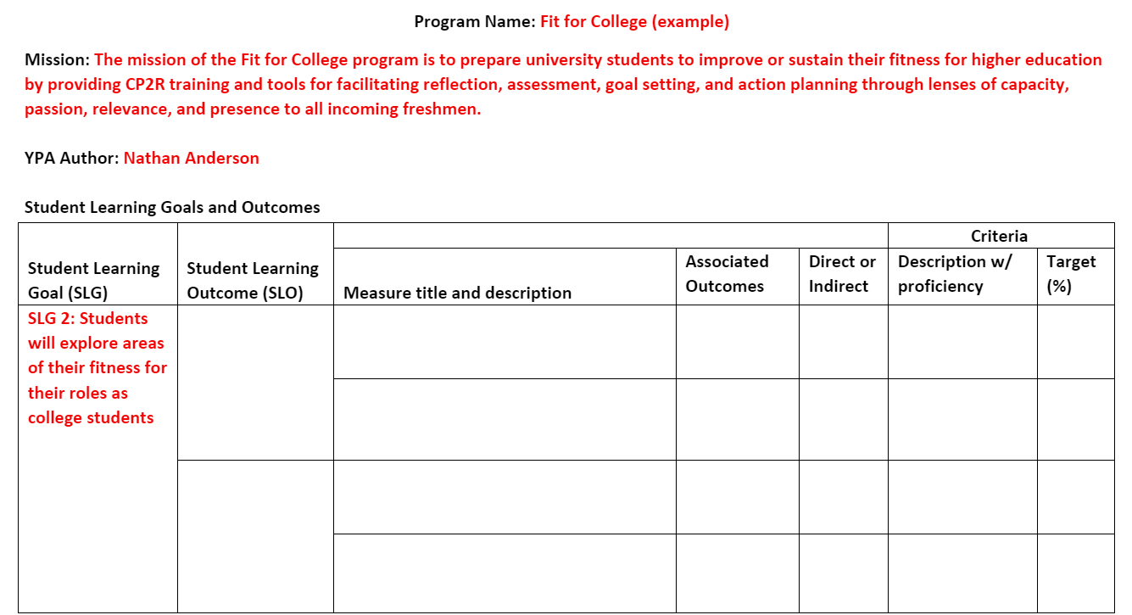
Notes:
Here is the sample SLG in the YPA plan template

Slide 38
Write a Student Learning Outcome (SLO)

Slide 40
Definition
SLO
Specific statement of the knowledge, skills, values, or other attributes that students are expected to demonstrate by the time that they complete a program
Detailed representation of a generally stated SLG
Recommend 2-4 SLOs per SLG
Notes:
Student learning outcomes (SLOs) are specific statements of the knowledge, skills, values, or other attributes that students are expected to demonstrate by the time that they complete a program. A specifically stated SLO is a more detailed representation of a generally stated SLG. To reinforce the theme of keeping assessment manageable, each SLG should have around two to four SLOs, which is in line with guidelines from other institutions and organizations (e.g., Appalachian State University, n.d.; College of Business Administration [COBA], 2019; Los Positas Community College, 2016; Peregrine Pathways, 2022); however, there are no strict rules on the number of SLOs that a program should assess. A program may determine that more or fewer outcomes would be appropriate to assess annually and report on the YPA. A single SLG may subsume multiple SLOs, and a single SLO may subsume multiple measures

Slide 41
Key components
Component of SLO | Response
SLO number
Learner description
Observable action verb
Statement of learning to be demonstrated
Notes:
Key components of an SLO mirror the key components of an SLG. They include an SLO number, learner description, an observable action verb, and a statement of learning to be demonstrated

Slide 42
Bloom's Taxonomy Action Verbs
One observable action verb per SLO
Examples
  Identify, select, define, describe, explain, summarize, review, compute, demonstrate, apply, write, analyze, solve, create, design, compose, synthesize, tell, recommend, defend, judge
Notes:
As with SLGs, each SLO should include only one observable action verb based on Bloom’s Taxonomy of Educational Objectives (Anderson & Krathwohl, 2001; Bloom, 1956).

Slide 43
Template
[SLO NUMBER]:​
[LEARNER DESCRIPTION] will​
[OBSERVABLE ACTION VERB]​
[STATEMENT OF LEARNING TO BE DEMONSTRATED]​
Notes:
Responses to the key components may be synthesized into an SLO statement using a template like the one that is utilized for writing an SLG statement, as follows:
(SLO Number): (Learner description) will (observable action verb) (statement of learning to be demonstrated)

Slide 44
Key Components - Example
Component of SLO | Response ​
SLO number | SLO 2.1
Learner description | ​Students
Observable action verb | ​examine
Statement of learning to be demonstrated | ​the ways in which they perceive themselves to be fit for their roles as college students through various domains of holistic fitness
Notes:
This table depicts an example of how the hypothetical Fit for College addresses the key components of an SLO

Slide 45
SLO Example
SLO 2.1: Students will examine the ways in which they perceive themselves to be fit for their roles as college students through various domains of holistic fitness.
Notes:
Here is a sample SLO statement for the hypothetical Fit for College program based on the SLO template. SLO 2.1: Students will examine the ways in which they perceive themselves to be fit for their roles as college students through various domains of holistic fitness.

Slide 46
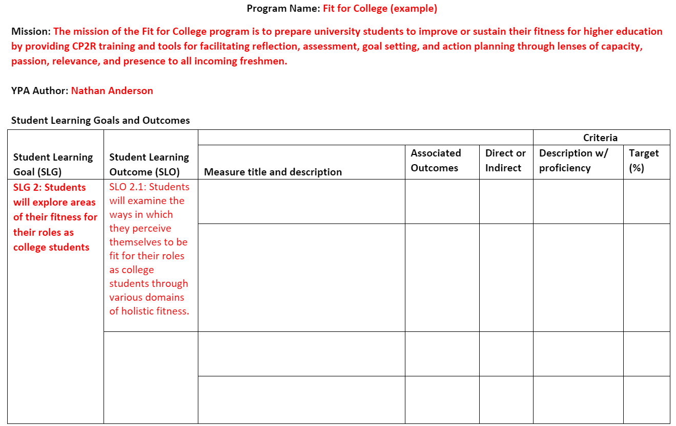
Notes:
Here is the sample SLO in the YPA plan template

Slide 47
Describe a Measure of an SLO

Slide 49
Definition
Measure
A tool, methodology, activity or other means of assessing an outcome
At least 1 measure per outcome
At least 1 set of criteria per measure
Notes:
A measure is “a tool, methodology, activity or other means of assessing an outcome” (SPOL, 2021, p. 39). Each SLO should subsume at least one measure, and each measure should subsume at least one set of criteria.

Slide 50
Direct or Indirect
Direct: a means of assessing a student learning outcome that requires students to demonstrate their learning
  e.g., standardized exams, locally developed exams, oral exams, essays/reports, performances/recitals, clinicals/practicums, presentations, portfolios, capstone projects, and simulations
Indirect: means of assessing a student learning outcome that requires students to report, describe, or reflect on their learning.
  e.g., surveys, questionnaires, interviews, and focus groups
Notes:
A measure may be classified as direct or indirect. A direct measure of student learning is a means of assessing a student learning outcome that requires students to demonstrate their learning. Examples of types of direct measures include standardized exams, locally developed exams, oral exams, essays/reports, performances/recitals, clinicals/practicums, presentations, portfolios, capstone projects, and simulations. An indirect measure of student learning is a means of assessing a student learning outcome that requires students to report, describe, or reflect on their learning. Examples of types of indirect measure types include surveys, questionnaires, interviews, and focus groups.

Slide 51
Key components
Component of Measure | Response
Measure number
Title
Type
Course or setting
Description
Notes:
Key components of a measure include a title, a type, an indication of whether it is direct or indirect, one or more associated courses or settings where the measure is administered, and a description (Figure 13). The description of the measure should describe the instrument that is utilized to collect data, the time frame when it is implemented, and the personnel involved.

Slide 52
Key Components - Example
Component of SLO | Response ​
Measure number | 2.1.1
Title | ​Fit for College Reflection Rubric
Type | ​Direct
Course or setting | Session 2 of 3
Description | Students write responses to reflective prompts regarding their fitness for their role as a college student after the second session of the program. They are prompted to reflect on the ways in which they perceive themselves to be fit for their role through domains of capacity, passion, relevance, and presence as well as strategies that they could implement to sustain or improve their fitness in those domains. Faculty use the Fit for College Reflection Rubric to rate students on each of the four domains on a scale from 1-4 (1=Beginning, 2=Developing, 3=Accomplished, 4=Exemplary). Each student is given a score of 1-4 for each of the four domains.
Notes:
This table depicts an example of how the hypothetical Fit for College program addresses the key components of a measure

Slide 53
Associations
May be associated with more than one outcome in one or more programs
Examples of associations in academic programs
  Academic program SLO
  General education SLO
  Institutional-level academic SLO
Examples of associations in co-curricular programs
  Co-curricular program SLO
  Institutional-level co-curricular SLO
Notes:
A measure may be associated with more than one outcome in one or more programs. For example, a measure of an outcome in an academic program may simultaneously serve as a measure of the academic program outcome, a relevant General Education outcome, and a relevant institutional-level student learning outcome. A measure of an outcome in a co-curricular program may simultaneously serve as a measure of the co-curricular program outcome a relevant institutional-level co-curricular student learning outcome.

Slide 54
Associations - Example
Measure 2.1.1 Fit for College Reflection Rubric
Program name | Fit for College | MiSU Co-Curricular Learning
Outcome level | Program | Institutional
Outcome statement | SLO 2.1: Students will examine the ways in which they perceive themselves to be fit for their roles as college students through various domains of holistic fitness. | SLO 3.3 Students will reflect on their emotional and situational adaptivity
Notes:
This table depicts an example of how the hypothetical Fit for College measure 2.1.1, Fit for College Rubric, serves as a measure of the Fit for College program-level outcome 2.1, students will examine the ways in which they perceive themselves to be fit for their roles as college students through various domains of holistic wellness, and the institutional-level co-curricular outcome 3.3, students will reflect on their emotional and situational adaptivity.

Slide 55
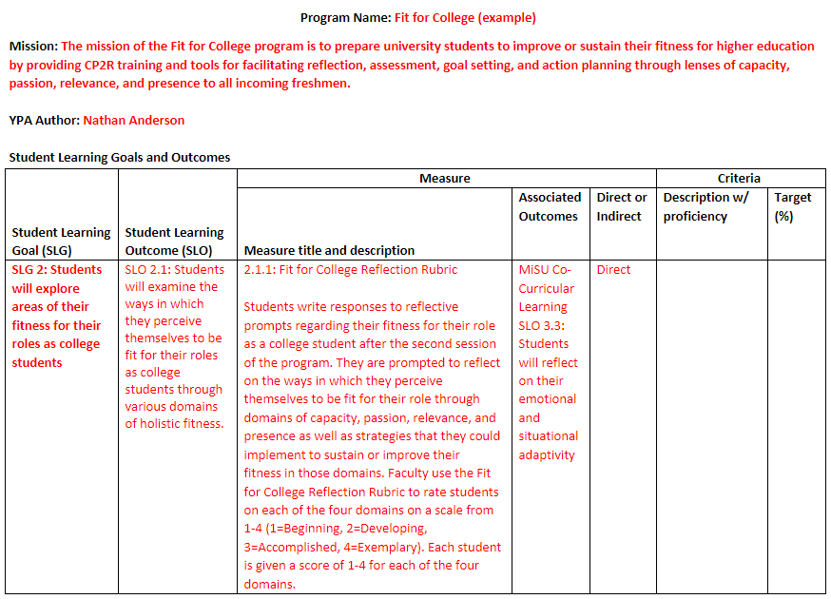
Notes:
Here is the sample measure in the YPA plan template

Slide 56
Describe Criteria for Success on a Measure

Slide 58
Definition
Criteria
Methods of reporting student learning assessment data
At least 1 set of criteria per measure
At least 1 finding per set of criteria
Notes:
Criteria for a student learning outcome are methods of reporting student learning assessment data (SPOL, 2021). Each measure should subsume at least one set of criteria (Figure 3), and each set of criteria should subsume at least one finding.

Slide 59
Key components
Component of Criteria | Response
Criteria number
Title
Proficiency
Target %
Notes:
Key components of criteria for a student learning outcome include a criteria number, title, proficiency, and a target percentage (Figure 16). If a measure has multiple sets of criteria, it would be plausible for a student to meet the minimum performance level for success on one set of criteria but to not meet the proficiency requirement for another set of criteria.

Slide 60
Proficiency
Minimum performance required on a measure to represent achievement of an SLO
Notes:
Proficiency represents the minimum performance required on a measure to represent successful achievement of an SLO. If a measure has multiple sets of criteria, it would be plausible for a student to meet the minimum performance level for success on one set of criteria but to not meet the proficiency requirement for another set of criteria.

Slide 61
Target
Future quantitative value that is expected to be achieved on a measure as a point of reference for a program to evaluate or judge its own performance
Expressed as a percentage of students
Examples of how a program may set targets
  Use its own historic performance data
  Use performance data from another comparable or exemplary program
Notes:
The target component of a set of criteria is a future quantitative value that is expected to be achieved on a measure as a point of reference for a program to evaluate or judge its own performance. A program may use its own past performance data or data from another comparable or exemplary program as a benchmark against which to compare future data/performance. A target for a student learning outcome is a future value expressed as a percentage of students that are expected to achieve proficiency on a measure (e.g., COBA, 2019; SPOL, 2021). A target percentage is established for each set of criteria.

Slide 62
Key Components - Example
Component of SLO | Response ​
Criteria number | 2.1.1.1
Title | Capacity
Proficiency | 3 Accomplished
Target % | 80%
Notes:
This table depicts an example of how the hypothetical Fit for College program addresses the key components of criteria. In this example, the minimum performance level required for success (i.e., proficiency) for the set of criteria under measure 2.1.1 is 3 Accomplished. Therefore, if a student is rated 3 Accomplished or 4 Exemplary on the Capacity (2.1.1.1) item, then they are counted as meeting the minimum performance level for success on the measure. If a student is rated 2 Developing or 1 Beginning on the item, then they are counted as not meeting the minimum performance level for success on the measure.

Slide 63
Target Statement
Combine key components of a set of criteria with key components of its respective measure and SLO
  Criteria: percentage, proficiency level, title
  Measure: title, course or setting
  SLO: learner description, observable action verb, statement of learning to be demonstrated
Notes:
Target statements may be written by combining the target and proficiency components of a set of criteria with applicable components of its respective measure and outcome. The key components of a target statement include the target percentage, proficiency level, and title components of the criteria; the title and course or setting components of the measure; and the learner description, observable action verb, and statement of learning to be demonstrated components of an SLO

Slide 64
Target Statement – Template
(Target percentage) of (Learner description) will show proficiency of their ability to (observable action verb) (statement of learning to be demonstrated) by scoring (Proficiency) or higher on the (criteria title) criteria of the (type) measure, (Measure Title), which is implemented in (course or setting).
Notes:
Responses to the key components of a set of criteria, measure, and SLO may be synthesized into a target statement using the following target statement for a student learning outcome template:
(Target percentage) of (Learner description) will show proficiency of their ability to (observable action verb) (statement of learning to be demonstrated) by scoring (Proficiency) or higher on the (criteria title) criteria of the (type) measure, (Measure Title), which is implemented in (course or setting).

Slide 65
Target Statement – Example
80% of students will show proficiency of their ability to examine the ways in which they perceive themselves to be fit for their roles as college students through various domains of holistic fitness by scoring 3 Accomplished or higher on the instrument criteria of the direct measure, Fit for College Reflection Rubric, which is implemented in Session 2 of 3.
Notes:
Here is a sample target statement for Criteria 2.1.1.1 of the Fit for College program based on the target statement template.
80% of students will show proficiency of their ability to examine the ways in which they perceive themselves to be fit for their roles as college students through various domains of holistic fitness by scoring 3 Accomplished or higher on the instrument criteria of the direct measure, Fit for College Reflection Rubric, which is implemented in Session 2 of 3.

Slide 66
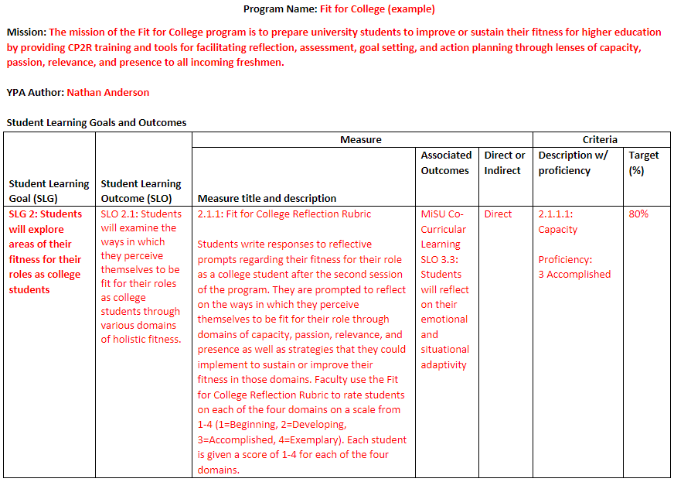
Notes:
Here is the sample set of criteria in the YPA plan template

Slide 67
Review of Objectives
Write a mission statement
Write a student learning goal (SLG)
Write a student learning outcome (SLO)
Describe a measure of an SLO
Describe criteria for success on a measure
Notes:
Here is a review of the objectives

Slide 68
Notes:
And how they relate to the YPA essential elements diagram

Slide 69
Thank You!

