Slide 1
Strategic Plan Training –
Report Outcome Findings in SPOL
Nathan Anderson
Director of Institutional Assessment
2023

Slide 2
Objectives
Identify quantitative indicators that are due for reporting
Translate strategic plan terminology to SPOL Assessment module terminology
Enter findings for quantitative indicators in SPOL

Slide 3
Target Audience
University leaders with the responsibility of reporting metrics for the quantitative indicators on MiSU Strategic Plan 2022-2025
VPAA, AVPAA, VPAF, VPSA, VPEMO, VPA
Prerequisite
Strategic plan indicators have been entered into the Assessment module in SPOL
Data are available in a suitable format for reporting in SPOL

Slide 4
Required Materials
Strategic Plan Dashboard
Strategic Planning Online (SPOL)

Slide 5
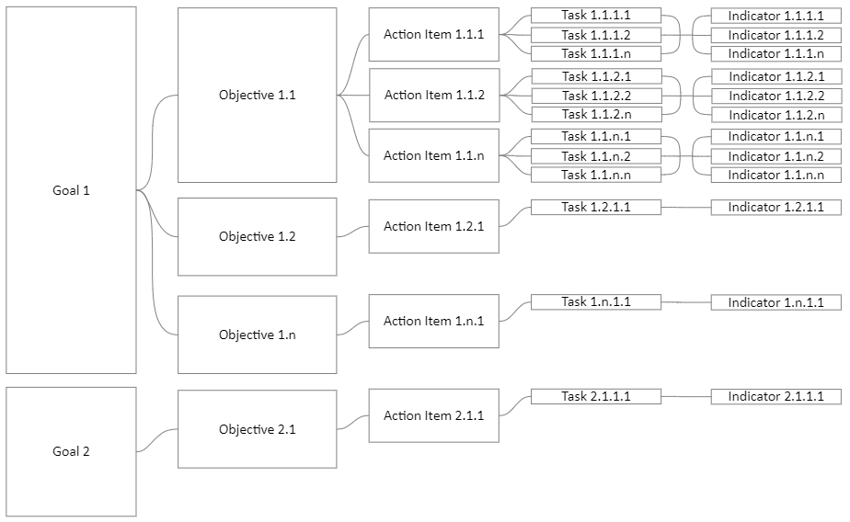
Strategic Plan Basic Structure
The guidance in these slides focuses on indicator-level reporting

Slide 6
How to Open the Strategic Plan Dashboard

Slide 7
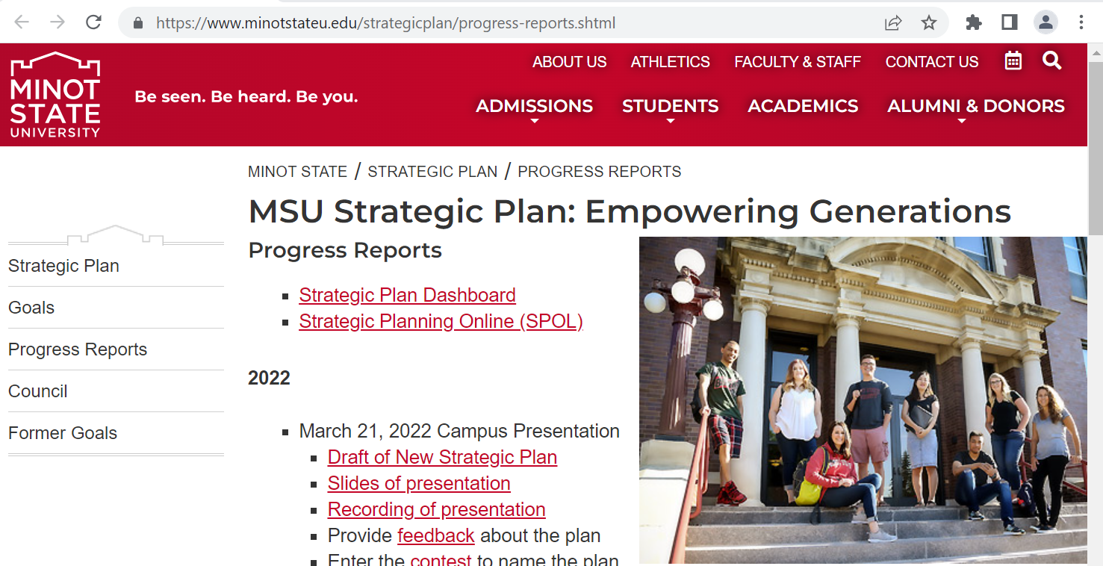
Go to the Strategic Plan Progress Reports page.
https://www.minotstateu.edu/strategicplan/progress-reports.shtml

Slide 8
Click Strategic Plan Dashboard

Slide 9
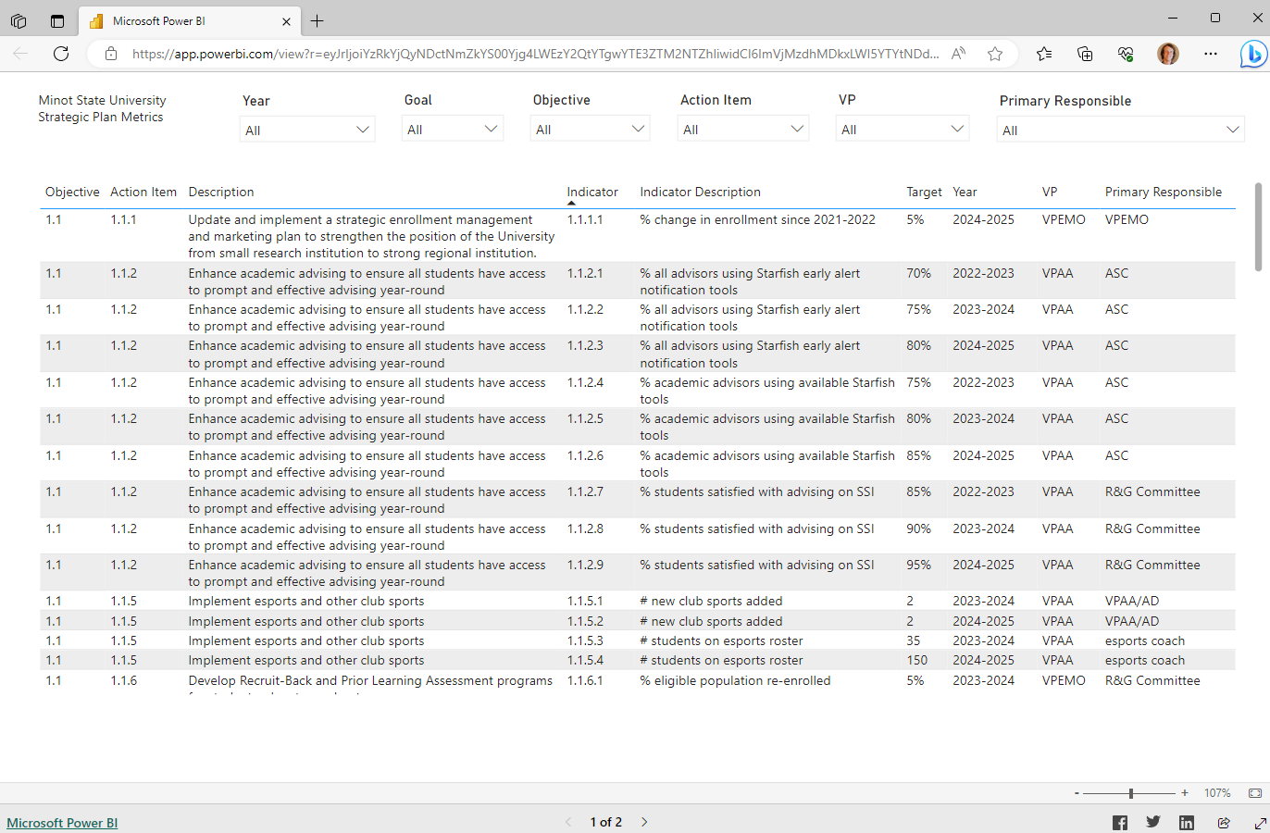
The Strategic Plan Dashboard displays

Slide 10
How to Log In to SPOL

Slide 11
Go to the Strategic Plan Progress Reports page.
https://www.minotstateu.edu/strategicplan/progress-reports.shtml

Slide 12
Click Strategic Planning Online (SPOL)

Slide 13
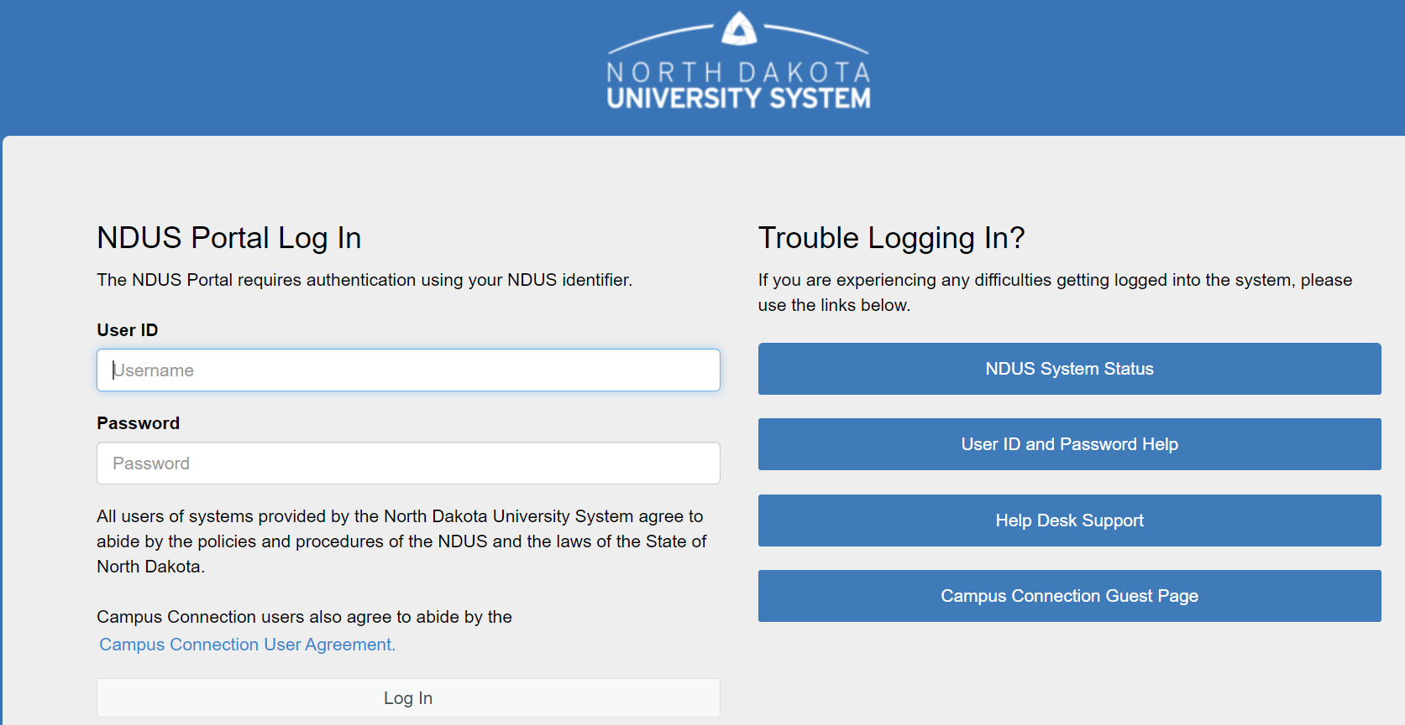
Log In with your NDUS User ID and Password

Slide 14
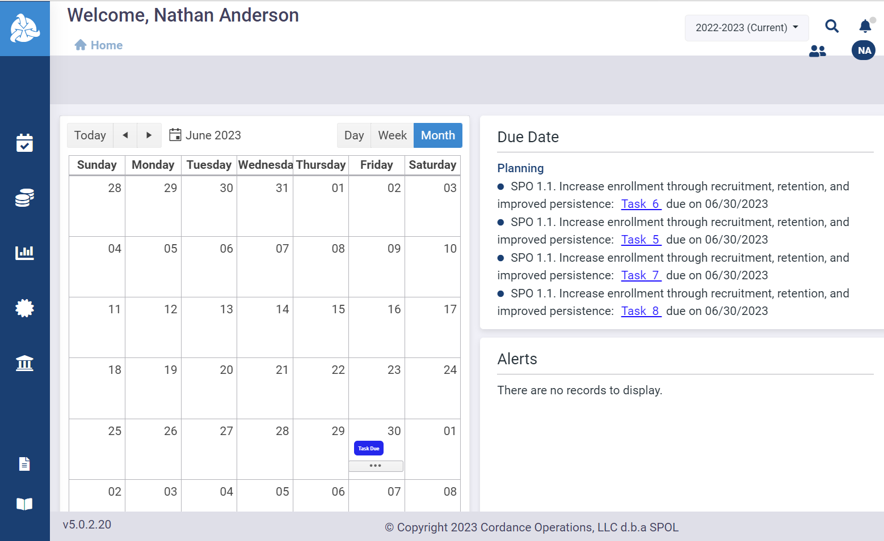
The SPOL Home page displays

Slide 15
Identify Quantitative Indicators That Are Due for Reporting

Slide 16
Open the Strategic Plan Dashboard

Slide 17
Go to page 1 (Strategic Plan Metrics)

Slide 18
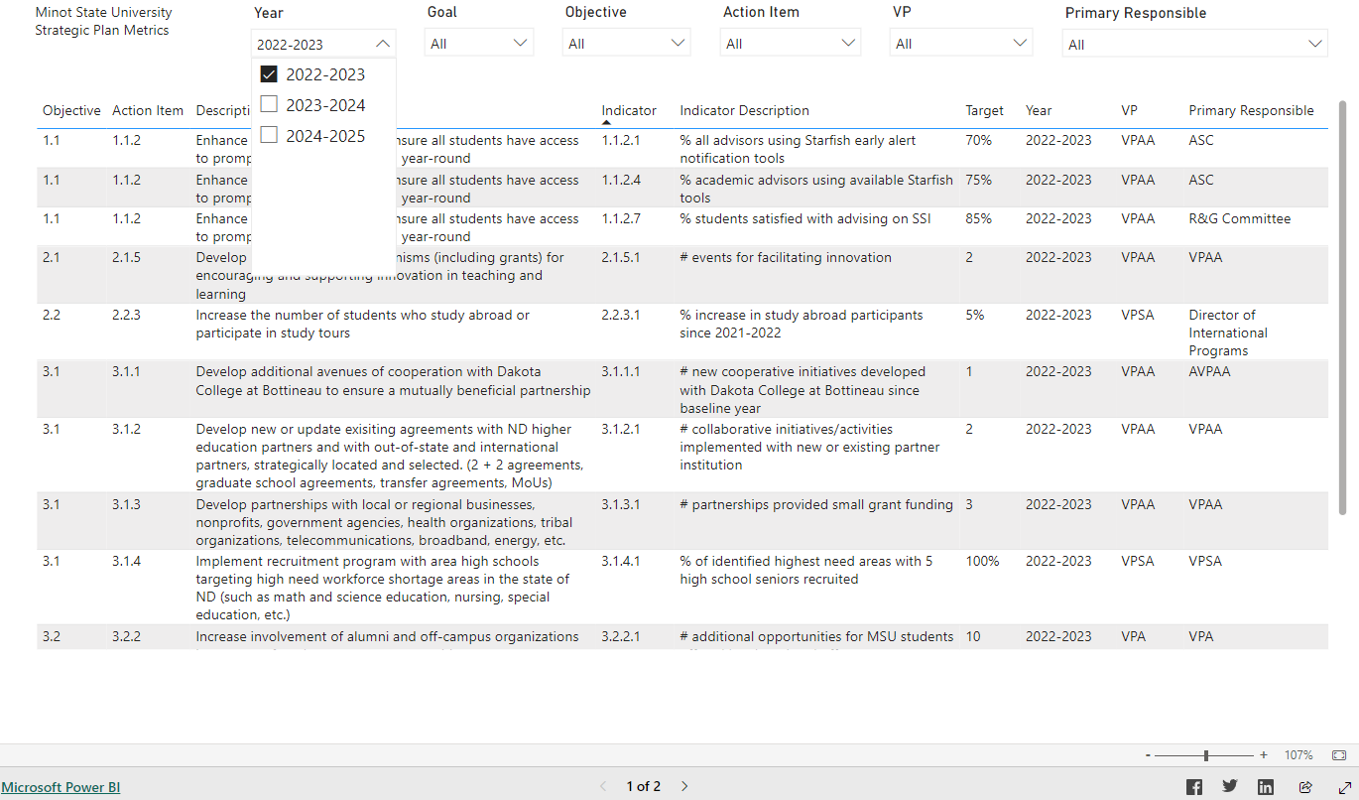
Select the academic year representing the timeframe of the quantitative indicators to be reported from the Year dropdown menu

Slide 19
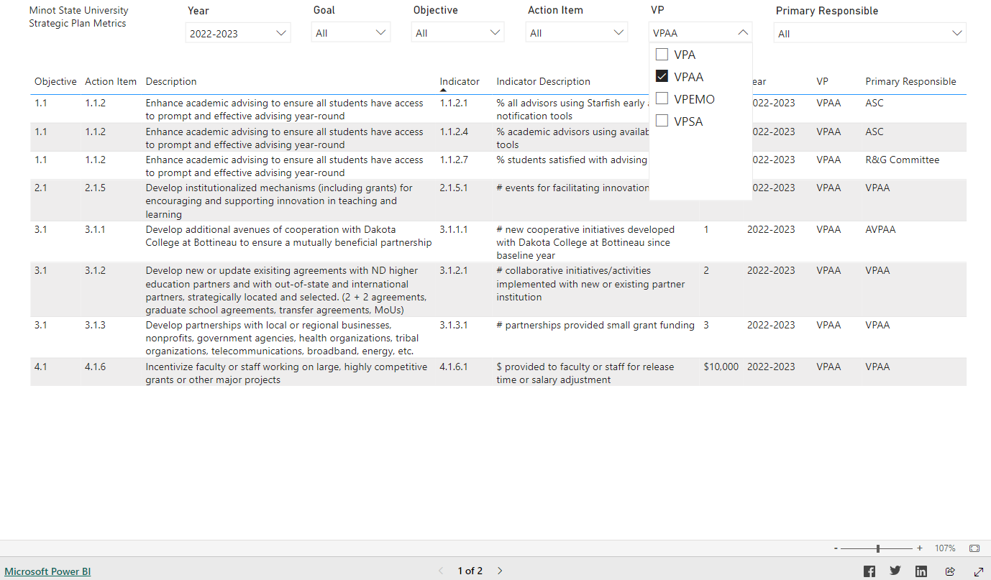
Select your role from the VP dropdown menu

Slide 20
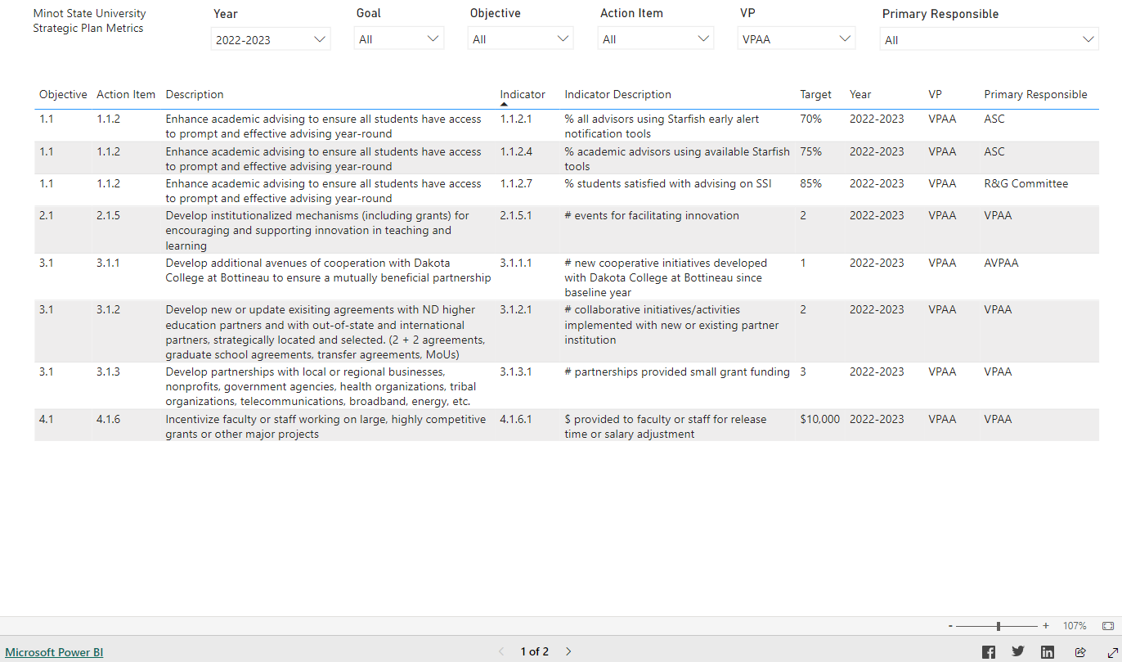
Your quantitative indicators that are due for reporting for the selected year are displayed.

Slide 21
Translate Strategic Plan Terminology to SPOL Assessment Module Terminology

Slide 22
The terminology in MiSU's Strategic Plan translates to the terminology in SPOL's Assessment Module as follows:
Numeric code format | Strategic Plan Terminology | SPOL Assessment Module Terminology
#.# | Objective | Program Outcome
#.#.# | Action Item | Measure
#.#.#.# | Indicator (Description, Target) | Criteria (Description, Target)

Slide 23
The 2-digit objective represents the 2-digit program outcome in SPOL. The 3-digit action item represents the 3-digit measure in SPOL. The 4-digit indicator represents the 4-digit critiera in SPOL.

Slide 24
Enter Findings for Quantitative Indicators
in SPOL

Slide 25
Open SPOL

Slide 26
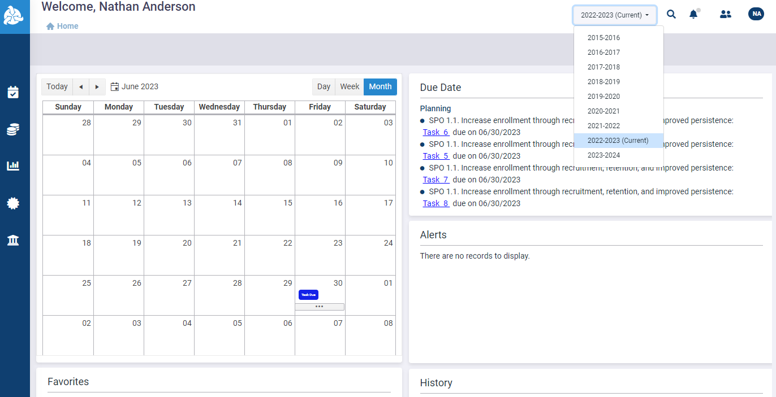
Select the desired year from the planning year dropdown menu in the upper right corner

Slide 27
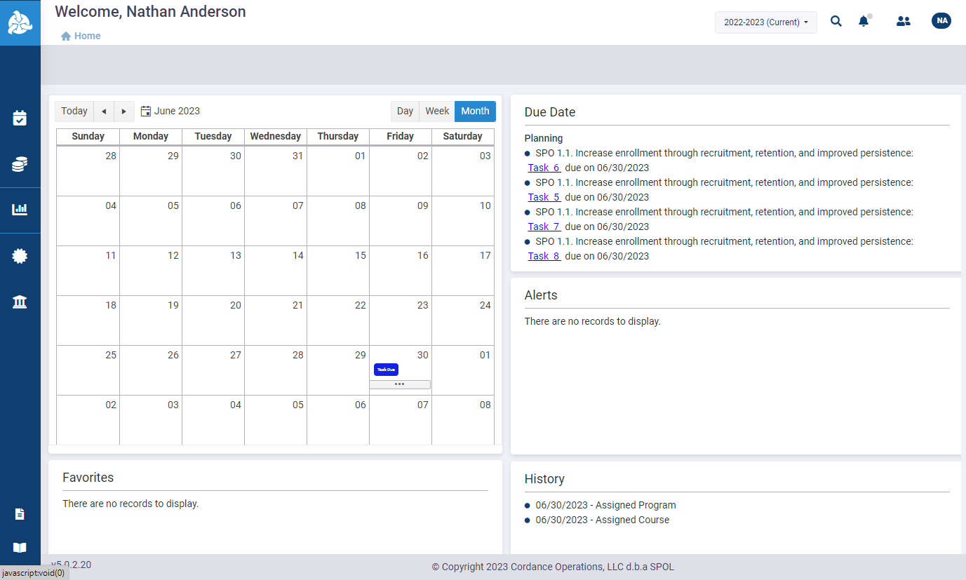
Click the Assessment icon in the left sidebar

Slide 28
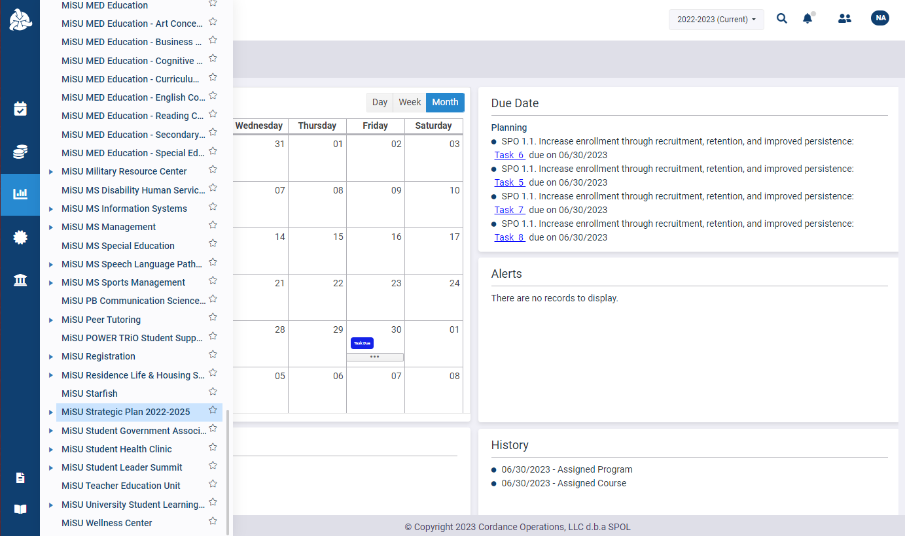
Click MiSU – Strategic Plan 2022-2025 in the expanded sidebar

Slide 29
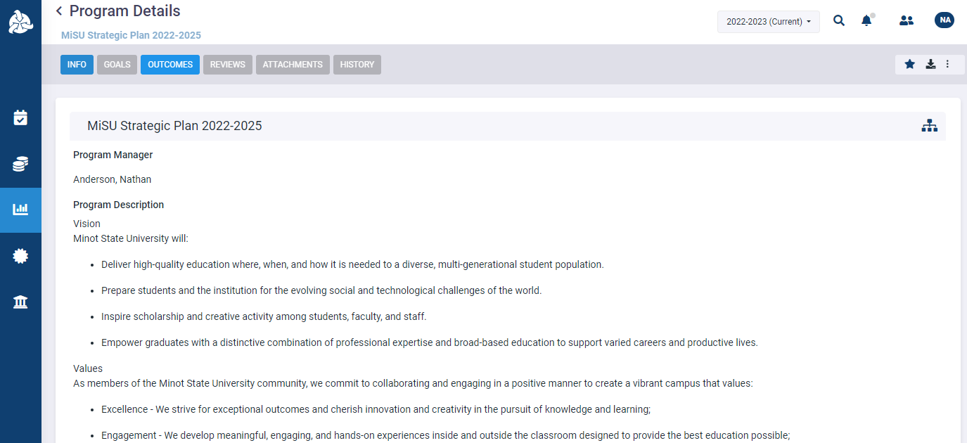
Click the Outcomes tab

Slide 30
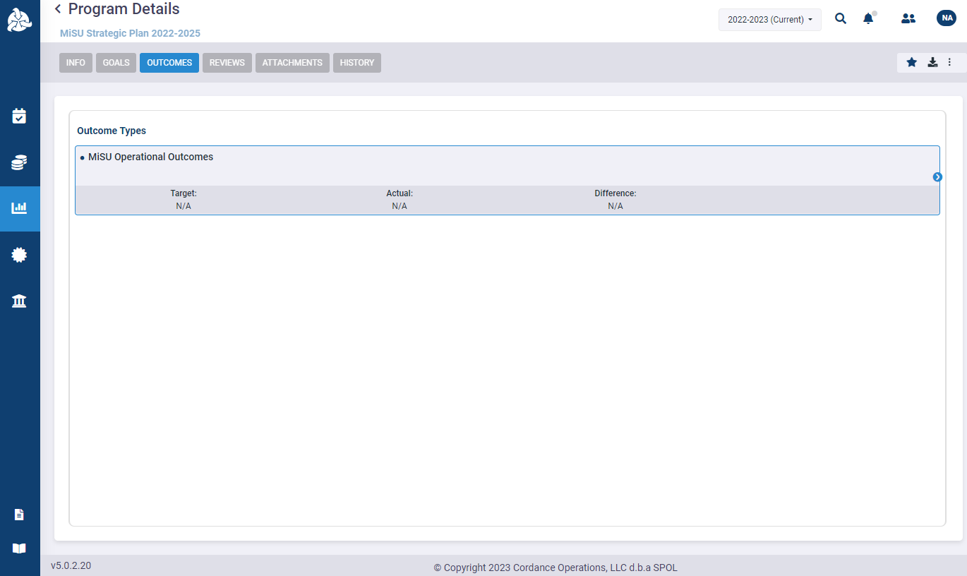
Hover over the MiSU Operational Outcomes outcome type. Click the blue arrow that appears on the right to open the Program Outcomes pane.

Slide 31
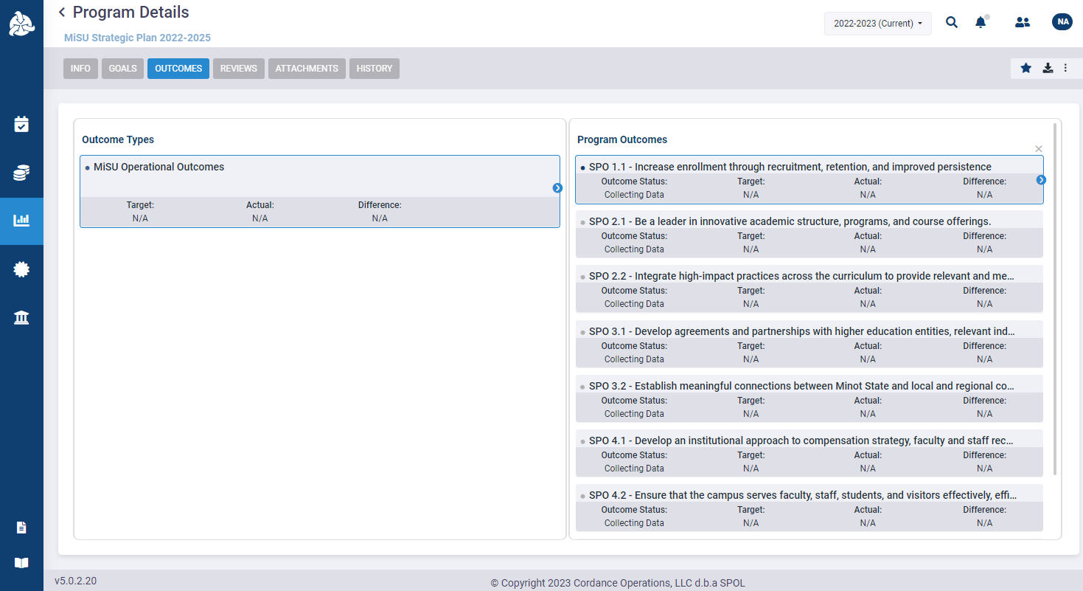
Hover over the desired Strategic Plan Objective (SPO). Click the blue arrow that appears on the right to open the Measures pane.

Slide 32
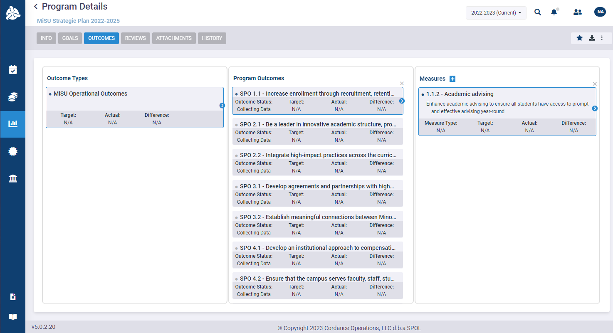
Hover over the desired Measure. Click the blue arrow that appears on the right to open the Criteria pane.

Slide 33
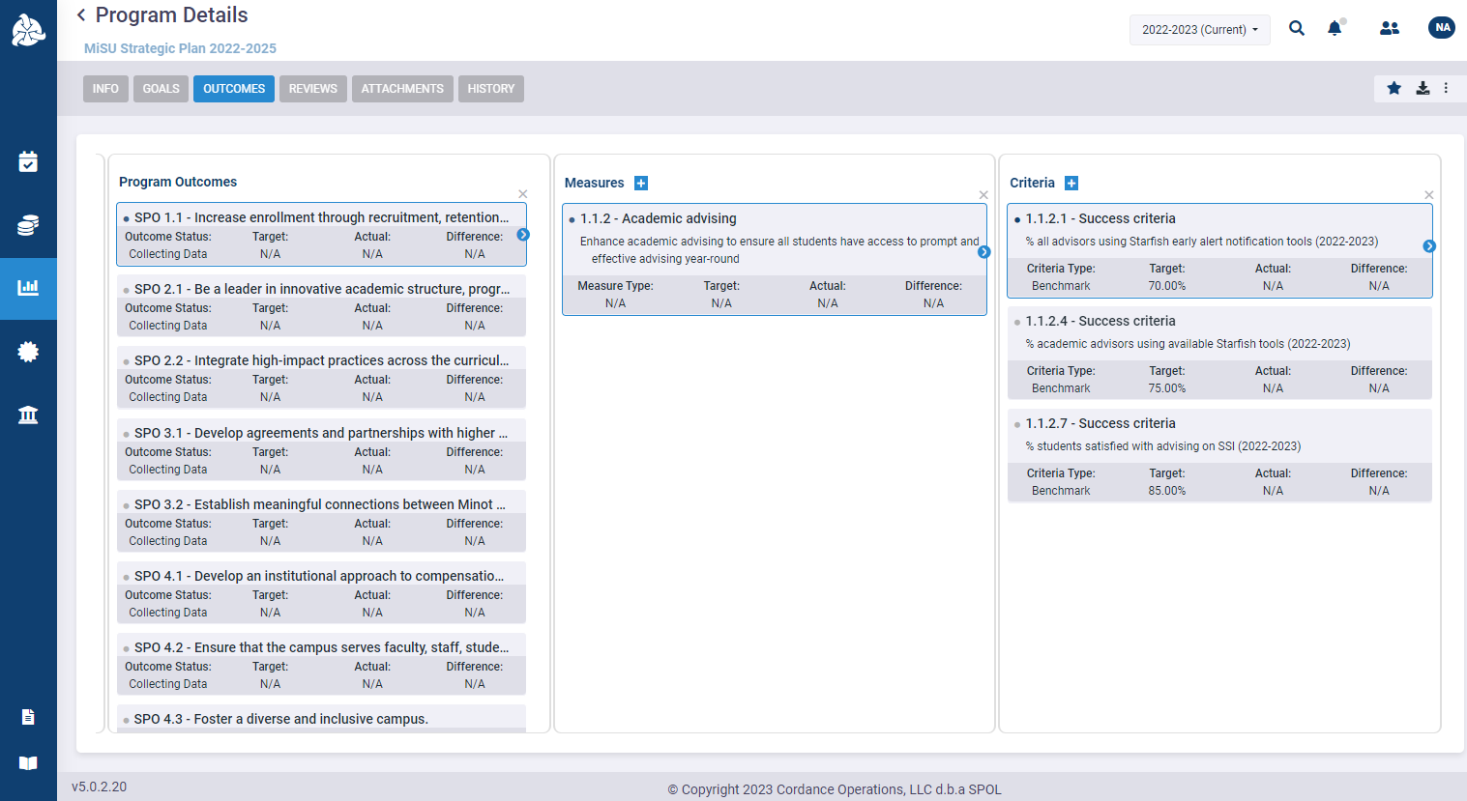
Hover over the desired Criteria. Click the blue arrow that appears on the right to open the Findings pane.

Slide 34
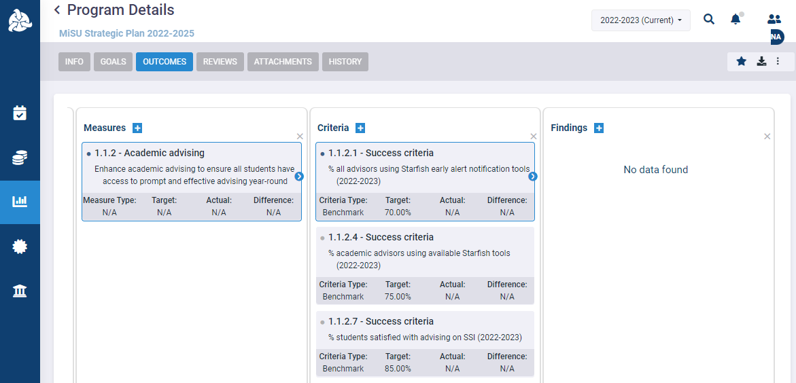
Click the plus (+) icon next to Findings to open the New Finding window.

Slide 35
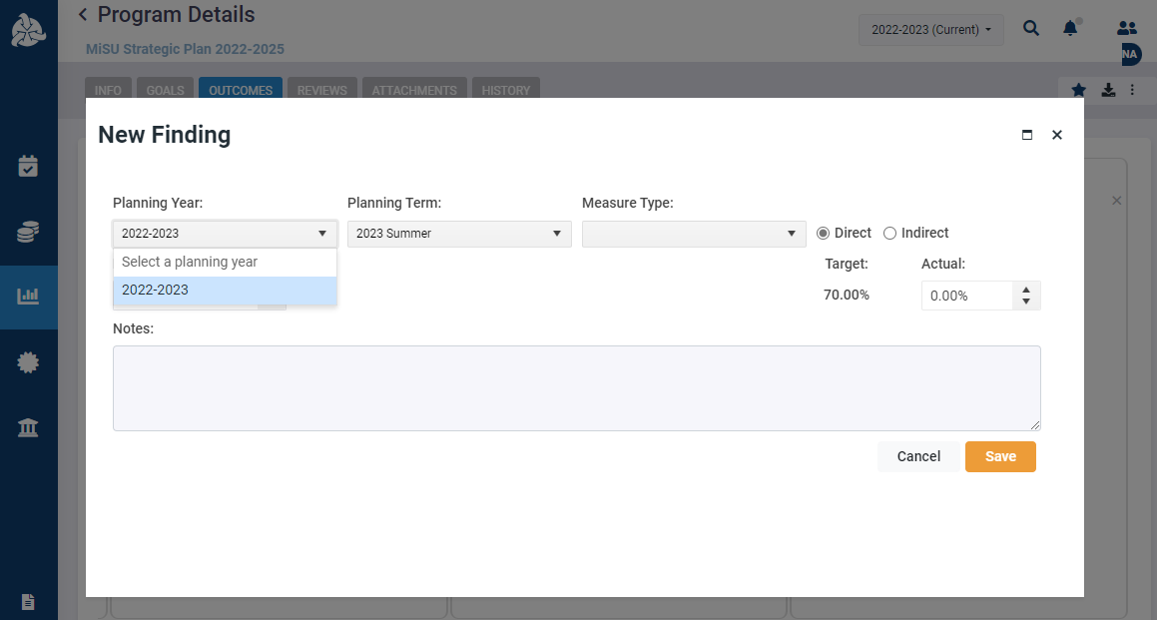
Select the desired Planning Year

Slide 36
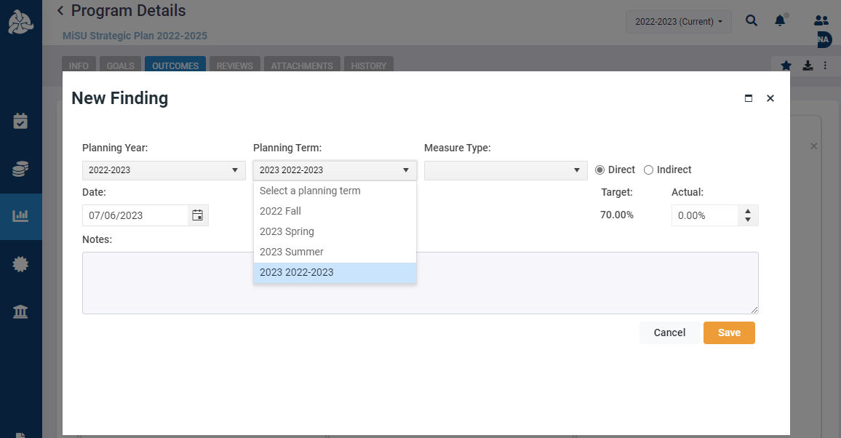
Select the Planning Term that represents the complete academic year

Slide 37
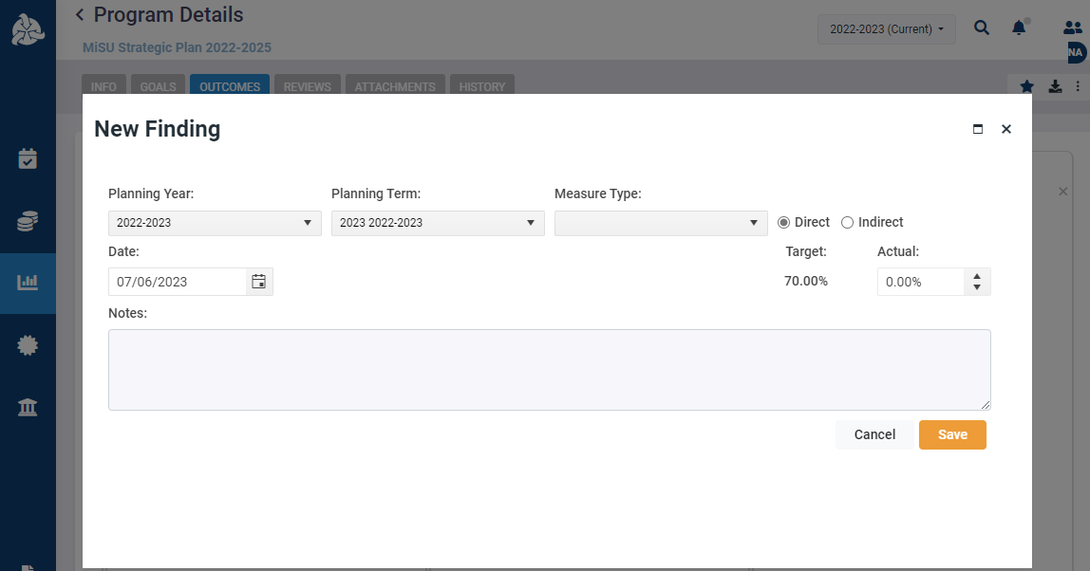
Select a Measure Type if desired

Slide 38
Mark whether the measure is Direct or Indirect

Slide 39
Enter the date that the finding is entered

Slide 40
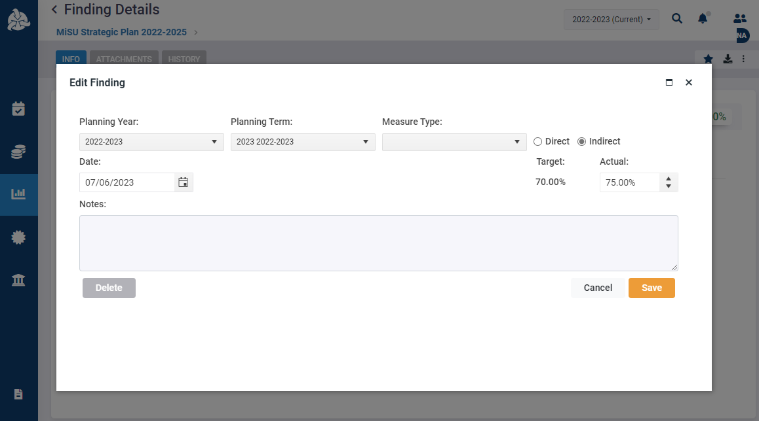
Enter the Actual value

Slide 41
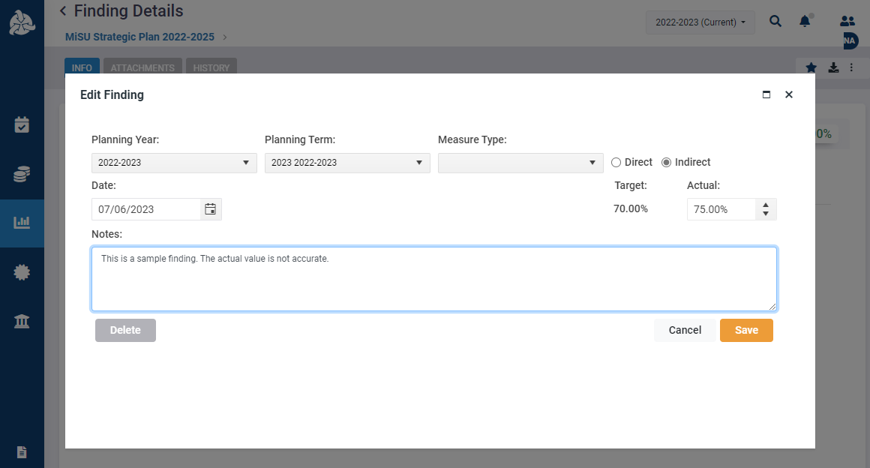
Enter Notes if desired

Slide 42
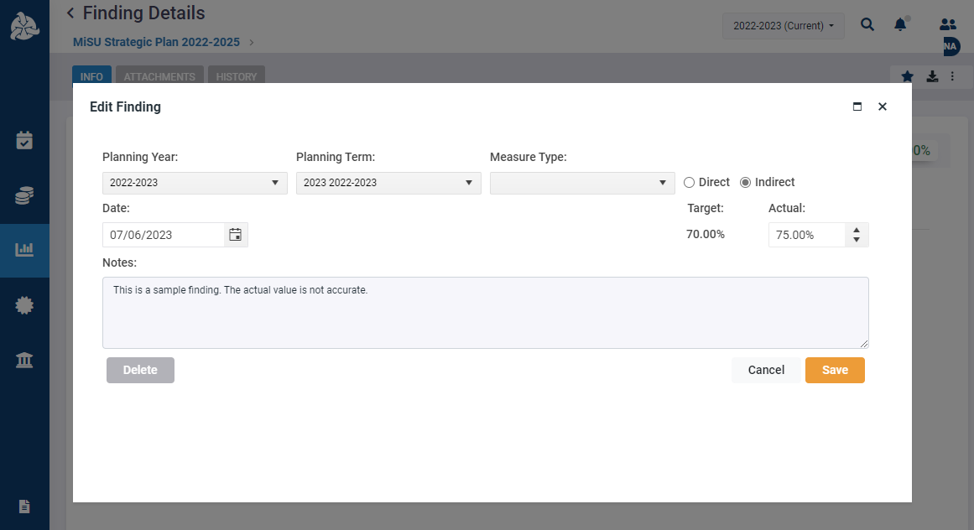
Click Save

Slide 43
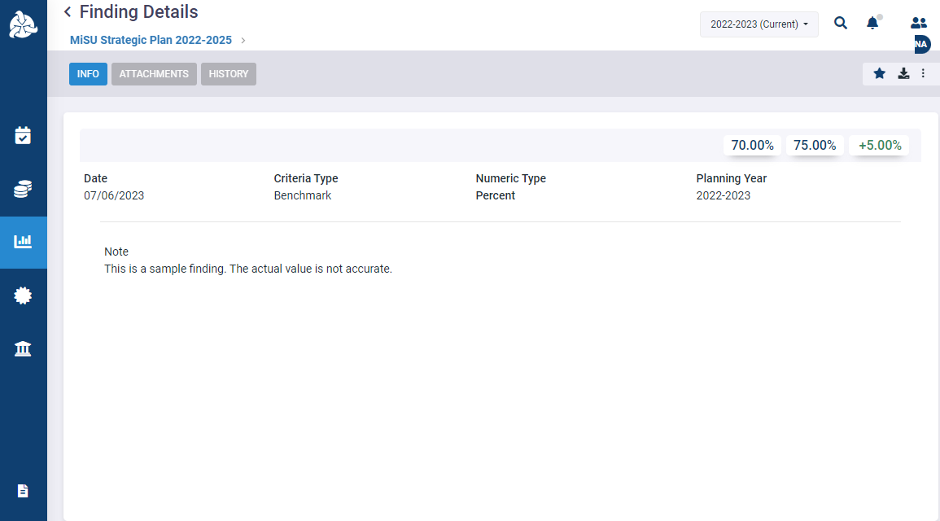
The new finding is displayed on the Finding Details page

Slide 44
Click the back arrow next to Finding Details to return to the Program Details page.

Slide 45
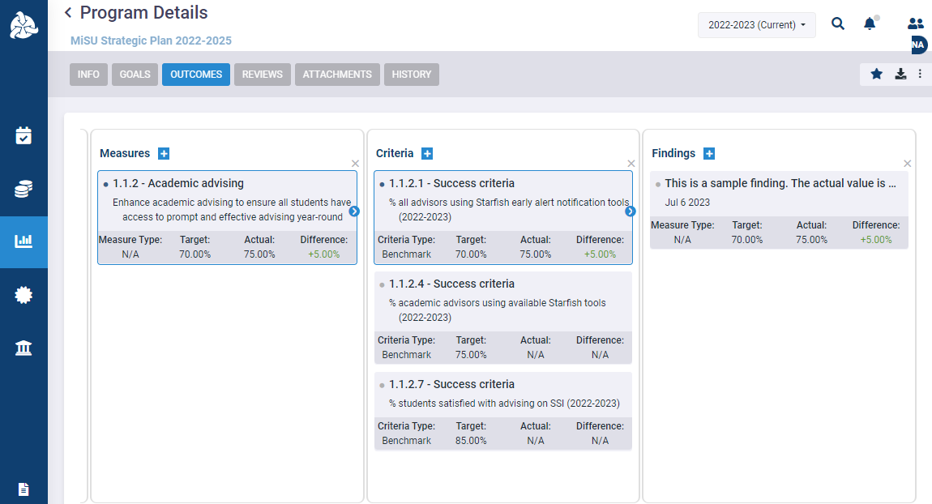
Click the blue arrows to expand or collapse the panes as desired

Slide 46
Thank You!

