Slide 1


Herding CATs
Assessing Learning and Driving Classroom Communication
David J. Paterno, PhD
Associate Professor, Professional Communication

Slide 2

Land Acknowledgement
Minot State University gratefully acknowledges the Native Peoples on whose ancestral lands we sit. We praise the Anishinaabe and Assiniboine peoples, as well as the other sovereign nations of the northern plains whose lands encompass North Dakota today: The Turtle Mountain Band of Chippewa, the Mandan Hidatsa Arikara Nation, the Spirit Lake Nation, the Standing Rock Sioux Tribe, and the Sisseton Wahpeton Oyate.

Slide 3
About me
Human Communication:
  Communication isn’t just the production, sending, or receiving of messages – it is the primary social experience in which we work with others to create and manage meaning.
  Classrooms, and learning itself, live in Communication.

Slide 4
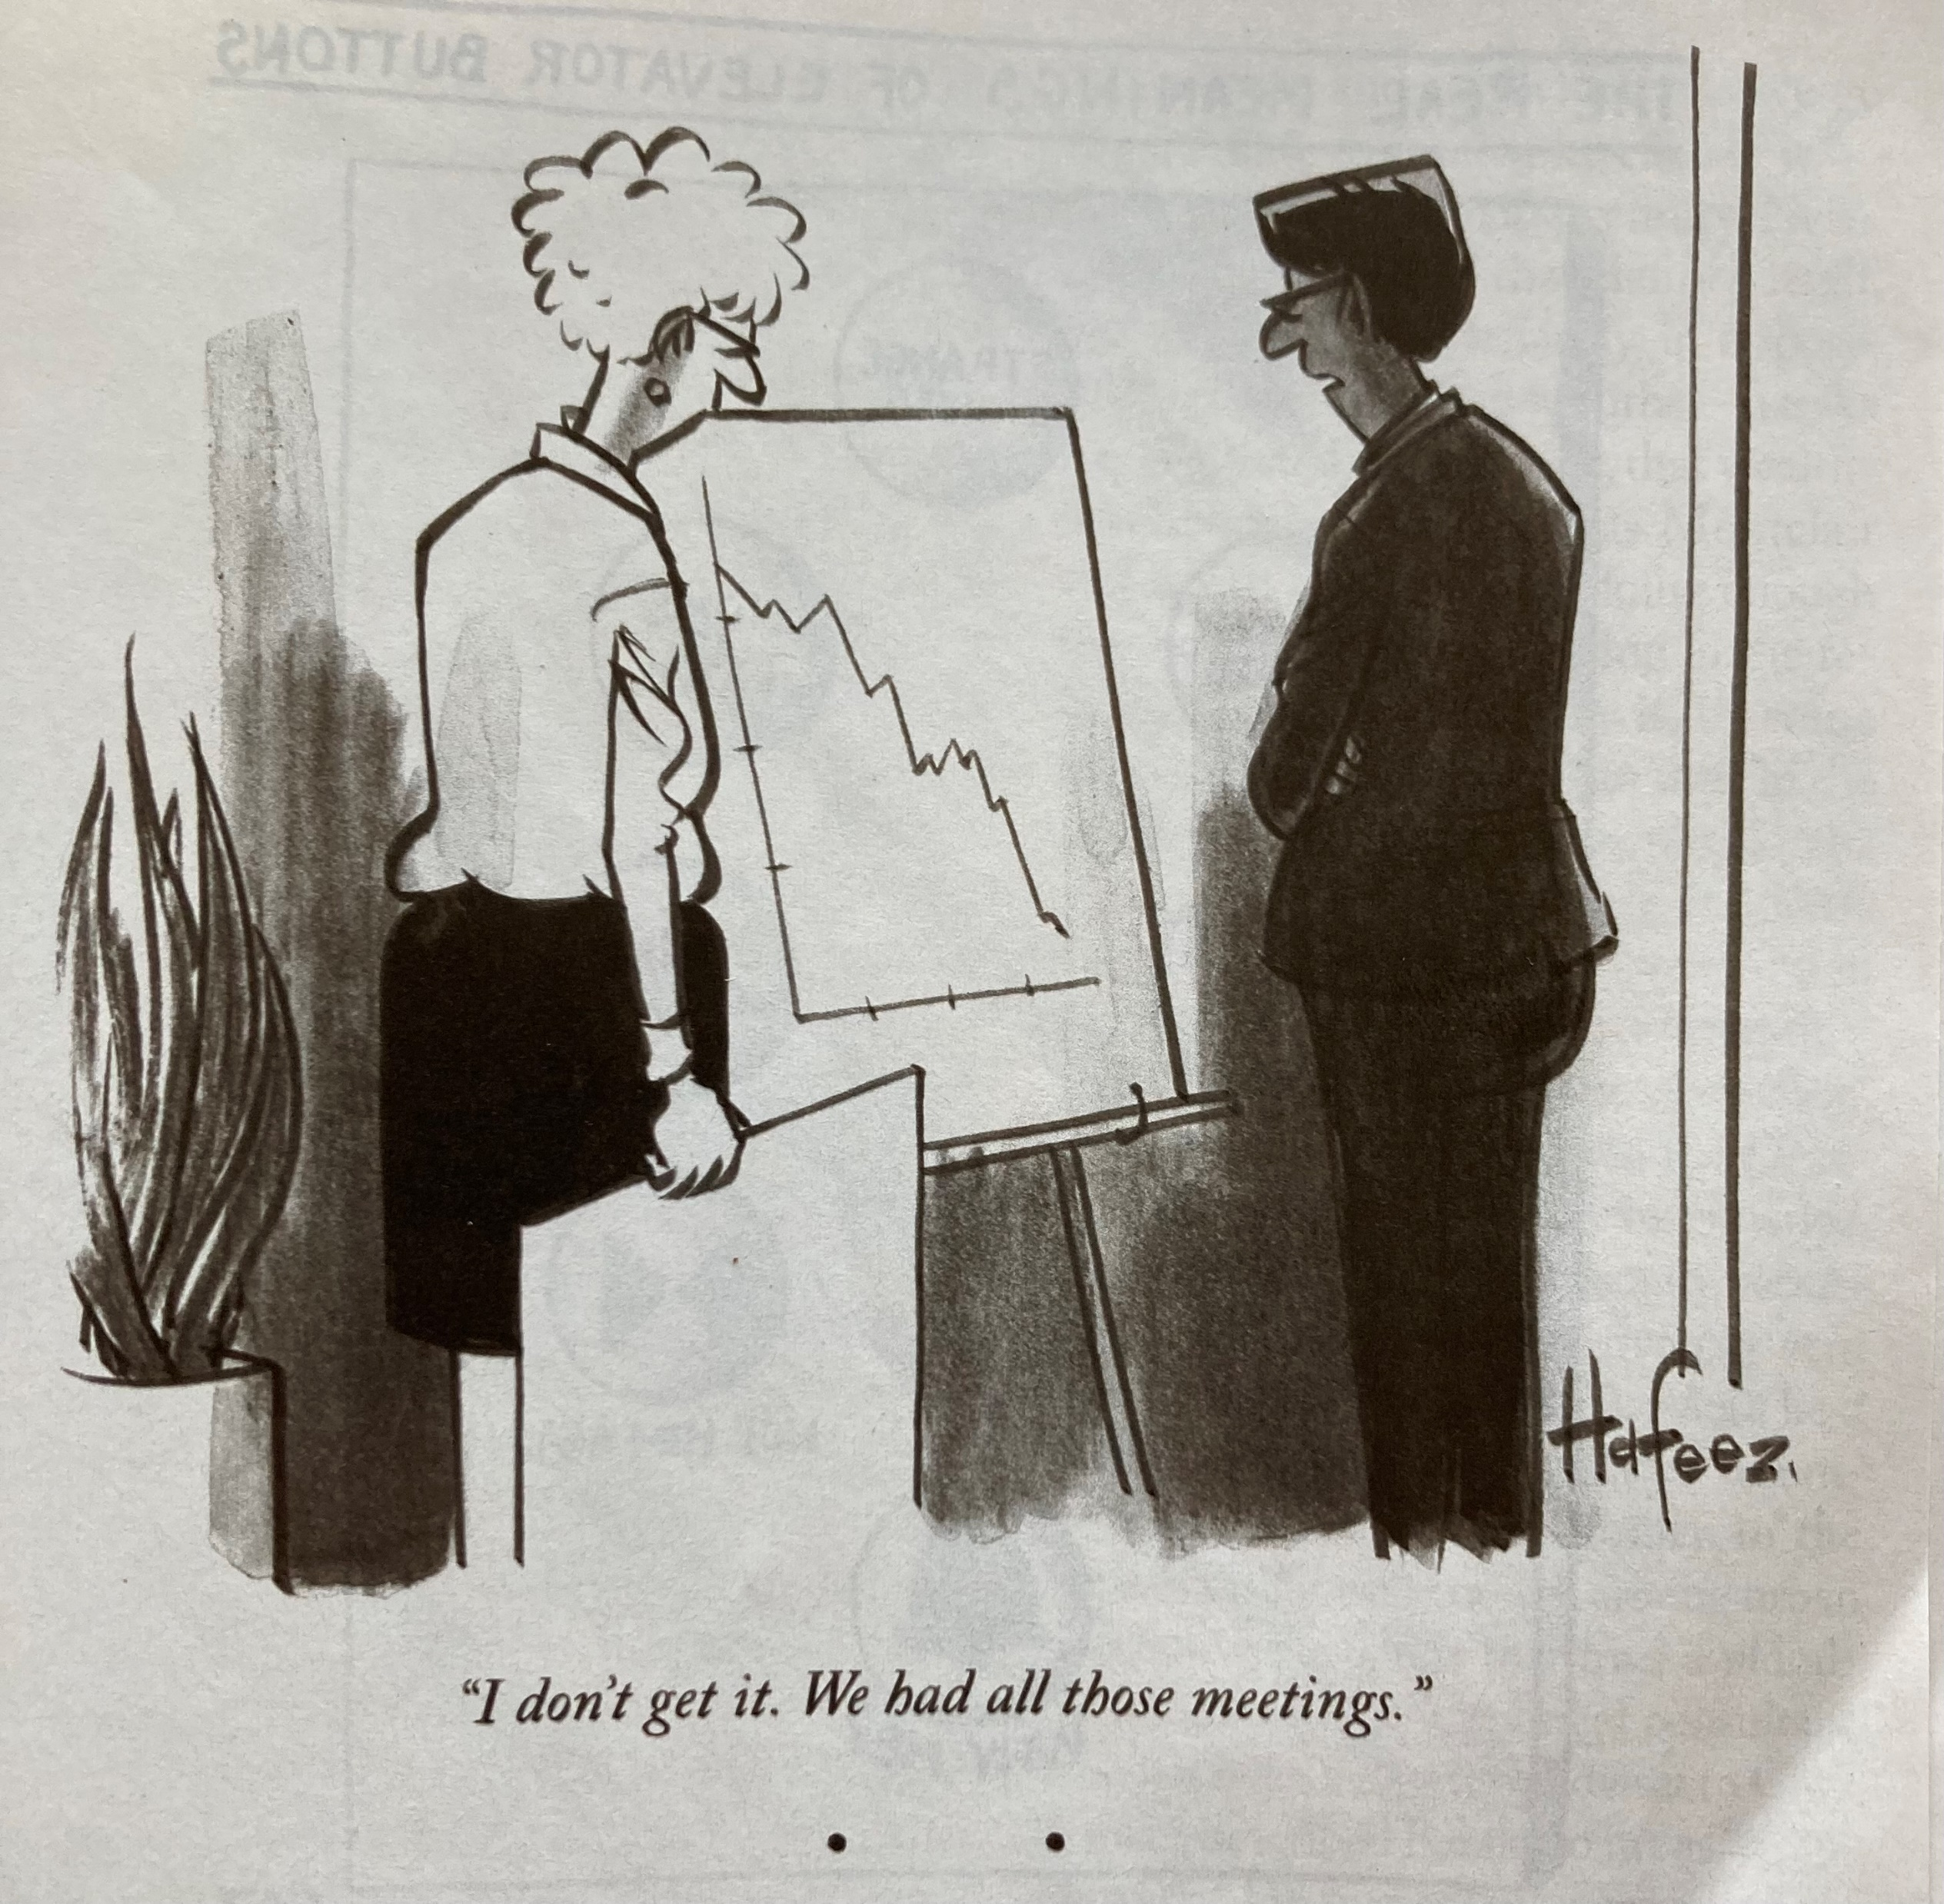
Classroom Management / Classroom Assessment

Slide 5
Classroom Management / Classroom Assessment
Assessment is not as an add-on – it is essential to our work with learners.
US, NZ, Australian teaching experience…
Learners always need feedback – as do educators.

Slide 6
Classroom Management / Classroom Assessment
Who’s the boss here?
Okay…but how do I know what’s working and what isn’t?

Slide 7
Classroom Management / Classroom Assessment
Learner-Centered
Teacher-Directed
Mutually Beneficial
Formative
Context-Specific
Ongoing
Nested within Good Teaching Practice
(Angelo and Cross, 1993)

Slide 8
CATs
Formative assessments
Easy-to-do
Provide an example that educators are reflective and value student feedback in guiding our craft
Demonstrate deep listening
Coordinate and manage our Instructional Communication

Slide 9
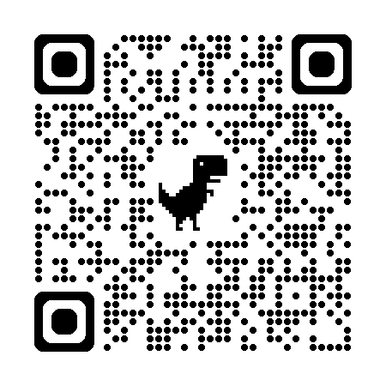
Exploring CATs
  Minute Paper
    What was the most meaningful thing you learned during class today? What questions do you still have about the material? What content do you want further clarification on?
  Documented Problem Solutions
    During a class period, present the class with a problem. Ask students to record the steps they are using, while they are solving the problem. Later, have students share these steps in either pairs, small groups, or with the whole class.

Slide 10
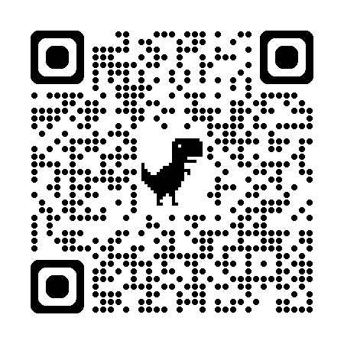
Okay…how much work does this take?
  Compile all the responses and give them a quick thematic read
  Tabulate these for reporting back to the class
  Action the results!

Slide 11
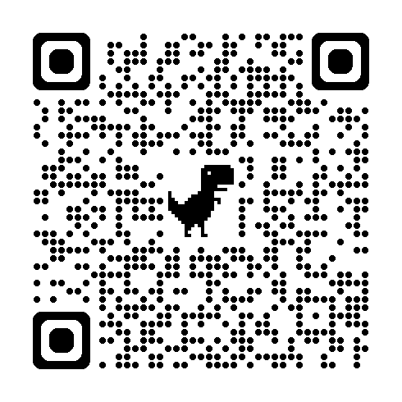
3-2-1

Slide 12
Example – MiSU Spring 2024
For our next class consider the following and list your answers for each:
Three things (topics, ideas, practices) you’ve learned this term – or otherwise enjoyed, or found useful about class.
Two things about which you’re uncertain, about which you would like to learn more or otherwise don’t find useful...
One thing you’d change NOW – be specific and practical.
Type your answers to each of these and print them out. Please DO NOT enclose your name on the sheet. This exercise works best when you know you’re free to express your authentic view.
I will thematically organize and tabulate the responses and report these back to the class in our next class meeting.
THANK YOU!

Slide 13
Example – MiSU Spring 2024
COMM 221 (2024) – CAT – Results
Things Learned Things Liked
Depth required for a SMP (3) Classroom environment is open conversational
Email news briefs – being clear and engaging Discussions are enjoyable
Formatting a press release (2) Challenges in drafting materials, diversity of
Primers assignments
Things Discovered Things Not liked
Started examining crisis – more, please? (3) Prep time, needs expansion
Exploring company actions, more examples
of success?
Ethics – we’ve started exploring, more maybe?
Ads – more on this?
One thing to change:
Improved Powerpoint coverage
Additional examples of assignments before assigned

Slide 14
Let’s try one now!
  3 – Things learned today
  2 – Things you find interesting
  1 – Question you still have about CATs

Slide 15
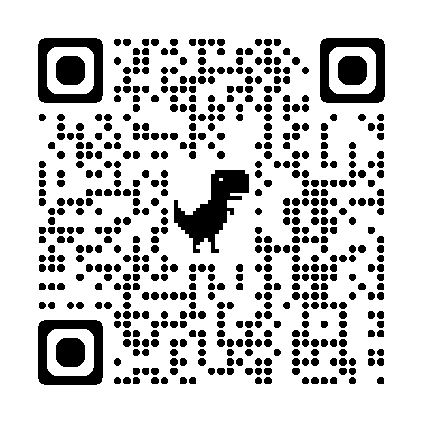
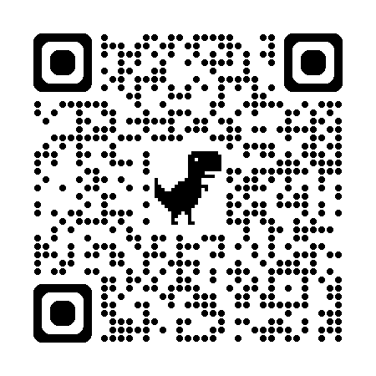
Discussion

Slide 16
Thank you!
david.paterno@minotstateu.edu

